Slide 1
DS6306
Week 1-Git-ing Sta-R-ted!
By Ben Goodwin

Slide 2
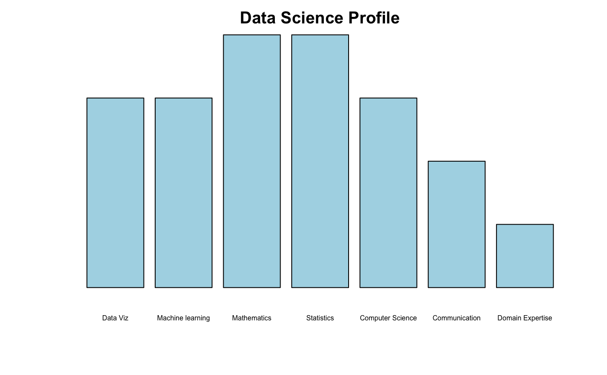
Question 1 Data Science Profile

Slide 3
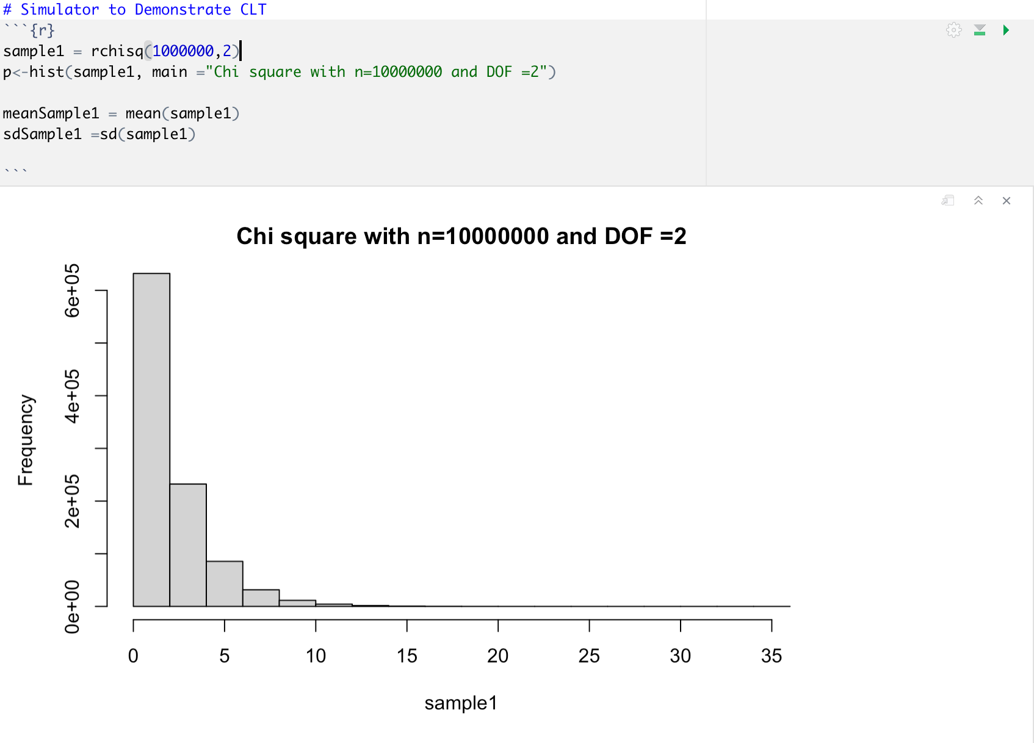
Question 2 (Parts 1/2) Central Limit theorem

Slide 4
Question 2 Mean and Standard deviation of chi^2 population (Part 3)
Mean = 1.9988
SD = 1.9999
In a chi^2 distribution our mean and standard deviation is k (SD is the square root of 2k (variance parameter)) (our degree of freedom, positive natural number)

Slide 5
Question 2 (Part 4)
A sample of size 50 from this population should be normally distributed. According to the CLT as we sample more and more our data will begin to look more and more normal (should we follow model assumptions correctly).
Since we are relying on the CLT, we should be interested in a N(0,1) distribution.
Mean = 0, Standard error =1

Slide 6
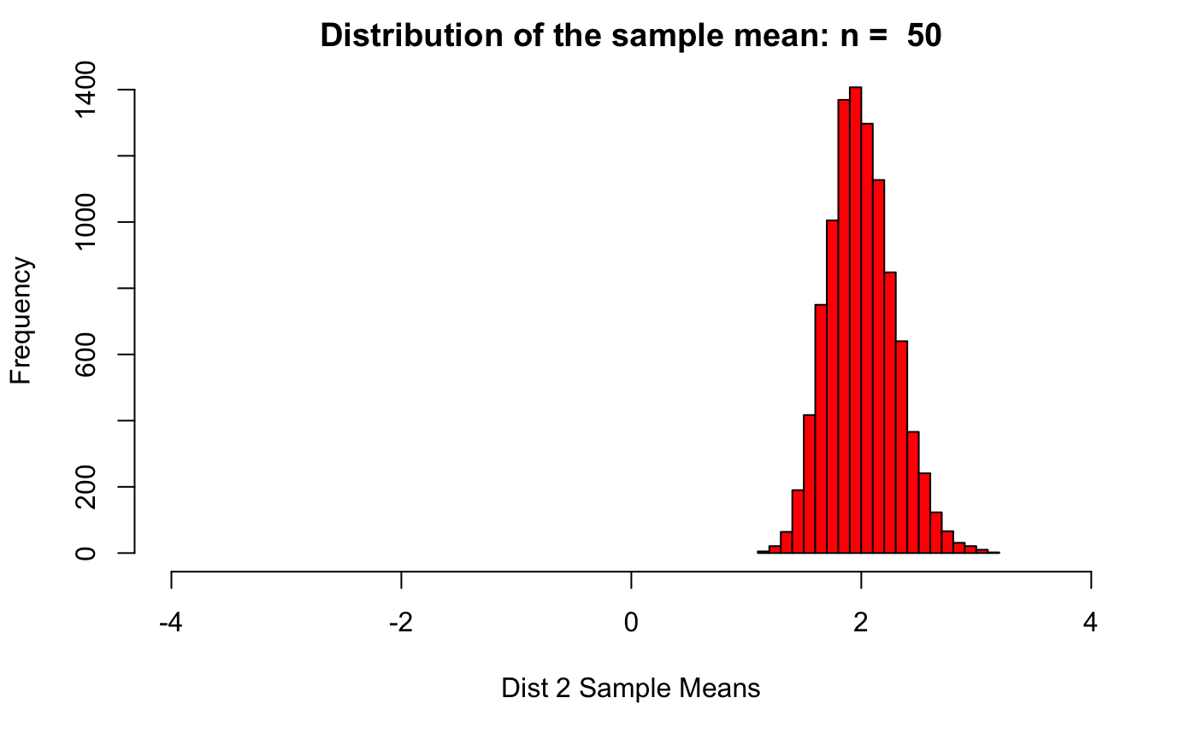
Question 2 Part 5/6
Mean =2.58
SD = 2.49

Slide 7
Question 3
mu_0 = 21
mu_1 != 21
Alpha =0.05
T = 3.309
P= 0.0019, reject the null hypothesis!
Since we rejected the null, we can conclude that that there is a difference in the mean age of comber patrons.

Slide 8
Takeaways/Questions
I had a little difficulty discerning the exact approach to answering question 2, part 4. In the populations I created, the first came from a chi square, as did the second, but with the CLT we approximate things using a normal distribution, which the data seemed to follow. Is this the correct approach?

