Slide 1
For Live Session Assignment Unit 3
Assumption of the T Test
Ben Goodwin

Slide 2
Part 1

Slide 3
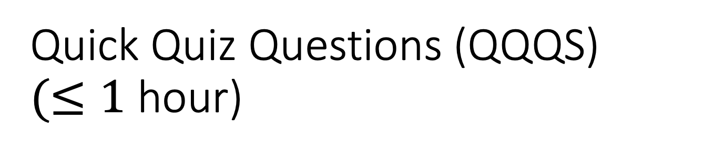
Quick Quiz Questions (QQQS) $(≤1$ hour)

Slide 4
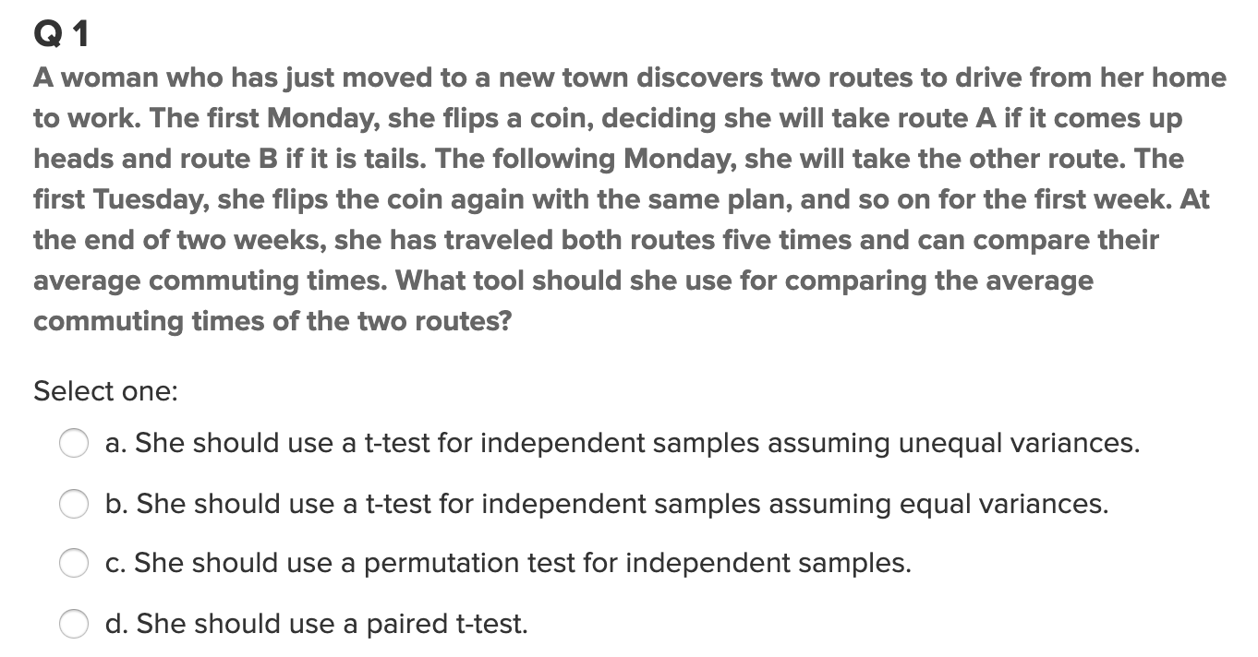

Question 1

Slide 5
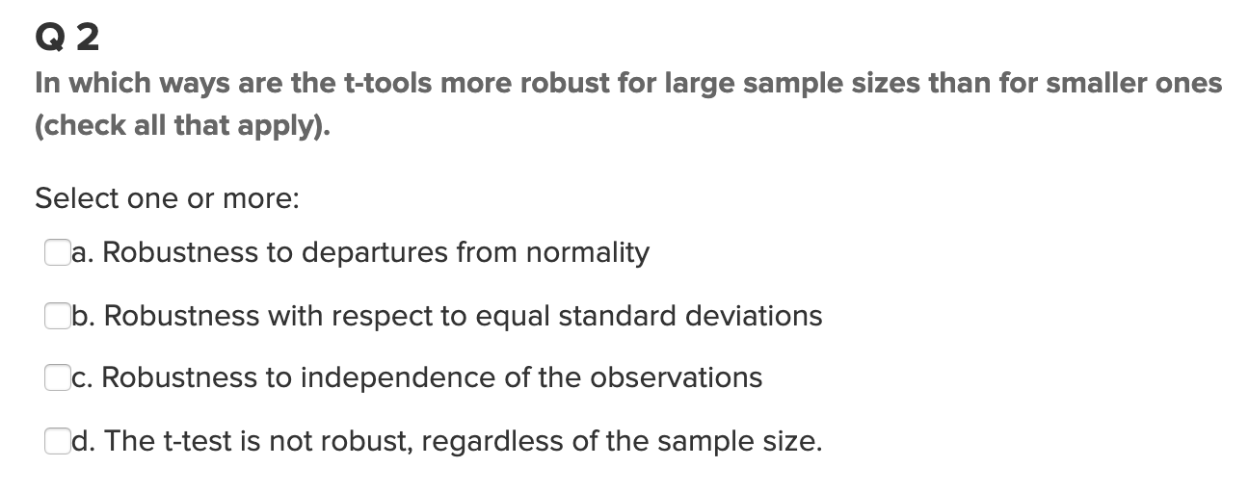

Question 2

Slide 6
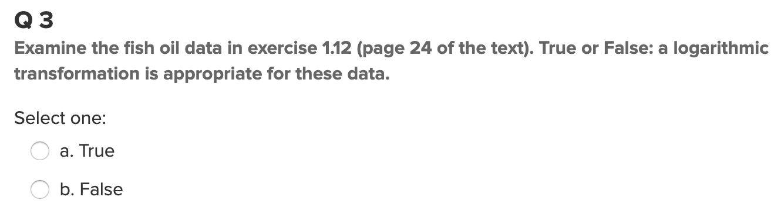

Question 3

Slide 7
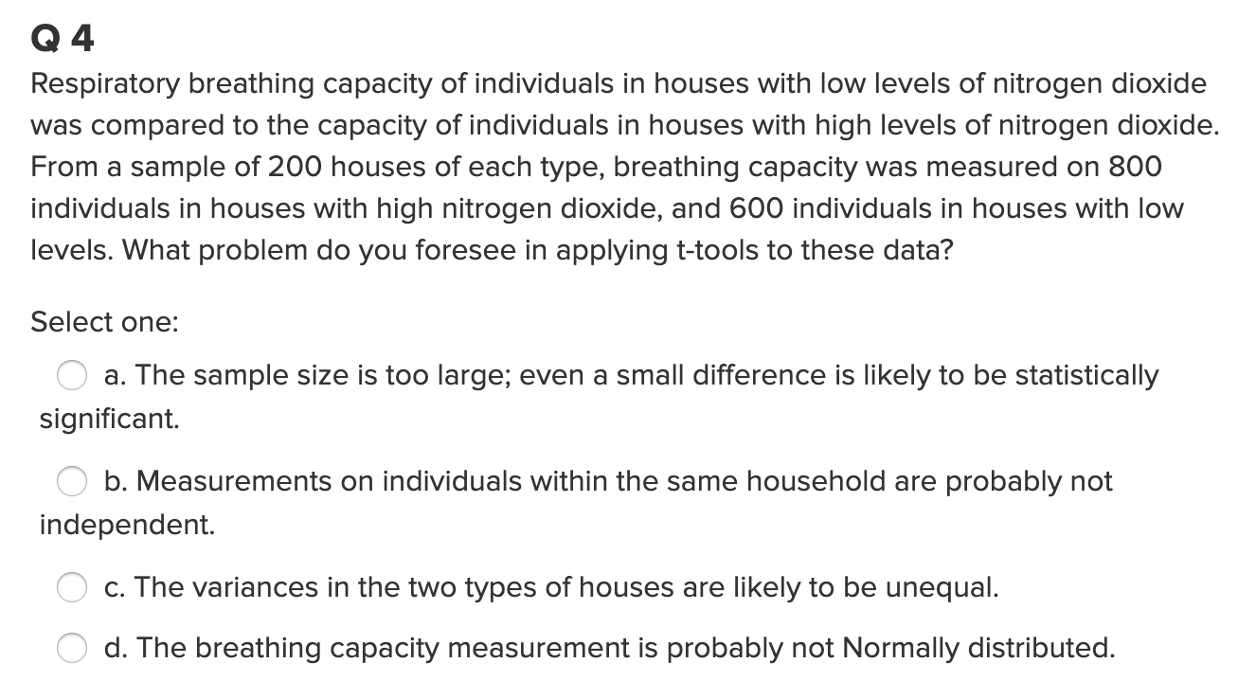

Question 4

Slide 8
End Quick Quiz Questions (QQQs)

Slide 9
End Part 1

Slide 10
Part 2

Slide 11
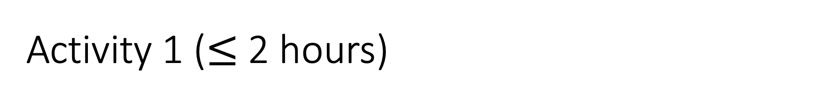
Activity 1 ($≤$2 hours)
Use your knowledge from the asynch material and run through the following slides on conducting a Complete Analysis. There are 3 Examples.
You will use the same ideas to complete Question 1 following the slides.

Slide 12
Examples of A Complete Analysis:
Statement of the Problem
Address the Assumptions
Perform the Appropriate Test (5 Steps)
Step 6: Provide a conclusion that a non statistician can understand. Include a p-value and confidence interval
Scope of Inference

Slide 13

Example: Beach Comber
The following are ages of 7 randomly chosen patrons seen leaving the Beach Comber in South Mission Beach at 7pm! We assume that the data come from a normal distribution and would like to test the claim that the mean age of the distribution of Comber patrons is different than 21.
25, 19, 37, 29, 40, 28, 31

Slide 14
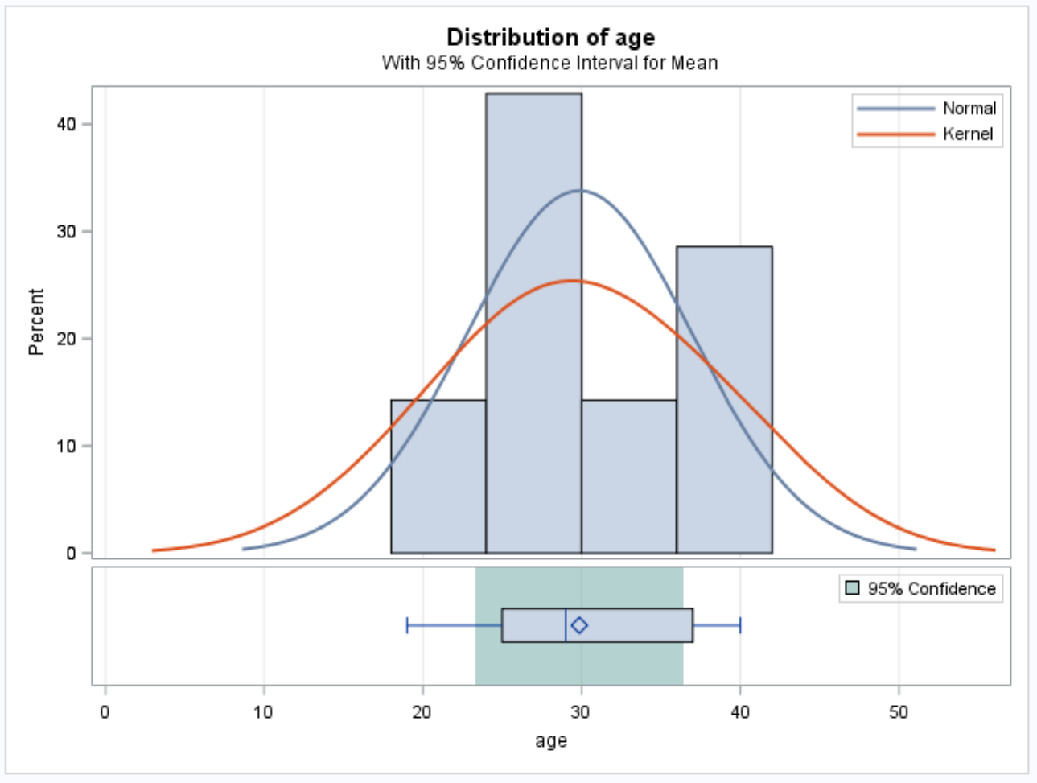
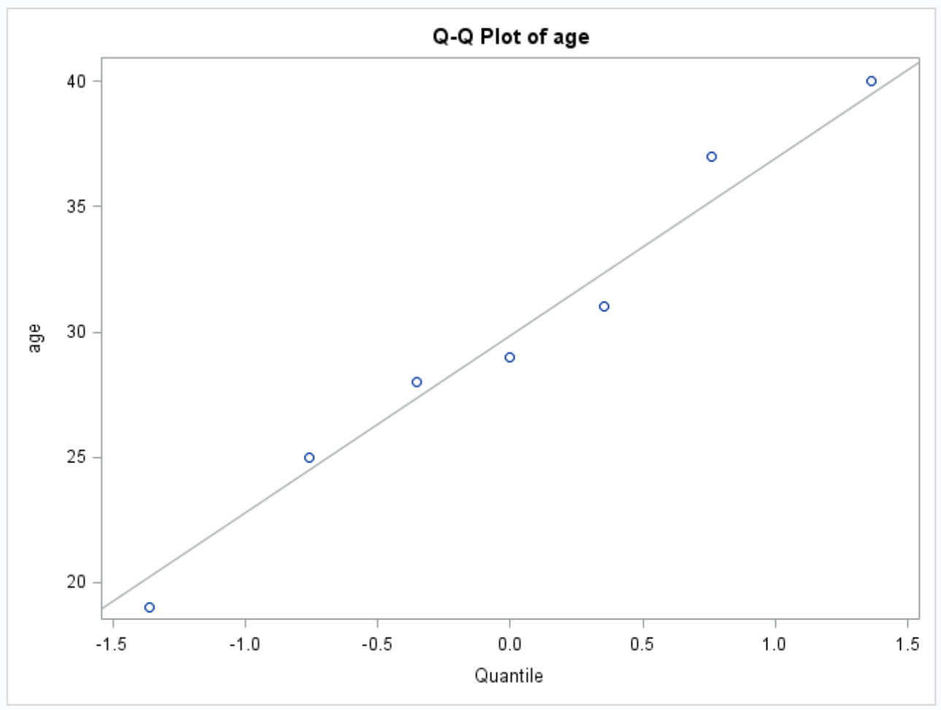
Example: Comber
PROBLEM STATEMENT:
Test the claim that the mean age of Beach Comber patrons at 7pm is different from 21.
ASSUMPTIONS:
Normal Population Distribution: Judging from the histogram and q-q plots, there is little to no evidence that the population distribution of patron ages at the Comber at 7pm is not normal. We will assume that this distribution is normal and proceed.
Independence: These subjects were randomly selected from the population; thus, we will assume that the observations are independent.

Slide 15
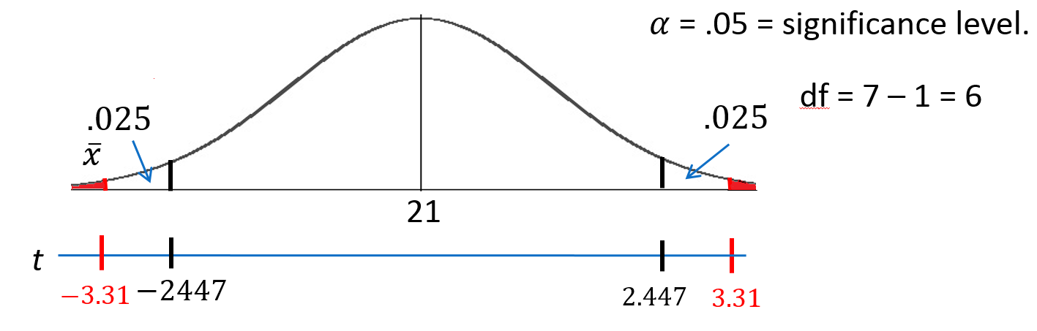
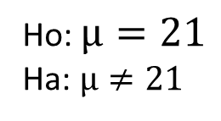


Revised Write Up!
We would like to test the claim that the population mean is different from $21.$ To do this, we take a sample of size n = 7 and find that $\overline{x}$ = 29.86 years and s = 7.09 years.
Ho: $µ=21$
Ha: $µ≠21$
Step 1: Identify the null (Ho) and alternative (Ha) hypothesis.
Step 2: Draw and Shade and Find the Critical Value.
$$t=\frac{\overline{x}−μ}{\frac{s}{\sqrt{n}}}$$
$$=\frac{29.86−21}{\frac{7.09}{\sqrt{7}}}$$
$$=3.31$$
Step 3: Find the test statistic. (The t value for the data.)
Step 4: Find the p-value: P-value = .0162 < .05
Step 5: REJECT Ho
Step 6: There is sufficient evidence to conclude that the true mean age of patrons at the Comber at 7pm is different from 21 (p-value =.0162 from a t-test). A 95% confidence interval for the mean age is (23.3, 36.4) years. Scope: Since this was a random sample, we can generalize these findings to the entire population of Comber patrons at 7pm. Note that we have evidence to support the claim that the mean age is greater than 21 as well.

Slide 16
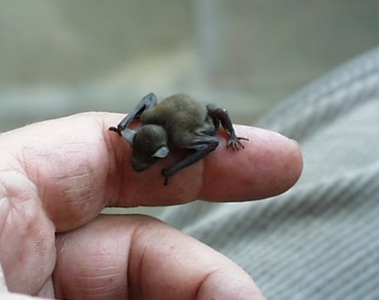
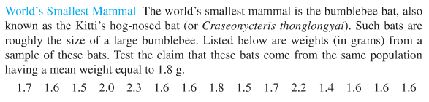
Example: Bats

Slide 17
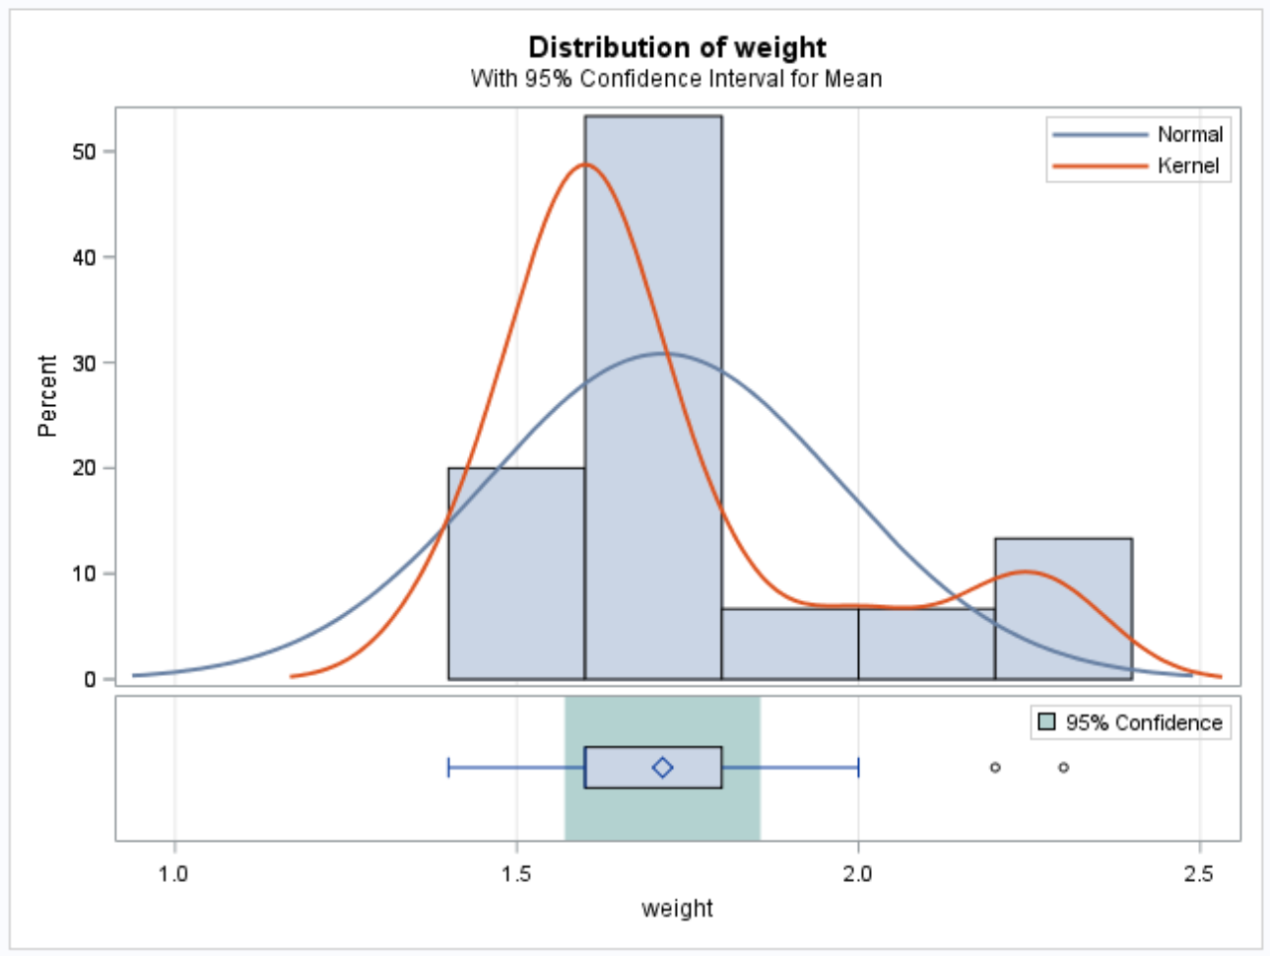
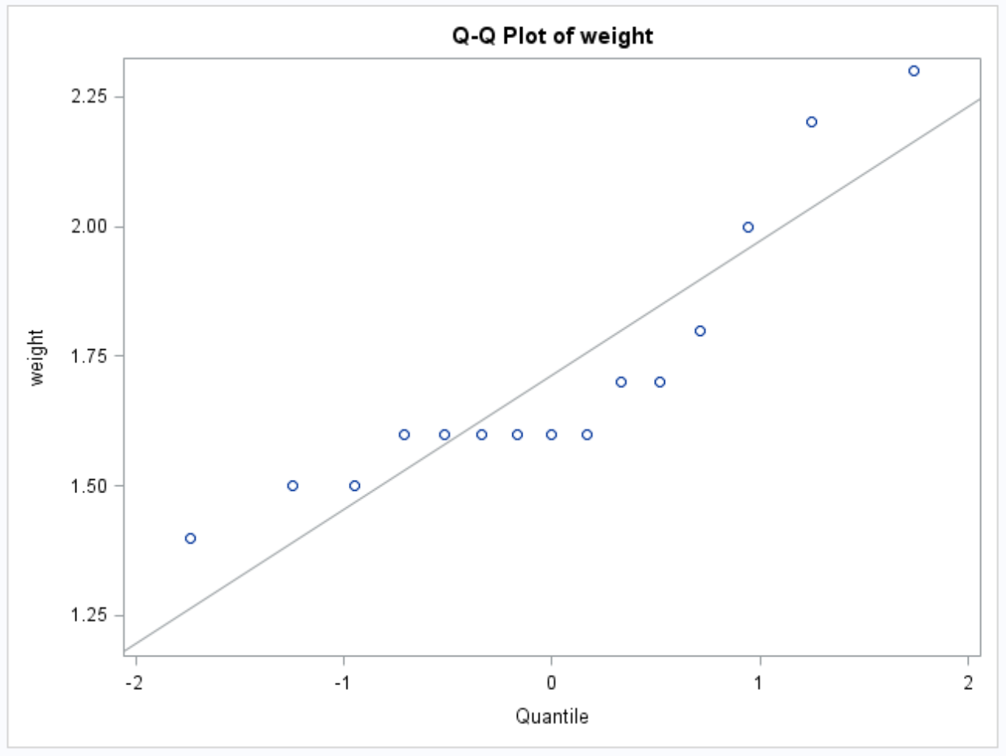
Example: Bats
PROBLEM STATEMENT:
Test the claim that the mean weight of the bumble bee bat is different from 1.8 g.
ASSUMPTIONS:
Normal Population Distribution: Judging from the histogram and q-q plots, there is some visual evidence of a departure from normality. With a sample size of 15 and no extreme outliers, we will assume the distribution of sample means is well approximated by a normal distribution via the CLT and proceed with caution.
Independence: Not much is known about the sampling scheme used to obtain this sample. We will assume the observations are independent.

Slide 18
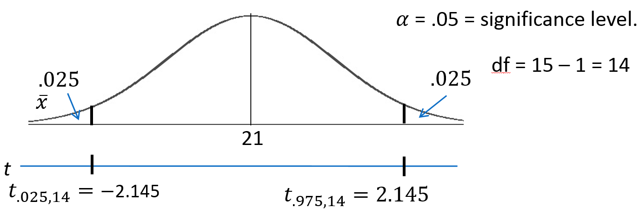
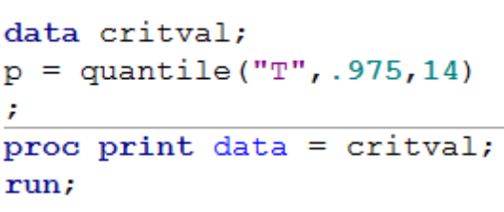
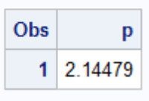
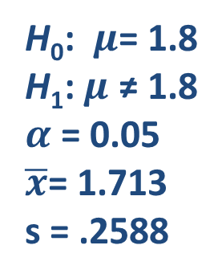
H₀: $μ$= 1.8
H₁: $μ$ ≠ 1.8
$α$ = 0.05
$\overline{x}$= 1.713
s = .2588
Critical Values
t = ± 2.145
Test Statistic
P-value: .2155 > .05
Fail to Reject H₀
t = -1.297
On the basis of this test, there is not enough evidence to reject the claim that the mean weight of bumblebee bats is equal to 1.8 g (p-value = .2155 from a t-test). A 95% confidence interval is (1.57, 1.8566) grams. The problem was ambiguous on the randomness of the sample; thus, we will assume that it was not a random sample, which makes inference to all bats strictly speculative.

Slide 19
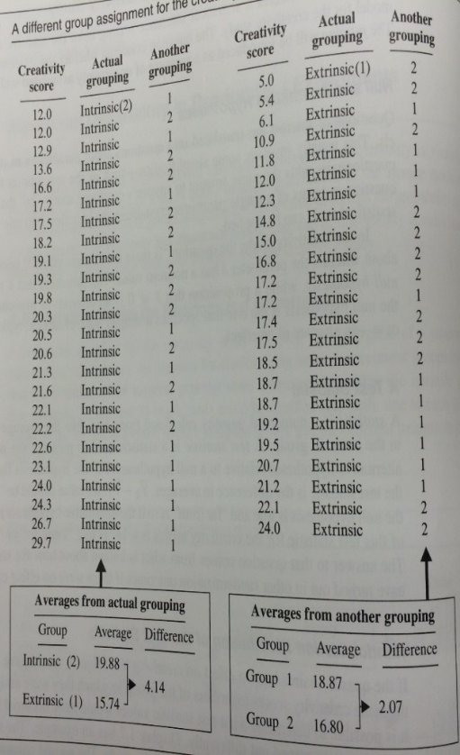
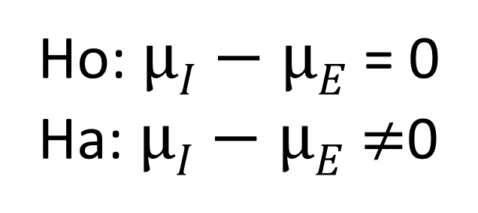
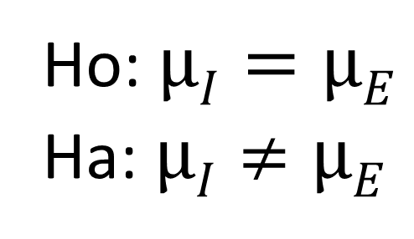
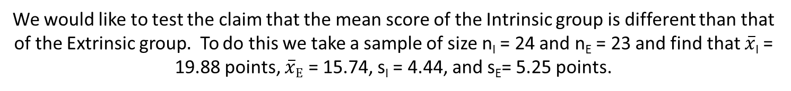
FULL EXAMPLE: CREATIVITY STUDY!
We would like to test the claim that the mean score of the Intrinsic group is different than that of the Extrinsic group$.$ To do this we take a sample of size n_{I} = 24 and n_{E} = 23 and find that $\overline{x}$_{I} = 19.88 points, $\overline{x}E$ = 15.74, s_{I} = 4.44, and s_{E}= 5.25 points.
Step 1: Identify the null (Ho) and alternative (Ha) hypothesis.
Ho: $µI=µE$
Ha: $µI≠µE$
Which is equivalent to:
Ho: $µI−µE$ = 0
Ha: $µI−µE$ $≠$0

Slide 20
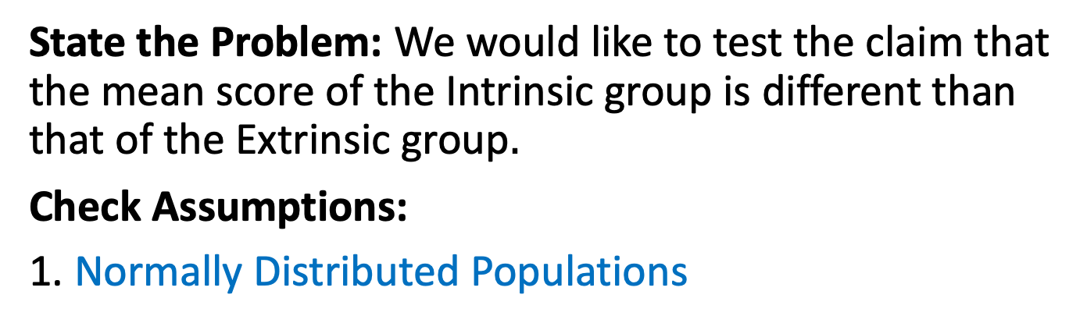
Full Example: Creativity Data
State the Problem: We would like to test the claim that the mean score of the Intrinsic group is different than that of the Extrinsic group$.$
Check Assumptions:
1. Normally Distributed Populations

Slide 21
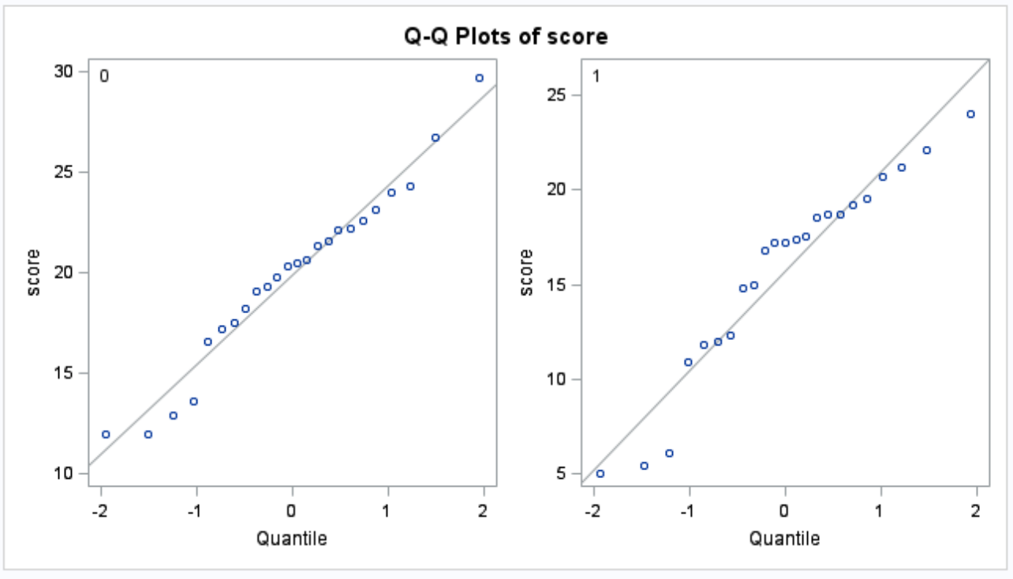
First Check …. q-q Plot
The q-q plots for both populations look sufficiently normal. We look at the histograms as well … but there is not sufficient evidence here to suggest that they are not normal.

Slide 22
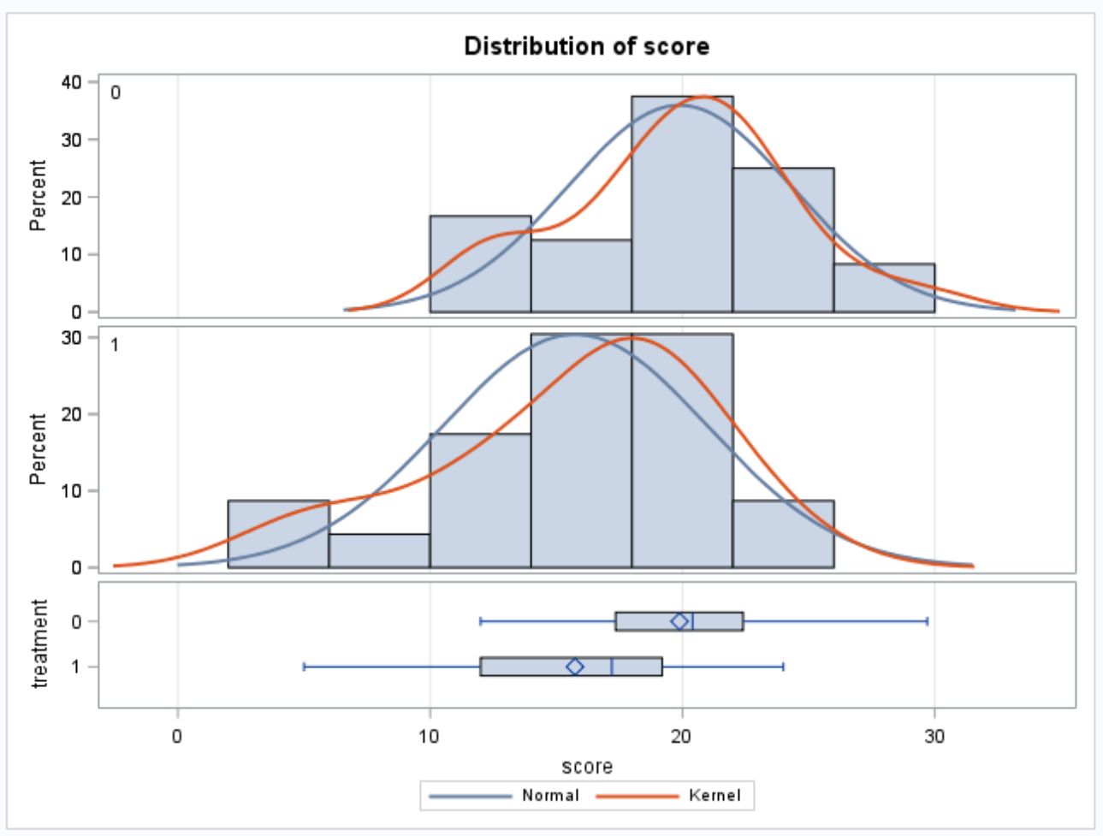
Histograms
Keeping in mind the relative small sample size from each population, we do not observe any extreme outliers and observe a pretty strong bell shape which lends evidence to support normality of the populations.

Slide 23
Normality Assumption
Visual inspection of the histograms and q-q plots of each population are consistent with the normality of each population. We assume normality and move on to the second assumption.

Slide 24
Full Example: Creativity Data
State the Problem: We would like to test the claim that the mean score of those with intrinsic motivation is the same for those with extrinsic motivation.
Check Assumptions:
Normally Distributed Populations
Equal Standard Deviations

Slide 25

Equality of Variances
A visual check was done by looking at the histograms, which reveal similar shapes and support the equal variances assumption. You can assume equal variances here.
Since we are able to assume normal population distributions, we can use the F-Test to provide secondary evidence if the visual is inconclusive. Since the p-value is greater than our significance level of alpha = 0.05, we fail to reject the null hypothesis of equality (p-value = 0.1043) and conclude that there is not enough evidence to suggest the variances are different.

Slide 26
Full Example: Creativity Data
State the Problem: We would like to test the claim that the mean score of those with intrinsic motivation is the same for those with extrinsic motivation.
Check Assumptions:
Normally Distributed Populations
Equal Standard Deviations
Independent Observations

Slide 27
Independent Observations
The sample consisted of volunteers and thus subjects may not be independent of one another. We will assume independence and proceed with caution.

Slide 28
Full Example: Creativity Data
State the Problem: We would like to test the claim that the mean intrinsic score is the same as the extrinsic score.
Check Assumptions:
Normally Distributed Populations
Equal Standard Deviations
Independent Observations
Run the Test:
1. First 5 steps.

Slide 29
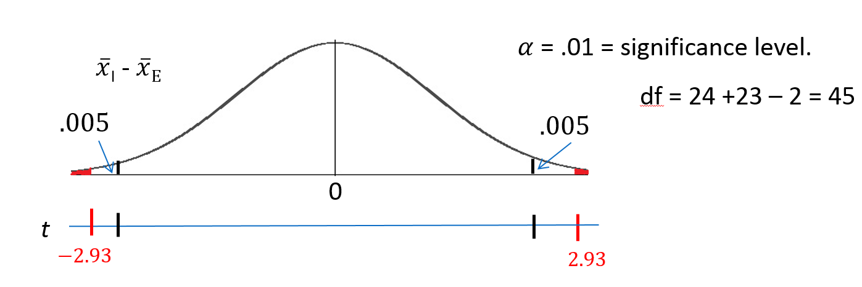
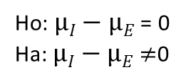
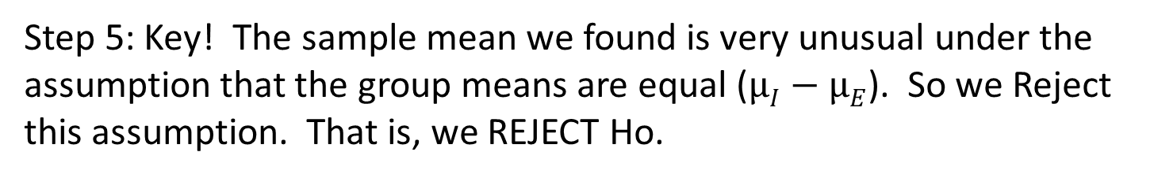
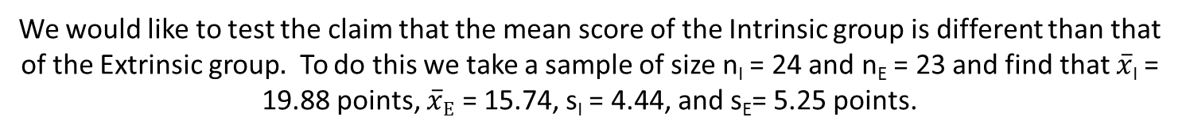

Let’s Formalize This Test Into 6 Steps!
We would like to test the claim that the mean score of the Intrinsic group is different than that of the Extrinsic group$.$ To do this we take a sample of size n_{I} = 24 and n_{E} = 23 and find that $\overline{x}$_{I} = 19.88 points, $\overline{x}E$ = 15.74, s_{I} = 4.44, and s_{E}= 5.25 points.
Ho: $µI−µE$ = 0
Ha: $µI−µE$ $≠$0
Step 1: Identify the null (Ho) and alternative (Ha) hypothesis.
Step 2: Draw and Shade and Find the Critical Value.
$$t=\frac{(\overline{xI}−\overline{xE}) }{sp\sqrt{\frac{1}{nI}+\frac{1}{nE}}}=2.93$$
Step 3: Find the test statistic. (The t value for the data.)
Step 4: Find the p-value: P-value 0.0054< .01
Step 5: Key! The sample mean we found is very unusual under the assumption that the group means are equal ($µI−µE$). So we Reject this assumption. That is, we REJECT Ho.

Slide 30
Full Example: Creativity Data
State the Problem: We would like to test the claim that the mean intrinsic score is the same as the extrinsic score.
Check Assumptions:
Normally Distributed Populations
Equal Standard Deviations
Independent Observations
Run the Test:
1. First 5 steps.
State the Scope and Conclusion.

Slide 31
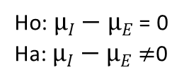
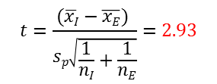
Let’s Fill in the P-value (and add a CI)!
We would like to test the claim that the mean score of the Intrinsic group is different than that of the Extrinsic group$.$ To do this we take a sample of size n_{I} = 24 and n_{E} = 23 and find that $\overline{x}$_{I} = 19.88 points, $\overline{x}E$ = 15.74, s_{I} = 4.44, and s_{E}= 5.25 points.
Ho: $µI−µE$ = 0
Ha: $µI−µE$ $≠$0
Step 1: Identify the null (Ho) and alternative (Ha) hypothesis.
Step 2: Draw and Shade and Find the Critical Value.
$$t=\frac{(\overline{xI}−\overline{xE}) }{sp\sqrt{\frac{1}{nI}+\frac{1}{nE}}}=2.93$$
Step 3: Find the test statistic. (The t value for the data.)
Step 4: Find the p-value: P-value = .0054
Step 5: REJECT Ho
Step 6:
Conclusion: There is sufficient evidence to suggest that those who receive the Intrinsic treatment have a higher mean score than those who receive the Extrinsic treatment (p-value = .0054 from a two sided t-test). A 99% confidence interval for this difference is (1.29, 7.00).
SCOPE: Since this was a randomized experiment, we can conclude that the Intrinsic treatment caused this difference. However, since the study was of volunteers, this inference can only be generalized to the 47 participants.

Slide 32
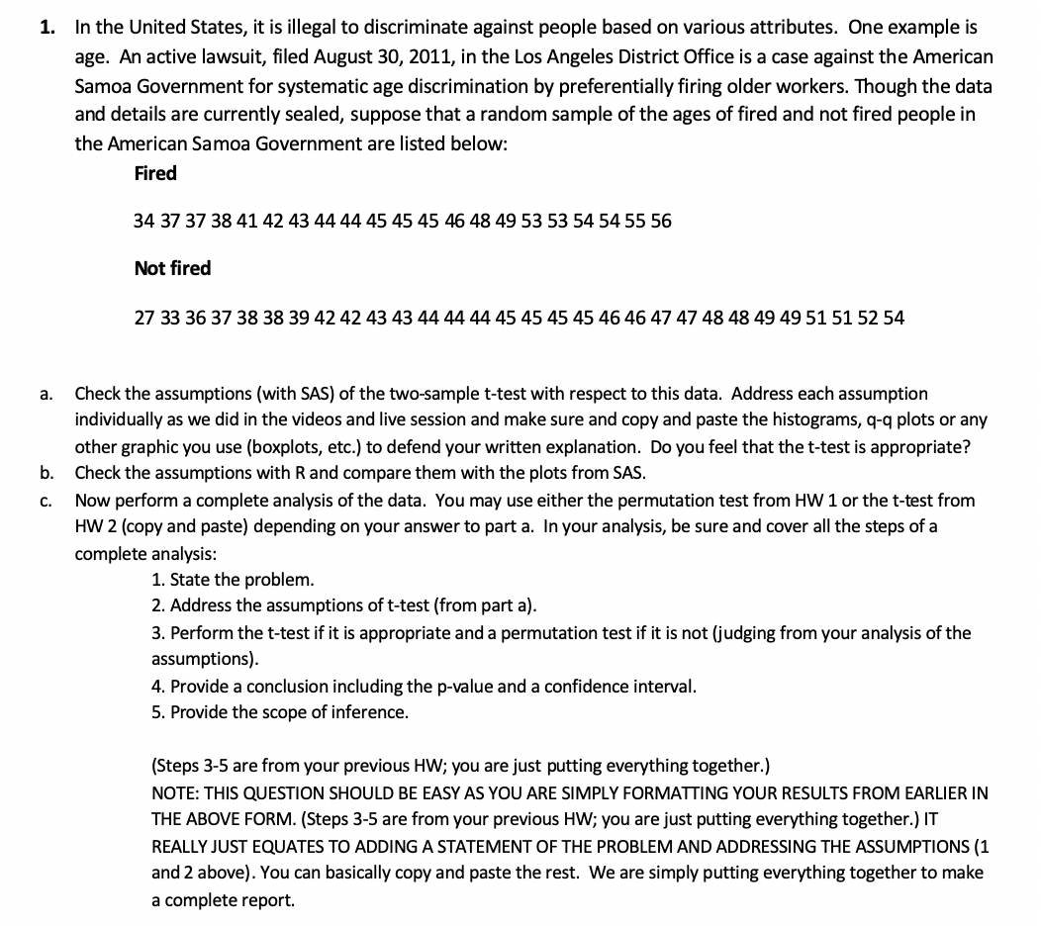

Question 1: ( $≤2 hours)$

Slide 33
Question 1 Part A
It seems that the T-test is reasonable to undertake given the data.
The data appears to be normally distributed based on the QQ-plots
The data appears to have nearly equal standard deviations. The distributions appear to have normal standard deviations.
The data can be assumed to be independent (independent observations).

Slide 34
Question 1 Part A (SAS charts)

Slide 35
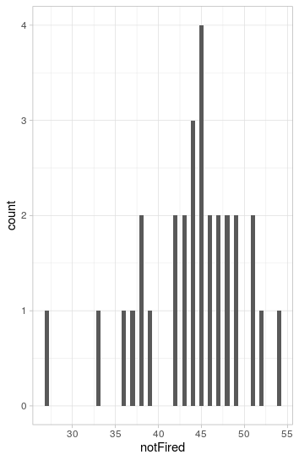
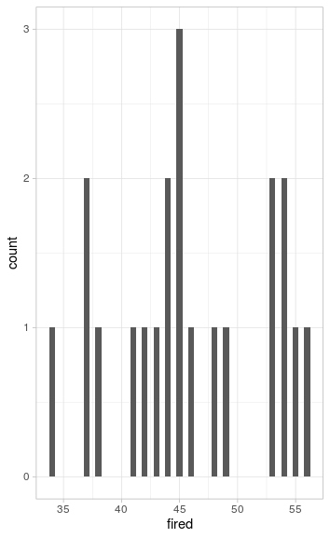
Question 1 Part B

Slide 36
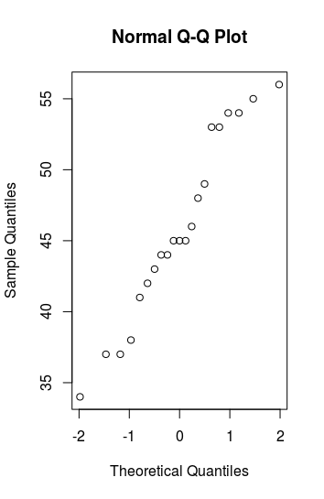
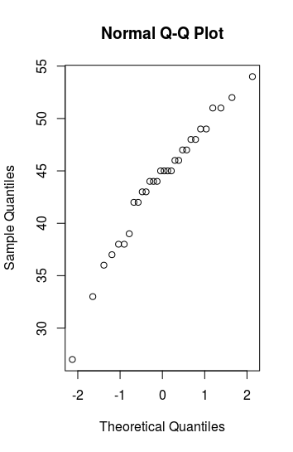
Question 1 Part B continued
Fired
Not-Fired

Slide 37

Question 1 ( $≤2 hours$)

Slide 38
Question 1 Hypothesis Test
Step 1:H_0: mu_fired = mu_not_fired
Step 2: H_a mu_fired != mu_not_fired
Step 3: TCV: 1.079
Step 4: P-value: 0.287
Step 5: Conclusion: FTR!
Step 6: From the results above we can conclude that there is insufficient evidence to conclude the mean ages of the fired and not fired groups are different. The 95% CI for the difference is (1.68,5.53). This was from a random sample, so the scope can be generalized to all members of the population.

Slide 39
Note: Perhaps you might be wondering at this point in the course,
“Why are we always testing the assumptions of the t-test? Is it the best test?
Should we always run the t-test when we can?”
These are very good questions and open questions that are up for debate! The one thing that is mathematically proven and not up for debate is that if the assumptions are met, the two-sample t test is the most powerful (in terms of Power = 1 – beta) test in the universe at testing the claim of the difference of means. Two questions may arise here:
1. Do we ever really have the assumptions fully met in the real world and just how much power do we give up at varying degrees of violation of the assumptions?
2. Do we always want inference on the equality/difference of means?
We will continue to answer these questions in Unit 4. Also note that we started to answer number two with a t-test of log transformed data. The inference there is on the equality (ratio) of medians which may be a better measure of center when dealing with right or left skewed data!)

Slide 40
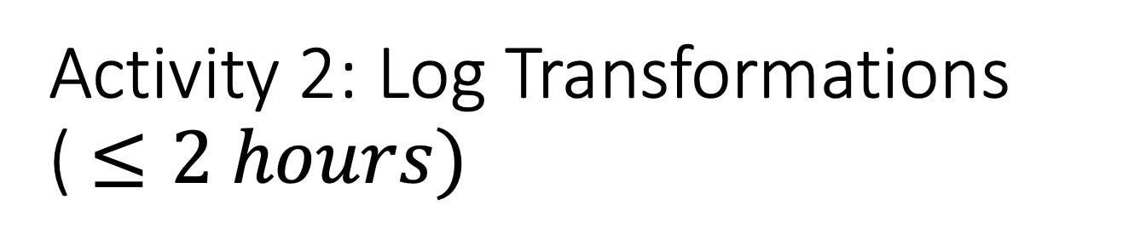
Activity 2: Log Transformations ( $≤2 hours)$
After completing the video lecture on log transformations, review the following example and we will revisit it in live session.

Slide 41
Transformations

Slide 42
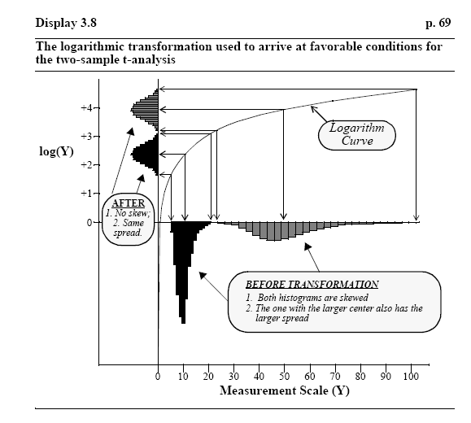
Log Transformation

Slide 43
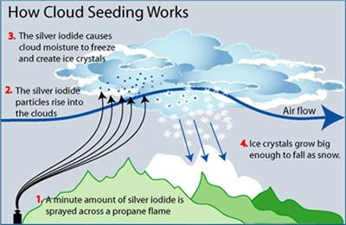
Cloud Seeding!

Slide 44
Does Cloud Seeding Work?
On days that were deemed suitable for cloud seeding, a random mechanism was used to decide whether to seed the target cloud on that day or to leave it unseeded as a control. Precipitation was measured as the total rain volume falling from the cloud base following the airplane seeding run, as measured by radar. We would like to test at the alpha = .05 level of significance whether cloud seeding is effective in increasing precipitation.

Slide 45
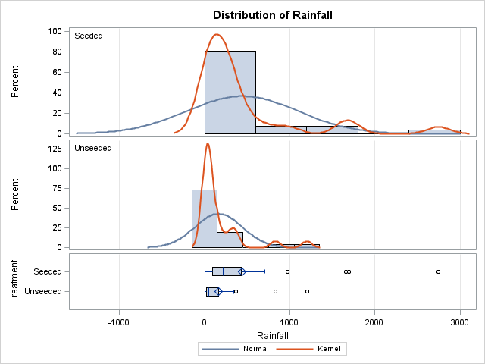
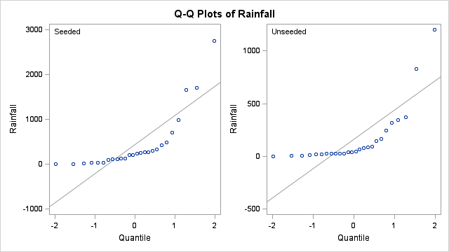
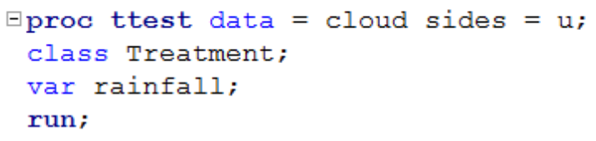
Cloud Seeding: Original Data

Slide 46
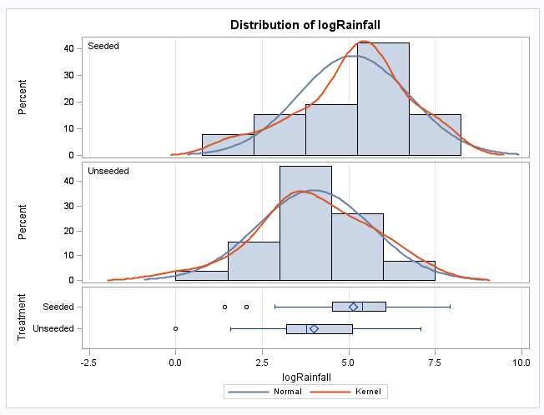
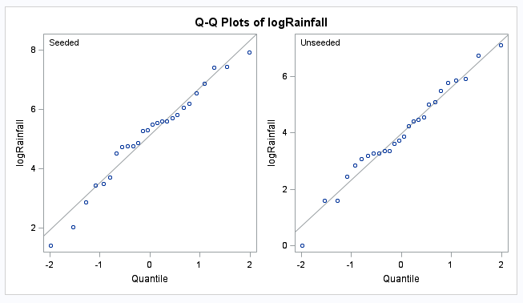
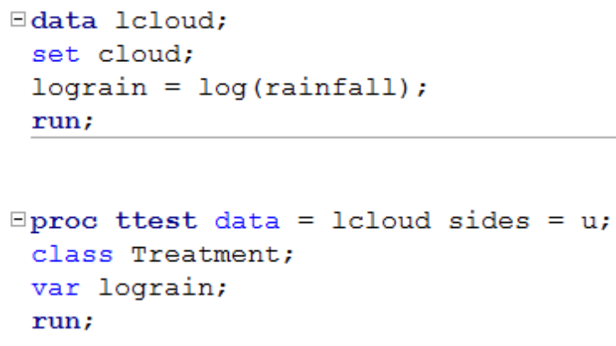
After Log Transformation

Slide 47
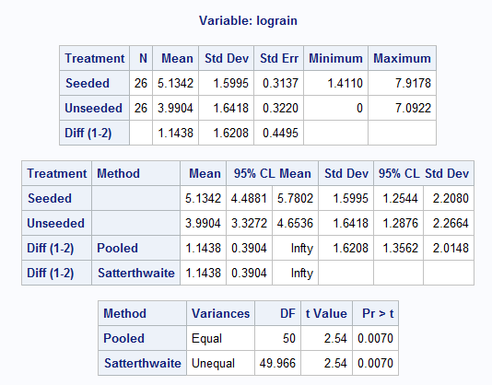
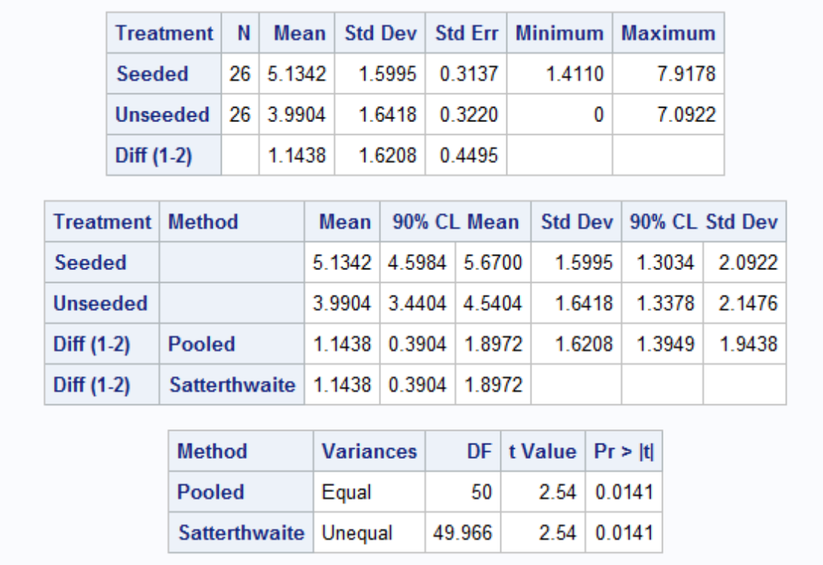


T Test and Confidence!!!
H₀: Cloud Seeding does not work.
H₁: Cloud Seeding does work.
e^{0.3904} = 1.5, e^{1.8972} = 6.7
H₀: Median_{seeded} = Median_{unseeded}
H₁: Median_{seeded} > Median_{unseeded}
For the one sided test.
For confidence interval.
It is estimated that the median volume of rainfall on days when clouds were seeded was e^{1.1438}=3.1 times as large as when not seeded (p-value = .007). A 90% confidence interval for this multiplicative effect on the median is 1.5 to 6.7 times. Since randomization was used to determine whether any particular suitable day was seeded or not, it is safe to interpret this as evidence that the seeding caused the larger median rainfall.

Slide 48
Example Write Ups….
Observational Study:
“It is estimated that the median for population X is exp(mean(log(x)) – mean(log(y))) times as large as the median for population Y.”
Randomized Experiment:
“It is estimated that the median response of an experimental unit to treatment x will be exp(mean(log(x)) – mean(log(y))) times as large as its response to treatment y.”

Slide 49

Cloud Seeding Book Example
Original
Logged

Slide 50
Recap: The Take Away
What you will find in practice will most likely not fit exactly into the scenarios we identified here. There will be some judgment involved … this is the “art” of statistics.
Here are some general rules of thumb that we will assume this semester.
If sample sizes are the same and sufficiently large, the t tools (tests and confidence intervals) are valid … since they are robust to the violation of normality.
If the two populations have the same standard deviation then the t tests are valid … given sufficient sample sizes.
If the standard deviations are different and the sample sizes are different then the t tools are not valid and another procedure should be used. (Ch. 4)

Slide 51
Question 2
Please provide your takeaways (at least 4) from this unit and any question you may have.
When two use one sided vs two-sided tests?
A good conclusion for when a confidence interval contains zero.
Alternatives to t-test
Mathematical basis for log transform.

Slide 52
End Part 2

Slide 53
End FLS for Unit 3!

