Slide 1
UNIT 14
Influential Observations and
Variable Selection

Slide 2
Part 1
Quick Quiz Questions

Slide 3
End Part 1

Slide 4
Part 2
We are investigating Influential Observations in this part. For each of the two data sets below
Fit simple linear regression of y (response) versus x (explanatory) and calculate confidence intervals for each slope.
Identify the Cook’s D for each observation and identify which observation has the most ”influence”.
subject | x | y | group
5 | 1 | 2 | Include
6 | 2 | 3 | Include
7 | 3 | 3 | Include
8 | 4 | 3 | Include
9 | 30 | 50 | Include
subject | x | y | group
1 | 1 | 2 | Exclude
2 | 2 | 3 | Exclude
3 | 3 | 3 | Exclude
4 | 4 | 3 | Exclude

Slide 5
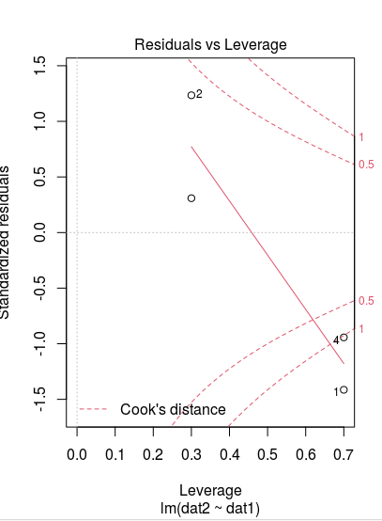
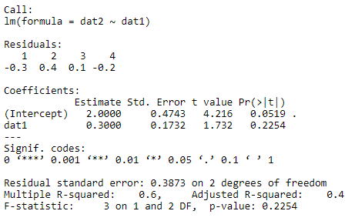
Part 2, Data Set 1

Slide 6
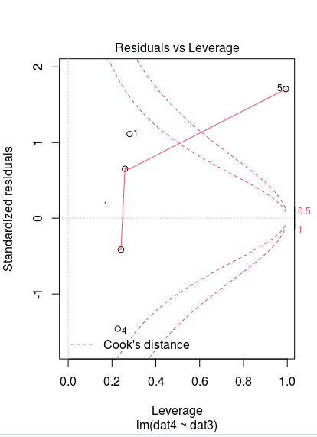
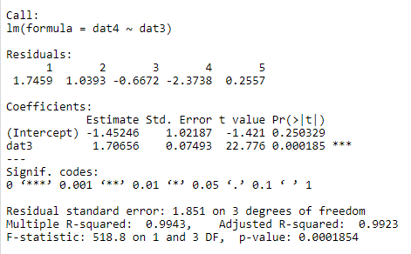
Part 2, Data Set 1

Slide 7
End Part 2

Slide 8
Part 3

Slide 9
SAT Analysis… QOI and Data
QOI: A common discussion in education is if, and to what extent, spending money on students is significantly associated with increased test scores. We would like to conduct an analysis to quantify any evidence that the amount of money spent on each student (Expend) is associated with an increase in the average SAT score for that state after accounting for possible confounding factors that have been recorded in the data set.
The Data (50 observations … 1 for each state):
SAT: average SAT score for the state
TAKERS: % of the state’s students that take the test
INCOME: Median income of families in the state
YEARS: average number of years students received formal education in social studies, natural sciences and humanities
PUBLIC: percentage of test takers that attend public schools
EXPEND: amount of money in $100s that the state spends on each student
RANK: median percentile rank of the students in their secondary school.
Goal for Live Session: Exclude ”Expend” and perform at least one variable selection technique to obtain a set of potential confounding factors. Identify these variables and we will continue the analysis in live session!

Slide 10
End Part 3

Slide 11
Part 4

Slide 12
SAT Analysis… QOI and Data
Please Provide at least 4 Takeaways.
Also include any questions you may have!

Slide 13
Takeaways
I felt this unit was straightforward

Slide 14
End Part 4

