Slide 1
Unit 12: For Live Session Assignment

Slide 2
Part 1: Quick Quiz Questions

Slide 3
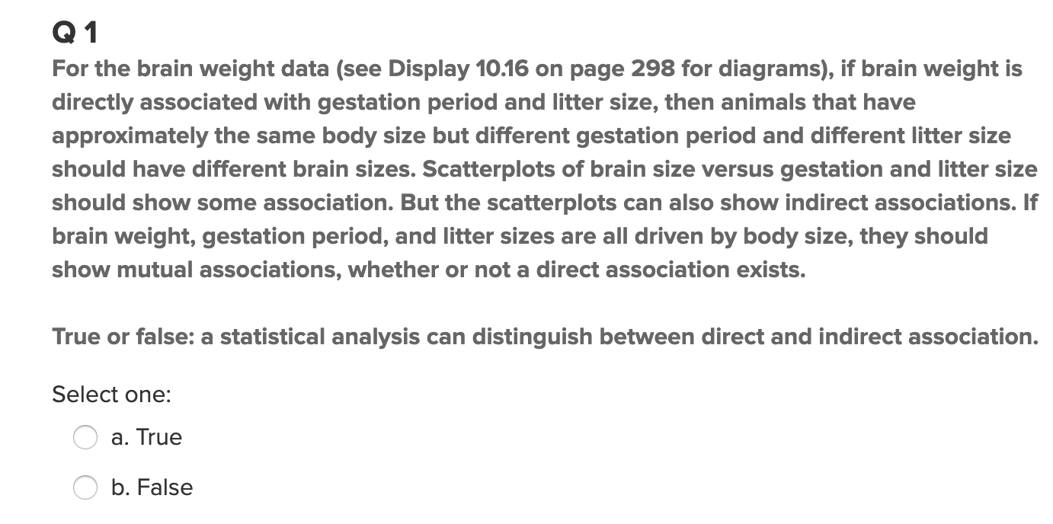
Part 1: Quick Quiz Questions

Slide 4
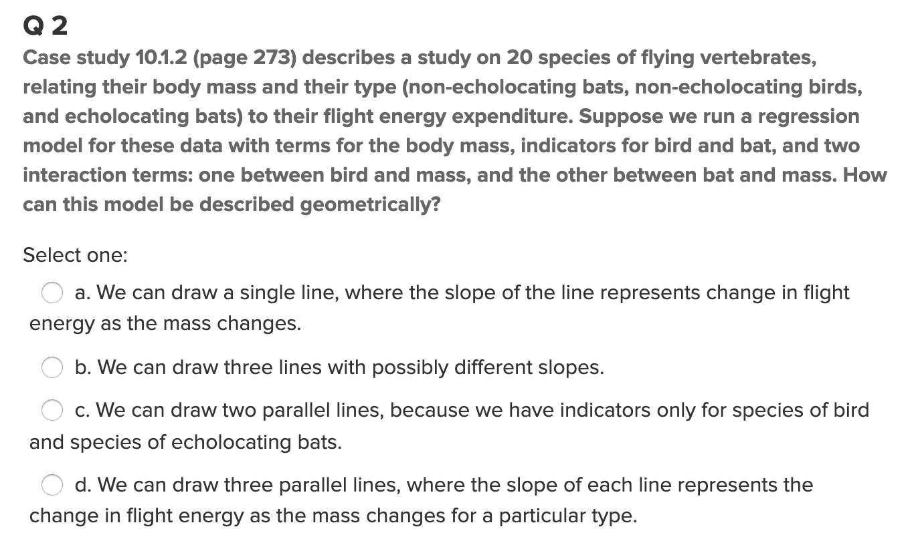
Part 1: Quick Quiz Questions

Slide 5
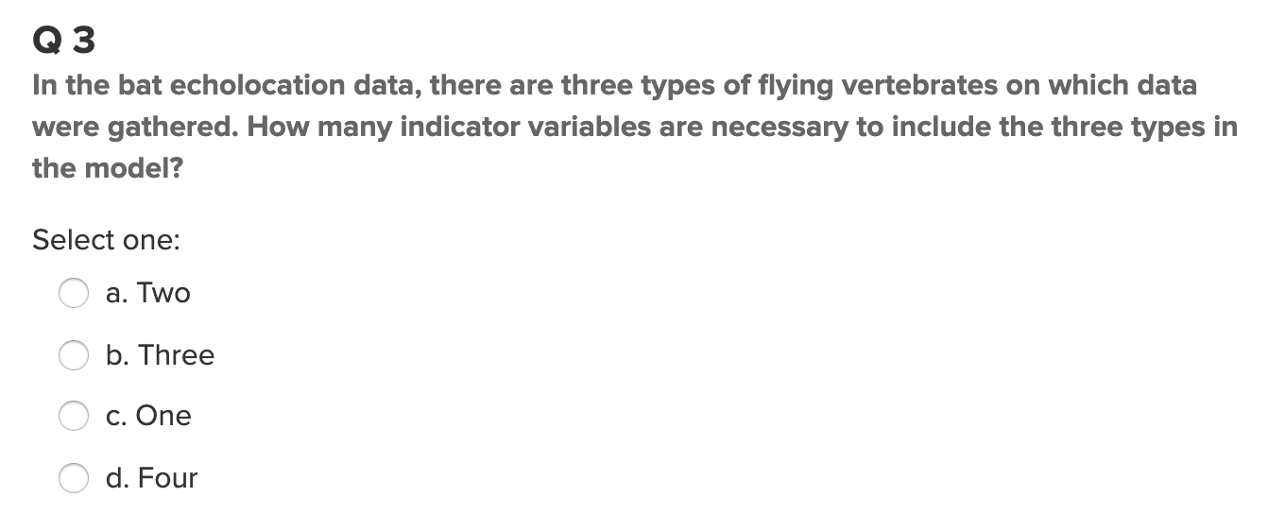
Part 1: Quick Quiz Questions

Slide 6
Part 2: Review the Meadowfoam Example

Slide 7
Review Meadowfoam Example Thoroughly
It will be extremely helpful to have reviewed the following example completely and thoroughly before live session. Try to be able to justify every step in every slide and record questions as they come up. Implementing and Interpreting categorical variables in regression models is a very powerful tool and while it is intuitive in the end, it is not trivial by any means. Learning the ins and outs of categorical variables is fairly involved and challenging although reviewing this example will give us the head start we need to make the topic much more intuitive and accessible. Please generate any questions or comments in the Questions Section! These will help the individual student and the class immensely! Let’s do it!

Slide 8
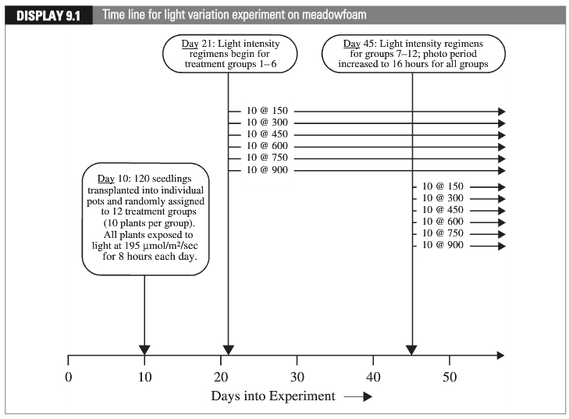
Case 1 Experimental Design: Meadowfoam
“Early”
“Late”
Data from M. Seddigh and G. D. Jolliﬀ, “Light Intensity Eﬀects on
Meadowfoam Growth and Flowering,” Crop Science 34 (1994): 497–503.)

Slide 9
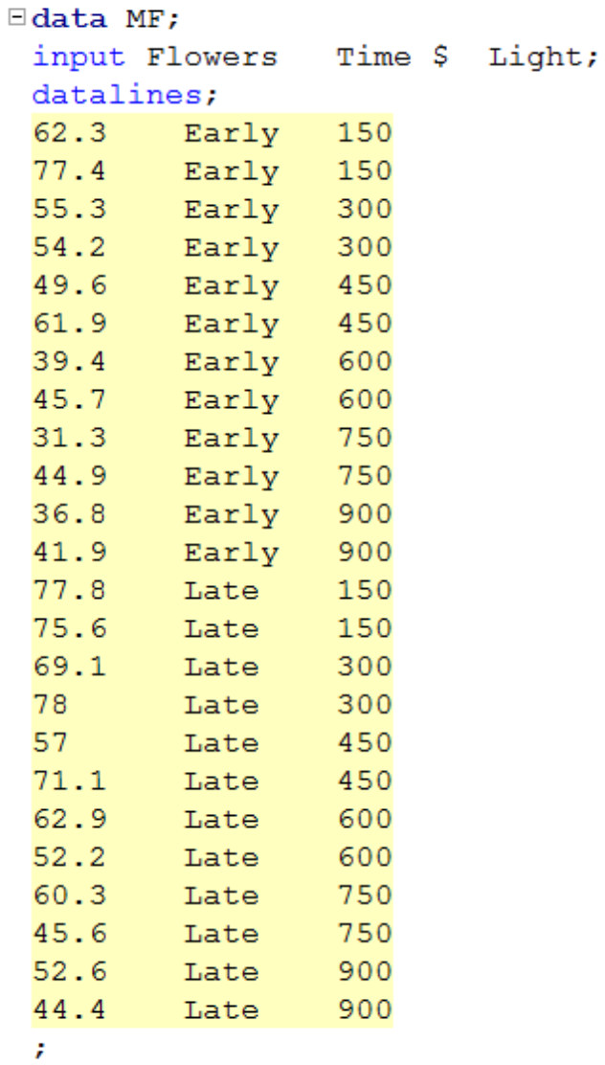
Meadowfoam: Data

Slide 10
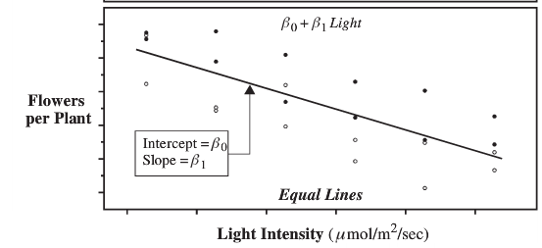
Equal Lines

Slide 11
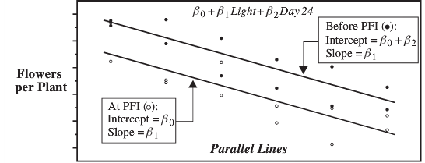



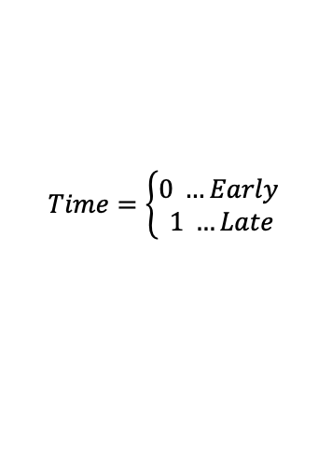






Parallel Lines: different intercepts, same slopes
$$Time=\left\{\begin{aligned}0 …Early \\ 1 …Late\end{aligned}\right.$$
$$β_{0}+β_{1}Light+β_{2}Time$$
Late
Early
$$For Time=\text{late} \left(or 1\right):$$
$$For Time=\text{early} \left(or 0\right):$$
$$β_{0}+β_{1}Light+β_{2}Time$$
$$β_{0}+β_{1}Light+β_{2}Time$$
0
$$β_{0}+β_{1}Light+β_{2}∗1$$
$$β_{0}+β_{1}Light+β_{2}∗0$$
$$β_{0}+β_{1}Light+β_{2}$$
$$β_{0}+β_{1}Light$$
$$\left(β_{0}+β_{2}\right)+β_{1}Light$$
slope
intercept

Slide 12
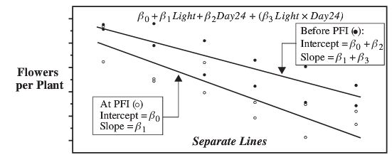







Nonparallel lines: different slopes (and intercepts)
Time is called an indicator variable:
Early = 0
Late = 1
$$β_{0}+β_{1}Light+β_{2}Time+β_{3}\left(Light x Time\right)$$
Late
Early
$$For Time=\text{late} \left(or 1\right):$$
$$For Time=\text{early} \left(or 0\right):$$
$$β_{0}+β_{1}Light+β_{2}Time+β_{3}\left(Time∗Light\right)$$
$$β_{0}+β_{1}Light+β_{2}Time+β_{3}\left(Time∗Light\right)$$
0
0
$$β_{0}+β_{1}Light+β_{2}∗1+β_{3}\left(1∗Light\right)$$
$$β_{0}+β_{1}Light+β_{2}∗0+β_{3}\left(0∗Light\right)$$
$$β_{0}+β_{1}Light+β_{2}+β_{3}Light$$
$$β_{0}+β_{1}Light$$
$$\left(β_{0}+β_{2}\right)+\left(β_{1}+β_{3}\right)Light$$
slope
intercept

Slide 13
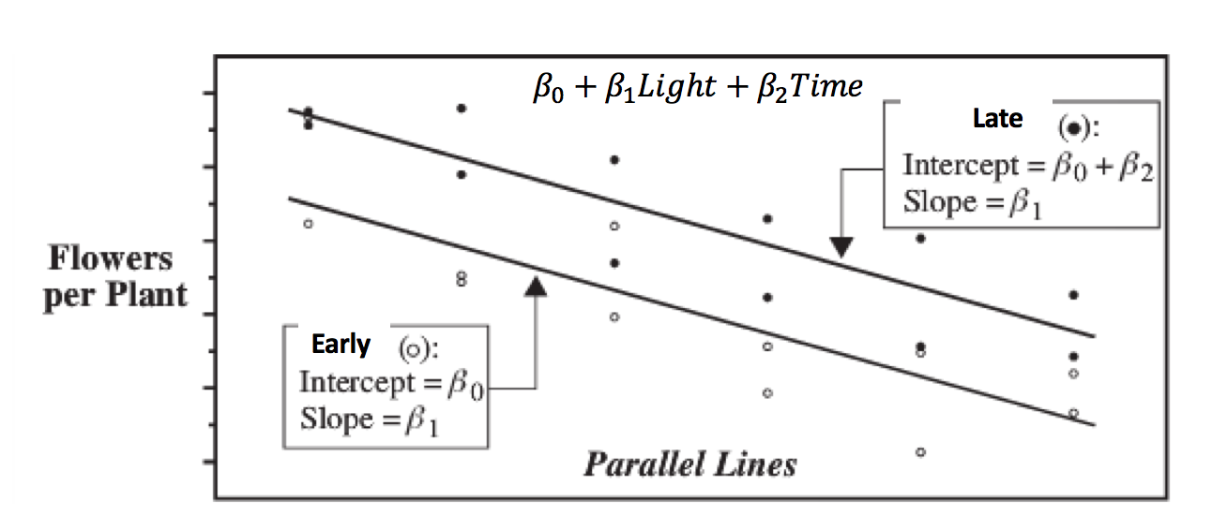
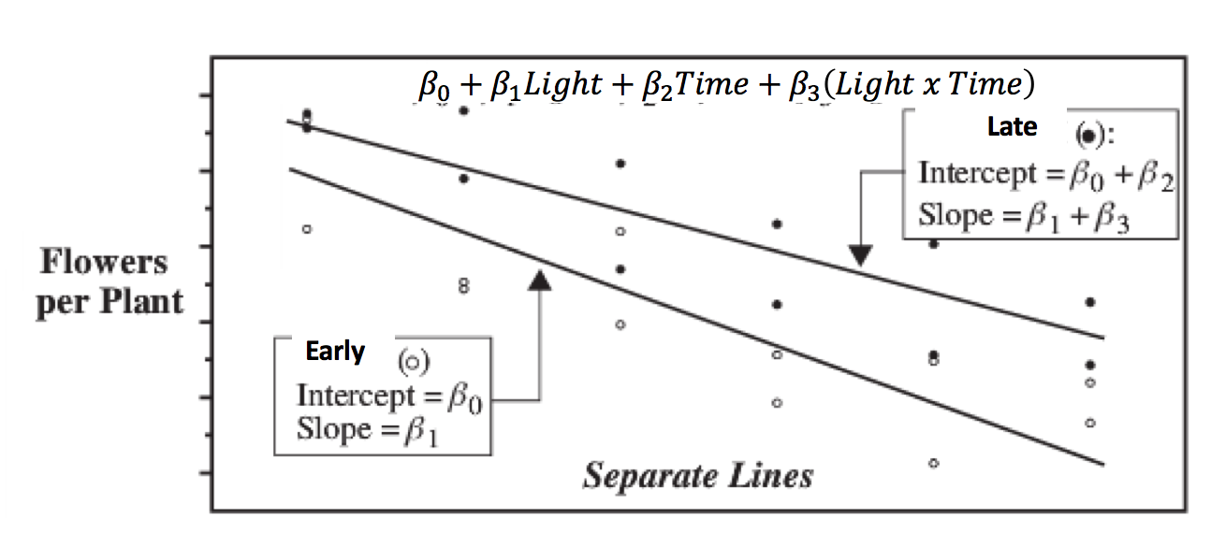
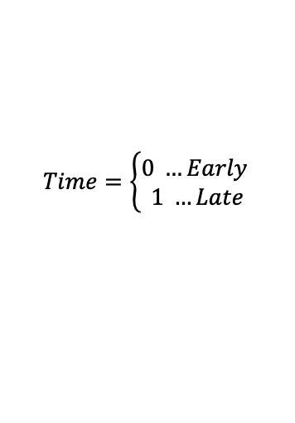
$$Time=\left\{\begin{aligned}0 …Early \\ 1 …Late\end{aligned}\right.$$
Simple Linear Regression
Time with No Interaction
Time with Interaction
Interaction means we can adjust the slope!!!

Slide 14

Interaction Terms! … (Flexible Slopes!)
$$μ\left\{flowers \right|light, time)= β_{0}+β_{1}Light+β_{2}Time+β_{3}\left(Light x Time\right)$$
$$μ\left\{flowers \right|light, time)= β_{0}+β_{2}Time+β_{1}Light+β_{3}\left(Light x Time\right)$$
Factor out Light and combine last two terms.
intercept
slope
$$μ\left\{flowers \right|light, time)=\left(β_{0}+{β_{2}Time)+(β}_{1}+β_{3}Time\right)Light$$
Now the intercept AND the slope depend on the time!

Slide 15

Is the separate slope model appropriate?
Construct a model in which the mean flower production depends linearly on the light intensity and the time category. Also allow for the possibility of unequal slopes and intercepts.
Which model is correct?
No possibility of unequal intercepts OR unequal slopes for different time categories.
$$Pred Flower= β_{0}+β_{1}Light$$
Possibility of unequal intercepts BUT NO possibility of unequal slopes for different time categories.
$$Pred Flower= β_{0}+β_{1}Light+ β_{2}Time$$
No possibility of unequal intercepts BUT has a possibility of unequal slopes for different time categories.
$$Pred Flower= β_{0}+β_{1}Light+β_{3}Light ∗ Time$$
Typically, we do NOT include an interaction term with out relevant single terms!!!
Possibility of both unequal intercepts or unequal slopes for different time categories.
$$Pred Flower= β_{0}+β_{1}Light+ β_{2}Time+ β_{3}Light ∗ Time$$

Slide 16
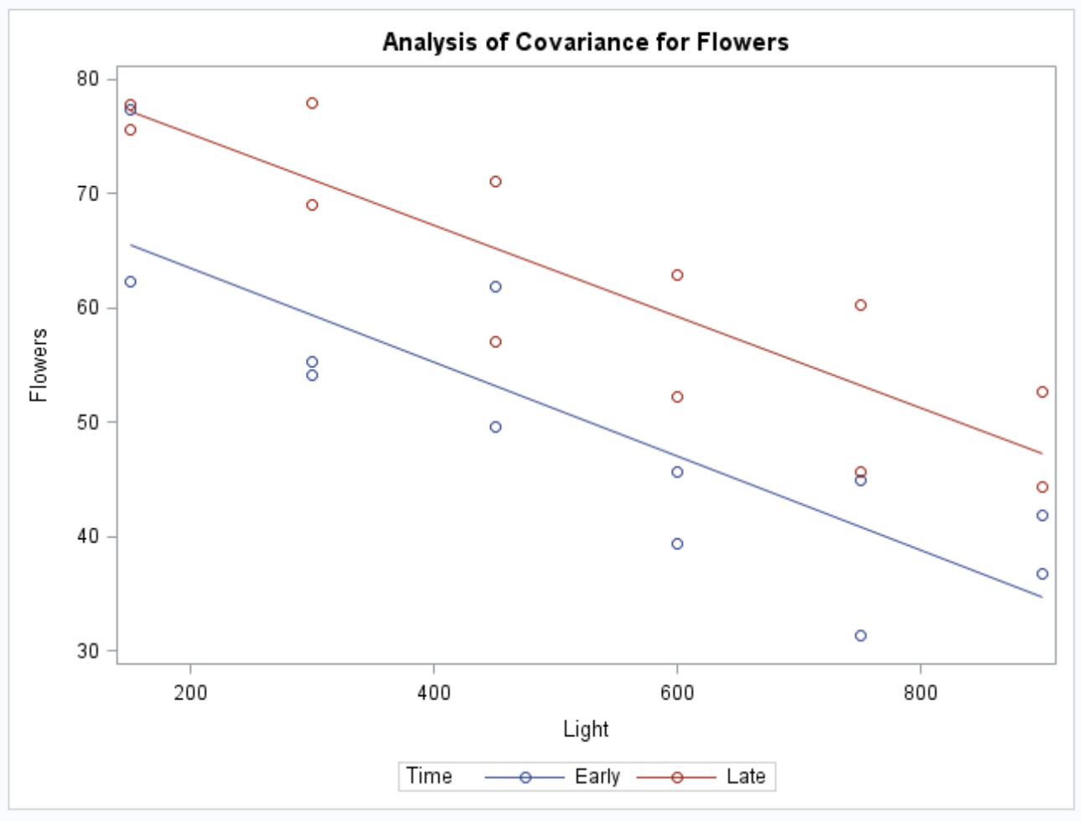
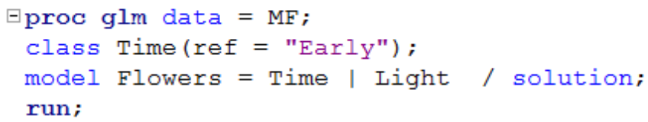
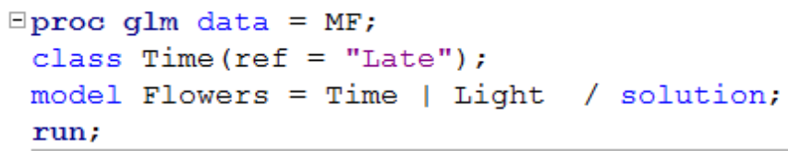
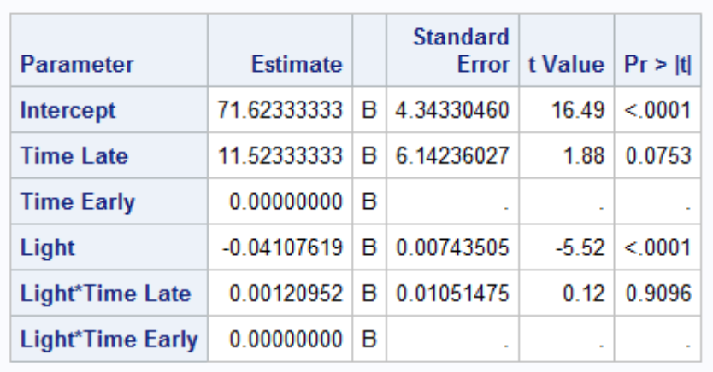
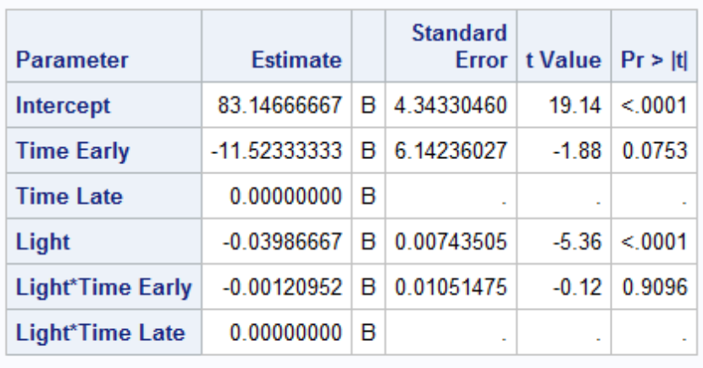
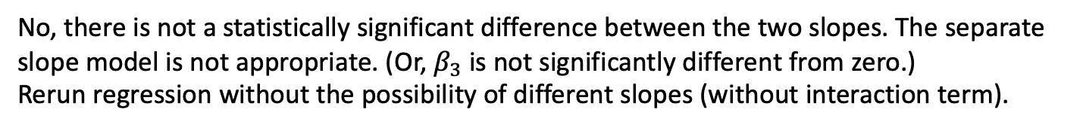
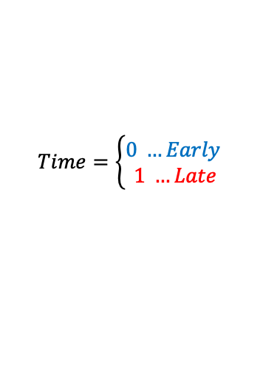
Is the separate slope model appropriate?
Construct a model in which the mean flower production depends linearly on the light intensity and the time category. Also allow for the possibility of unequal slopes and intercepts.
$$Pred Flower= β_{0}+β_{1}Light+ β_{2}Time+ β_{3}Light ∗ Time$$
$$Time=\left\{\begin{aligned}0 …Early \\ 1 …Late\end{aligned}\right.$$
No, there is not a statistically significant difference between the two slopes. The separate slope model is not appropriate. (Or, $β_{3}$ is not significantly different from zero.)
Rerun regression without the possibility of different slopes (without interaction term).

Slide 17
Part 3: Takeaways

Slide 18
Please Provide a summary of at least 4, but as many any as you like, takeaways from this unit!
Multiple regression is very nuanced and requires careful interpretation.
Indicator variables have always been a difficult topic for me and making sure I get them right is something I’ve spent quite a bit of time on.
A challenge for me is deciding whether multiple slopes are worth having for a single model.
I would like to go over some techniques for evaluating the effect of each variable in these models, such as dfbetas.
Other than these things, multiple linear regression is super interesting and it always pays to review this topic!

Slide 19
Part 4: Questions or Comments

