Slide 1
Unit 9: For Live Session Assignment
Simple Linear Regression!

Slide 2
Part 1

Slide 3
Quick Quiz Questions

Slide 4
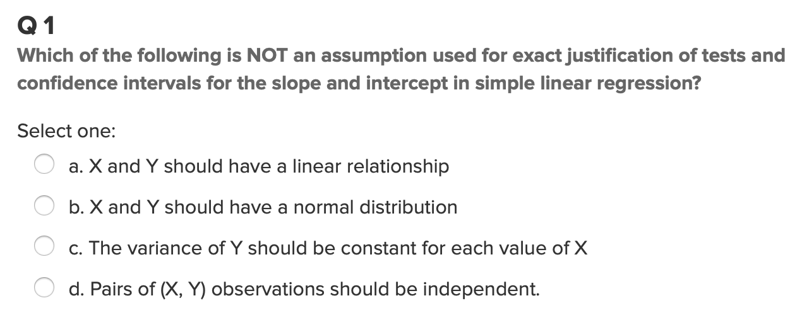
Question 1 (<15 min)

Slide 5
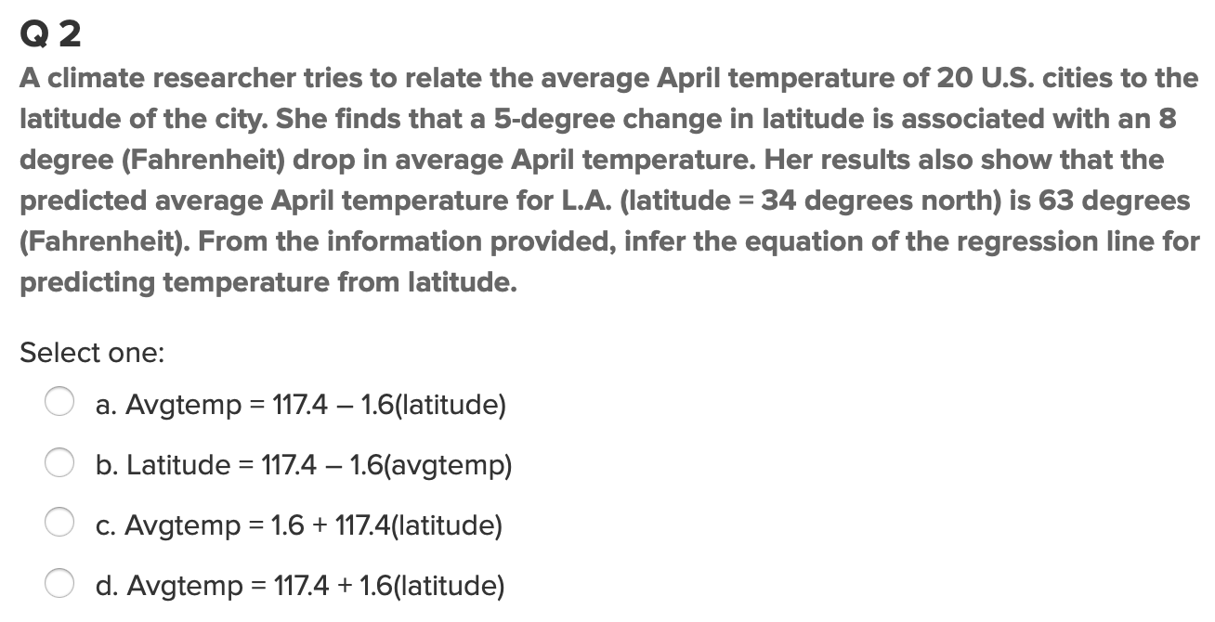
Question 2 (< 15 min)

Slide 6
End Part 1

Slide 7
Part 2

Slide 8
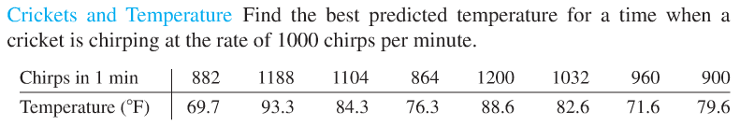
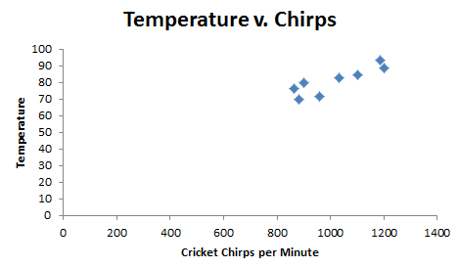
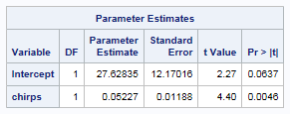
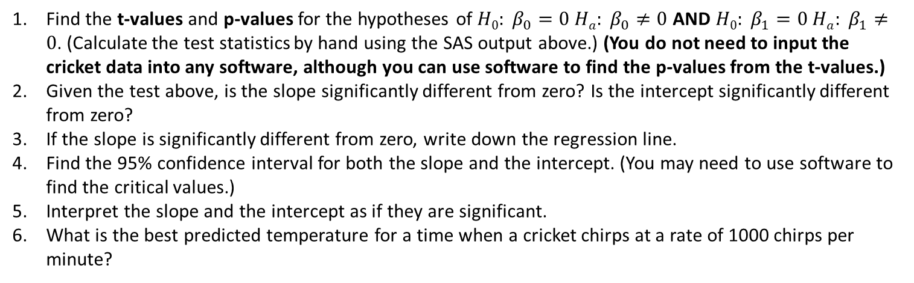
Crickets!!!
Find the t-values and p-values for the hypotheses of $H0: β_{0}=0{ Ha: β}_{0}≠0$ AND $H0: β_{1}=0{ Ha: β}_{1}≠0$. (Calculate the test statistics by hand using the SAS output above.) (You do not need to input the cricket data into any software, although you can use software to find the p-values from the t-values.)
Given the test above, is the slope significantly different from zero? Is the intercept significantly different from zero?
If the slope is significantly different from zero, write down the regression line.
Find the 95% confidence interval for both the slope and the intercept. (You may need to use software to find the critical values.)
Interpret the slope and the intercept as if they are significant.
What is the best predicted temperature for a time when a cricket chirps at a rate of 1000 chirps per minute?

Slide 9
Cricket Solutions first HT!
Step 1: H0: B_0=0, HA:B_0!=0
Step 2: t_0: = 27.6286/12.17016=2.27
Step 3: tcv: 2.446912
Step 3: P-value: 0.06365
Step 4: Fail to rejct H0
Step 5: We fail to reject H0 and conclude that there isn’t a difference!

Slide 10
Cricket Solutions second HT!
Step 1: H0: B_1=0, HA:B_1!=0
Step 2: t_0: = 0.05227/0.01188=4.399
Step 3: tcv: 2.446912
Step 3: P-value: 0.00457
Step 4: Reject H0
Step 5: We reject H0 and conclude that B_1 is different than zero!

Slide 11
Cricket Solutions Question 3
Y_i=27.62835082+0.05227223x

Slide 12
Cricket Solutions Question 4
95% CI for coefficients:
Slope: (0.02319537,0.08134908)
Intercept: (-2.15095666,57.40765830)
CI(slope)=(2.446912*0.01188)-/+0.05227
CI(intercept)=(2.446912*12.17016)+/-27.62835

Slide 13
Cricket Solutions Question 6
Predicted temperature when bird chirps 1000 times.
79.90058 degrees
99% CI: (74.25861,85.54254)

Slide 14
End Part 2

Slide 15
Part 3

Slide 16
Takeaways and Questions (1 hour)
Can we discuss interpretation of intercept?
My confidence intervals were a bit strange, and I forget the rules for computing tcv in R
Overall regression is a great subject
Regression is at the basis of everything more advanced in statistics (more or less, it helps)
Oher than those comments, I feel pretty good about this unit.

Slide 17
End Part 3

Slide 18
End Unit 9 For Live Session Assignment

