Slide 1
Week 6 Presubmission Question
By Ben Goodwin

Slide 2
Weekly Summary
This week was all about Bayes theorem and its applications
The posterior is proportional to the prior times the sampling distribution
Naive Bayes is a powerful classification algorithm
The “naïve” part assumes that all data is independent
Great for applications like spam email classification
Most emails can be assumed to be spam, and if we assume our prior for spam is 80% we can update our posterior based on text within the email

Slide 3
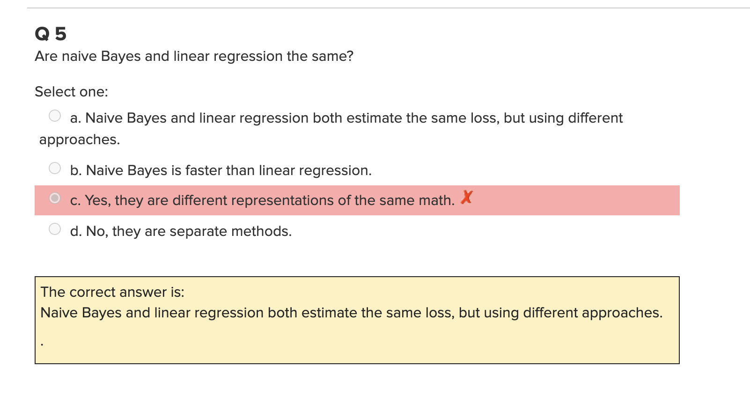
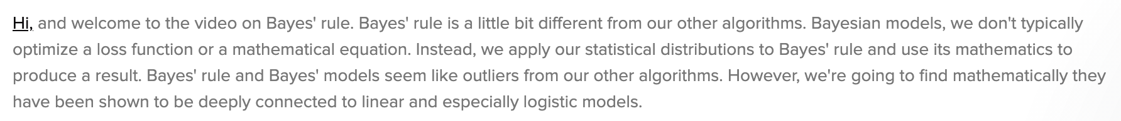
Weekly Questions
My first question relates to this week’s quiz
I have an issue with question 5
I believe asynchronous material conflicts correct answer. I think this is a poorly worded question as it relates to the material

Slide 4
Weekly Questions
As powerful and as widely used as naïve bayes is, why isn’t there more emphasis on Bayesian methods when compared to frequentist methods?
What is a consequence if any of a very incorrect prior?

