Slide 1
Metropolis-Hastings and High Dimensional Integration
By Ben Goodwin

Slide 2
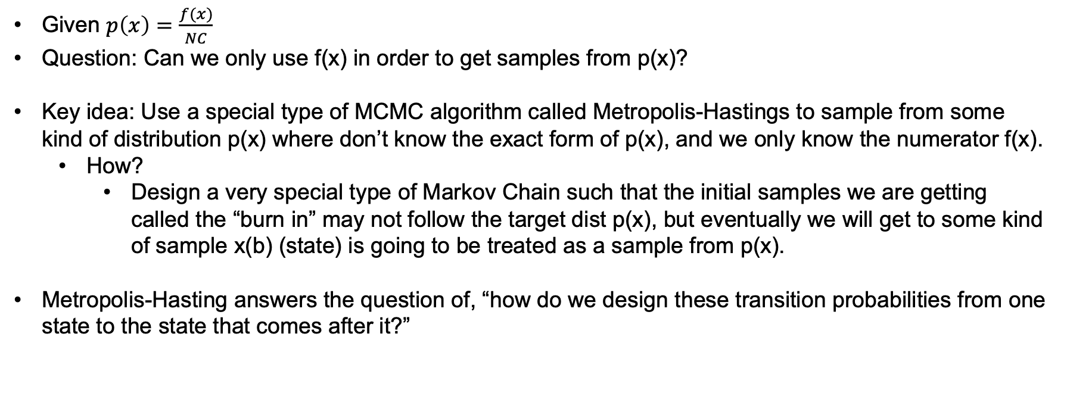
What do I aim to accomplish?
Given $p\left(x\right)=\frac{f(x)}{NC}$
Question: Can we only use f(x) in order to get samples from p(x)?
Key idea: Use a special type of MCMC algorithm called Metropolis-Hastings to sample from some kind of distribution p(x) where don’t know the exact form of p(x), and we only know the numerator f(x).
How?
Design a very special type of Markov Chain such that the initial samples we are getting called the “burn in” may not follow the target dist p(x), but eventually we will get to some kind of sample x(b) (state) is going to be treated as a sample from p(x).
Metropolis-Hasting answers the question of, “how do we design these transition probabilities from one state to the state that comes after it?”

Slide 3
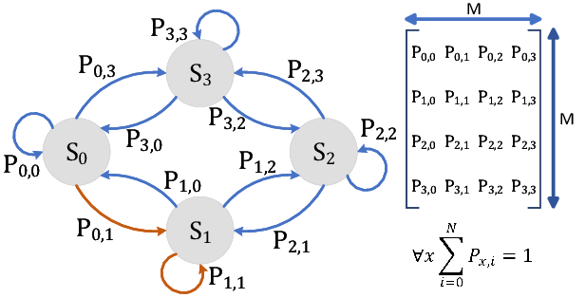
The variety of topics we’ll discuss en route to the solution
Monte Carlo Simulation
Terms: Repeated sampling, deterministic
Markov Chains
Terms: State, Transition Probabilities

Slide 4
Why do we care?
Metropolis-Hastings algorithm is used to generate serially correlated draws from a sequence of probability distributions that converge to a given target distribution.
Final takeaway: MH is algorithm for producing samples from distributions that may otherwise be difficult to sample from.

