Slide 1
For Live Session
Case Study / Example
https://www.youtube.com/watch?v=gIXNTebJOe8
Unit 7
By Ben Goodwin
R Package for Network Flow
https://transportfindings.org/article/6945-dodgr-an-r-package-for-network-flow-aggregation

Slide 2
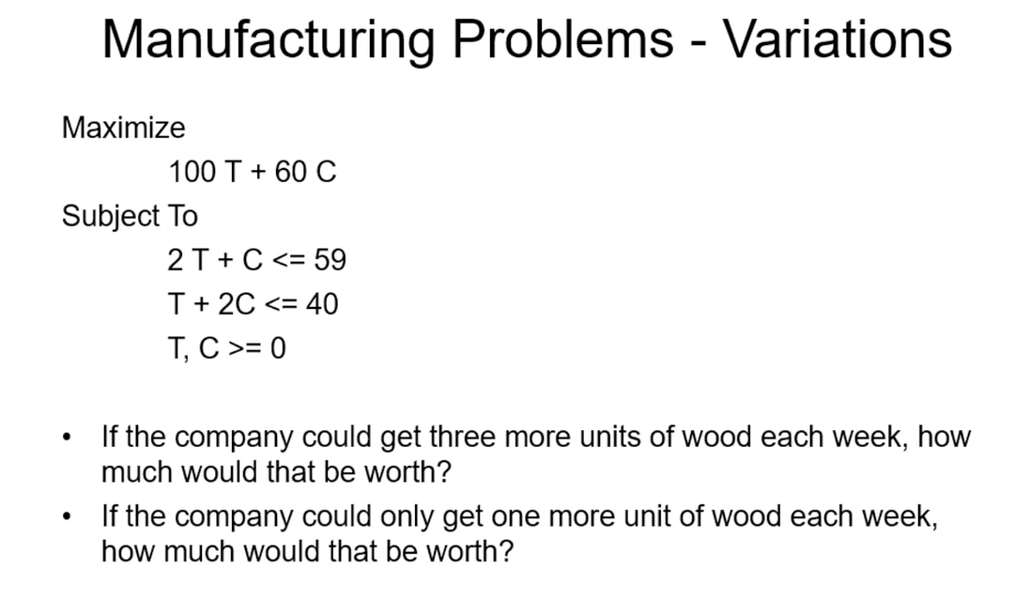
Activity 1: Graphical Method to Solve LP
Keeping with the manufacturing problem (below), make a coordinate plane and plot and use the graphical method introduced by Rusty to solve the problem as it is written below. You may plot this by hand on paper and provide a pic or you may use software and provide screen shots.

Slide 3
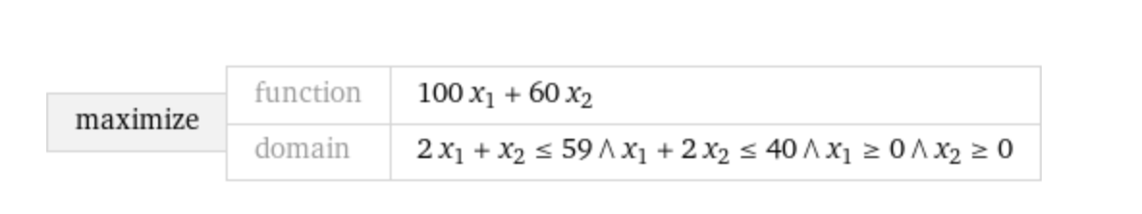
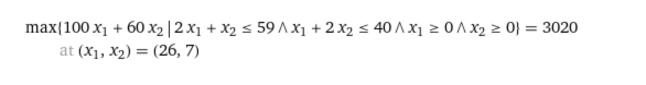
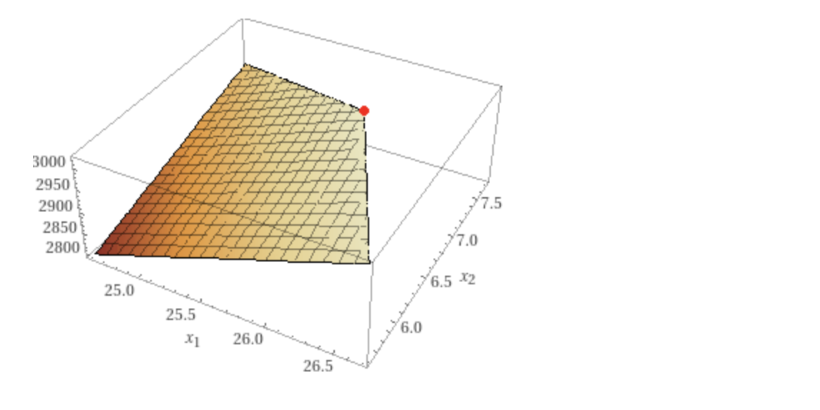
Activity 1 Solution

Slide 4
Activity 2: Solve LP
If you have not done so, ”code” in Excel Solver to solve the problems that Rusty Burlingame showed in 7.4. No slide necessary here… this is an exercise to get the practice necessary to master the ideas.
In his Excel Solver video (7.4) Rusty solved the manufacturing problem (tables and chairs). However there were some variations / additional questions asked (make any reasonable assumptions you need to answer to problem). Answer those two questions on a slide or two!

Slide 5
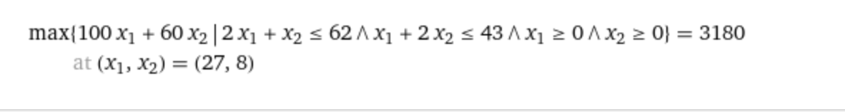
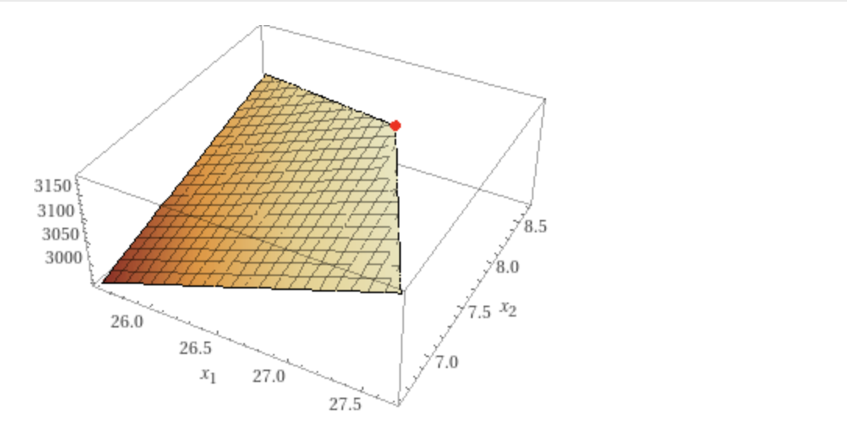
Activity 2: Solve LP Solution

Slide 6
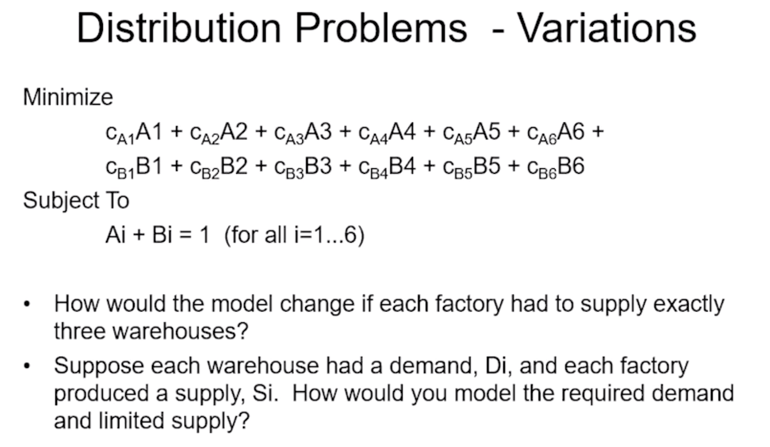
Activity 3: Distribution Problem
Rusty introduced an example of LPs for distribution problems (below). Answer the two questions he posed in a slide or two.

Slide 7
Activity 3: Distribution Problem Solution
Instead of the current iteration of the mode it could look something like this:
c_A1A1+c_A2A2+c_A3A3+c_B1B1+c_B2B2+c_B3B3
To model the demand, Di and each factories supply Si
We could use a constraint problem where we model the supply as a function of the demand. We would try to maximize demand and minimize supply

Slide 8
Activity 4: LP / Integer in R
As we know well by now, a very useful and critical capability to be able to understand the problem and to be able to research potential solutions to solve the problem. Your goal here is to use R to solve the manufacturing problem below (same one you have already solved using Excel Solver. Hint: you will first have to look for a package that will handle this task.
A slide or two will be good here. Be sure and include your commented code and what package you used.
https://www.oag.com/on-time-performance-dashboards

Slide 9
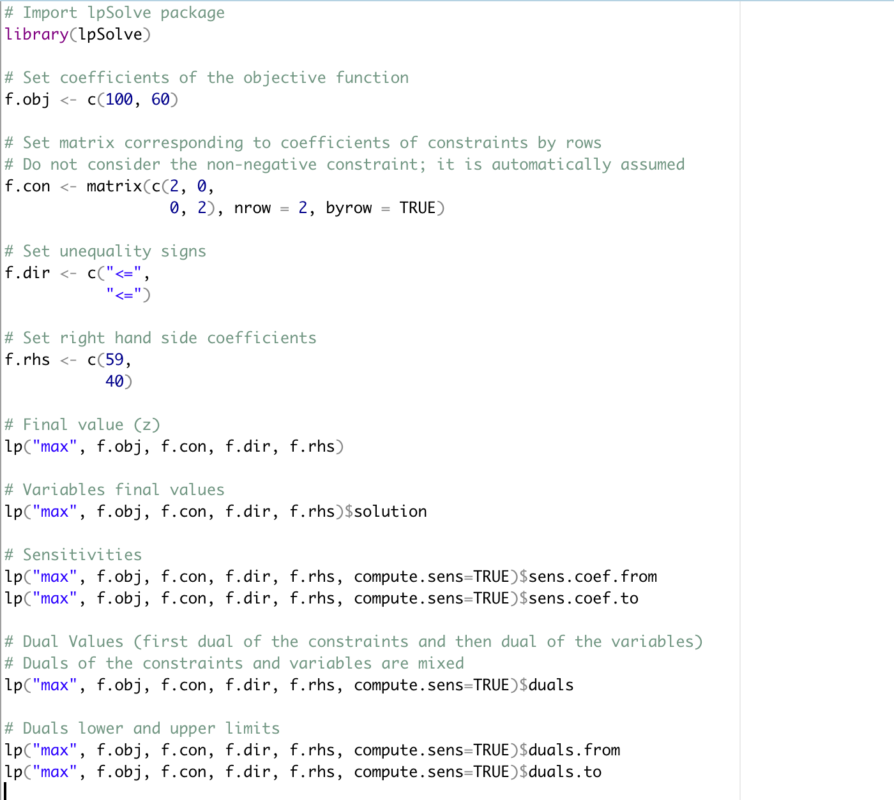
Activity 4: Solution
lpSolve package!
https://www.oag.com/on-time-performance-dashboards

