Slide 1
UNIT 4: For Live Session
By Ben Goodwin

Slide 2
Empirical Study of Revenue Management
Download the Paper: An Empirical Study of Revenue Management Practices in the Airline Industry http://faculty.washington.edu/yongpin/RM_Nov_15_07.pdf
Read these sections of the paper:
Section 1: Introduction
Section 2: Literature Review (THIS IS NOT REQUIRED BUT IS INTERESTING). IF TIME IS SHORT, YOU MAY SKIP THIS SECTION.
Section 3: Data and Variables
Section 4: Hypotheses and Models
Put special focus on 4.3 Revenue
Put special focus on the model for Revenue in 4.4
Section 5: Results (Pay close attention to the results pertaining to revenue.)
3. Make at least one slide to answer each of the following questions
a. GINI SCORE
i. Provide a formula for the GINI score and describe what it measures in this context. (Define price dispersion as part of this effort).
ii. Get a feel for the GINI score. Calculate a GINI score for: (Show your calculations.)
a. Ticket Prices: $350, $150, $600 $1300
b. Ticket Prices $600, $400, $700, $700
b. Investigate the Data Sources. Find a snapshot of at least 1 of the three data sources.
c. Investigate the model for Revenue (Model (5))
i. Specify the model (what is the mathematical form of the model?)
ii. Define endogenous vs. exogenous variables. https://www.sciencedirect.com/topics/nursing-and-health-professions/exogenous-variable
iii. What are the 3 methods of parameter estimation considered?
iv. Why were the OLS parameter estimates not recommended?
v. Was multicollinearity an issue? Why or why not?
vi. Which is the “right” model … the model the data were generated from? OLS, Random Effects, Hausman-Taylor (HT)
vii. Using Table 6, interpret the HT parameter estimate for Load Capacity. Assume this slide is meant for a client or audience that does not have a background in statistics. Phrase your interpretation in the language of the problem and industry.
viii. Using Table 6, interpret the HT parameter estimate for GINI (price dispersion) Assume this slide is meant for a client or audience that does not have a background in statistics. Phrase your interpretation in the language of the problem and industry. (Does it appear that price dispersion and thus revenue management (RM) is positively associated with revenue (RASM)?
http://www.businessdictionary.com/definition/exogenous-variable.html
https://www.transtats.bts.gov/tables.asp?Table_ID=310&SYS_Table_Name=T_T100D_MARKET_ALL_CARRIER
https://www.sciencedirect.com/topics/nursing-and-health-professions/exogenous-variable

Slide 3
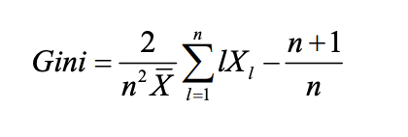
Answers to empirical study of revenue management
3a i. Variable GINI is the Gini index of the fares for carrier k with origin i and destination j. It is a measure of price dispersion, or price inequality. Gini index is a scale invariant measure that has been applied widely in economics literatures to measure income and price inequality where Xl (l n =1,..., ) are the prices in ascending order and X is the average price. Higher GINI simply indicates higher price dispersion.

Slide 4
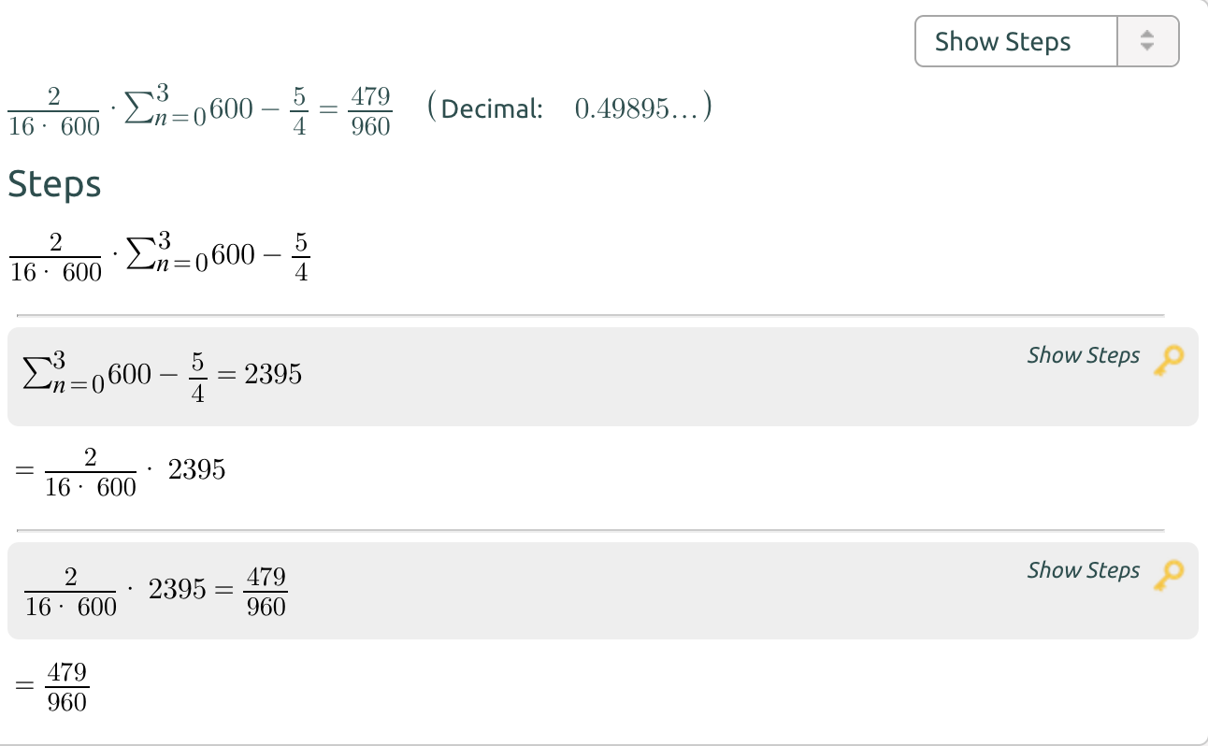
3a ii.

Slide 5
3B.
https://www.transtats.bts.gov/TRAFFIC/
These statistics are fantastic and provide huge insights into the world of commercial aviation.
I used these exact numbers for my machine learning I projects.
You can derive which airline to fly out of which airports on a given day to avoid arriving late to your destination

Slide 6
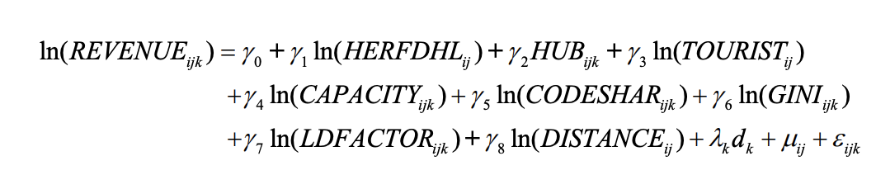
3C i.

Slide 7
3C ii.
In an economic model, an exogenous variable is one whose value is determined outside the model and is imposed on the model, and an exogenous change is a change in an exogenous variable. In contrast, an endogenous variable is a variable whose value is determined by the model.

Slide 8
3C iii.
I. Capacity
II. Code-Share
III. Price-dispersion

Slide 9
3C iv.
This is due to the negative coefficients

Slide 10
3C v.
“All of the VIF-values are below the threshold of 10. Consequently, multi-collinearity should not be a problem in our specifications ”

Slide 11
3C vi.
Hausman-Taylor (HT)

Slide 12
3C vii.
The natural log of capacity indicates for a one unit change in revenue we can expect an increase of 0.009 in log space of capacity.
We can expect these variables to vary together, they have a positive relationship. Meaning that when revenue increases, we expect capacity to increase as well.

Slide 13
3C viii.
The natural log of gini indicates for a one unit change in revenue we can expect an increase of 0.019 in log space of gini.
We can expect these variables to vary together, they have a positive relationship. Meaning that when revenue increases, we expect the gini to increase as well.

Slide 14
Optimization
This Unit provided some insight into the use of optimization in the airline industry.
Does your work or the company you work (or one you have worked for in the past … or one you would like to work for) for currently make use of prescriptive statistics? Optimization?
Not yet- but we are working towards this
Could your company (or one you have worked for in the past … or one you would like to work for) take advantage of prescriptive statistics?
Absolutely, but the data needs to arrive first

Slide 15
Key Takeaways and Questions!
Please list your key takeaways from this Unit!
Please include any questions that you had in this unit.
Airlines are incredible interesting businesses
How they work as a system is unrivaled in the world
This unit, and the asynchronous materials were fascinating and showcased how even a hugely capital intensive business like an airline can consistently produce revenue.
The people express vs American story is a great one for advertising the benefits of analytics.

