Slide 1
For Live Session
Unit 5
By Ben Goodwin

Slide 2
Activity 1
Be prepared to discuss the discussion topics that you responded to in the asynch material. You don’t need to include any slides for this (but you can if you like).
Dicuss any "opportunities and/or threats" data and data science represented in your field/experience?
What software / languages do you / have you used at your company or in your career? If this is a long list, just think about the most ones you have used most recently, or are the most familiar with.
Have you ever encountered a business challenge like the ones described by Diana?
If so, be prepared to describe your experience.
If not, be prepared to discuss a business challenge (or academic challenge) that you do have experience with.

Slide 3
Activity 2
On one or two slides, DELTTAA Diana’s project given what you learned from the videos.
Data – Southwest has a treasure trove of data on all flights past and present
Enterprise – Leveraging analytics is a key tenant of modern airline operations
Leadership- As a data first company, leveraging data is a priority
Targets – The target is measuring and predicting on time arrival performance
Technologies – Southwest proprietary tools
Analytic Techniques – Machine learning (LASSO was final selected model)
Analysts – Data scientists across different areas competed to find a solution

Slide 4
Activity 3
For Live Session
There is an R package called nycflights13 that contains a record of all flights into and out of New York City in 2013. These records are in the dataset flights that is included in the package. the package includes 4 additional datasets that includes information about the weather, the airlines, the airports and planes themselves.
Create a new data set in R or Python (or Tableau) that calculates On Time Performance (OTP) for Delta (DL), American (AA) and Southwest (WN) Airlines for each day. Show the head of this data with a screen shot.
Bring in this data set (if it is not already in Tableau) into Tableau. Bring in the airlines dataset as well. No slide is needed here.
In DS 6306 (DDS) we discussed merging and joining datasets. In Tableau, merge the data set you created with the airlines data frame to create one data set that includes the date (by day), the carrier, the flightnumber, the on time performance (otp) and the airline name. Show the head of this dataset with a screen shot.
In Tableau, create a time series plot of OTP with a separate series for each airline. To be clear, there should be three time series plots (color coded) on the same coordinate plane with OTP on the y axis and time (in days) on the x-axis. Provide a screen shot of this plot and be prepared to share you Tableau workbook in class.
What inference / insights can you get derive from these plots? (One Slide)
Use Tableau to forecast (and plot) the next week (7 days) of OTP. Hint: Check out the Analytics Tab. Can you provide any additional insight? Provide a slide with a screen shot of this plot and include any additional insights. Also, research and find out what type of forecast Tableau is providing here.
FREE STYLE! Use the data sets in the nycflights13 R package and Tableau to create a plot / analysis of something you find interesting! What inference/ insight do you derive from this analysis? (This should be on a separate “Sheet” in Tableau but in the same workbook. One or two slides should work here.

Slide 5
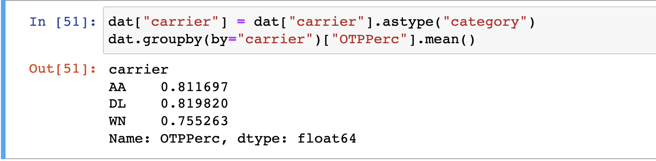
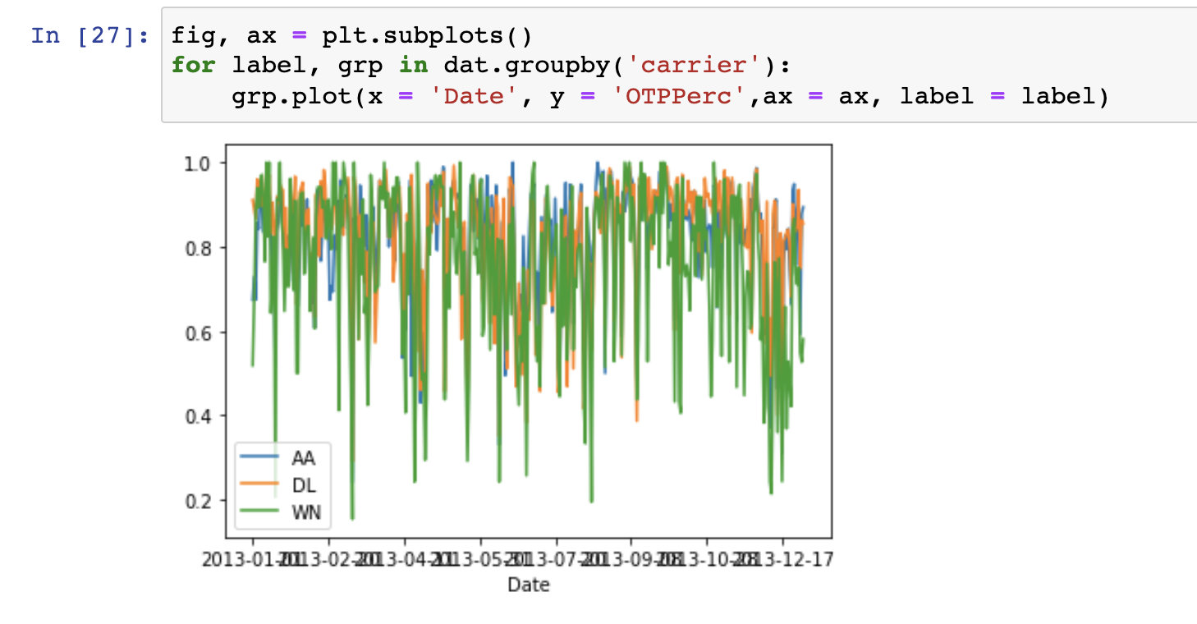
Activity 3
3A
3D

Slide 6
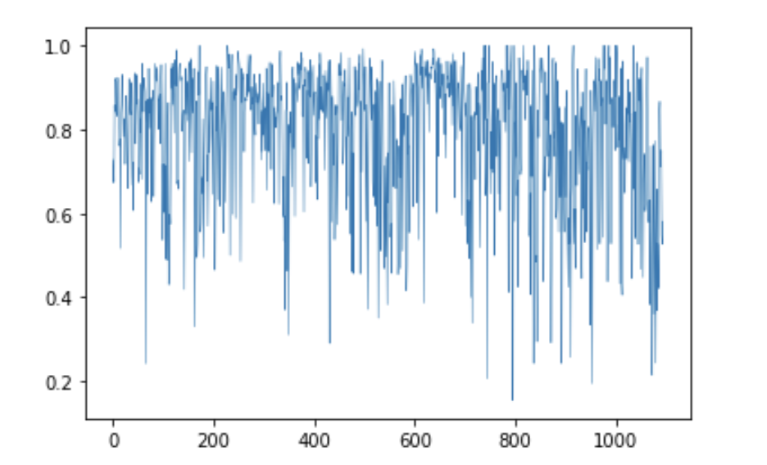
Activity 3
3E. Based on the plots, it looks like that southwest has the lowest OTP performance on average, although this could require further investigation and weighting. They may operate more flights or something to that effect.
Additionally, it looks like when one airline struggles, they tend to struggle as a group. Suggesting outside forces impact all these carriers, although again WN seems to dominate here.

Slide 7
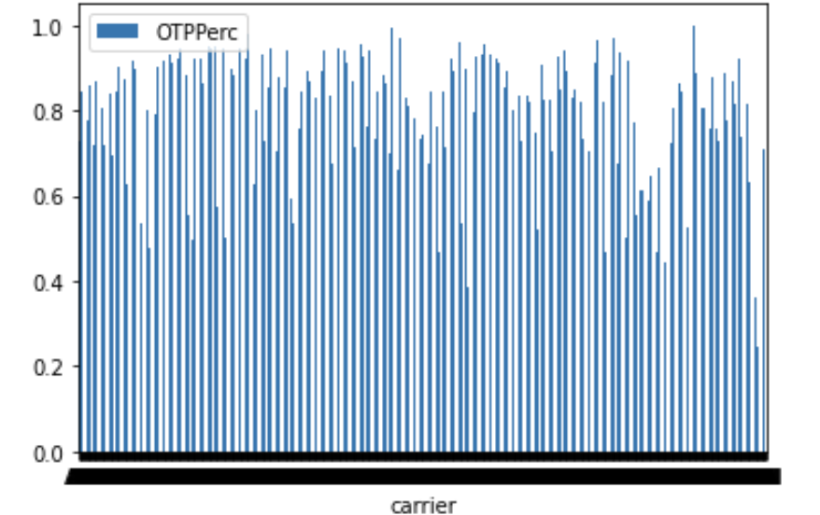
Activity 3, Free style

