Slide 1
UNIT 8: More Practice With Optimization
For Live Session Assignment
By Ben Goodwin

Slide 2
Directions
Solve the following two problems using both Excel Solver and the R package lpsolve.
Display your work on at least 1 PowerPoint slide for each problem so that you may easily describe your work/solution to a peer.
Do the best you can on these problems. The goal is to get a good idea of the problem and the challenges in solving it before live session. This is to facilitate a great discussion and to insure that the solution presented by peers and the professor not only makes sense, but sticks with the student.

Slide 3
Problem 1
You need to buy some filing cabinets. You know that Cabinet X costs $10 per unit, requires six square feet of floor space, and holds eight cubic feet of files. Cabinet Y costs $20 per unit, requires eight square feet of floor space, and holds twelve cubic feet of files. And Cabinet Z costs $25 per unit, requires 9 square feet of floor space and holds 15 cubic feet of files. You have been given $140 for this purchase, though you don't have to spend that much. The office has room for no more than 72 square feet of cabinets. How many of which model should you buy, in order to maximize storage volume?
How would your optimal solution change if you were able to afford $185 for the purchase?
How would your optimal solution change if you decided you could stack all the cabinets which allowed you double the square feet requirement to 144 feet? (Assume your budget is back to $140.)

Slide 4
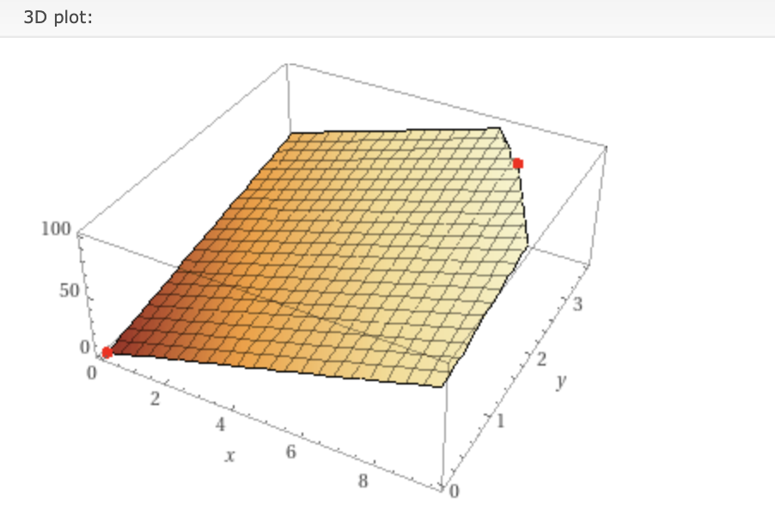
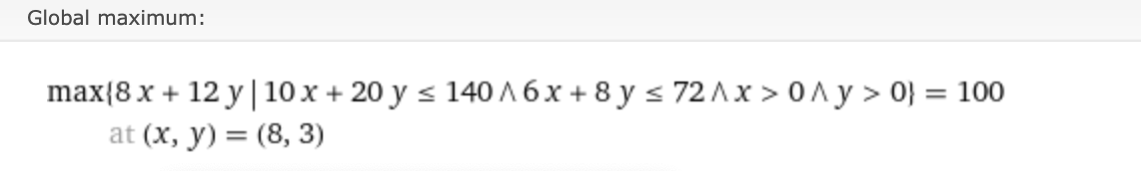
Problem 1 Solution
Purchase 100 to maximize volume
108 become available with a $185 budget

Slide 5
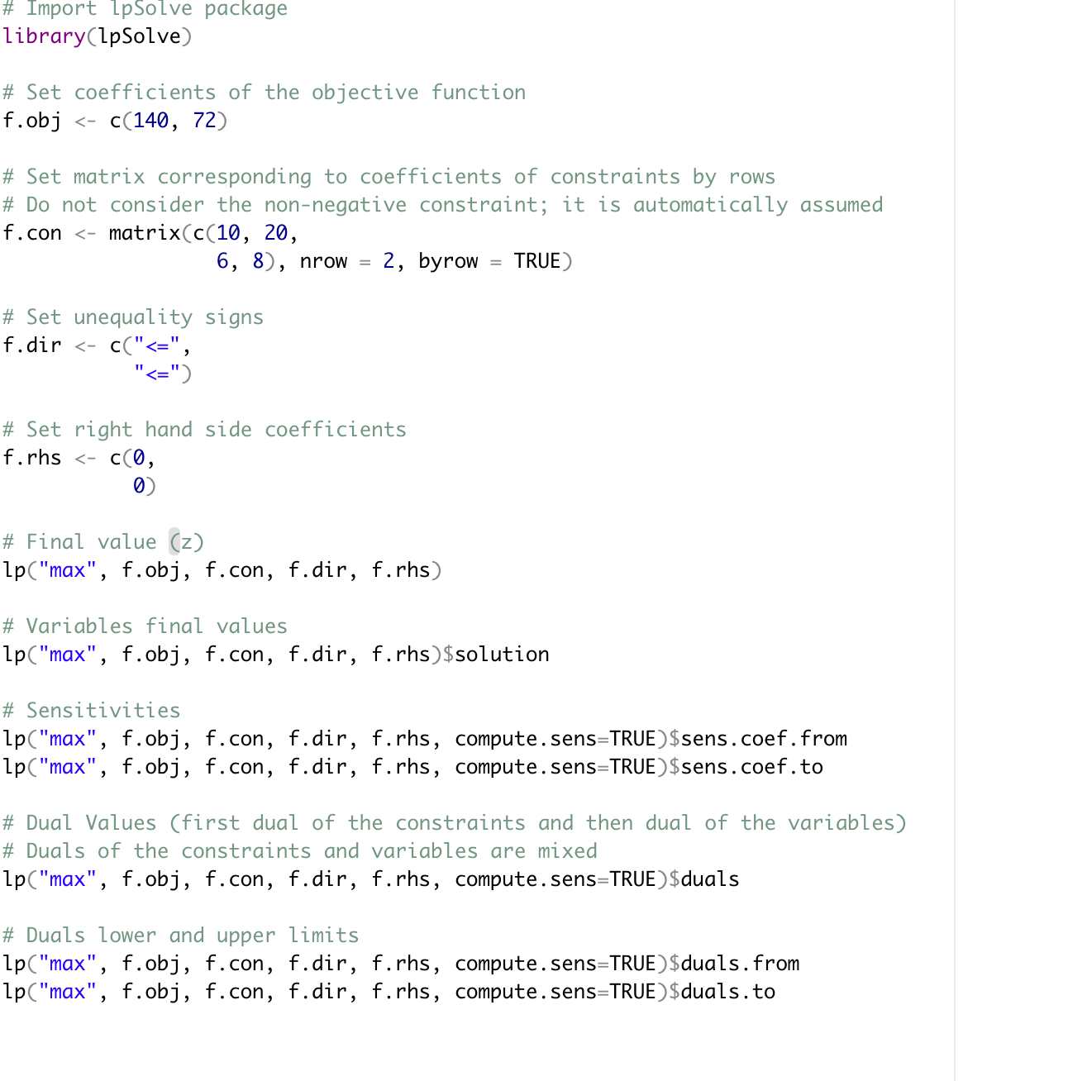
Problem 1 R Solution

Slide 6
Problem 1, Part 3
If the allowed square footage changes to 144, the optimal solution becomes 112

Slide 7
Problem 2
You have $12,000 to invest, and three different funds from which to choose. The municipal bond fund has a 7% return, the local bank's CDs have an 8% return, and the high-risk account has an expected (hoped-for) 12% return. To minimize risk, you decide not to invest any more than $2,000 in the high-risk account. For tax reasons, you need to invest at least three times as much in the municipal bonds as in the bank CDs. Assuming the year-end yields are as expected, what are the optimal investment amounts?
How would your optimal solution change if you decided you could tolerate more risk and could invest up to a third of your money in the high-risk account?

Slide 8
Problem 2 Solutions
x + y + z – 12000
z<= 2000
x>=3*y
z = 2000
x = 7500, y = 2500
Municipal bonds = $7500
CD’s = $2500
High Risk = $200
Objective function: 0.07*7500+0.08*2500 + 0.12 *2000 = 965

