Slide 1
Unit 10: Health Care Part 2
For Live Session Assignment

Slide 2
Medicare Fraud and ML
Assume you are consulting for Blue Cross Blue Shield and your boss found this paper and has asked you to prepare an explanation / report of its finding. He has been in the company for 30 years and is the VP of Fraud detection but is relying in you to interpret the statistics / evidence / meaningful conclusion presented in this paper. Prepare at least one slide for each topic (number) below. Expected time: 3-5 hours.
Director Gray makes mention of the costs of medicare fraud. In order to see the relevance and importance of this problem, what evidence / information does this paper provide to underline the potential impact that ML methods could have?
Describe the final data set used in this study (size, source, etc.) and any challenges / decisions made in obtaining this final data set from the original source.
Describe to your boss what an ROC curve is, how to interpret the AUC and how the plot is formed.
Define Oversampling and Undersampling. Why is Undersampling preferred here? What are its disadvantages?
What method of cross validation was employed? How many AUC / FPR and FNR statistics were generated?
What software was used to fit the models and generate the fit statistics? What information can you find about it from a quick web search? Sidenote:
What software do you / have you used in your company? Do they prefer a particular software / language or are they “agnostic” and leave it up to the researcher/data scientist/analyst?
Write a conclusion statement(s) for the ANOVA? What does this test tell us in the context of this study?
Remember the Tukey HSD from STAT 1 (6371?) Write a conclusion statement(s) for the Tukey HSD?
To finish up, breifly describe the results of the study! Is there hope for Medicare Fraud detection using ML?

Slide 3
Medicare Fraud and ML
Director Gray makes mention of the costs of medicare fraud. In order to see the relevance and importance of this problem, what evidence / information does this paper provide to underline the potential impact that ML methods could have?
As I was unable to read the paper, I cannot comment on the specifics of this paper, however my capstone project concerns Medicare Fraud, Waste, and Abuse. Currently, CMS maintains large archives of claims data that concerns all Medicare transactions. The data is generally structured and can be easily accessed to gain analytic insights. My capstone project used unsurprised methods such as Isolation Forest to glean information on the behavior of claims with the assumption being that most claims will follow a general path, whereas the fraudulent ones will exhibit other behaviors.

Slide 4
Medicare Fraud and ML
Describe the final data set used in this study (size, source, etc.) and any challenges / decisions made in obtaining this final data set from the original source.
No idea on the data source for this paper, although it may be wise to assume that this data was also derived from CMS. The data I used contained some 35m records and was quite large.

Slide 5
Medicare Fraud and ML
Describe to your boss what an ROC curve is, how to interpret the AUC and how the plot is formed.
AUC - ROC curve is a performance measurement for the classification problems at various threshold settings. ROC is a probability curve and AUC represents the degree or measure of separability. It tells how much the model is capable of distinguishing between classes. Higher the AUC, the better the model is at predicting 0 classes as 0 and 1 classes as 1. By analogy, the Higher the AUC, the better the model is at distinguishing between patients with the disease and no disease.
The ROC curve is plotted with TPR against the FPR where TPR is on the y-axis and FPR is on the x-axis.
https://towardsdatascience.com/understanding-auc-roc-curve-68b2303cc9c5

Slide 6
Medicare Fraud and ML
Define Oversampling and Undersampling. Why is Undersampling preferred here? What are its disadvantages?
Occasionally data will not lend itself to machine learning, sometimes there is a major class imbalance when using classification algorithms. This can be corrected by techniques such as oversampling and undersampling.
There are two main approaches to random resampling for imbalanced classification; they are oversampling and undersampling.
Random Oversampling: Randomly duplicate examples in the minority class.
Random Undersampling: Randomly delete examples in the majority class.
Random oversampling involves randomly selecting examples from the minority class, with replacement, and adding them to the training dataset. Random undersampling involves randomly selecting examples from the majority class and deleting them from the training dataset.
https://machinelearningmastery.com/random-oversampling-and-undersampling-for-imbalanced-classification/

Slide 7
Medicare Fraud and ML
What method of cross validation was employed? How many AUC / FPR and FNR statistics were generated?
Not being able to read the paper, this is purely subjective, but I would say that 5-fold cross validation was used.

Slide 8
Medicare Fraud and ML
What software was used to fit the models and generate the fit statistics? What information can you find about it from a quick web search? Sidenote:
Again, the paper is unavailable, so we cannot glean this information. It would be a wise guess to assume that this is either python, R, or SAS.

Slide 9
Medicare Fraud and ML
What software do you / have you used in your company? Do they prefer a particular software / language or are they “agnostic” and leave it up to the researcher/data scientist/analyst?
In my company, and my group specifically, we mainly use excel. I realize that this is a cliché within data science but excel has many advantages and can be used to perform any task within reason. Excel is also portable and can be easily run on a different machine. However, we are somewhat platform agnostic, and I occasionally use python.

Slide 10
Medicare Fraud and ML
Write a conclusion statement(s) for the ANOVA? What does this test tell us in the context of this study?
P-value ≤ α: The differences between some of the means are statistically significant If the p-value is less than or equal to the significance level, you reject the null hypothesis and conclude that not all of population means are equal. Use your specialized knowledge to determine whether the differences are practically significant. For more information, go to Statistical and practical significance.
P-value > α: The differences between the means are not statistically significant If the p-value is greater than the significance level, you do not have enough evidence to reject the null hypothesis that the population means are all equal. Verify that your test has enough power to detect a difference that is practically significant. For more information, go to Increase the power of a hypothesis test.

Slide 11
Medicare Fraud and ML
Remember the Tukey HSD from STAT 1 (6371?) Write a conclusion statement(s) for the Tukey HSD?
No record of the Tukey HSD

Slide 12
Medicare Fraud and ML
To finish up, breifly describe the results of the study! Is there hope for Medicare Fraud detection using ML?
As expected, since the paper was unavailable, I can only imagine what results could be. I will say, however, based on my capstone research there is certainly hope for Medicare Fraud detection using ML. Currently CMS loses around $100b a year, so even a reduction in FWA by a few percentage points offers hope and savings into the billions.

Slide 13
ANN vs LRM in Classifying Malignant and Biopsy
You read the ANN v LRM paper in the asynch. Prepare at least one slide to discuss each of the 7 topics below with respect to that paper. Expected time: 2-3 hours.
Were the data balanced 50% malignant / 50% benign? If not what was the breakdown?
What was the train / test split percentages?
What software was used to implement the neural network and logistic regression models?
What was the structure of the neural network model? They also call it a “training paradigm” in the Discussion.
There was a full and reduced logistic regression model (LRM). Specify each model (a screen shot is fine). What do you notice that is odd about how the reduced model was formed?
Table 3 has the parameter estimates from the LRM model. Select a significant feature (at the .05 level of significance) and interpret that parameter. Information on each parameter can be found in Table 2. As usual, please provide confidence intervals with your interpretation. Hint: You may need to go back to your Stat 2 slides for this question (Unit 12 of 6372.)
Discuss at least one limitation of the study.

Slide 14
ANN vs LRM in Classifying Malignant and Biopsy
Were the data balanced 50% malignant / 50% benign? If not what was the breakdown?
No, (45 of 46 of the patients with malignant breast
cancers and 10 of 15 with benign entity).

Slide 15
ANN vs LRM in Classifying Malignant and Biopsy
What was the train / test split percentages?
Train – 100
Test - 61

Slide 16
ANN vs LRM in Classifying Malignant and Biopsy
What software was used to implement the neural network and logistic regression models?
Matlab – Neural network
Logistic Regression – PROC LOGISTIC in SAS

Slide 17
ANN vs LRM in Classifying Malignant and Biopsy
What was the structure of the neural network model? They also call it a “training paradigm” in the Discussion.
It was a back propagated neural network

Slide 18
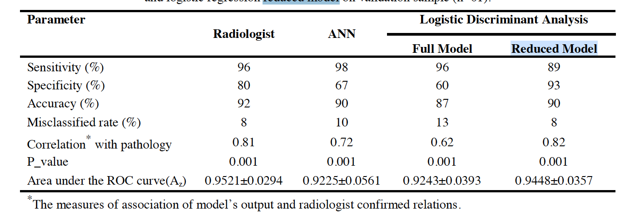
ANN vs LRM in Classifying Malignant and Biopsy
There was a full and reduced logistic regression model (LRM). Specify each model (a screen shot is fine). What do you notice that is odd about how the reduced model was formed?

Slide 19
ANN vs LRM in Classifying Malignant and Biopsy
Discuss at least one limitation of the study.

