Slide 1
For Live Session
Unit 6
By Ben Goodwin

Slide 2
Activity 1
Be prepared to discuss the discussion topics that you responded to in the asynch material. You don’t need to include any slides for this (but you can if you like).
Question 1:
Below is a list of operational challenges, issues, and constraints that might arise when considering your data and data source.
When do the forecasts need to be provided?
How long can the model take to run (maximum)?
How often will the model need to run?
What kind of system is the model running on?
Multithreaded/optimized? Personal machine? Alteryx Gallery?
How quickly does the user need a model/forecast for their work? How long do you have to research and build a model?
Are there any constraints associated with the source database?
Only daily aggregations available? Live feed of data available?
Consider permissions/SLAs for the source data
What happens with your model if the source data are not available? Are the users able to still perform the business process?
Pick one of these, and discuss how it has impacted you in the past. If that question is tough to answer, simply pick one and discuss a scenario (feel free to create one) in which it could be an impact.
Question 2:
Alec discussed improving on the baseline model. If you decided to add regressors to the time-series model (multivariate time series), discuss from your former experience/coursework what methods might help you build this type of model.
No slide necessary here… but you may provide one if it helps you speak to the topic.

Slide 3
Activity 2
On one or two slides, DELTTAA or FACE or PACHINKO Diana’s project given what you learned from the videos. Choose a “device” that you did not use in Unit 5. For instance, if you used FACE for Diana’s problem in Unit 5, use DELTTAA or PACHINKO in this one. Reminder, these are tools to help dissect, identify and organize dimensions, issues and constraints in the problem. Answer will vary … there is not one “correct” answer.
This should fit on 2 slides or less. It does not need to be super detailed or researched outside of the asynch material.

Slide 4
Activity 2
Data – Southwest has a treasure trove of data on all flights past and present
Enterprise – Leveraging analytics is a key tenant of modern airline operations
Leadership- As a data first company, leveraging data is a priority
Targets – The target is measuring and predicting on time arrival performance
Technologies – Southwest proprietary tools
Analytic Techniques – Machine learning (LASSO was final selected model)
Analysts – Data scientists across different areas competed to find a solution

Slide 5
Activity 3
Check out this website that collects, cleans and provides airline and airport data to primarily airlines and airports (however, they will sell it to whoever would like to purchase it!).
https://www.oag.com
Read through the opening page to get an idea of what they do. (No slides here)
Click the “Read More” under ”Understanding OAG” (No slides here.)
Read each of the topics on the page:
Fueled by Data
How We Help You
Grow, Streamline, Delight ( Does OAG provide Descriptive, Diagnostic, Predictive, or Prescriptive capabilities?)
Our Vision
Our Difference
Customers
Testimonials (Alec refers to BWI in his lecture. They use OAG!)
Will there always be a need for inhouse development? Which do you think OAG will be able to help more with? (One slide is fine)
Diana’s OTP problem?
Alec’s Open Time Problem?
OAG is a third part data and solutions provider for the airline industry. Does your industry have third party companies that offer similar data and solutions? Create at least one slide that addresses this. (One slide is just fine.).
Two slides total will be fine here: 1 for the Diana v. Alec question and one for your thoughts on a third party providers. If there are no competitors…. That is interesting as well… and an opportunity!
https://www.oag.com/on-time-performance-dashboards

Slide 6
Activity 3
Will there always be a need for inhouse development? Which do you think OAG will be able to help more with? (One slide is fine)
Diana’s OTP problem?
Yes, absolutely. Diana has a specific internal SW driven need. They need something developed tailored specifically for their problem.
Alec’s Open Time Problem?
Yes, absolutely. Alec has a specific internal SW driven need. They need something developed tailored specifically for their problem. The operational constraints, while similar, are quite different than other airlines.
https://www.oag.com/on-time-performance-dashboards

Slide 7
Activity 3
OAG is a third part data and solutions provider for the airline industry. Does your industry have third party companies that offer similar data and solutions? Create at least one slide that addresses this. (One slide is just fine.).
Nope, I live in an industry of proprietary information and secrets. There is no data sharing and no collaboration. Each and every tool is inhouse developed.
https://www.oag.com/on-time-performance-dashboards

Slide 8
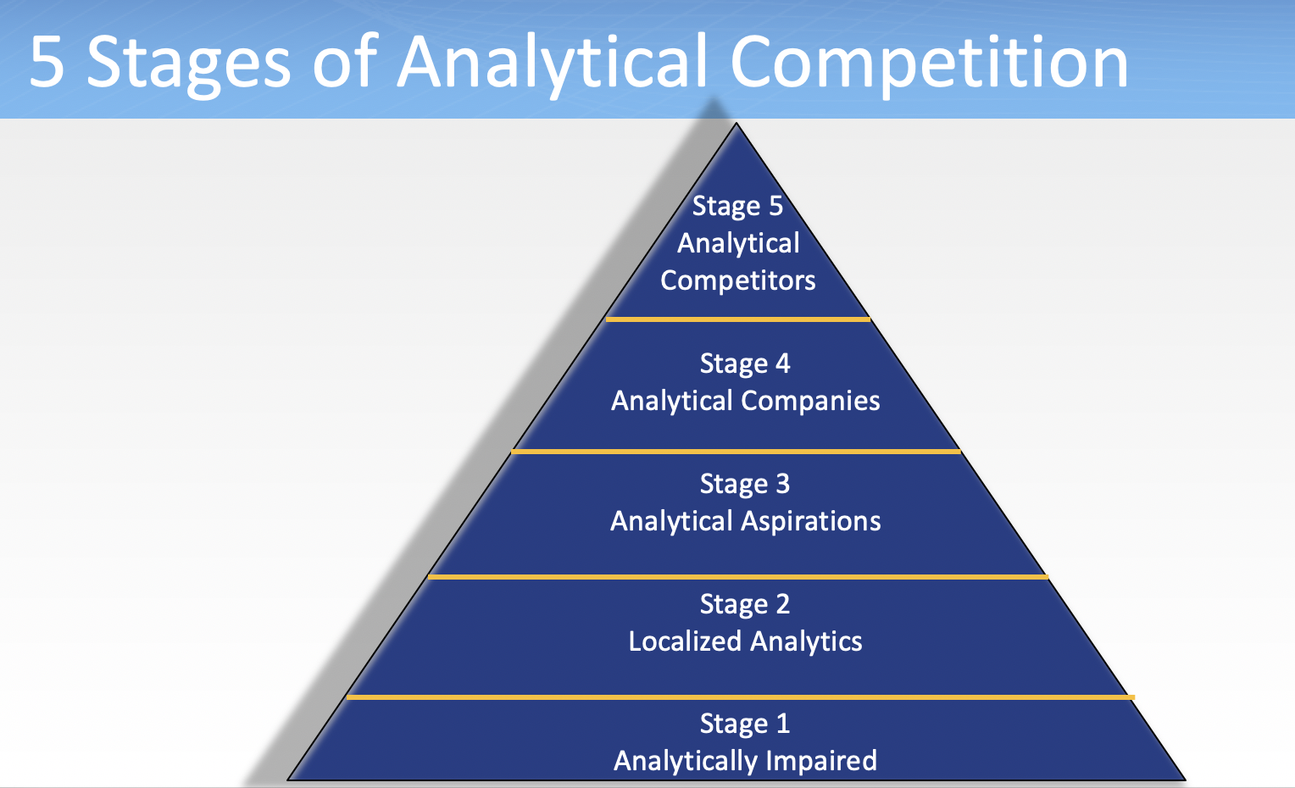
Activity 4: Data Science and Careers
https://www.oag.com/careers
Check out the careers at OAG listed above.
Just reading the titles, are any of them listings for a “Data Scientist”?
Not currently, but there is a listing for data specialist.
Now read the Job Descriptions. Which jobs do not require “analysis” or “statistics”.
Of the seven jobs listed (6 unique) on the data specialist job requires analysis or statistics
What does this suggest to you (if it suggests anything) about the role of data science in the modern work force?
Im assuming that typically this company hires more people in the analytics realm, this is probably different now with COVID.
Given what you know about OAG so far (which granted may not be in depth) where would you place them on the 5 Levels / Stages of Analytical Competition.
Based on my understanding on the 5 levels of analytical competition I would say that they are an analytical company. I think they have still yet to achieve god like status.

Slide 9
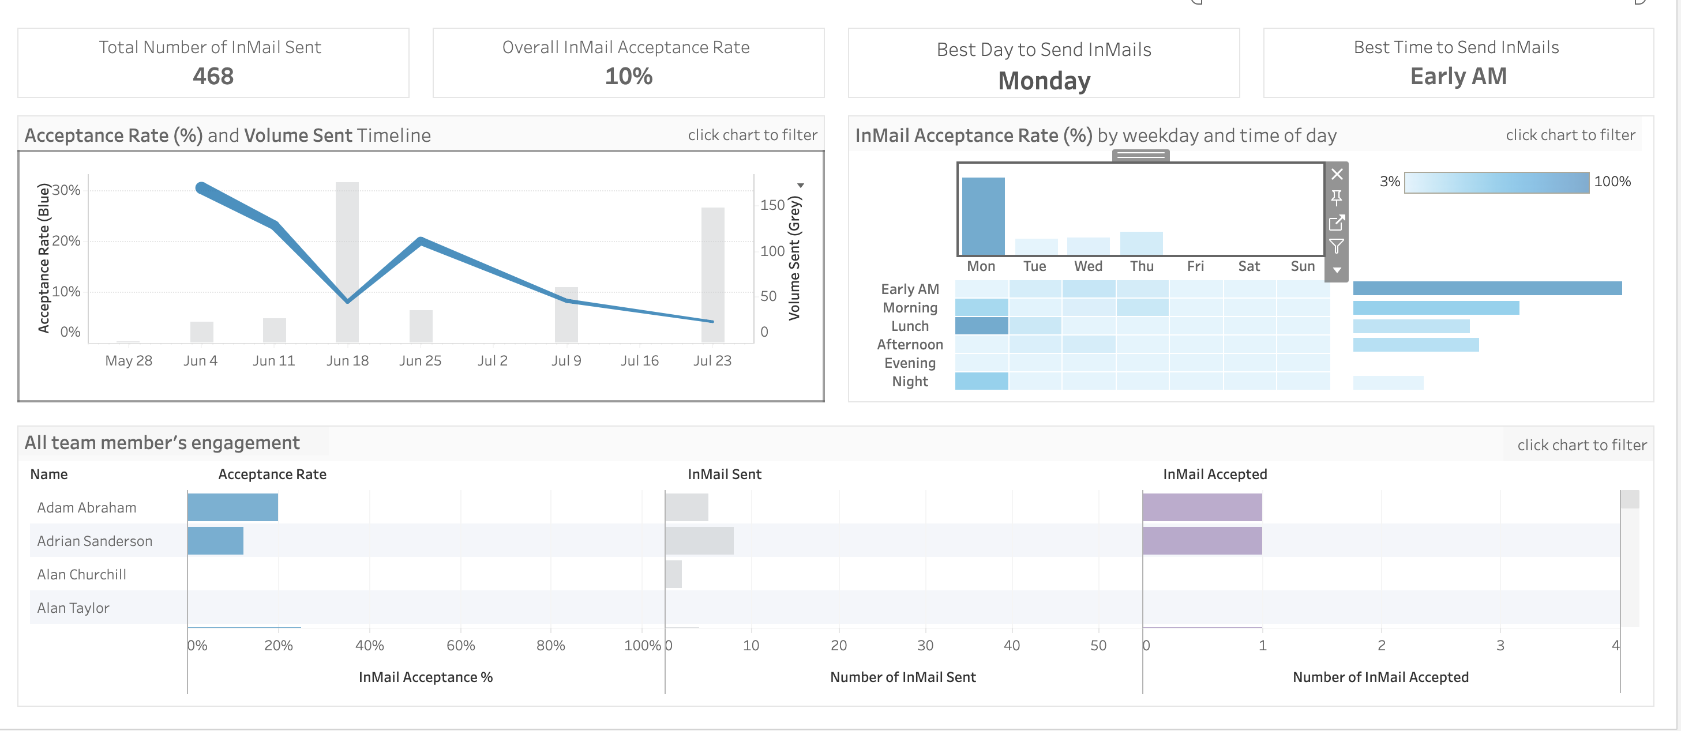
Activity 5: Deploying with Tableau
Add a link to access your dashboard to the Google Doc provided by your professor:
https://10az.online.tableau.com/t/smubusinessanalytics/authoring/InMailEngagement/InMailEngagement#1

Slide 10
Bonus!
OAG creates various reports. You have to give your email in order to download them so I have included two of them in our Google Drive:
One on OTP
One on the Busiest Routes
If you want to download others and don’t mind giving up your email, you can access them here: https://www.oag.com/oag-research
Check them out if you have time and interest !
Also, OAG actually provides an OTP Dashboard! This could have been one of the competitors that Diana mentioned last week! Again, check it out if you have time and interest!
https://www.oag.com/on-time-performance-dashboards

