Slide 1
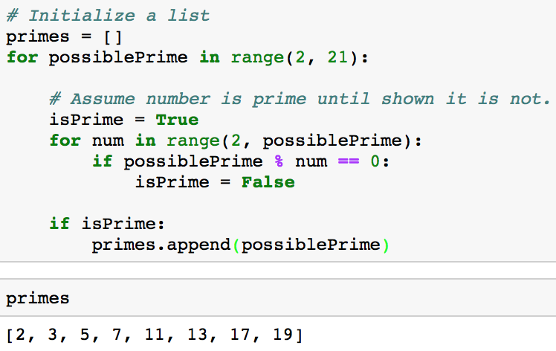

Slide 2
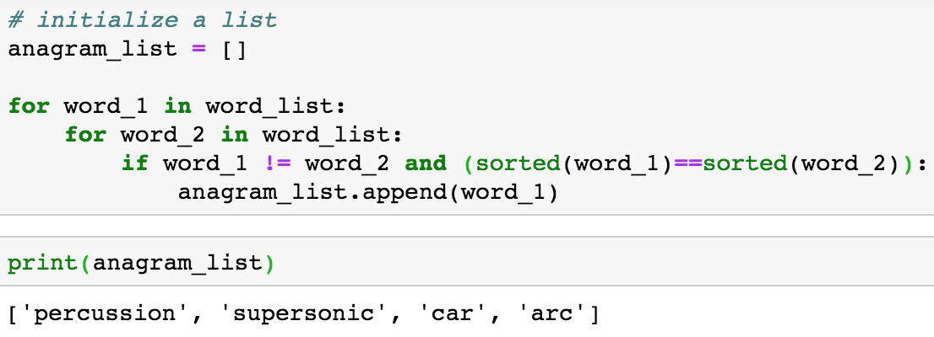

Slide 3
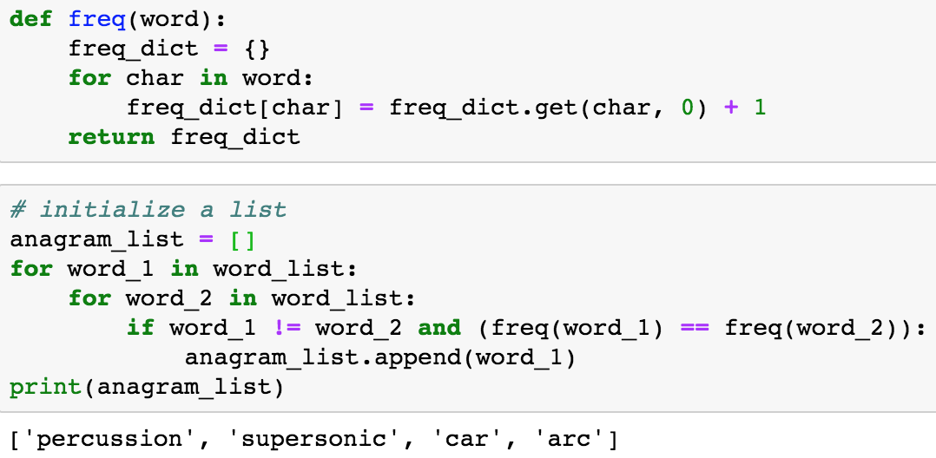

Slide 4
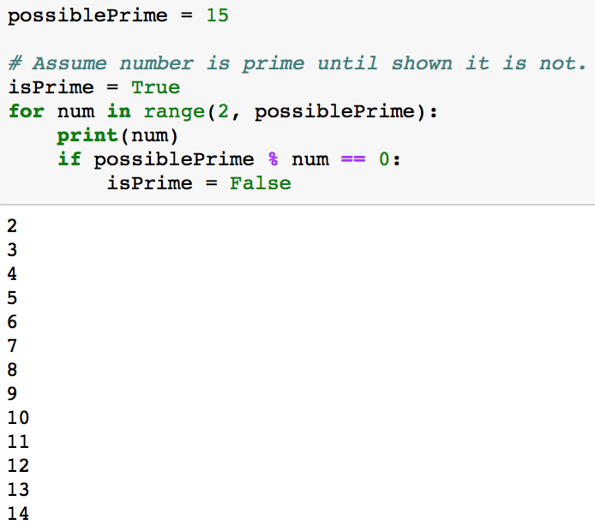
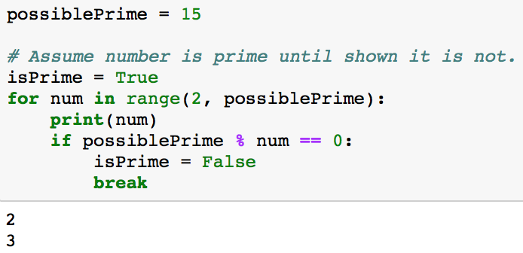
Approach 1
Approach 2

Slide 5
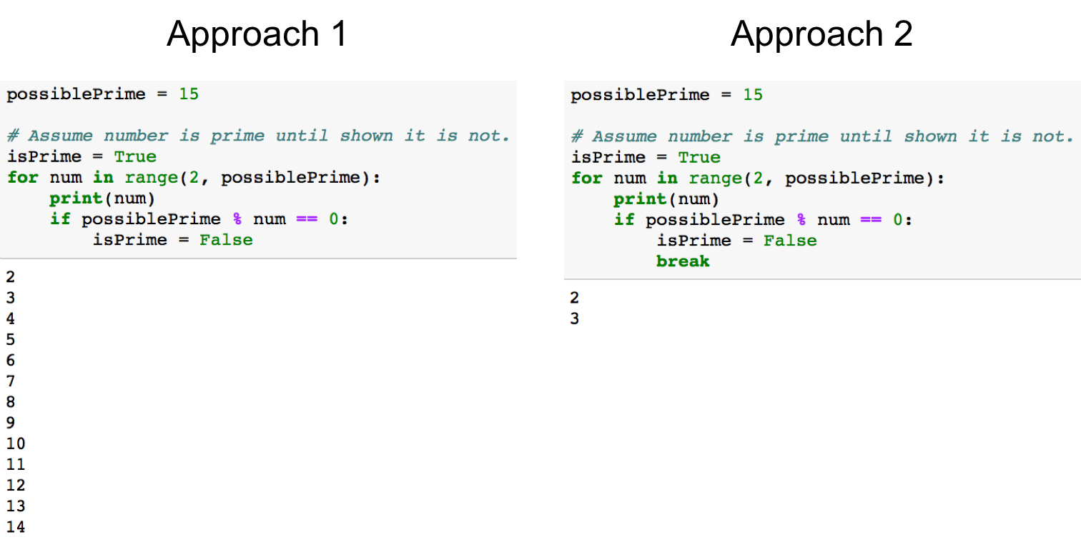

Slide 6
Factors of 15
15 / 2 = 7 remainder 1
15 / 3 = 5 remainder 0
15 / 4 = 3 remainder 3
15 / 5 = 3 remainder 0
15 / 6 = 2 remainder 3
15 / 7 = 2 remainder 1
15 / 8 = 1 remainder 7
15 / 9 = 1 remainder 6
15 / 10 = 1 remainder 5
15 / 11 = 1 remainder 4
15 / 12 = 1 remainder 3
15 / 13 = 1 remainder 2
15 / 14 = 1 remainder 1
15 / 15 = 1 remainder 0

