Slide 1
Assessment Structure
1 hour, 55 minutes
Mixture of multiple choice (5-10), free response (1-3) and VSCode problems (40ish specs).
Free response just requires enough detail to answer the question, 1-3 sentences. As long as you are able to explain the concept and answer all aspects that it asks, you are good.
Coding problems come in two varieties:
Writing raw SQL like the projects from Tuesday to create tables, insert values, query for records, join tables for queries, etc.
Using sequelize to perform actions such as creating migrations, models, seeders, and then interacting with those models to query for, create, modify, delete, etc.
Both of these sections have their own practice assessment
Standard assessment procedures
You will be in an individual breakout room
Use a single monitor and share your screen
Only have open those resources needed to complete the assessment:
Zoom
VSCode
Browser with AAO and Progress Tracker (to ask questions)
Approved Resources for this assessment:
Postgres Docs: https://www.postgresql.org/docs/
Sequelize Docs: https://sequelize.org/
Sequelize "Cheatsheet"

Slide 2
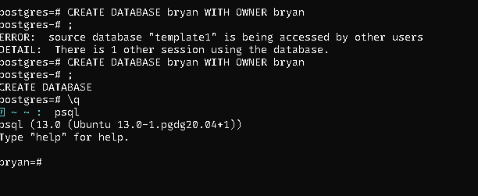

Slide 3
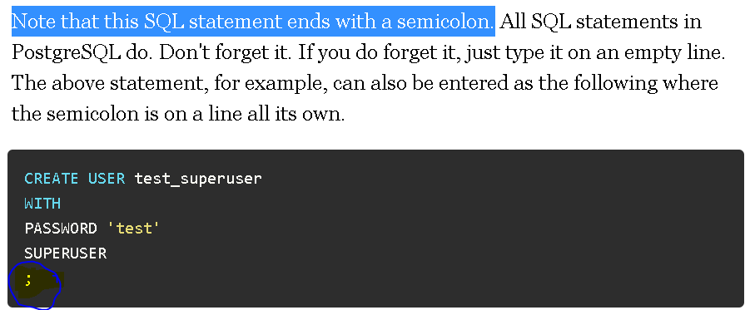
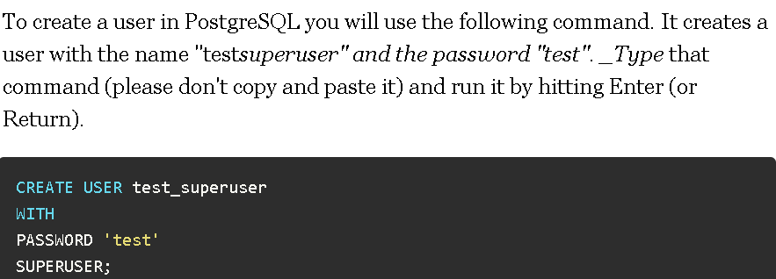
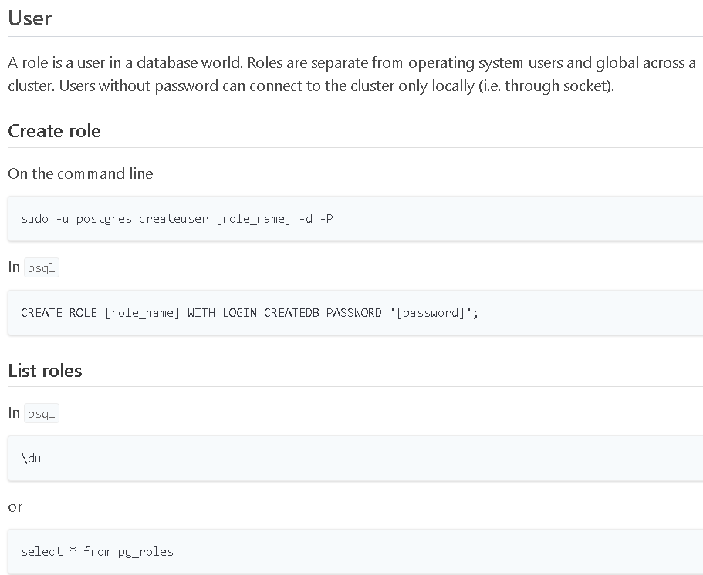

POSTGRES
Quit your current session by typing \q
psql -W -U test_superuser postgres
To prove to you that you're now the "test_superuser", type the following command.
SELECT CURRENT_USER;

Slide 4
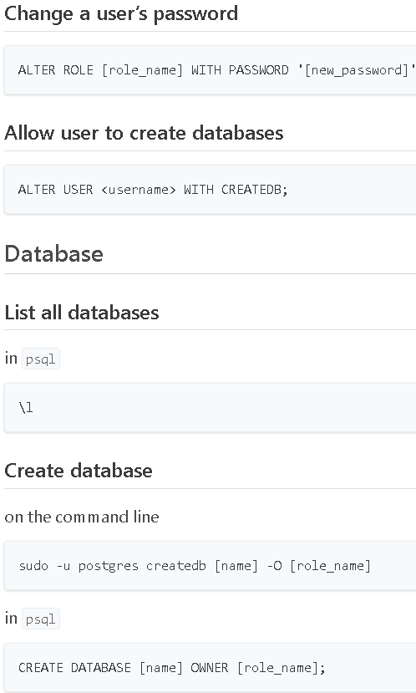
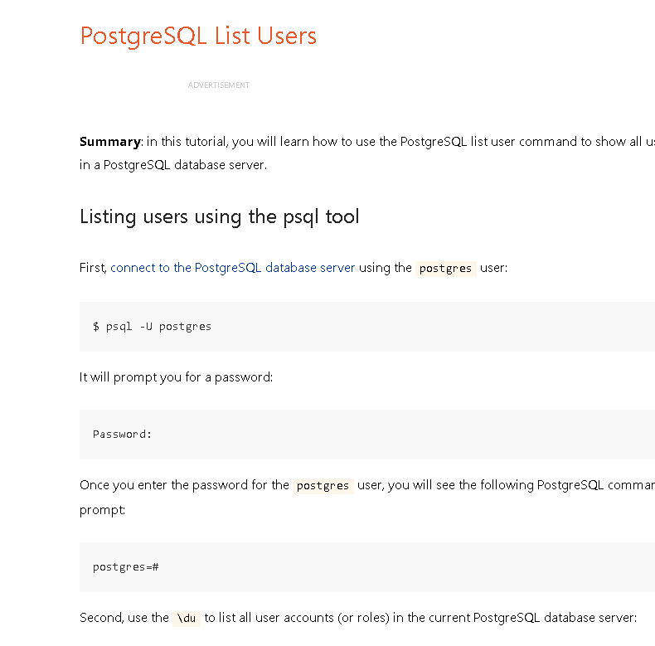
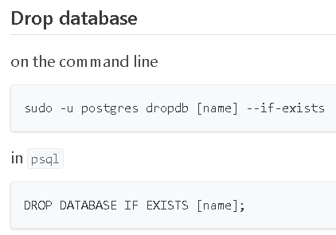

Slide 5
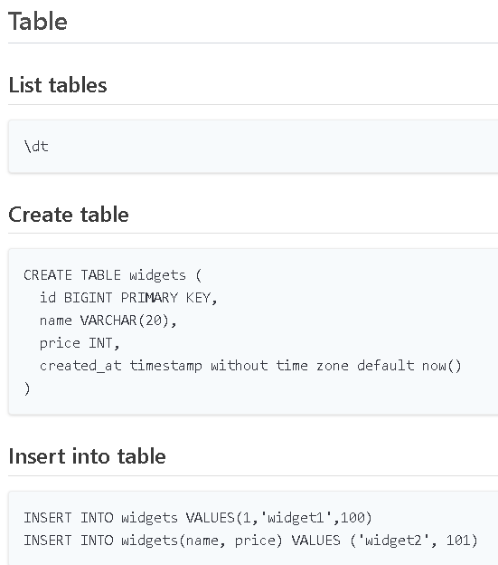
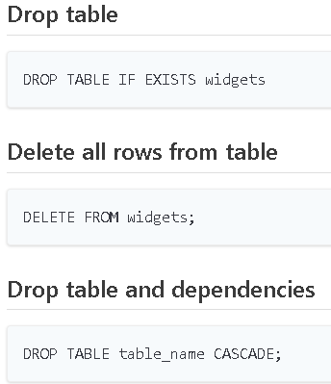

Slide 6
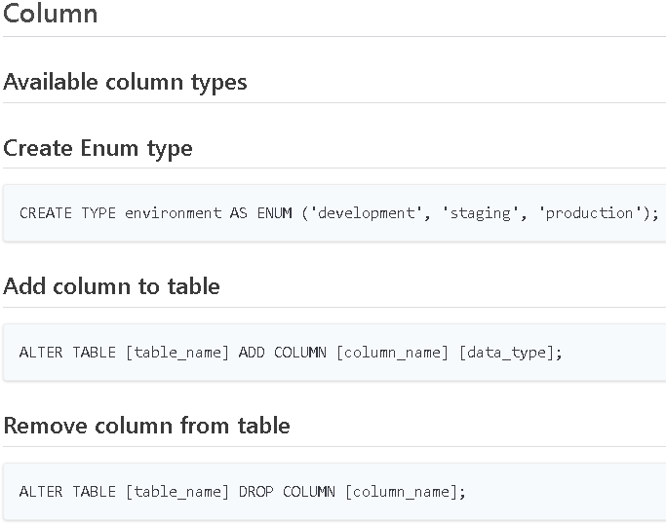

Slide 7
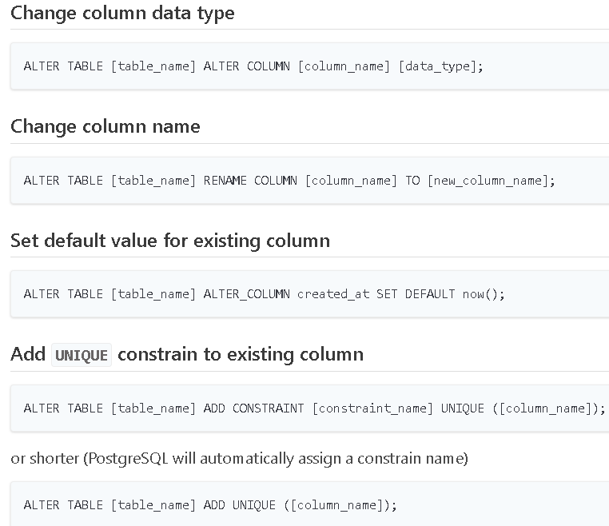

Slide 9
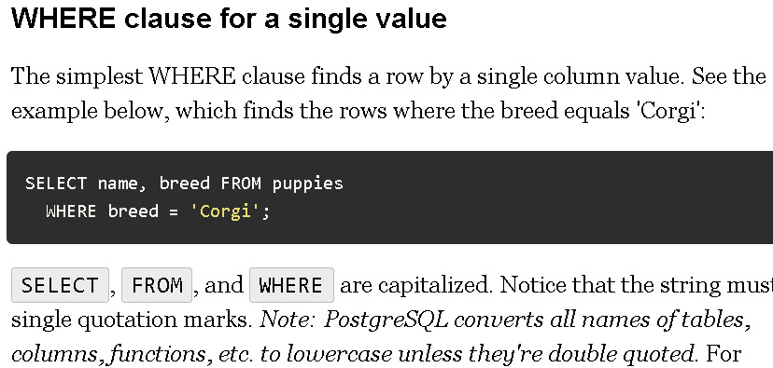
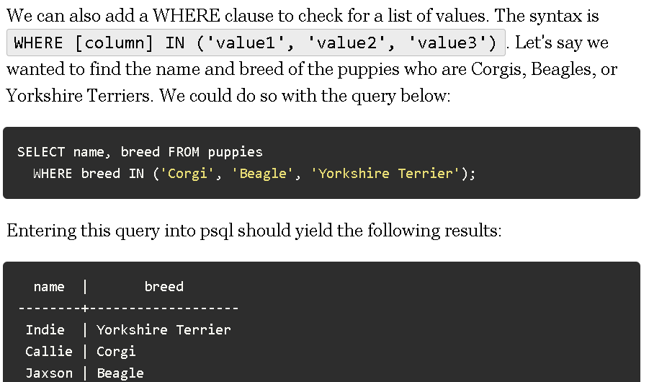
Use the command psql -U postgres in the terminal, and type in your 'postgres' user password to connect to the PostgreSQL server.

Slide 10
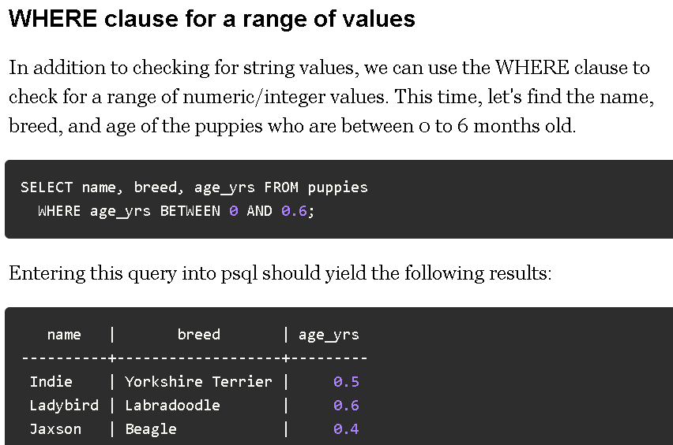

Slide 11
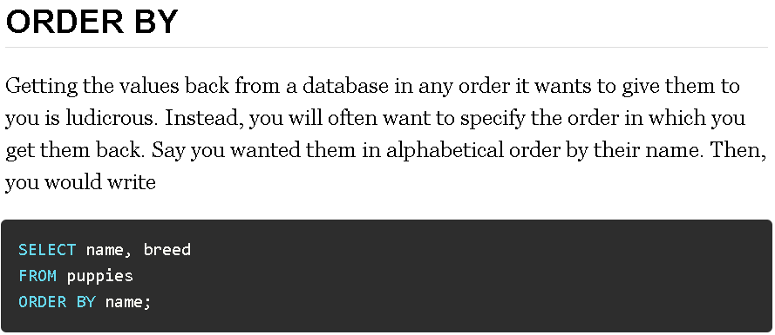
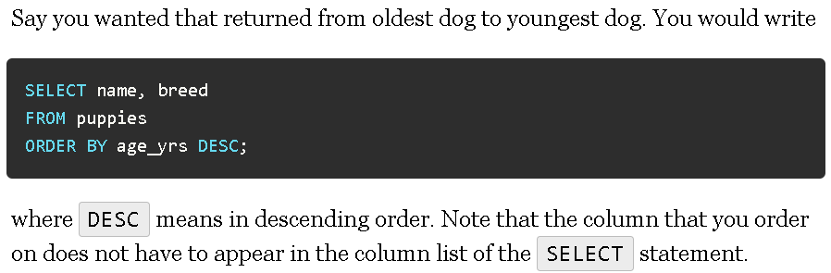

Slide 12
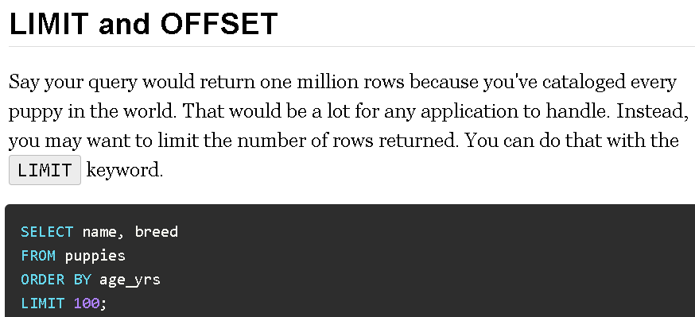

Slide 13
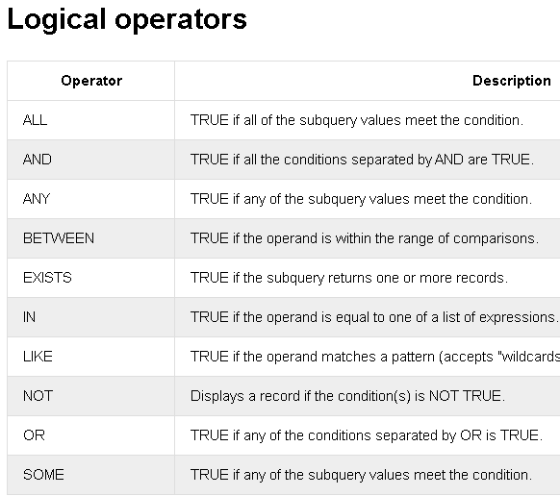

Slide 14
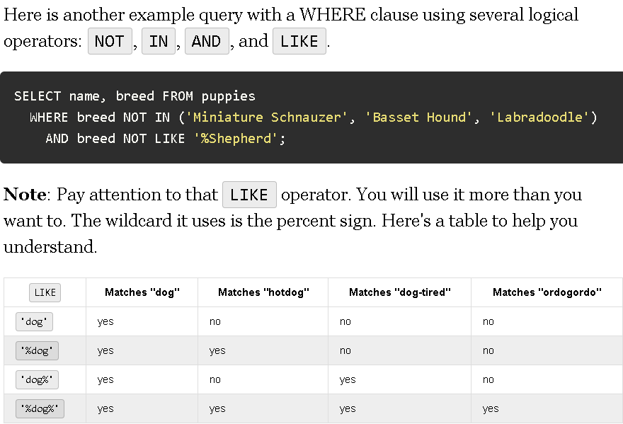
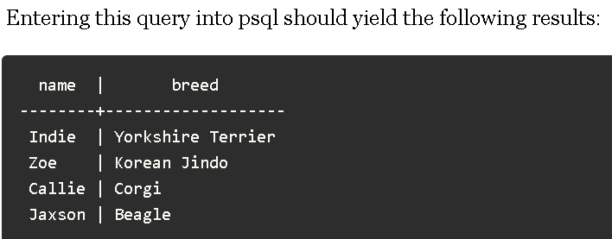

Slide 15
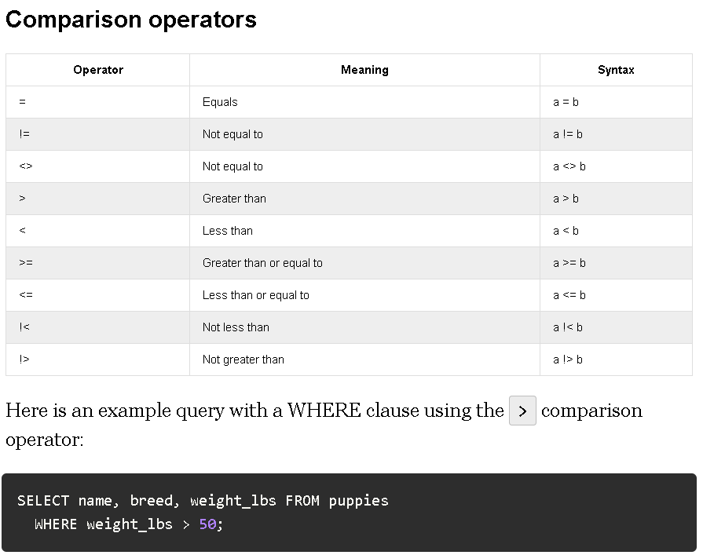

Slide 16
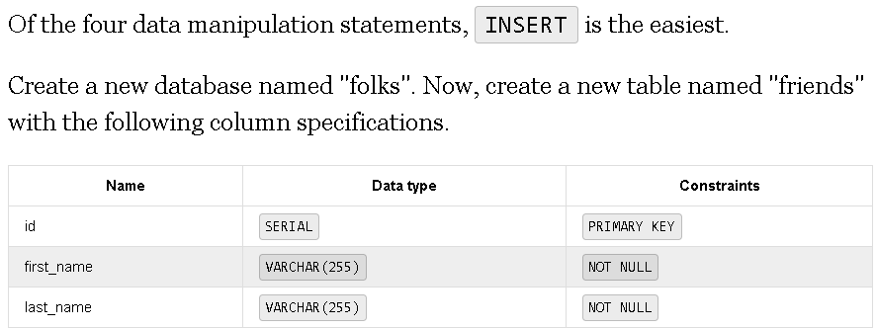

Slide 17
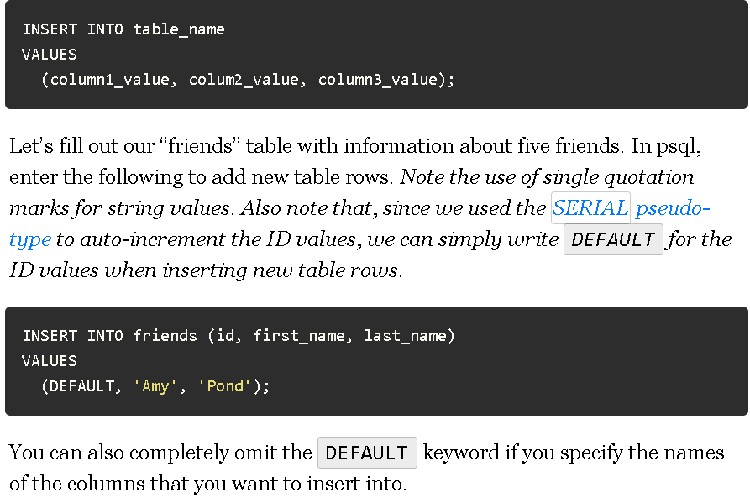

Slide 18
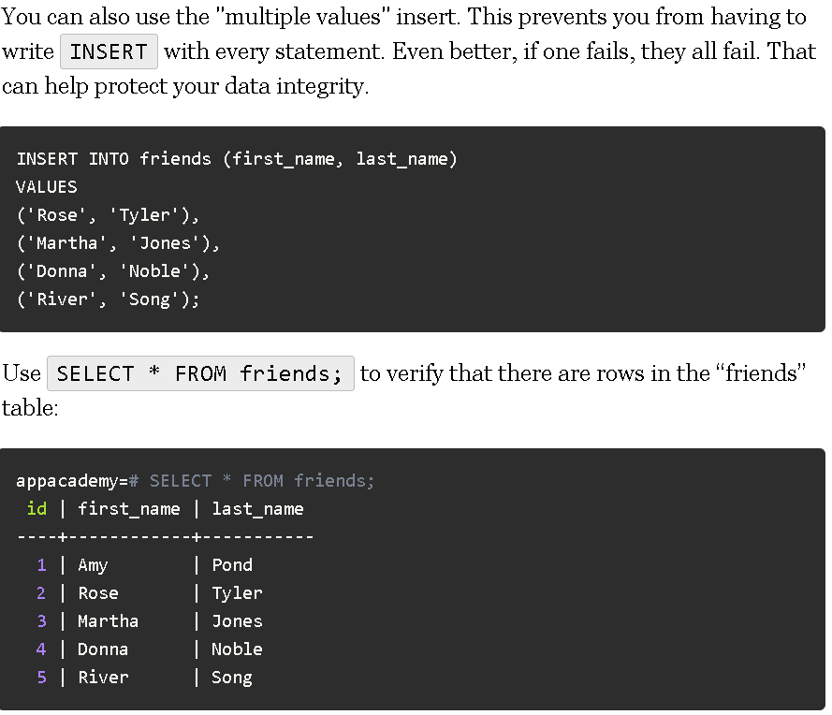

Slide 19
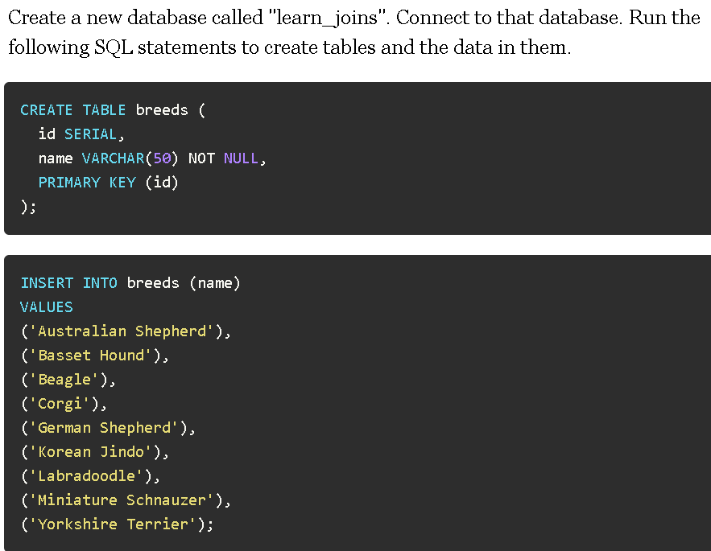
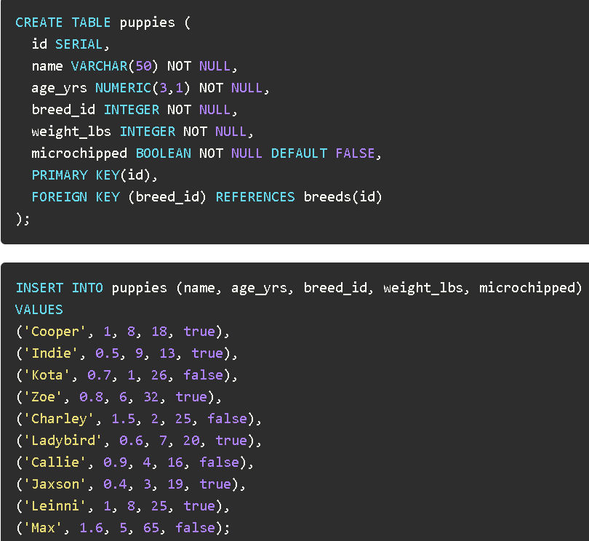
Foreign Keys And The JOIN Operation

Slide 20
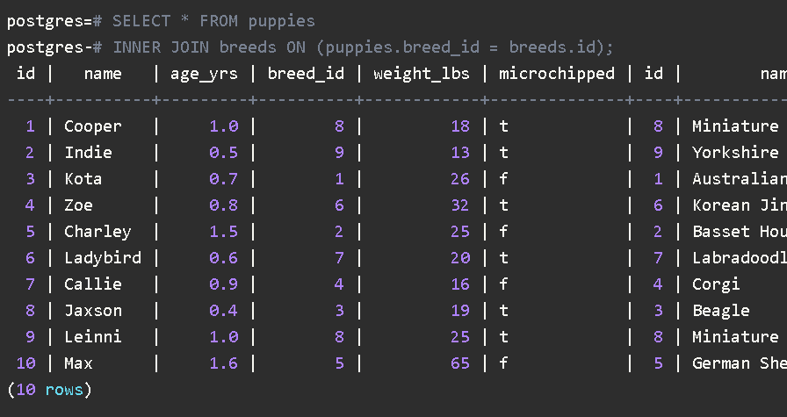
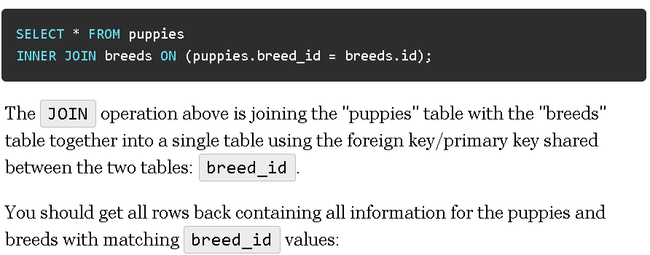

Slide 21
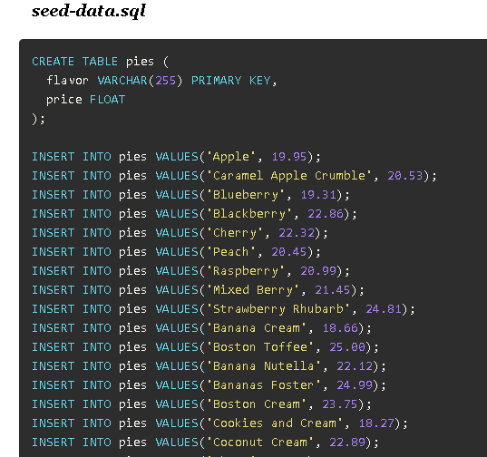
Creating a seed file
You can create a seed file by opening up VSCode or any text editor and saving a file with the .sql extension.

Slide 22
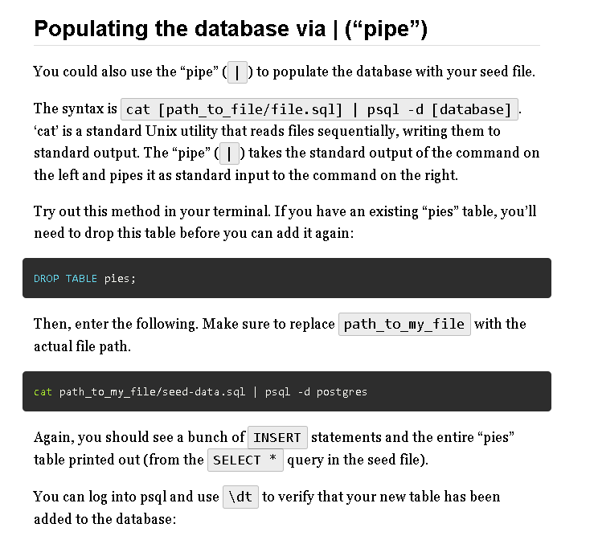
Populating a database via < (“left caret”)
The syntax is psql -d [database] < [path_to_file/file.sql]
cat [path_to_file/file.sql] | psql -d [database]

Slide 26
SEQUALIZE

Slide 27
Sequelize is an example of an Object Relational Mapping (commonly abbreviated ORM).
An Object Relational Mapping is a library that allows you to access data stored in a SQL database through object-oriented, non-SQL code (such as JavaScript).

Slide 66
PROJECTS

Slide 67
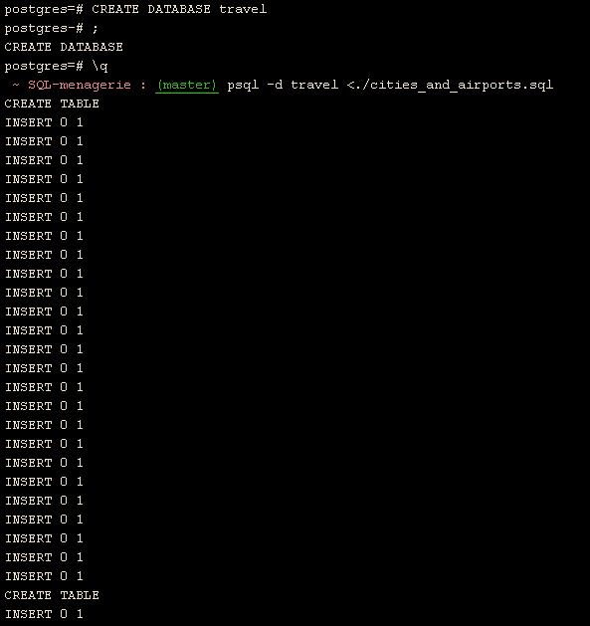
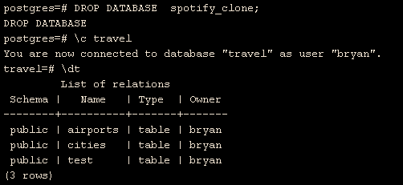
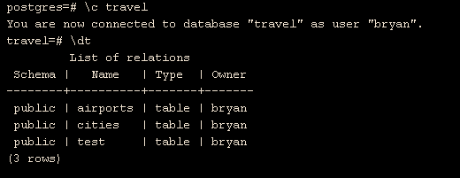
SQL-Menagerie
CREATE DATABASE dbname;
psql -d travel <./cities_and_airports.sql
Check that there's data in both the "cities" and "airports" tables.
List of tables

Slide 68
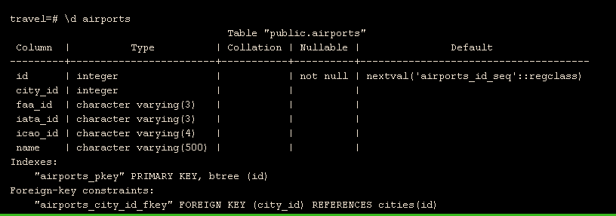
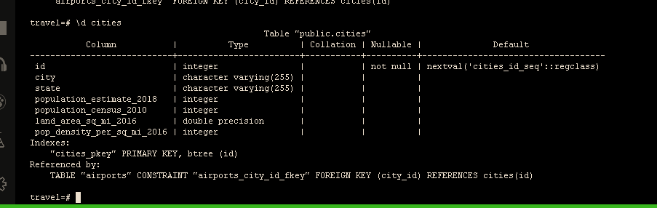
This is a list of coluns in airports

Slide 69
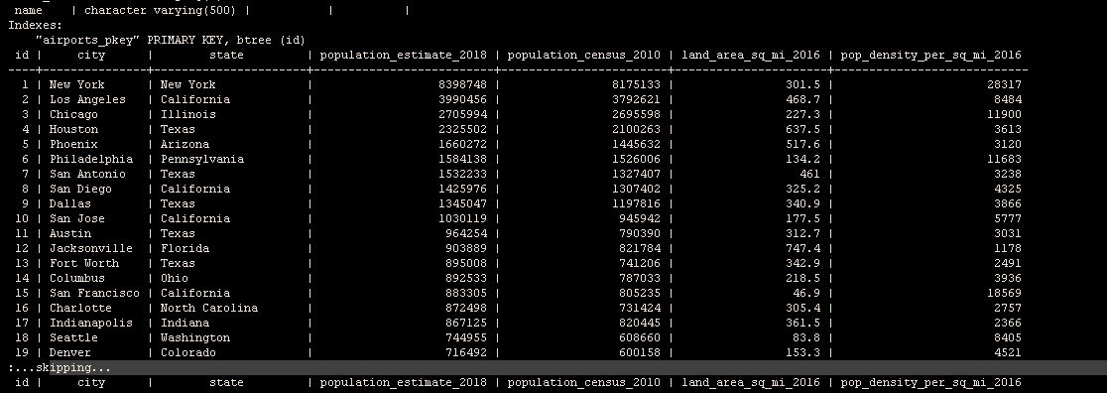

Slide 70
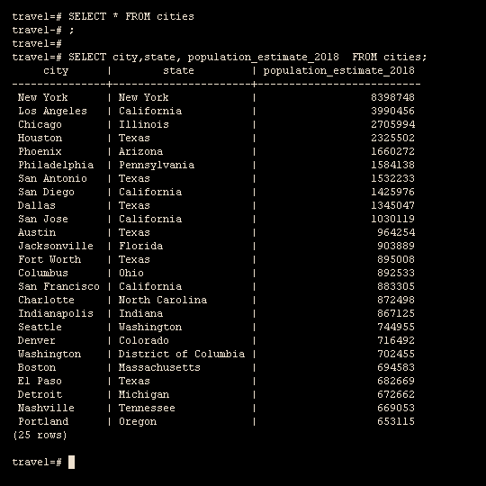

Slide 71
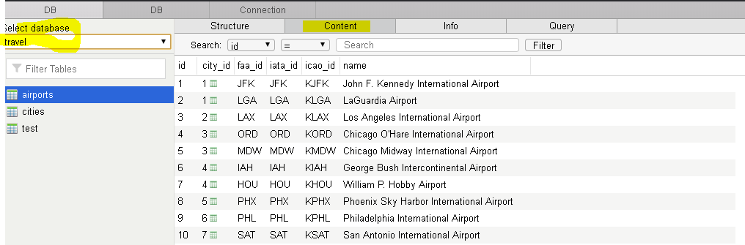
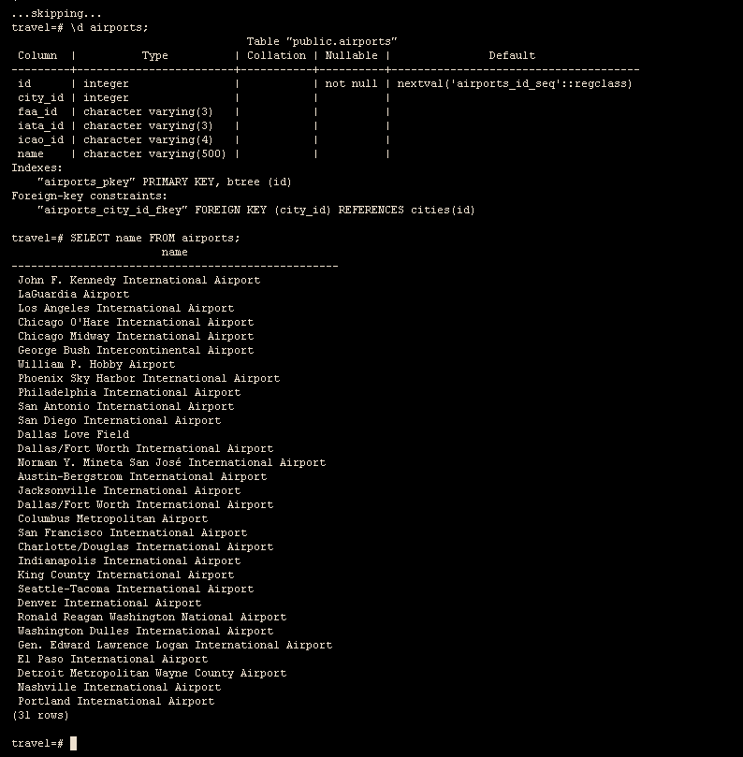

Slide 72
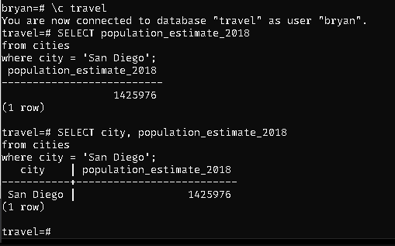
Ctrl + l to clear terminal

Slide 73
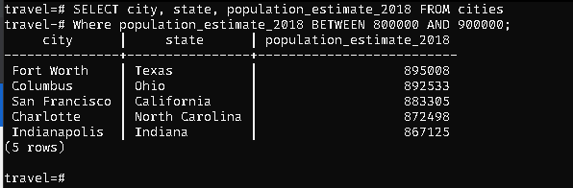

Slide 74
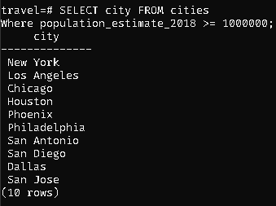

Slide 75
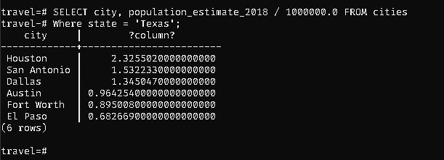
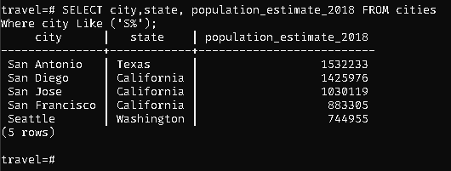
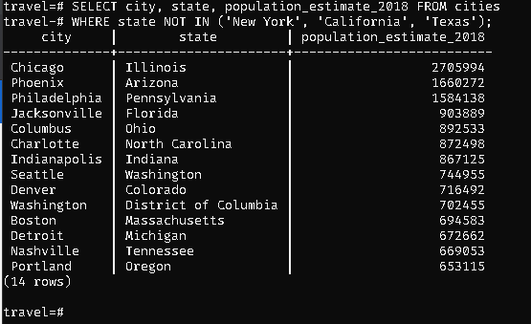

Slide 76
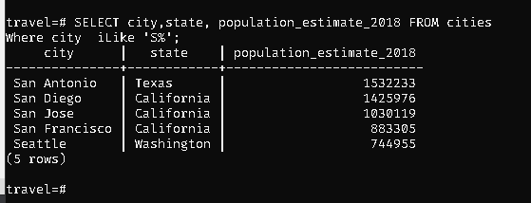
The I makes it case insensitive

Slide 77
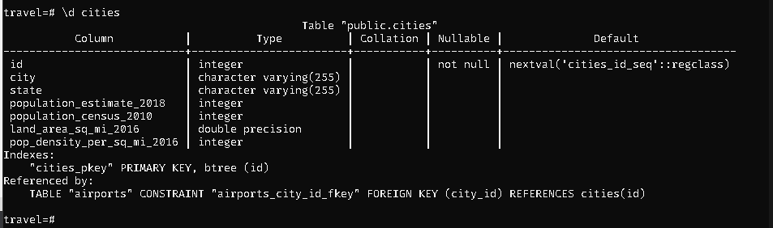

Slide 78
