Slide 1

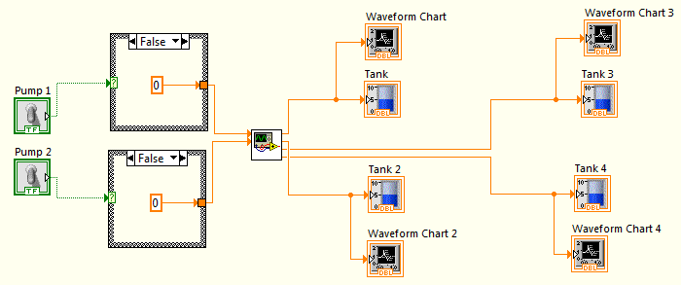
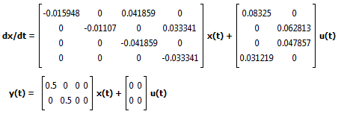
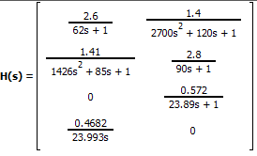
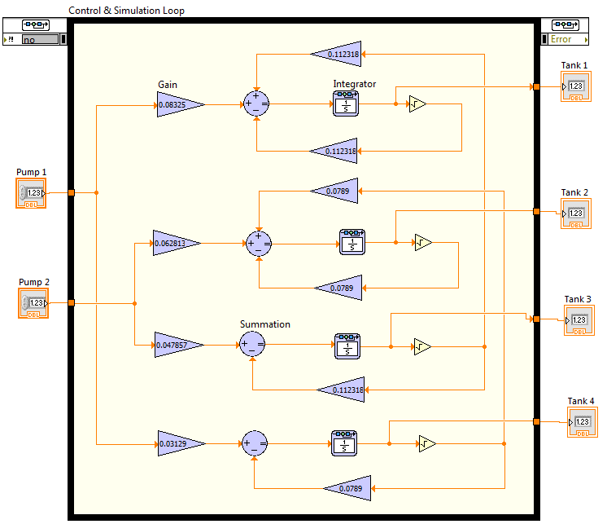
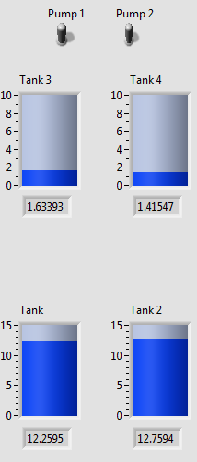
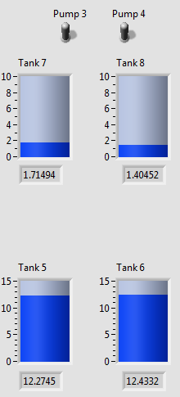
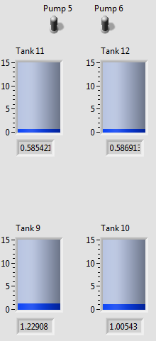
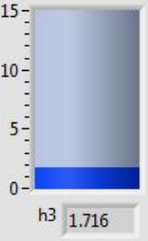
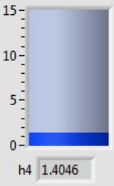
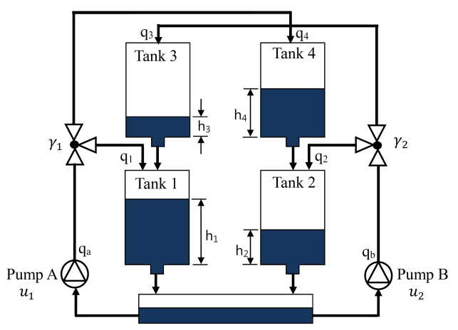

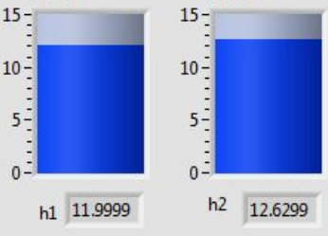
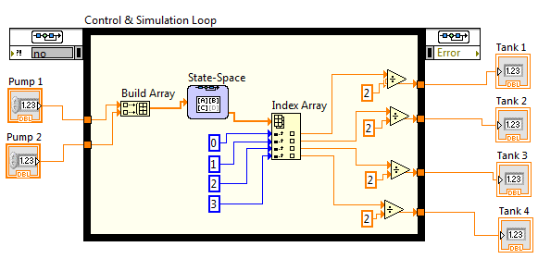
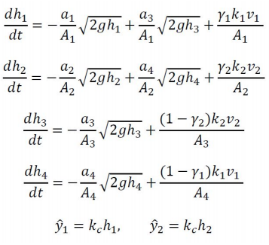
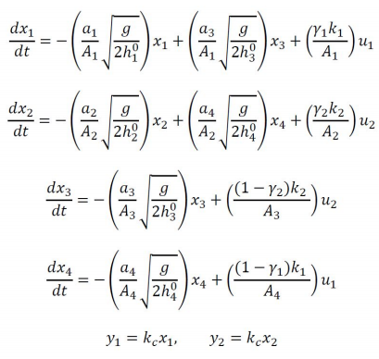
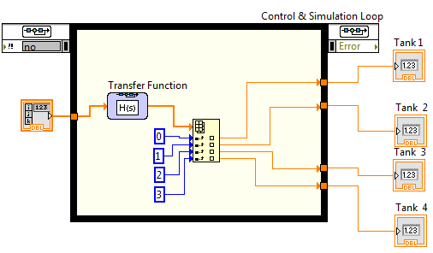
Modeling and Discrete-Logic Control
of a Quadruple-Tank System
Bryan Guner¹ and Sean Fernandez¹; Advisor: Dr. Ambrose Adegbege¹
¹Department of Electrical and Computer Engineering, The College of New Jersey, Ewing, NJ
Abstract
Design/Methods
Quadruple Tank-System Block Diagram:
The goal of this design assignment was to develop and simulate a mathematical model of a quadruple-tanks system and subsequently implement discrete-logic control using the LabVIEW software package. The purpose was to exercise our knowledge of the differential equations that represent such a system, and to convert them into linearized state-space and transfer function descriptions that could be more easily used to simulate said system in LabVIEW.
State-Space Configuration:
Transfer Function Configuration:
Introduction
LabVIEW Implementation:
The aforementioned quadruple tank system consists of four water tanks and two pumps that form a two-input two-output system. The intention is to control the level of the water in the bottom two tanks while the pumps delivers water to the top two tanks that trickle down into the bottom two via two outlets situated at the bottom of the top two tanks. The inputs are the control voltages sent to the pumps and the outputs are the sensor voltages corresponding to the water levels in the lower tanks. A mathematical model is developed using a combination of the mass balance equation, Bernoulli’s equation and the derived flow coefficient taking into account the proportionality splitting in the pump system.
The system is first modeled by a set of nonlinear differential equations which are then linearized about an operating point that is comprised of a water level height argument and the voltage to the pumps.
Nonlinear Model sub-VI:
Results
Output Water Levels Front Panel:
Schematic of 4 Tank System:
Linearized State-Space Model sub-VI:
Conclusion
.
purpose of this design assignment was to implement and simulate both state space and transfer function descriptions of a set of linearized differential equations that model
Purpose was to implement and simulate both state space and transfer function to model behavior of system
Valuable learning experience in linearization of discrete control of systems
Overall, students successfully modeled a quadruple-tank system utilizing LabVIEW
Learned about the use of subVI’s to reduce complexity and size of code
Close approximation to working experience of a control systems engineer
Nonlinear Equations:
Linear Equations:
Linearized Transfer Function Model sub-VI:
Notes:
1

