Slide 1

Applied Data Science Capstone
Battle of The Neighborhoods
As the image above shows, Tourism plays an important part in the overall Irish Economy. It is vital, therefore, for any business or individual involved in the industry or wishing to create a new business to service the industry, to have access to demographic data in a timely and interactive manner.
The following slides summarize the report on 4 selected Neighborhoods : Carlow, Waterford, Kilkenny and Limerick

Slide 2
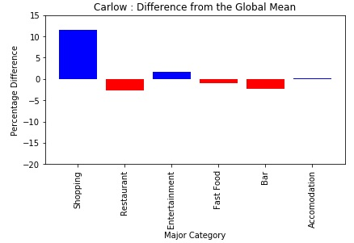
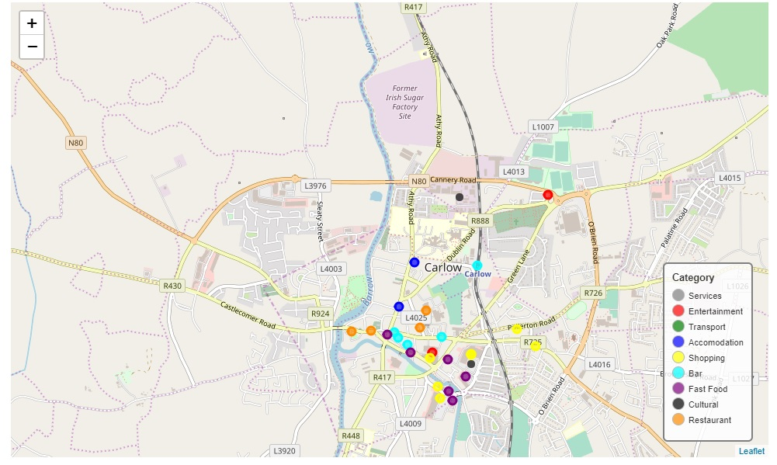
Applied Data Science Capstone
Battle of The Neighborhoods
* With approximately 12% more venues than the global mean, Shopping would be a good potential selling point for Carlow.
* The other categories are more or less on a par with the global mean, although with approximately 1% to 2% less venues than the global mean, the quantity of Restaurants, Fast Food Outlets and Bars could be increased by a small amount.

Slide 3
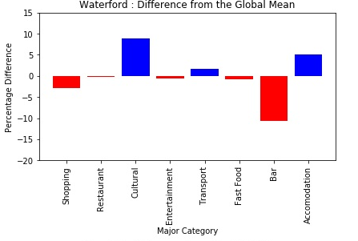
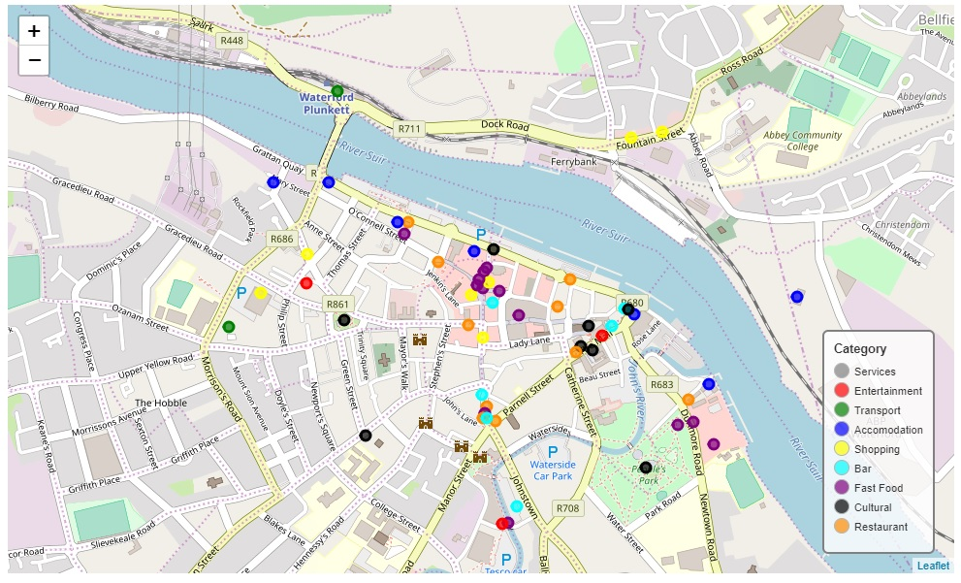
Applied Data Science Capstone
Battle of The Neighborhoods
* With approximately 8% and 5% more venues respectively than the global mean, Cultural Venues and Accomodation would be good selling points for Waterford.
* Shopping venues and Bars with 2% and 10% less venues respectively than the global mean could be areas which could be improved upon.

Slide 4
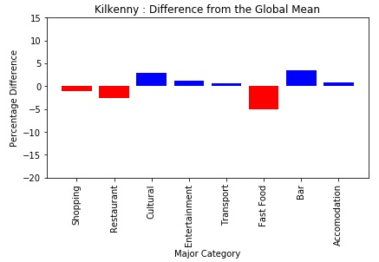
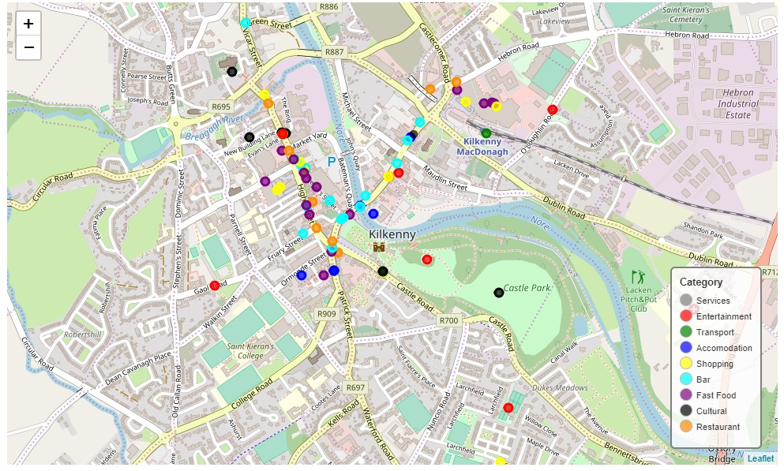
Applied Data Science Capstone
Battle of The Neighborhoods
* Overall Kilkenny fares well when compared to the global mean in most categories.
* Areas which could be used as selling points are Cultural and Bars with approximately 2% to 3% more venues than the global mean.
* Areas which could be improved slightly with 2% and 5% less venues respectively than the global mean are Restaurants and Fast Food venues.

Slide 5
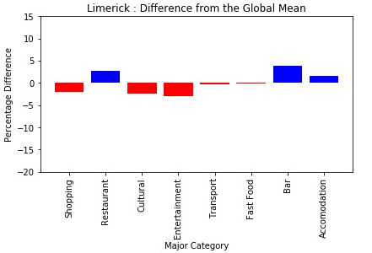
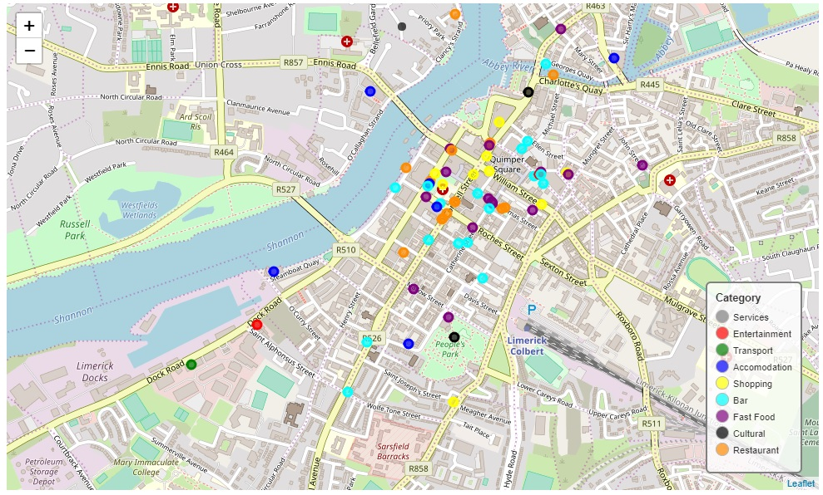
Applied Data Science Capstone
Battle of The Neighborhoods
* Overall Limerick fares well when compared to the global mean in most categories.
* Areas which could be used as selling points are Restaurants and Bars with approximately 2% to 3% more venues than the global mean.
* Areas which could be improved upon are Shopping, Cultural and Entertainment venues.

