Slide 1
Image Processing/Machine Learning on Electroluminescence Images of Solar Modules
Benjamin Pierce
Ahmad Maroof Karimi, Justin S Fada, Jiqi Liu,
Jennifer L Braid, Mehmet Koyutürk, Roger H. French

Slide 2
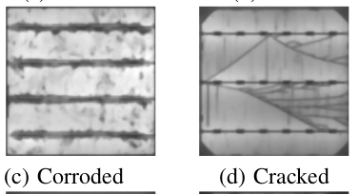
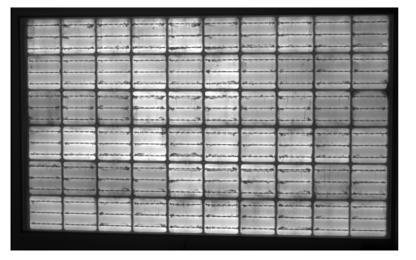
Introduction-Motivation
Solar cell defects may or may not be visible to naked eye
Even when they are, time consuming to find
Seek to automate the processing of identifying defects by visual inspection
Nondestructive
Can use electroluminescence images to reveal defects easily

Slide 3
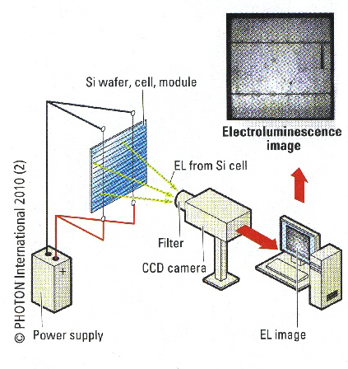
Background-Electroluminescence
Property of some materials such that when a current is passed through them, they emit light.
Essentially running solar cells in “reverse”
Putting energy in to get energy out.
In the case of solar cells, areas that are flawed (do not produce much energy) are dark
This may not be apparent to visual inspection
https://www.greateyes.de/en/ElectroluminescenceApplications.html

Slide 4
Background-Image Processing Pipeline
Since the goal is to automate the process of identifying degradation, an image processing pipeline was developed
Supervised learning w/ CNN
Simulated
Exposure
EL Imaging
Apache Hbase (Hadoop)
CWRU HPC cluster
Field Exposure
Unsupervised Learning

Slide 5
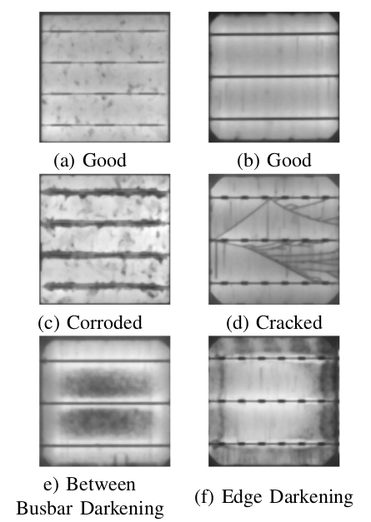
Background-Unsupervised vs. Supervised
Two (general) types of machine learning
Supervised
Requires labeled training data
Uses more traditional neural networks + convolutional for images
Time consuming/costly to label data
Unsupervised
Does not require labeled training data
Minimal human input, can reduce biases
Uses variety of methods, typically dimensionality reduction + clustering
Can classify into arbitrary classes, not limited to pre-specified
Supervised approach represented well in the literature, unsupervised less explored

Slide 6
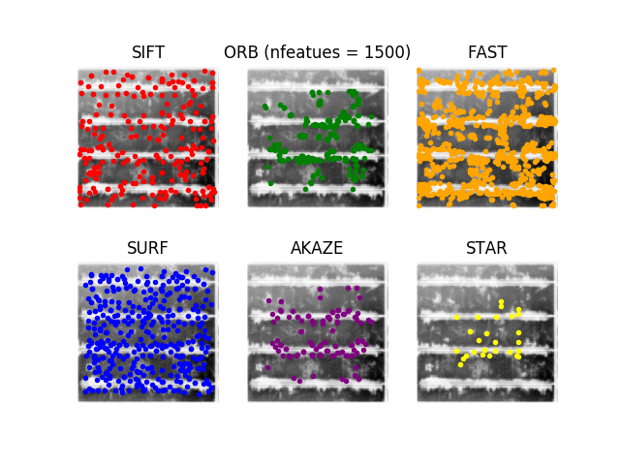
Unsupervised model improvements
My project is to improve the unsupervised model
Plus some bug fixes/maintenance of the pipeline
Can do this by improving the feature extraction methodology

Slide 7


Features/Descriptors
Small keypoints/areas of concern that are representative of a sample
Crack, corroded area, etc.
Needed because ML on 500px X 500px images is computationally expensive/ time consuming
Less intuitive
Can also describe features with a feature descriptor
In terms of location, scale, and orientation
Then can create bag of visual words to classify features
Dictionary of visual features

Slide 8
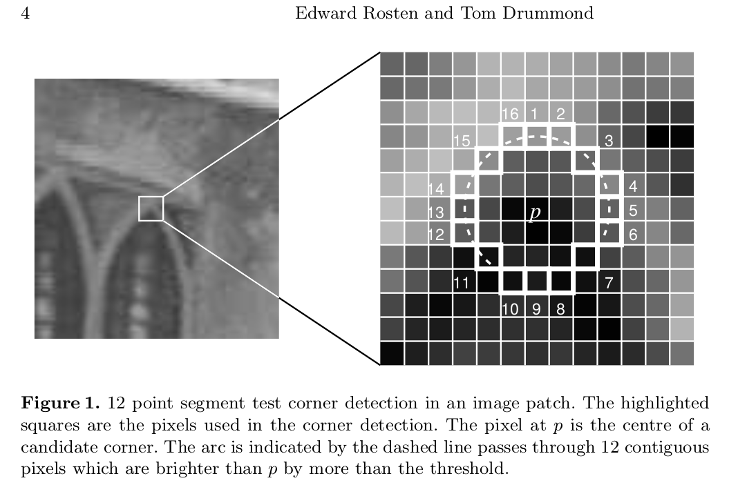

Common Feature Extraction methods
Approximation of Gaussian smoothing (SIFT/SURF)
Gaussian smoothing ≈ detail removal
Computationally expensive
SIFT uses difference of Gaussian, SURF uses determinant of the Hessian as approximation
Corner detection
Intuition: corners probably important points
Used in FAST keypoints
ORB uses FAST, but different descriptors
Nonlinear diffusion filtering
Only blur out details/noise
Preserve boundaries
Used in KAZE/AKAZE

Slide 9
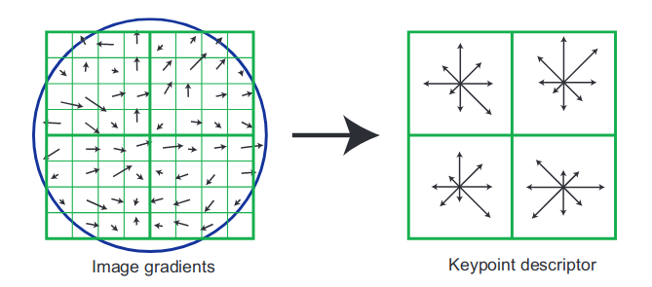
Descriptor computation
SIFT uses a histogram of gradients approach
Reduces size
For example, 16x16 window reduced to 4x4
Boundary points also excluded
Helps with orientation independence
Accounts for brightness
pixel difference vs. absolute
Final shape of descriptors:
4x4 array w/ 8 histograms = 128 dim. feature vector
Lowe, D. (2004). Distinctive Image Features from Scale-Invariant Keypoints. International Journal of Computer Vision, 60(2), pp.91-110.

Slide 10
Feature Classification
Features can then be classified individually
Is more descriptive than classifying as “bad” or “good”
We can then describe the degradation of the solar module in terms of its features
Number of cracks, corroded areas.
We may also identify new features that are not apparent to human inspection
More subtle patterns
Result: Automated identification of faults in PV modules

Slide 11
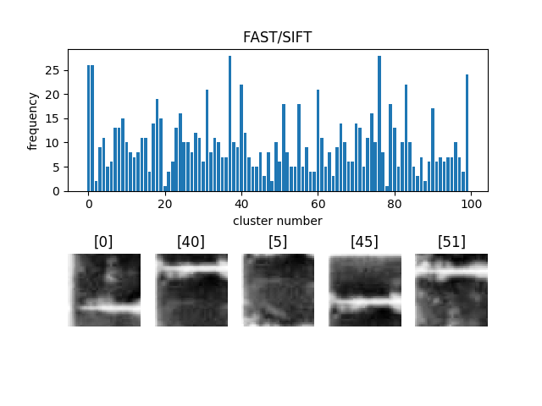
Findings-Bag of Visual Words
Can create a “visual dictionary” to classify features
This is done by clustering the feature descriptors
Using K-means w/ k = 100
128-dimensional K-means using batches
Can then compare to similar samples to see if similar features are exhibited
Then, clusters can be identified by human inspection or some automated method
Decision Trees

Slide 12
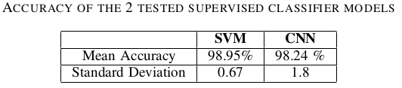

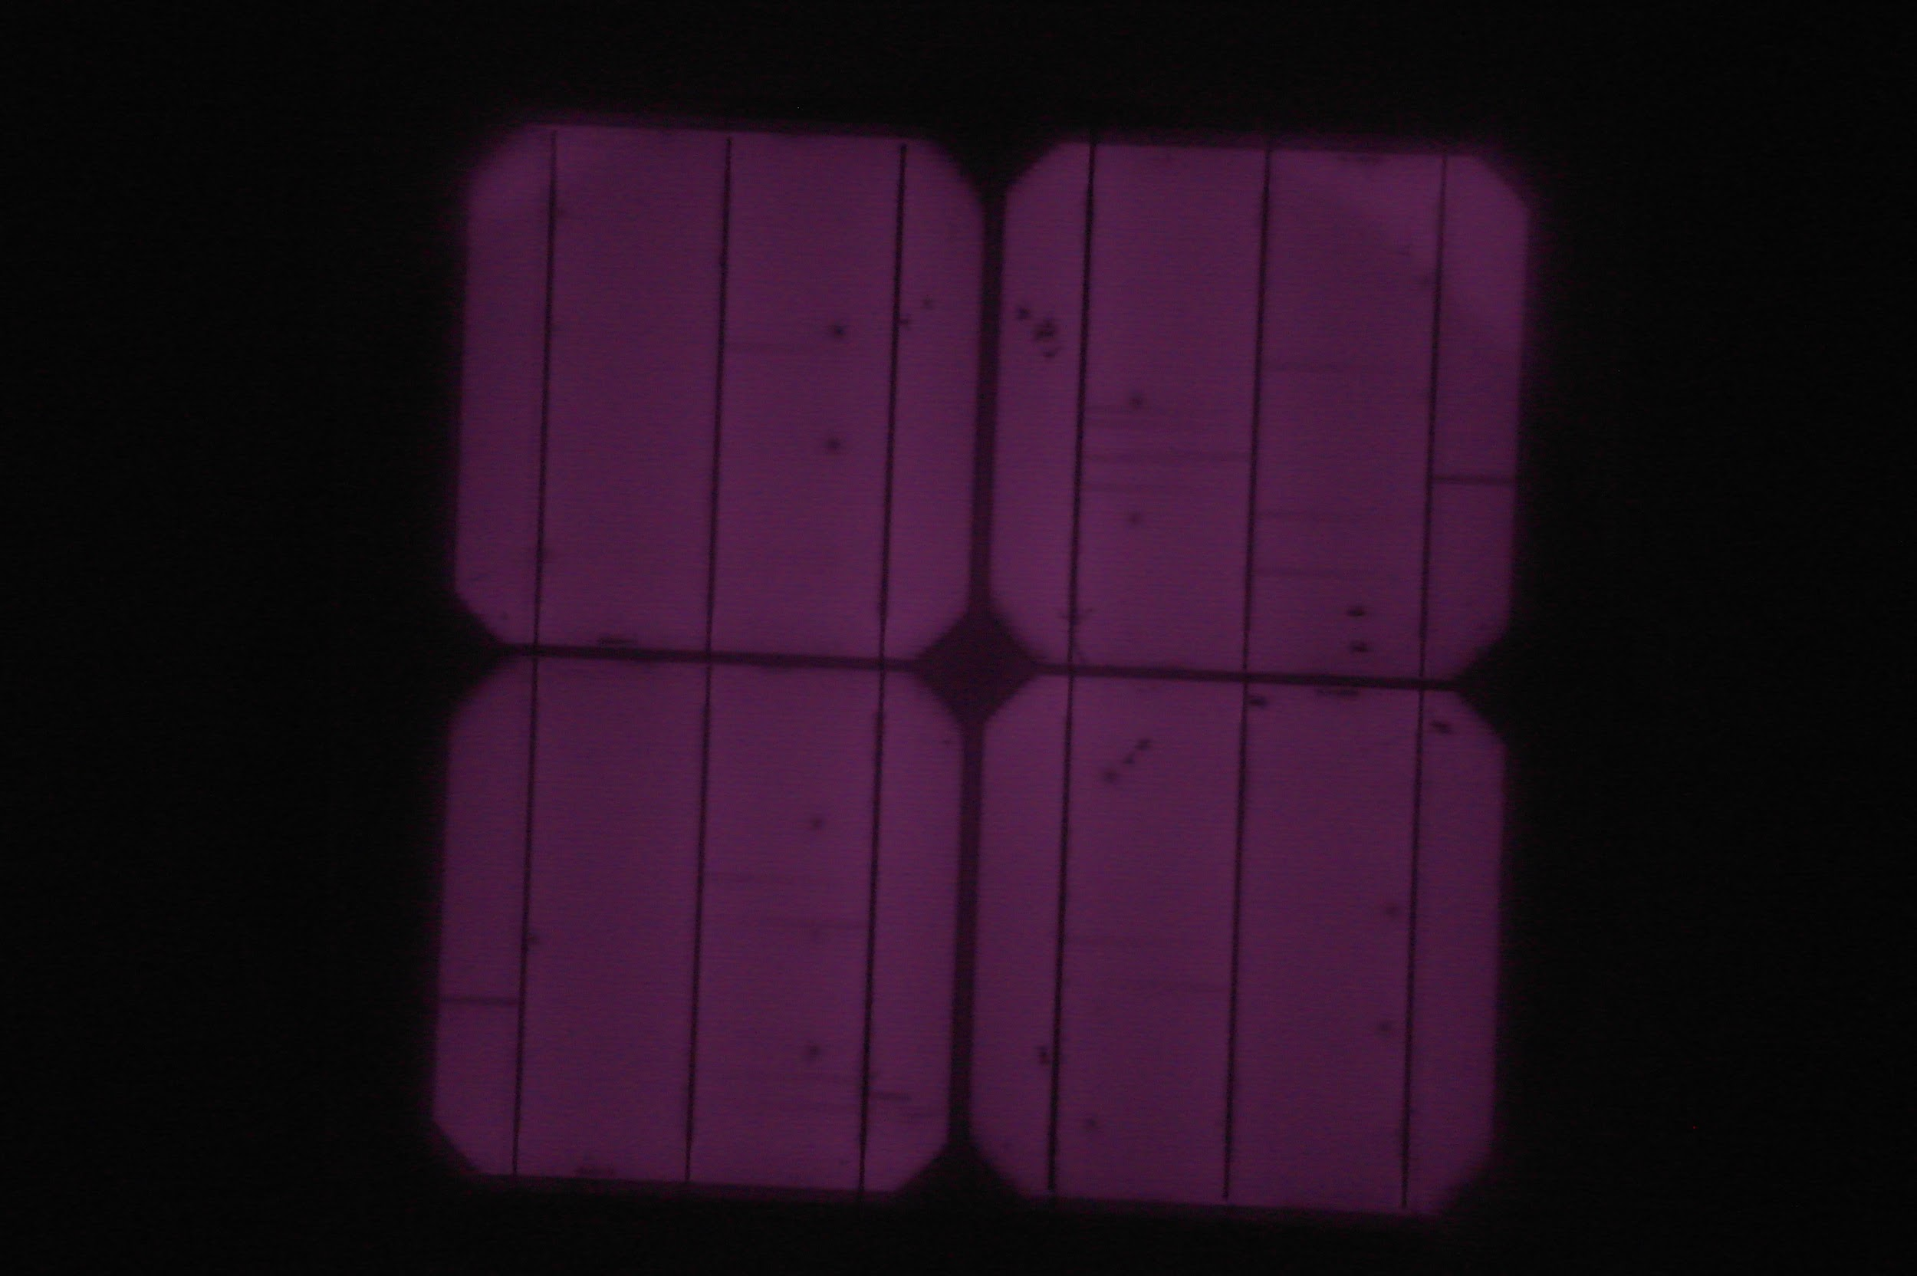
Future Work
Can apply technique to larger datasets
Test on previous dataset
Apply on newer datasets
Find overall classification
Features “normal” or “degraded/bad”
Compare model
Currently, the most effective models are supervised
CNN
SVM
Unsupervised less effective then either
Hopefully, the new model will be more effective
Investigate different feature extraction methods
CNN feature extractors

Slide 13
References
A. M. Karimi, J. S. Fada, J. Liu, J. L. Braid, M. Koyuturk and R. H. French, "Feature Extraction, Supervised and Unsupervised Machine Learning Classification of PV Cell Electroluminescence Images," IEEE 7th World Conference on Photovoltaic Energy Conversion, 2018.
R. M. Haralick, K. Shanmugam and I. Dinstein, "Textural Features for Image Classification," IEEE Transactions on Systems, Man, and Cybernetics, Vols. SMC-3, no. 6, pp. 610-621, 1973.
Bay, H., Ess, A., Tuytelaars, T. and Van Gool, L. (2008). Speeded-Up Robust Features (SURF). Computer Vision and Image Understanding, 110(3), pp.346-359.
Lowe, D. (2004). Distinctive Image Features from Scale-Invariant Keypoints. International Journal of Computer Vision, 60(2), pp.91-110.
M. Calonder, V. Lepetit, C. Strecha, and P. Fua. (2010). BRIEF: Binary robust independent elementary features. European Conference on Computer Vision,
E. Rublee, V. Rabaud, K. Konolige, and G. Bradski, (2011). ORB: an efficient alternative to SIFT or SURF. IEEE International Conference on Computer Vision
P. F. Alcantarilla, A. Bartoli, and A. J. Davison. Kaze features. European Conference on Computer Vision, pp.214–227. Springer, 2012.

Slide 14
Acknowledgements
This work was funded by the SURES program of CWRU’s SOURCE office through the generous contributions of the CAA and Dominion
Research was performed at the SDLE Research Center, which was established through funding through the Ohio Third Frontier, Wright Project Program Award tech 12-004.
This material is based upon work supported by the U.S. Department of Energy’s Office of Energy Efficiency and Renewable Energy (EERE) under Solar Energy Technologies Office (SETO) Agreement Number DE-EE0007140.
This work made use of the Rider High Performance Computing Resource in the Core Facility for Advanced Research Computing at Case Western Reserve University.

