Slide 1
Makefile
September 6, 2017
By Jeff Eben

Slide 2
How to compile program (Without Makefile)
We want to compile “for.c”, “input.c”, ”sleep.c”, and “while.c”
Must type:
gcc –o for for.c
gcc –o while while.c
gcc –o sleep sleep.c
gcc –o input input.c
This is tedious

Slide 3
How to compile program (With Makefile)
Create Makefile
By convention name is “Makefile” or “makefile”
Type in “make”
For makefiles with arbitrary names, type in “make –f filename”

Slide 4
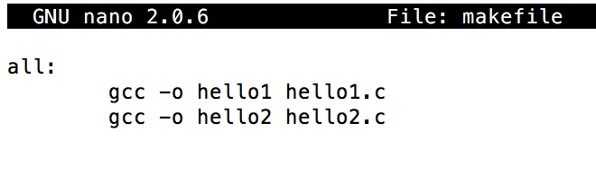
How to create basic Makefile
Create file
”nano makefile”
Enter code on right → (Must use tab)
To save in nano, press “Ctrl+o”
To exit, press “Ctrl+x”
To run the makefile, simply type in “make”

Slide 5
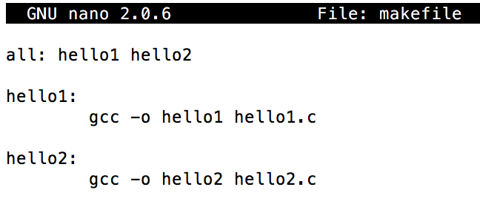
How it Works
Makefile syntax consists of the following:
Target: dependencies
command
command
…
If multiple files are controlled by makefile, convention is to have “all:” be the first header, which will execute on default if no file provided
In example on right, if “make” is executed, this will execute “all:”, creating both files. If “make hello1” is executed, only “hello1:” will be executed, creating only “hello1”

Slide 6
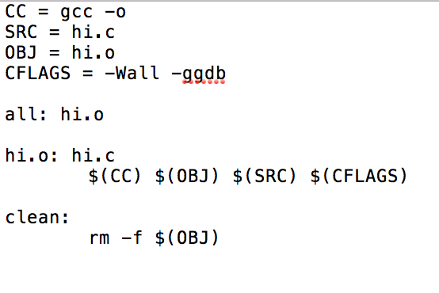
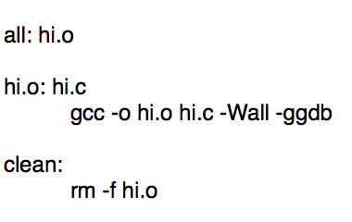
More Tools
Comments can be added to makefile by adding “#” at the beginning of the line
Variables can be used in the following way:
Equivalent

Slide 7
Other reasons it is useful
Faster than manually typing
Calling make will not recompile files that have been compiled in the past (unless changed)
Ex: If makefile compiles 10 files, and 3 are changed, calling “make” will only recompile 3 changed ones

Slide 8
Links to Additional Resources
http://www.tldp.org/LDP/LG/issue83/heriyanto.html
http://www.cs.colby.edu/maxwell/courses/tutorials/maketutor/

