Slide 1
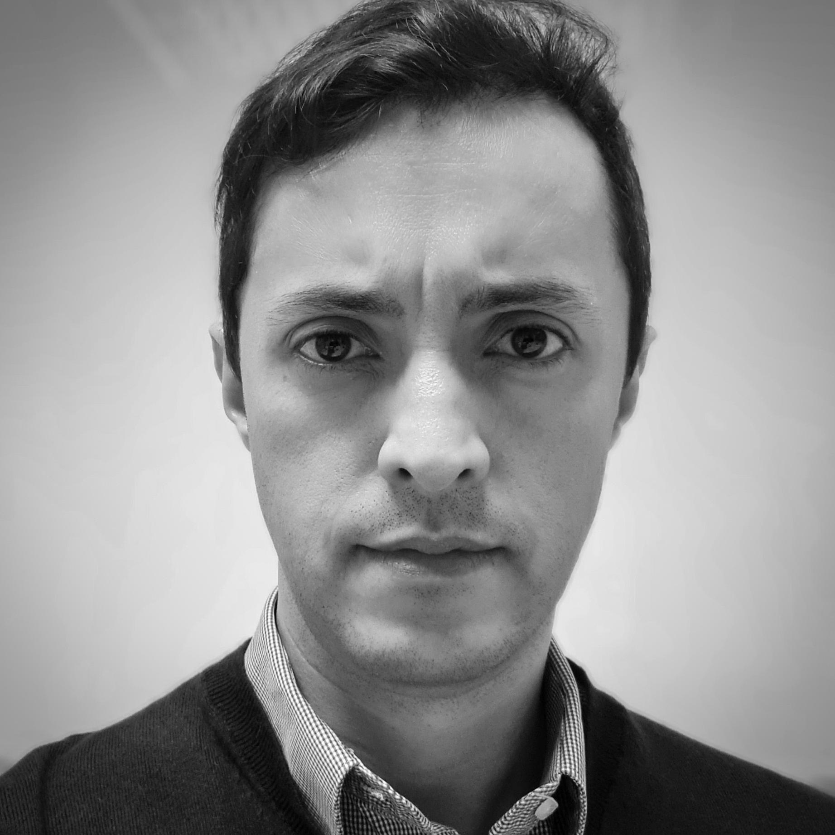
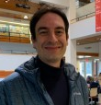
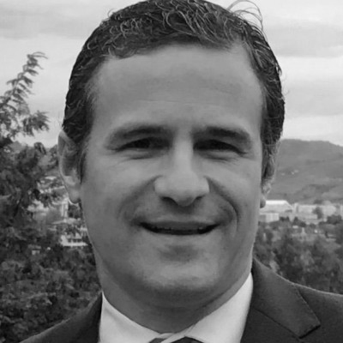

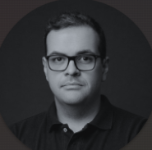
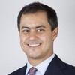
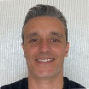

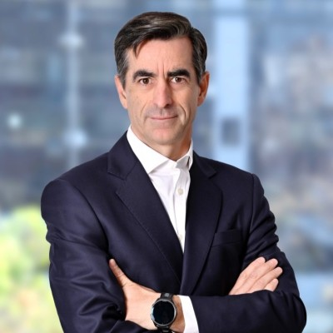


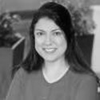
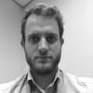
Project Leadership
Leadership for Itaú
Advisory Committee
Responsible for the interface with Itaú's leadership and coordination of the team in deliverables
Responsible for the success of the relationship between Itaú and Accenture
Committee set up to support in-depth discussions of industry content
Douglas F. Silva
Managing Director Tech Strategy for Banking Expert
Marcus Schalch
Experienced industry executive; responsible for all relationship with Itaú
Maurício Barbosa
Leader in charge of the Financial Services practice in Latin America
Brenno Graciotti
Principal Director
Banking Strategy Expert
Rogério Mascarenhas
Leader of the Banking Strategy practice, with +20 years of experience in strategy projects
Denis Freitas
Managing Director Lending Platforms
Mauricio Ariztegui
Associate Director
Banking Technology Expert
Matias Carvajal
Experienced industry executive; responsible for relationship with Itaú Chile
Nicolas Deino
Leader in charge of the Financial Services practice in Chile
Our senior executives will be in the day-to-day of the project and will be an effective part of the team that will be together with Itaú, throughout the process of mapping and discussing opportunities, not only having the role of administrators.

