Slide 1



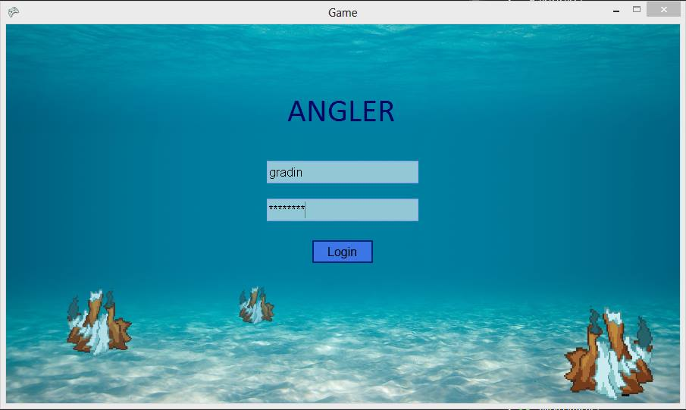






Angler: The title that no one likes but also is our only idea
Introduction
Server
The problem with MMOs nowadays is that they are all the same—they are all fantasy games with elves, humans, and dwarves. We as a software development team set out to create something different and unique; we came up with a deep see MMORPG where you are a female Anglerfish attempting to navigate out of an underwater labyrinth. Our project has two major components: a server piece that will host the map and validate all player actions, and a client that launches the game from each player’s machine.
The server side of the application will be hidden from the user, but will ultimately do all of the heavy lifting. Each client will be connected to and kept track of by the server, and will communicate its every move to it. Each action taken by the client will be sent to our server, where their actions will be validated and reflected in a master map which is in-turn sent out to every other client connected.
Client
Summary and Direction
The client aspect is a C# executable that is downloaded onto each player’s personal computer. Once they connect to our secure server, they will be prompted to log in using their unique username and password, also stored securely off-site. In game the player will move around a pre-built maze and attempt to collect bacteria. This bacteria, in version one, will only be used as a score-keeping mechanism. Their bacteria count will degrade over time, and will be their score when they complete the maze.
We all learned a lot from this project, and we all share a passion for doing a little bit more after this school year is over. We have preliminary plans for up to version four, with each version adding significantly more features. Versions two and three will add more items, combat, and ability for player interaction. Version four is where we really want the game to shine, with additional maps and areas, which will allow us to break free of the maze mold.
Team members: Jonathan Haas, Brian Gradin, Ellie Janzen, Ethan Moffat
Team Sponsor: Elaine Weltz

