Slide 1


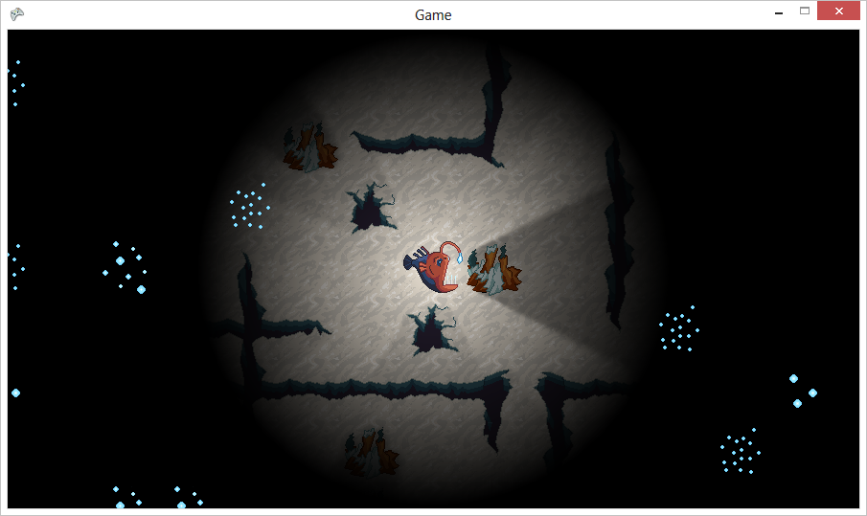
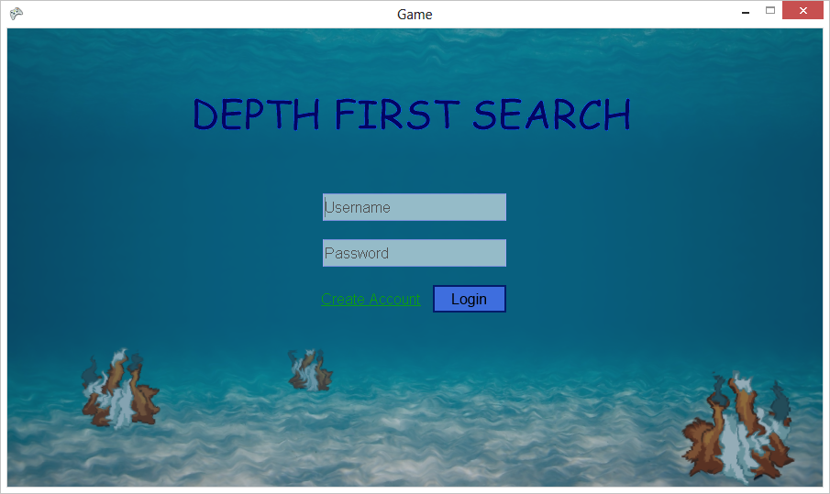
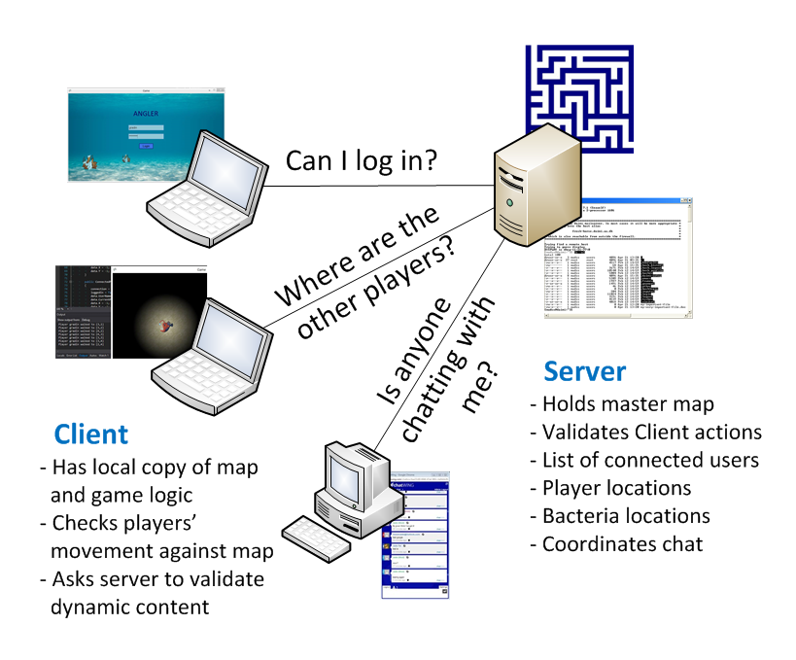





Depth First Search
A Deep Sea Multiplayer Online Game
Introduction
Our software team set out to create a unique online multiplayer experience—something different from a first person shooter or a fantasy RPG. In Depth First Search, the user controls a female anglerfish attempting to escape an underwater labyrinth. Our project has two major components: a server application which coordinates and validates all player actions, and a local client which launches the game.
Game Play
Once a user logs in, they move their anglerfish around a pre-built maze, completing the maze as quickly as possible while collecting bacteria. This bacteria will initially be used as a score-keeping mechanism, and will slowly decay over time. The player also has a limited light source, and outside of the light only bacteria and other players are visible.
Server
The server application keeps all players coordinated with each other and performs all validation and database operations. Once a client application connects, the server receives all actions performed by the user. The server validates these actions and updates the master map, which is sent to all other connected clients if necessary.
Client
The client is a C# executable which is downloaded onto each user’s personal computer. After logging in with their username and password, the game launches. The client application stores a local copy of the game logic, map, and graphics. Through the client interface, each player interacts with all items, objects and players on the server.
Future Development
While already a complete game, Depth First Search is really a prototype for a larger game that our team hopes to develop in the future. We have an outline for features up to Version 4, with each version adding significantly more functionality. Eventually, we would like the game to include more maps, items, combat, player interaction, and non-playable characters.
The Hurricanes (left to right)
Ellie Janzen • Jonathan Haas • Brian Gradin •
Ethan Moffat
Team Sponsor: Elaine Weltz

