Slide 1
War – Web Card Game
CMPT 350 – Web Programming Project
Brian Grosskleg, Paul Thomson, John Mason
March 28, 2014

Slide 2
Overview
Two Sub-Projects
Server Application
Client Applet(s)
Architecture
Card game
Java application and Java applets
Model-View-Controller
Synchronizing model state
Significant use of abstraction
Multiple concurrent threads and workers

Slide 3
The Card Game
War – simplistic in nature
Class is about web applications not game mechanics
Further card game applications
Abstraction facilitates easy future development

Slide 4
Abstraction
WarCardGameModel
WarCardGameView
GenericCardGameModel
GenericCardGameView
GenericModel
GenericView
WarCardGameController
WarCardGameSocketWorker
GenericCardGameController
GenericCardGameSocketWorker
GenericController
GenericSocketWorker

Slide 5
Model
Stores state information
Model contains a deck and players
The deck contains cards
A card contains:
Card images
Card details
A player contains:
Their cards
The socketWorker responsible for their communication
Maintains a list of ModelSubscribers

Slide 6
View
Extension of JPanel
Built off of the model details (ie. model state)
GridBagLayout provides layout flexibility
Displays card decks
Displays individual cards
Chat system
Provides user interface/interaction
Subscribes to model (to repaint state changes)

Slide 7
Controller
Heart of the application
Contains methods to manipulate the model
Client controller and server controller are unique
Has access to the model and the view

Slide 8
SocketWorker
Responsible for server-applet communication
Run in separate thread
Given a connection number to identify itself
Subscribes to the model
When the model is changed, the socket worker sends the new model to the other side of the connection
Receives a new model and synchronizes the existing model with the new state

Slide 9
The Server
Responsible for initializing the game
Waits for enough players to connect
Creates cards, deals cards, evaluates hand
Acts as hub for communication
Displays a master view of game
Client Applet
Client Applet
Server

Slide 10

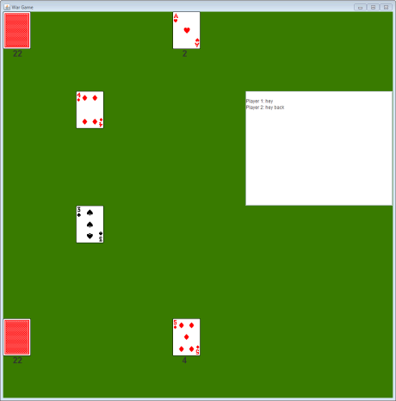
The Server
Waiting for Players Screen
Server Game View (draw deck on left, win pile right, comparison middle and chat window far right)

Slide 11
Client Applet
Java applet embedded within an HTML page
Upon creation, creates a socket connection to server. Server recognizes this connection, adds a player and pushes new state out to all clients.
Once enough players connected, the game view is displayed
If a player drops, the connection is terminated and system goes back to waiting for enough players
Real time chat system enables player communication while playing the game

Slide 12
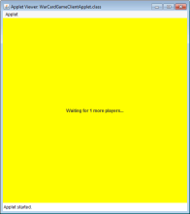
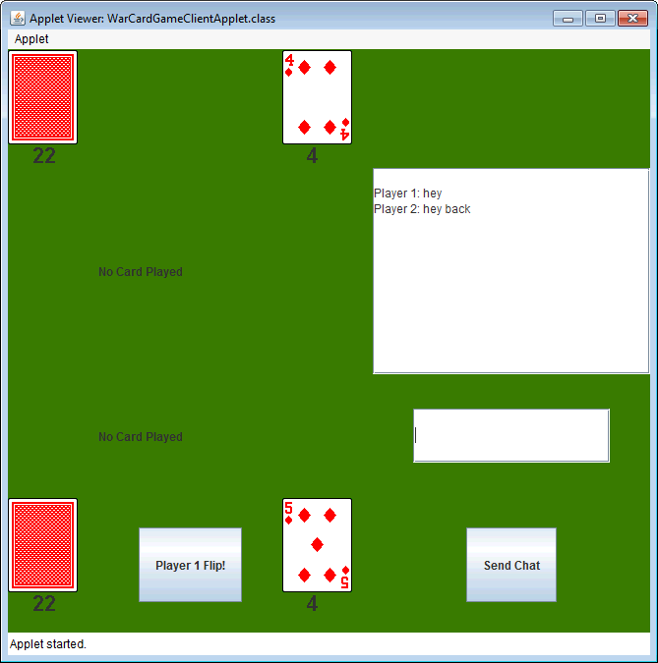
Client Applet
Waiting for Players Screen
Player 1 Game View (draw deck on left, win pile right, comparison middle and chat window far right)

Slide 13
Where to go from here
Different card games
Different options (play speeds, layouts)
Introduction of AI
User accounts
User scoring system
Again, CMPT350 is not focused on game mechanics but of developing a web application, which we have successfully achieved.
Implementation in JavaScript or other web language (using JApplets was approved)

