Slide 1


Recording a Jitsi Meet conference
Master 2
Réseaux Informatiques et Systèmes Embarqués
Boris Grozev
Supervisor:
Dr. Emil Ivov
June 24, 2014
Notes:
Hello, my name is Boris Grozev and I will present to
you the work that I've done in the last 6 months, under the supervision of Emil Ivov, as an intern in BlueJimp.

Slide 2
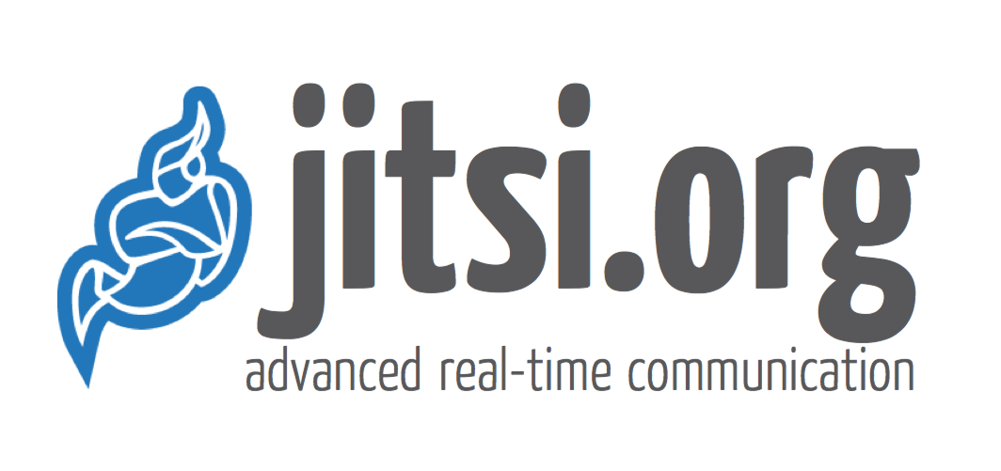
1.1 BlueJimp
Development services
  Based around Jitsi
    Opensource
    VoIP
  My role:
    Software developer
    Recording a video conference
Notes:
BlueJimp is a company founded by Emil Ivov and Yana Stamcheva, which provides software development services based around the Jitsi family of opensource projects, which is mostly focused on VOIP services.
My job was that of a software developer, and it was very exciting, interesting and rewarding to work on opensource projects. Most of my time was spent on designing and implementing a recording system for Jitsi Meet conferences.
40s
Total 40s

Slide 3
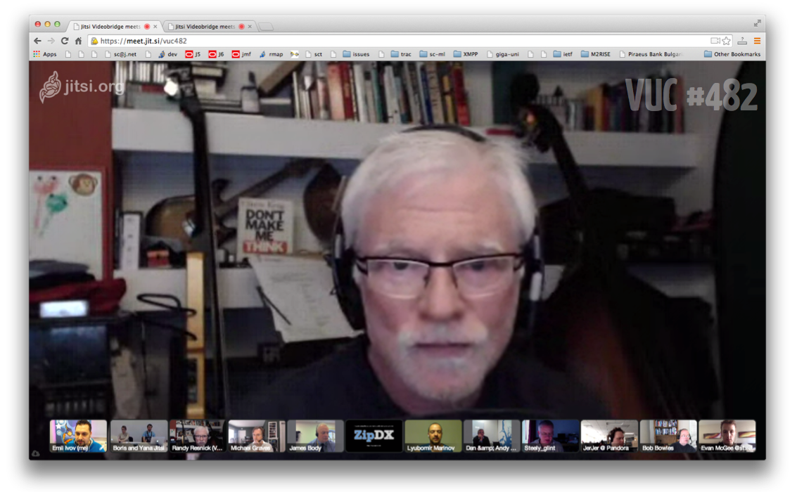
1.2 Jitsi Meet
Images: Emil Ivov
Notes:
Jitsi Meet is an application for real-time multi-party video conferences. It is a WebRTC application and runs in the browser. This is the JM interface:
In short, it shows the video of one participant in full size, and the rest of the participants scaled down – all the little pictures are other participants.
40sec
Total: 1:20

Slide 4
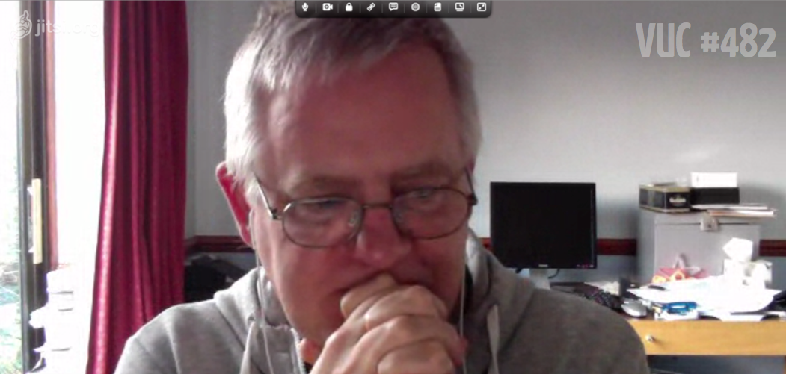
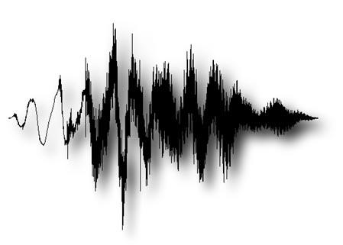
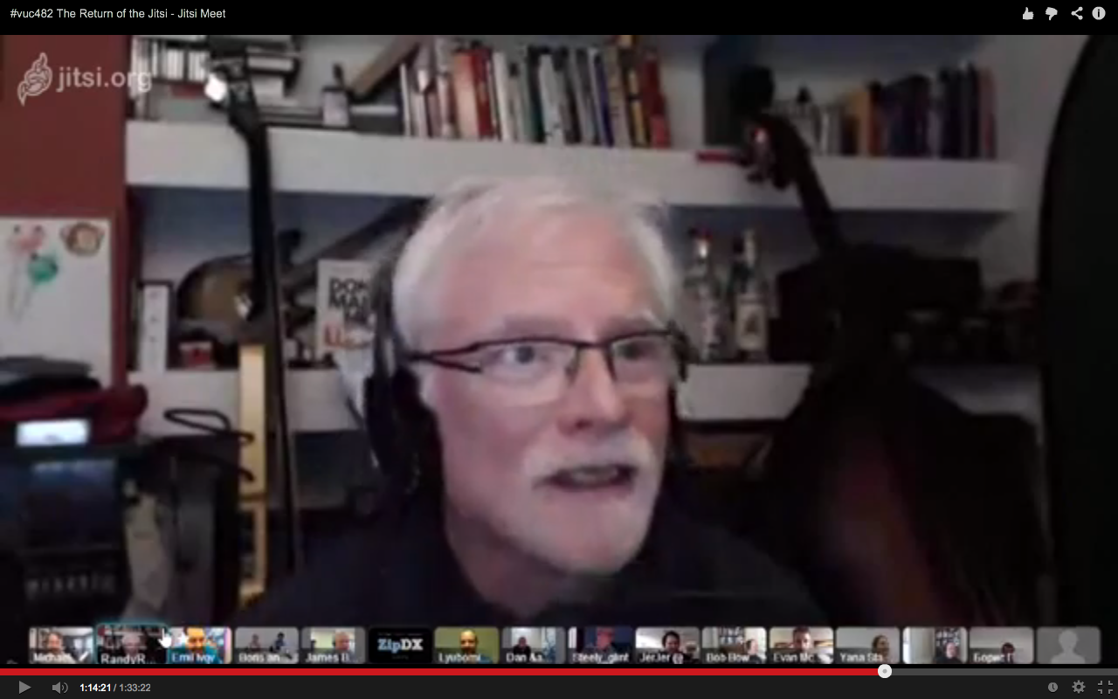
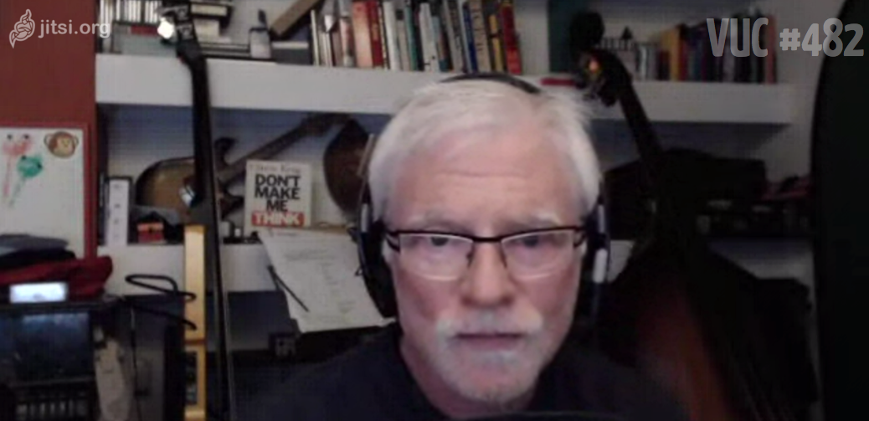
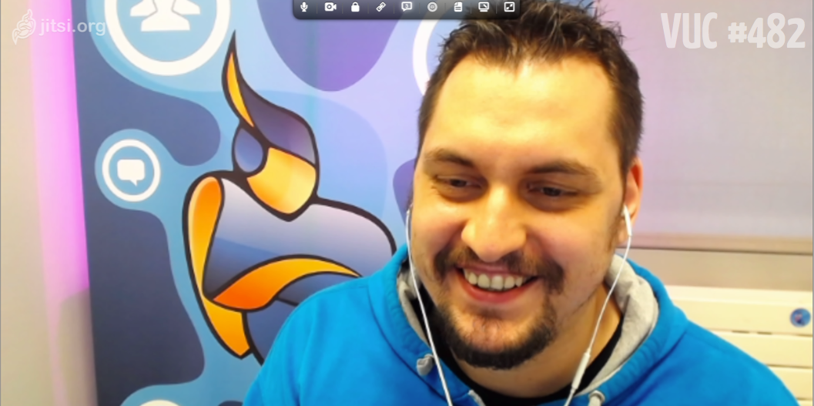
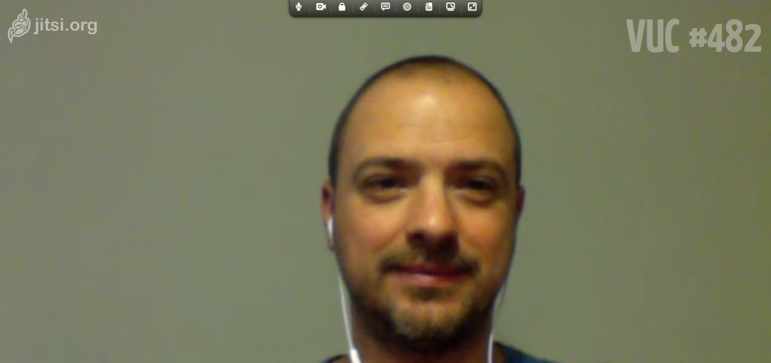
2 Recording (1/3)
We have :
We need :
A set of streams
A single file
Images: Emil Ivov
Notes:
In a live conference, we have a set of streams on the network, and each client renders them as they arrive. What we needed to do was record a conference for later viewing. Our aim was to have a single “flat” file with audio and video, which includes all participants in the conference and can be easily viewed, archived or published online (for example on youtube).
So, how do we go from a bunch of streams to a single file?
45sec
Total 2:05m

Slide 5
2 Recording (2/3)
Stage I:
Stage II:
video1.webm
(Post-processing)
Demultiplex streams,
Depacketize,
Put in container,
Save to disk
audio1.mp3
Mix audio,
Decode/Overlay/Encode video,
Mux audio and video
audio2.mp3
result.webm
video2.mp3
video3.webm
video4.webm
audio3.mp3
Images: Emil Ivov
Notes:
We decided to use a two-stage process. In the first stage, we separate the individual streams, convert them to a convenient format (transcoding, if necessary), place them in a container format and save them in a file on disk – each stream in its own file.
In the second stage, which we call post-processing, a separate application reads all recorded files, and combines them together in one file.
This has two important advantages: first, it separates the work which has to be done in real-time -- stage 1, from the post-processing, which can happen later on (whenevet resources are available).
Second, this allows us to use existing tools, such as ffmpeg, for the complex job of post-processing.
My job was design and implement most of Stage I, and this is what I will talk about in the rest of the presentation.
90sec
Total 3:35

Slide 6
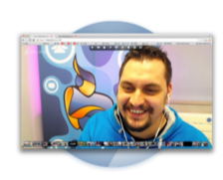
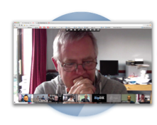
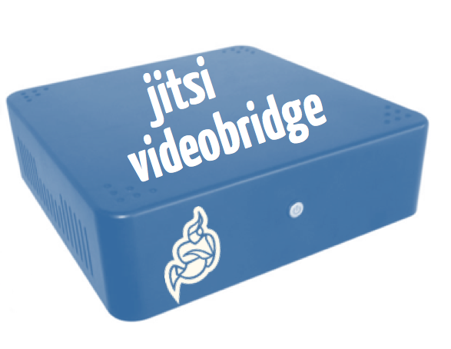
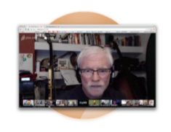
2 Recording (3/3)
SRTP: video
SRTP: audio
SRTP: audio
SRTP: video
SRTP: video
SRTP: audio
Images: Emil Ivov
Notes:
In a Jitsi Meet conference, there is a entity – Jitsi Videobridge – which serves as a media router. The conference has a star topology, with the videobridge in the center. This is what allows conferences to scale to 20 participants and more.
Each participant (running in a browser) has two SRTP streams – two UDP streams – towards the videobridge: one is used for audio and one for video. Each of these UDP streams carries multiple media streams, multiplexed by an RTP field called “SSRC”.
SRTP stands for Secure Realtime Transport Protocol – the connections are encrypted, each one with a different key, so apart from routing packets the videobridge has to re-encrypt every packet.
90sec
Total 5:05
Observed 3:35

Slide 7
The plan:
Video
Audio
Metadata
Synchronization
Images: Emil Ivov
Notes:
In a Jitsi Meet conference, there is a entity – Jitsi Videobridge – which serves as a media router. The conference has a star topology, with the videobridge in the center. This is what allows conferences to scale to 20 participants and more.
Each participant (running in a browser) has two SRTP streams – two UDP streams – towards the videobridge: one is used for audio and one for video. Each of these UDP streams carries multiple media streams, multiplexed by an RTP field called “SSRC”.
SRTP stands for Secure Realtime Transport Protocol – the connections are encrypted, each one with a different key, so apart from routing packets the videobridge has to re-encrypt every packet.
90sec
Total 5:05
Observed 3:35

Slide 8

3.1 Video: VP8
RFC6386
Libvpx – opensource implementation
Wide support
  Most browsers
  Many players (ffmpeg, gstreamer)
Notes:
Jitsi Meet conferences use the VP8 codec for video. This is a video codec released by Google – its specification is available as an RFC, and there is an opensource reference implementation – libvpx.
Given the same bitrate constraints, it produces quality comparable to that of H264. It is widely used: its available in most video player applications (VLC, mplayer, anything based on ffmpeg and gstreamer), including most browsers. It is now also supported in Jitsi.
A VP8 encoder takes a raw image as input and produces a VP8 Compressed Frame.
45sec
Total: 8:00

Slide 9
3.2 Video: packetization
VP8 Compressed Frame 1
VP8 Compressed Frame 2
UDP Header
RTP Header
VP8 PD
VP8 Payload
RTP Payload
Packetization:
1. Split
2. Add headers: RTP + VP8 Payload Descriptor (PD)
Notes:
In order to send a VP8 compressed frame over RTP, it has to be “packetized” first. This means first splitting it in parts, usually small enough so that after all encapsulation the UDP packet can fit the path MTU. Then each part is prefixed by a VP8 Payload Descriptor structure and placed in an RTP packet.
30sec
Total 8:30

Slide 10
3.3 Video: de-packetization
RTP Header
VP8 PD
0 1 2 3
0 1 2 3 4 5 6 7 8 9 0 1 2 3 4 5 6 7 8 9 0 1 2 3 4 5 6 7 8 9 0 1
+-+-+-+-+-+-+-+-+-+-+-+-+-+-+-+-+-+-+-+-+-+-+-+-+-+-+-+-+-+-+-+-+
|V=2|P|X| CC |M| PT | sequence number |
+-+-+-+-+-+-+-+-+-+-+-+-+-+-+-+-+-+-+-+-+-+-+-+-+-+-+-+-+-+-+-+-+
| timestamp |
+-+-+-+-+-+-+-+-+-+-+-+-+-+-+-+-+-+-+-+-+-+-+-+-+-+-+-+-+-+-+-+-+
| synchronization source (SSRC) identifier |
+=+=+=+=+=+=+=+=+=+=+=+=+=+=+=+=+=+=+=+=+=+=+=+=+=+=+=+=+=+=+=+=+
| contributing source (CSRC) identifiers |
| .... |
+-+-+-+-+-+-+-+-+-+-+-+-+-+-+-+-+-+-+-+-+-+-+-+-+-+-+-+-+-+-+-+-+
0 1 2 3 4 5 6 7
+-+-+-+-+-+-+-+-+
|X|R|N|S|R| PID |
+-+-+-+-+-+-+-+-+
X: |I|L|T|K| RSV |
+-+-+-+-+-+-+-+-+
I: |M| PictureID |
+-+-+-+-+-+-+-+-+
L: | TL0PICIDX |
+-+-+-+-+-+-+-+-+
T/K: |TID|Y| KEYIDX |
+-+-+-+-+-+-+-+-+
VP8 Compressed Frame 100
VP8 Compressed Frame 101
102
Notes:
The receiver has to do the opposite – it has to read RTP packets and reconstruct VP8 Compressed Frames. For this, six fields from the RTP Header and VP8 Payload Descriptor are used – the timestamp and PictureID fields help divide packets into frames, the S, PID and M fields allow to identify the first and last packets of a frame, and the sequence number field allows the check if there are missing packets.
We implemented this in libjitsi.
40sec
Total 9:10

Slide 11

3.4 Video: webm
Container format for audio and video
Open (based on matroska)
Designed for the web (for web-browsers)
Our use:
  Video only (VP8)
  Single track: a sequence of frames
Notes:
S/passive voice/active voice/
After the depacketization is done, we are left with a stream of VP8 Compressed Frames. We decided to use the webm container format to store it.
Webm is an open format, based on matroska, used in the web – most current browsers support it.
We implemented recording into webm format, and we use it in a very simple way: we produce single-track video-only files.There is no fixed frame rate – each frame has it's own presentation timestamp.
30 sec
Total 9:40
Observed: 8:35

Slide 12
3.5 Video: RTX and FEC (1/2)
Handling packet loss:
Retransmissions (RTX) & Forward Error Correction (FEC)
RTX:
Triggered by the clients
  RTCP NACK
Require at least a RTT
How do we handle it?
  Just keep a big buffer
Images: Emil Ivov
Notes:
RTP is not a reliable transport – the delivery of packets is not assured. There are two mechanisms which are used to mitigate the effects of packet loss for video streams.
The first one is RTX – packet retransmissions. These are triggered by a receiver via an RTCP NACK message. So the receiver has to wait at least one RTT before a retransmission arrives.
The videobridge is in a position to take advantage of retransmissions requested by the clients themselves: if the bridge is missing a packet, then so are the rest of the participants, so they will request its retransmissions. It only needs to handle packets retransmitted packets.
In order to do this, the only thing we do is ensure that we have big enough buffers – since we are not rendering live, a buffer of a couple of seconds is not a problem.
If recording happens in a separate application, it needs to request retransmissions on its own. We have not implemented this yet, but we plan to do it.
70sec
Total 10:50

Slide 13
3.6 Video: RTX and FEC (2/2)
Forward Error Correction (FEC, RFC5109):
Add redundancy data
Based on parity (similar to RAID5)
Not triggered by the receiver
No RTT delay
Requires special handling
media1
media2
media3
media4
FEC
⊕
⊕
⊕
=
media1
media2
FEC
media4
media3
⊕
⊕
⊕
=
Notes:
The second mechanism FEC. It involves adding redundancy data to a stream, in the form of additional FEC packets. A FEC packet is produced by doing XOR on a set of media packets. If one of the thus protected packets is lost, the received can reconstruct it by XORing the rest of the packets and the FEC packet.
In reality this is a bit more complicated, because packets might have variable length.
With this mechanism the receiver can reconstruct missing packets without any delay, but only if a single packet is missing – if two packets are lost reconstruction is not possible.
We implemented support for FEC in libjitsi.
1:30
Total 12:20
Observed: 11:40

Slide 14
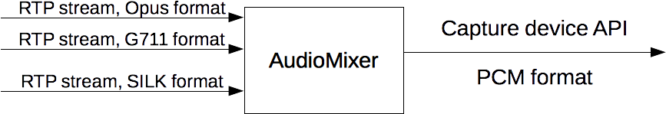
3.1 Audio: to mix or not to mix
Record a mix?
+ Already available in libjitsi
- More expensive (CPU-wise)
- No fine control over the streams
Notes:
On to recording audio.
In the final recording the audio has to be mixed together. So we had two general options: either follow the two-stage process introduced in the beginning, or do some of the post-processing while recording and record the audio already mixed.
Libjitsi includes a very advanced audio mixer, which made the implementation of recording a mix very easy, so we started with this, although it is conceptually more complex, and has other disadvantages (such as CPU use).
Soon we ran into a problem with synchronization, and in order to solve it, we needed fine control over the decoding of each stream. So we switched to recording streams individually, as we do for video.
1min
Total 13:20

Slide 15
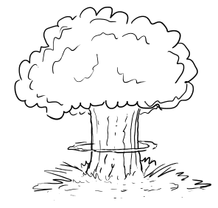




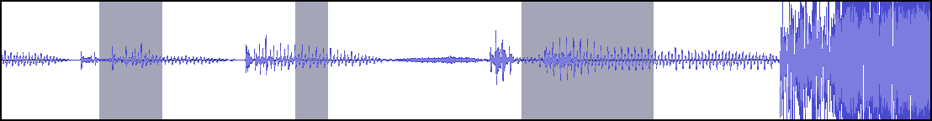
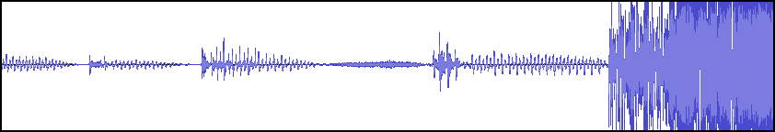
3.2 Audio: gaps
Ignore lost packets?
Images: xkcd
Notes:
The synchronization problem is this: when some of the audio RTP packets are lost on the network, the resulting audio becomes shorter than the video – this is because audio sample don't have their own timestamps, as video frames do. Over time this leads to de-synchronized audio and video in the final result.
30sec
Total 13:50
Observed 13:45

Slide 16
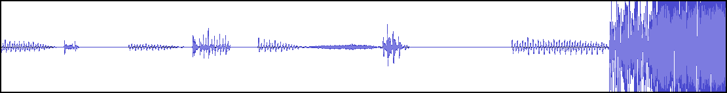
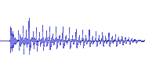
3.3 Audio: repairing gaps
Opus' FEC – single packet (20ms), based on actual sound
Opus' PLC – attempts to conceal packet lost (no crackling)
Actual silence – zeros
FEC
FEC
Packet 1
Packet 2
Packet 3
Notes:
In order to fix this problem we needed to “repair the gaps” in the stream. That is, to insert audio samples where RTP packets are missing.
We do this in three different ways.
One is to use the FEC mechanism in Opus. It is different from the one used for video. In this case, a packet might contain a lower-quality version of the audio in the previous packet. Packet 2 contains a lower-quality version of packet 1. This allows to fill in gaps when only a single RTP packet is lost.
When more packets are lost we have two options: use the Packet Loss Concealment mechanism of Opus, or just fill in with zeros. The PLC allows generates noise in such a way as to minimize the crackling sounds which normally appear when there's packet loss.
90sec
Total 15:20

Slide 17
3.4 Audio: the current scheme
SRTP
Packet
Transformer
Jitter
Buffer
Decoder
Silence
Effect
Encoder
Jitter
Buffer
SRTP
opus/rtp
PCM
mp3
Decrypt
FEC
Fill gaps (<3sec)
(zeros)
PLC
(up to 3 packets)
Reset if gap >3sec
Notes:
In the end, the scheme which we implemented to record audio (an individual stream) is the following:
We receive SRTP packets. They go through a chain of packet transformers, which perform various tasks, notably they decrypt the packets. We are left with an opus/rtp stream, which is fed to a decoder. The decoder converts the stream to PCM format, and uses FEC and PLC to repair gaps of up to three packets. Then the PCM stream goes through a SilenceEffect which repairs bigger gaps. Finally the stream is encoded into MP3 format and saved to disk.
Since we encode the final stream, filling in a big gap is expensive. If someone stays muted in a conference, and then unmutes after one hour, we'd have to generate that much silence (about 350MB) and encode it to MP3.
For this reason, when the SilenceEffect detects a gap bigger than a given threshold (currently 3seconds), it resets the recording in a new file, with its own timestamp.
This scheme is inefficient, mainly because it involves reencoding the audio. We plan to improve it.
90sec
Total 16:55

Slide 18
4. Metadata
{
"instant" : 0,
"type" : "RECORDING_STARTED",
"filename" : "video1.webm",
"ssrc" : 3141592654,
"mediaType" : "video",
"participantName" : "Jane Doe",
"participantDescription" : "Chief
Example Officer"
}
{
"instant" : 1500,
"type" : "RECORDING_STARTED",
"filename" : "audio1.mp3",
"ssrc" : 271828182,
"mediaType" : "audio",
}
{
"instant" : 6500,
"type" : "SPEAKER_CHANGED",
"ssrc" : 3141592654,
"audioSsrc" : 271828182
}
Used in post-processing
Indicate WHICH files WHEN
Indicate speaker changes
Additional information
  Participant names
JSON format
Sequence of events
Notes:
Remind “where we are” – audio and video are now recorded.
Apart from all the audio and video files, the post-processing application need additional information in order to correctly combine the files. We call this information “metadata” and we record it in a separate file.
Most importantly the metadata says which files should be included and when (at what offset). It also indicates speaker changed events, used the change the video shown in full-size, and participant names, which are overlayed on top of the video.
We chose a JSON format, and we save metadata as a sequence of events.
On the right we see a simple example with three events. The first happens at 1000 ms, and it indicates that the video file “video1.webm” should be included. It specifies an identifier for the participant (SSRC) and the name and description.
The second event indicates that an audio file should be included (500ms after the video) – “audio1.mp3”.
The third event indicates that 5 seconds after the audio starts (at 6500ms), the active speaker has changed to the participant with SSRC=314159...
90sec
Total 18:20
Observer 18:30

Slide 19
5. Synchronization (1/2)
1. Purpose:
  All streams mixed with the correct timing
  Generate the correct event “instants” in metadata
2. Synchronization between participants:
  We cannot assure it
  Based on time of arrival of packets
3. Between the streams of a single participant (audio/video sync)
  Use timestamps coming from the media source
    Removes the effects of jitter
Notes:
In the final resulting video, we want all participants to appear with the correct timing. To ensure this, we carefully calculate the “instant”s in the metadata file.
For the synchronization between participants we base the instants on the time of arrival of the first packet. We cannot assure that the result will be accurate.
However, for streams coming from a single source (for example one person's audio and video), we can use timestamps coming from the media source and thus removes the effects of jitter on our results.
40sec
Total 19:00

Slide 20
5. Synchronization (2/2)
For streams from the same source:
Clocks:
RTP clock for each SSRC (rtp0)
Wallclock for each source (ntp0)
Local system clock (local1)
Mappings:
RTP-to-Source for each SSRC (rtp0 – ntp0)
Source-to-local for each source (ntp1 – local1)
localX = local1 + (ntp0 – ntp1) + (rtpX - rtp0)
rtp0
rtpX
rtp: audio
rtp: video
ntp1
source
ntp0
local
X
local1
localX
Notes:
When two or more streams come from the same source we have a few different clocks involved:
Each stream has its own RTP clock, with its own rate. The media source has a wallclock, from which the RTP timestamps are generated, and we also have the local system clock.
We save the following mappings: for each stream a map from a given RTP timestamp, to a given time on the source wallclock (in NTP timestamp format) – rtp0 and ntp0 correspond to the same time. We obtain these mappings from RTCP Sender Reports, which contain them explicitly.
For the media source, we map a time on the source clock (ntp1) to a local system time (local1). We base this mapping on the time of arrival of an RTCP Sender Report from the source.
After we have saved all these mappings, we can translate, with precision, any RTP timestamp from a given stream into a local timestamp.
For example, to translate rtpX into localX we do the following calculation....
50sec
Total 21:10

Slide 21
6. Future work
Improving RTX support
  Requesting via RTCP NACK
Recording in ogg/opus format
  Avoids re-encoding
  More efficient
  Preserve sound quality
  Problem: FEC
SRTP
Packet
Transformer
Jitter
Buffer
Decoder
Silence
Effect
Encoder
Jitter
Buffer
SRTP
opus/rtp
PCM
mp3
ogg/opus
ogg/opus
muxer
Notes:
So that is all I have to say about the implementation so far. The system is functional – it can produce recordings and post-process them to a single file. But there are many improvements and optimizations that we plan to perform. Notably, adding support for triggering RTP retransmissions and recording audio directly in ogg/opus format.
Recording in ogg/opus avoids the un-necessary re-encoding from opus to mp3 and will be both more efficient in terms of CPU usage and preserve the sound quality. One problem that we currently face is how to handle FEC in this case.
1min
Total 20:50

Slide 22
7. Demo
if (time_left > 0)
demo();
else if (time_left)
oops();
Notes:
So that is all I have to say about the implementation so far. The system is functional – it can produce recordings and post-process them to a single file. But there are many improvements and optimizations that we plan to perform. Notably, adding support for triggering RTP retransmissions and recording audio directly in ogg/opus format.
Recording in ogg/opus avoids the un-necessary re-encoding from opus to mp3 and will be both more efficient in terms of CPU usage and preserve the sound quality. One problem that we currently face is how to handle FEC in this case.
1min
Total 20:50

Slide 23
Thank you!
Notes:
Total time:
21:00

