Slide 1

Galaxy
galaxy.uni-freiburg.de
usegalaxy.org

Slide 2
GALAXY
Team Members:
  Cameron Smith, Torsten Houwaart, Bjoern Gruening, Michael Röttger, Paul Kremser
Project Type:
Control System Integration in Galaxy
Open Data:
Generating Open Data sets - Microscopy
Application Type:
Data Processing Pipeline

Slide 3

About Galaxy
900 Bioinformatics Tools
100,000 Jobs
200 Users
2K cores
1TB RAM

Slide 4
Use Case – Automating Science
Automated Microscope
- take an image
- push this to galaxy, perform image processing on a cluster
- extract parameters for Microscope
- take a new image with parameters; REPEAT
CleanLab – Automated Experiments
- for an environment dangerous to humans
- a robot's hands are cleaner than a (dirty) biologists
giving galaxy hands

Slide 5
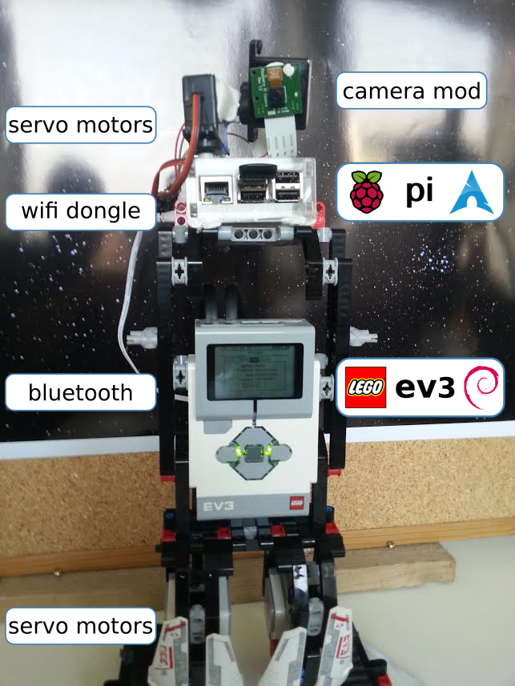
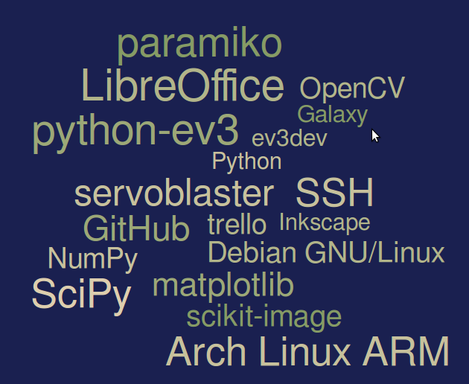
Meet Eve – our „Macroscope“

Slide 6
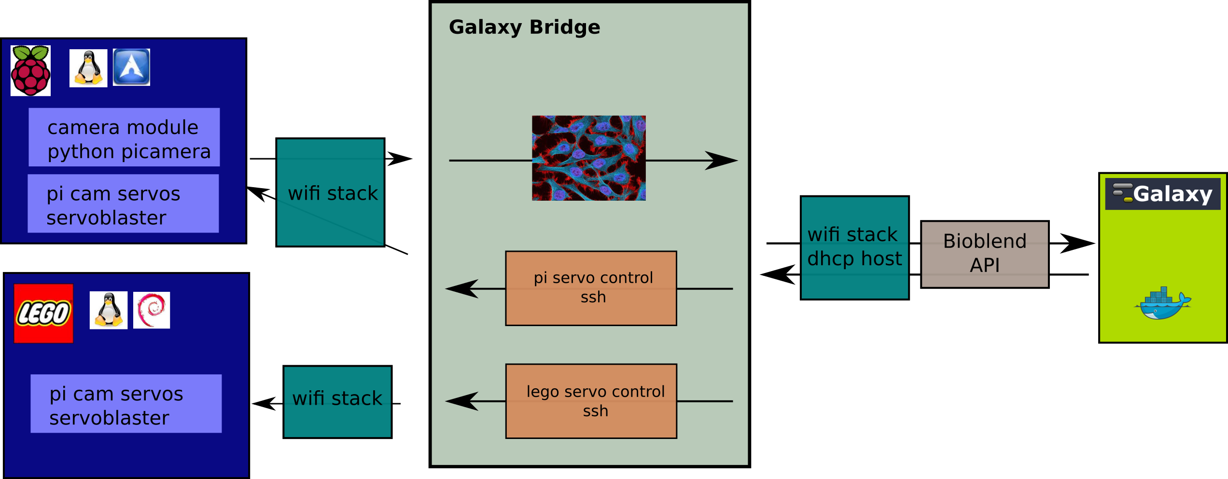

github.com/bgruening/hackathonfr

