Slide 1
Analyze more, process less:
Galaxy in Freiburg
September 2016 – Anika Erxleben – Freiburg Galaxy Team

Slide 2
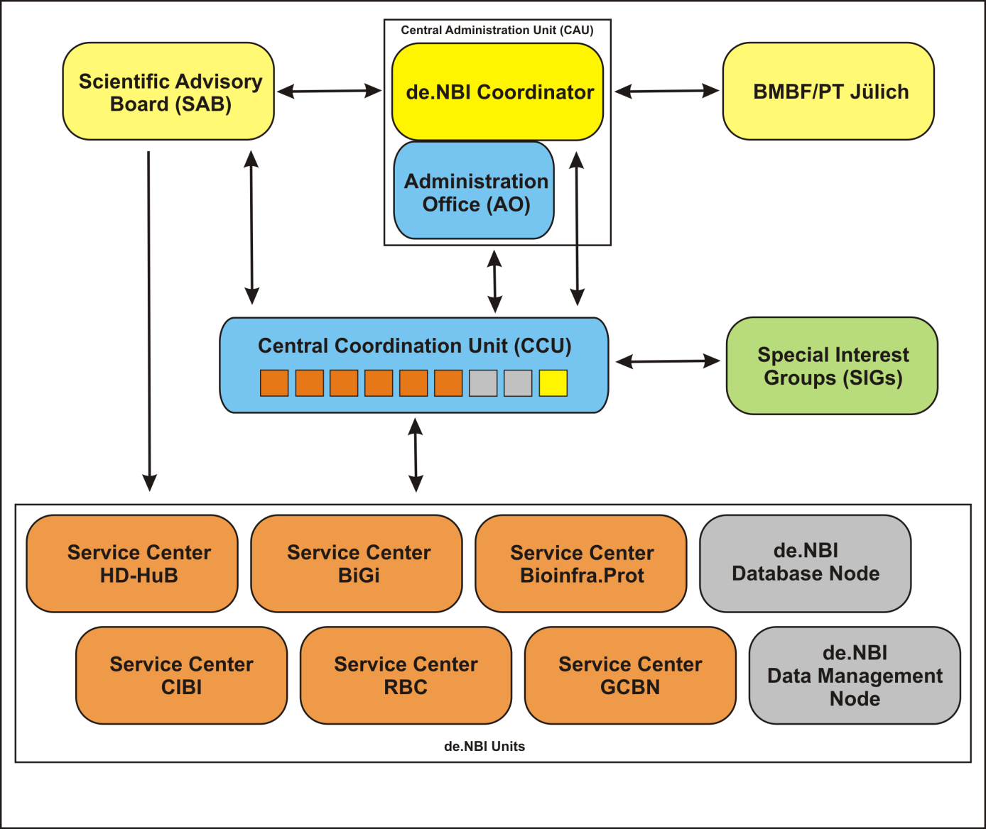
Who?
We are part of the German Network for Bioinformatics Infrastructure (de.NBI) & ELIXIR

Slide 3
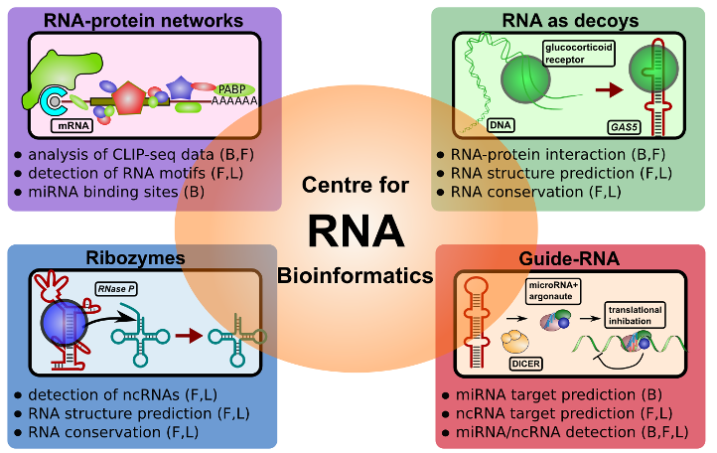
RBC – RNA Bioinformatics Center

Slide 4
What do we offer
Reproducible one-click ready-to-use pipelines
Easy access to data, tools and protocols
Easy deployment of tools and protocols
Data integration and management +SRA, Genbank upload, UniProt, …
Data visualization
Training!
Compute resources

Slide 5

What is
?

Slide 6
An analysis and data integration platform
A workflow management system
Open source, community driven software that makes integration of your favourite tools simple
http://galaxyproject.org

Slide 7
Our Aim
“Enable accessible, reproducible, and transparent computational research.”

Slide 8
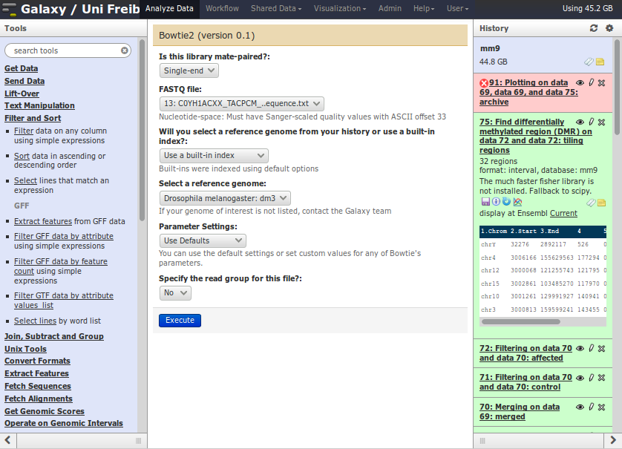
accessible – web interface

Slide 9
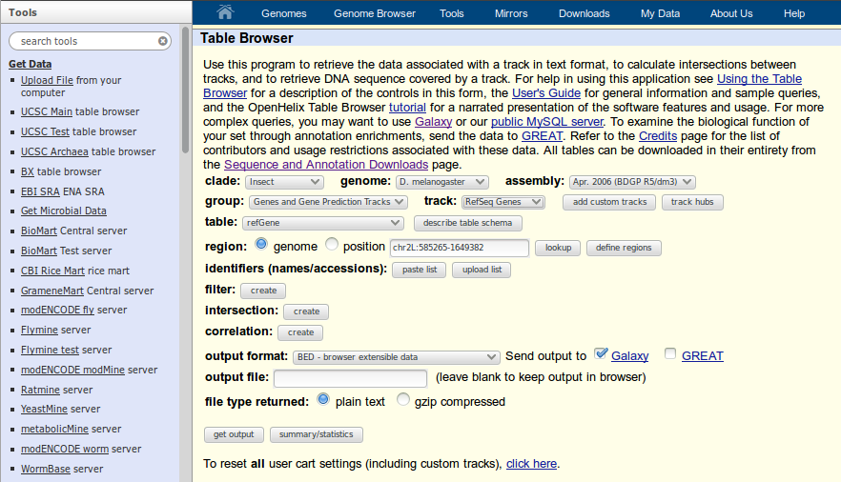
accessible – get your data

Slide 10
“Enable accessible, reproducible, and transparent computational research.”

Slide 11
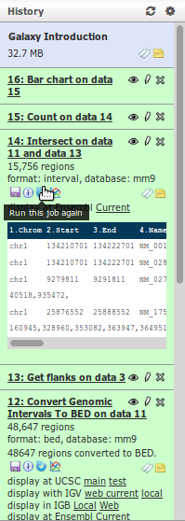
reproducible – reload experiments

Slide 12
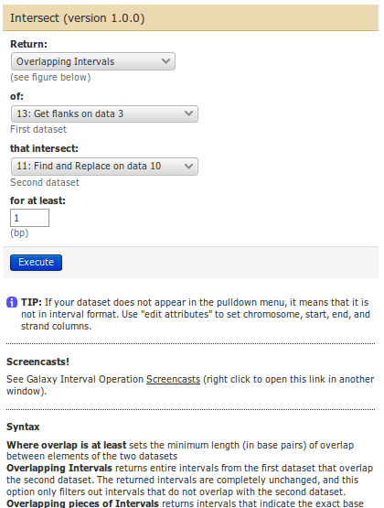
reproducible – reload experiments

Slide 13


reproducible – tools versioning

Slide 14
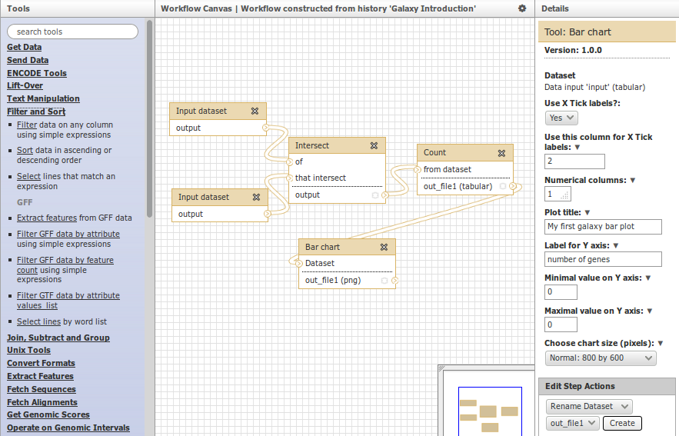
reproducible - workflows

Slide 15
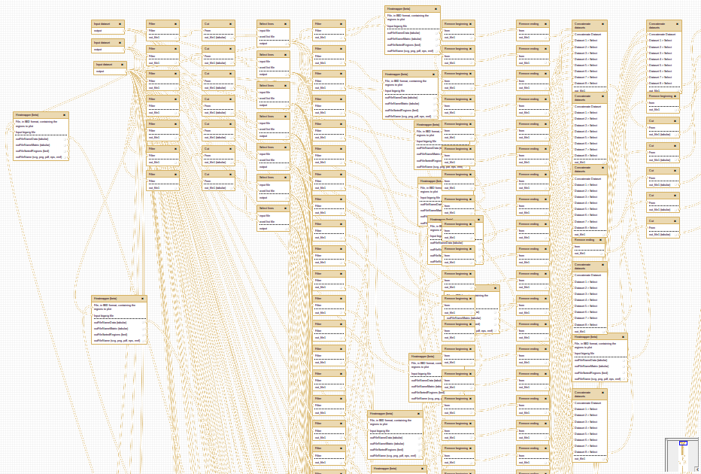
reproducible - workflows

Slide 16
“Enable accessible, reproducible, and transparent computational research.”

Slide 17
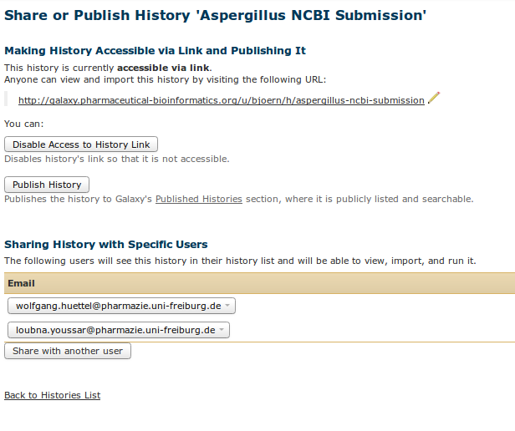
transparent – sharing everything

Slide 18
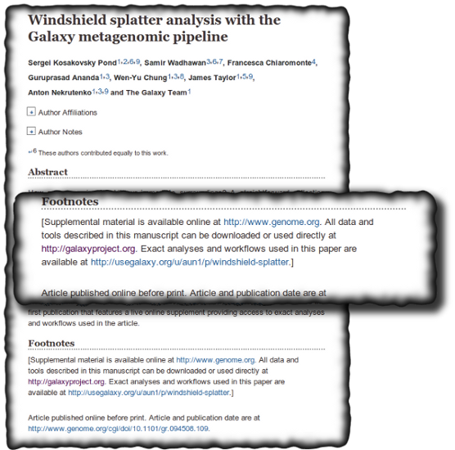
transparent – for other researchers

Slide 19
“Enable accessible, reproducible, and transparent computational research.”

Slide 20
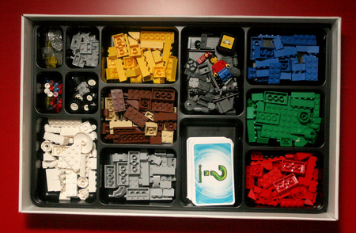
Tools, tools, tools

Slide 21
Freiburg Galaxy instance
RNA-seq
ChIP-seq
MethylC-seq
Exome-seq
Genome annotation
Metagenomics
Proteomics
… and more

Slide 22
>2000 tools
Text manipulation
Format converters
Filtering and sorting
Join, substract, group
Unix tools
Alignment tools
Mapping
Statistics
Plotting
EMBOSS
WES/WGAS
NCBI Blast+
Blast2GO
DAVID
ChemicalToolBoX
… and many more

Slide 23
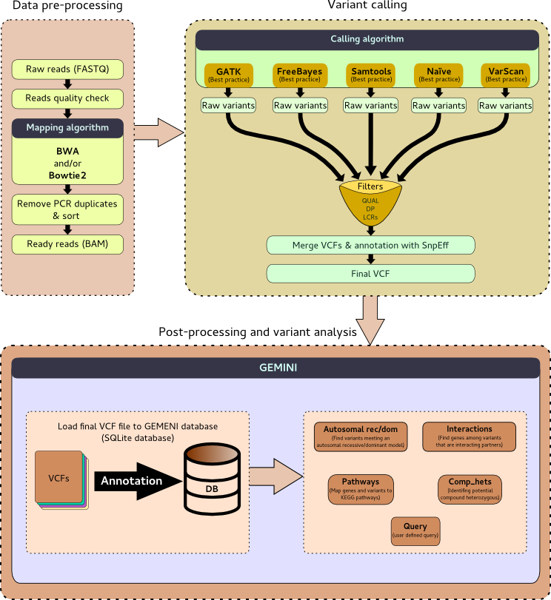
genVAST variant calling (SNPs)
Pipeline for exome-seq data analysis
Uniklinikum Freiburg

Slide 24
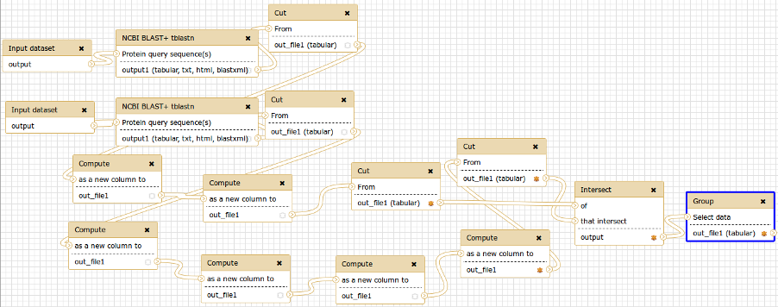
BLAST+ and genome annotation

Slide 25
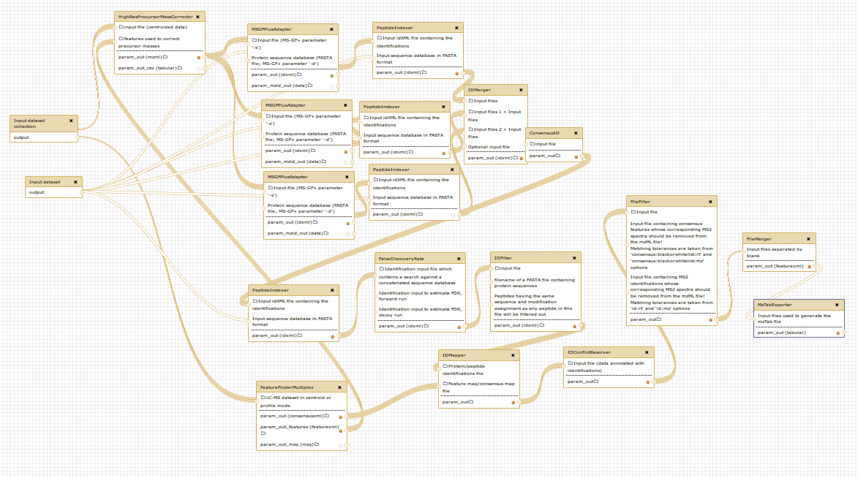
Proteomics
OpenMS workflow, Melanie Föll, AG Schilling

Slide 26
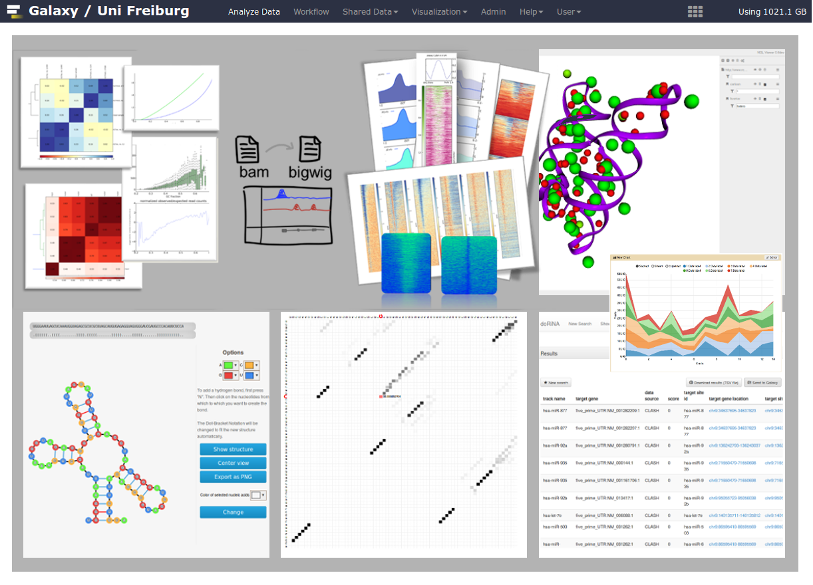
visualization – show your results

Slide 27
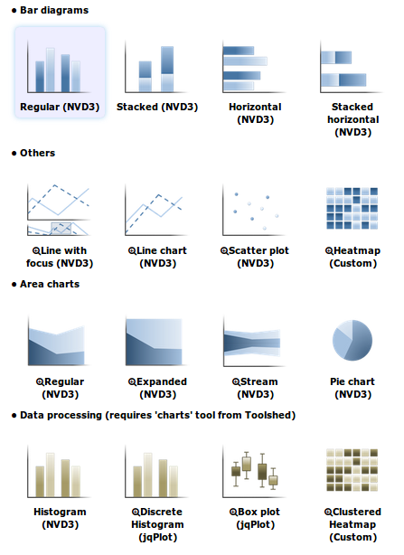
visualization - charts

Slide 28
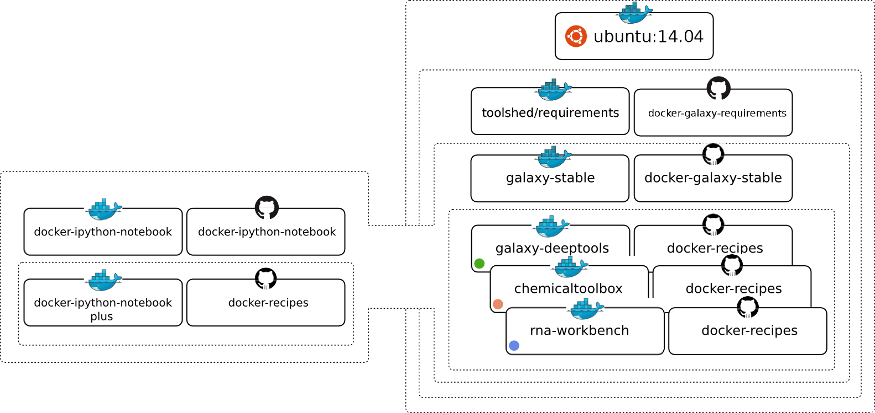
Virtualized Galaxy flavours
https://www.docker.io

Slide 29
Freiburg Galaxy stats
360 registered users
48 different groups
~1000 different tools
110,000 jobs per year
10 workshops with ~240 participants

Slide 30
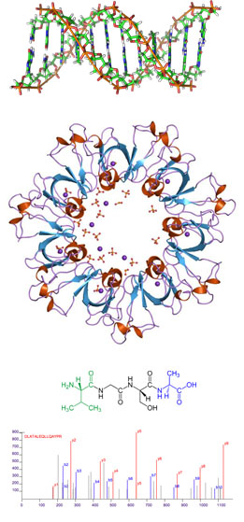
It's there!
Genomics
Proteomics
Metabolomics
Imaging, literature sciences, engineering, …

Slide 31

Training!
Galaxy HTS data analysis workshops
Developers day & international workshops
GTN (Galaxy Training Networks)
iPython for teaching
Galaxy for lecturing
Training material, protocols & slides online on github! https://github.com/bgruening/trainings-material
Galaxy interactive tours
https://wiki.galaxyproject.org/Community/GalaxyAdmins

Slide 32
Community is the key
~2900 publications since 2010, 1600 articles from 2015-2016
75 known public instances
https://biostar.usegalaxy.org (2016: 4600 active users)
~1200 registered developers (galaxy-dev mailing list
~400 mails per month
Annual international community conference
2 positions for community-related questions

Slide 33
Thank you!
Freiburg Galaxy Team
Dr. Björn Grüning
Dr. Torsten Houwaart
Dr. Berenice Batut
Clemens Blank
Joachim Wolff
Prof. Rolf Backofen
galaxy@informatik.uni-freiburg.de
http://www.bioinf.uni-freiburg.de

