Slide 1




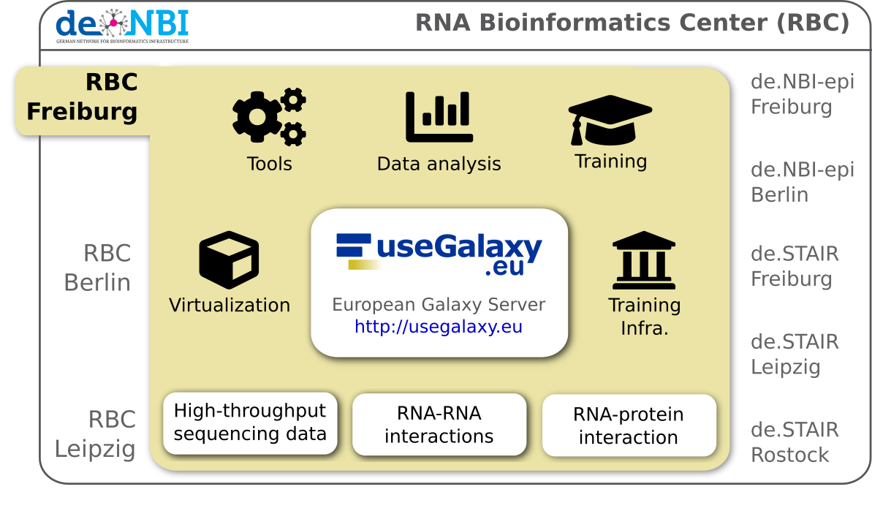
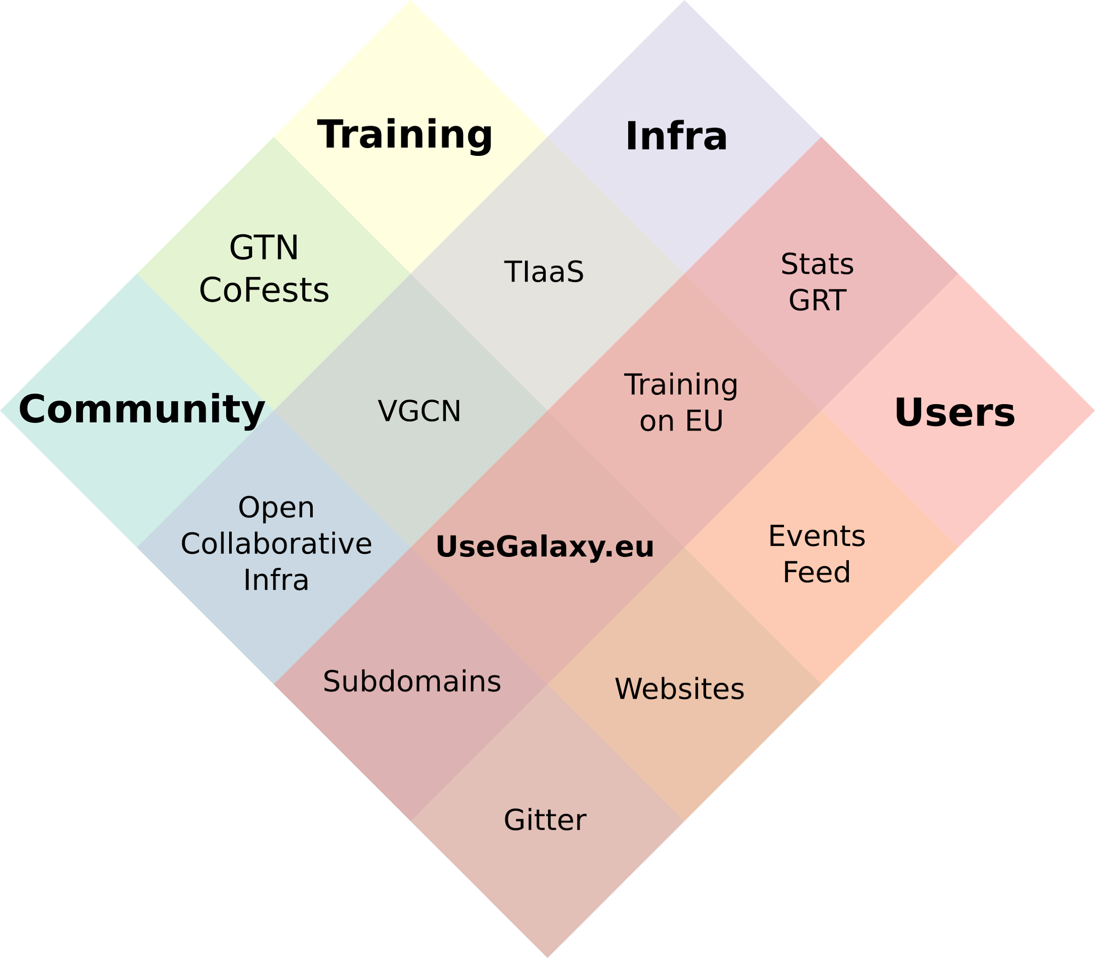

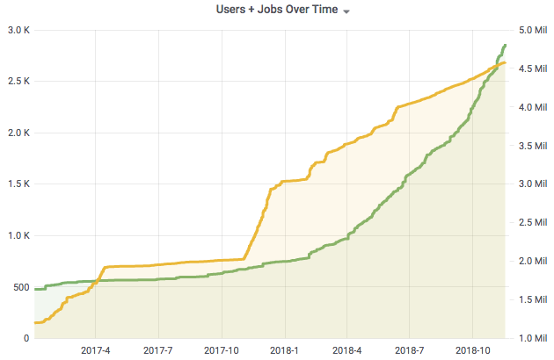


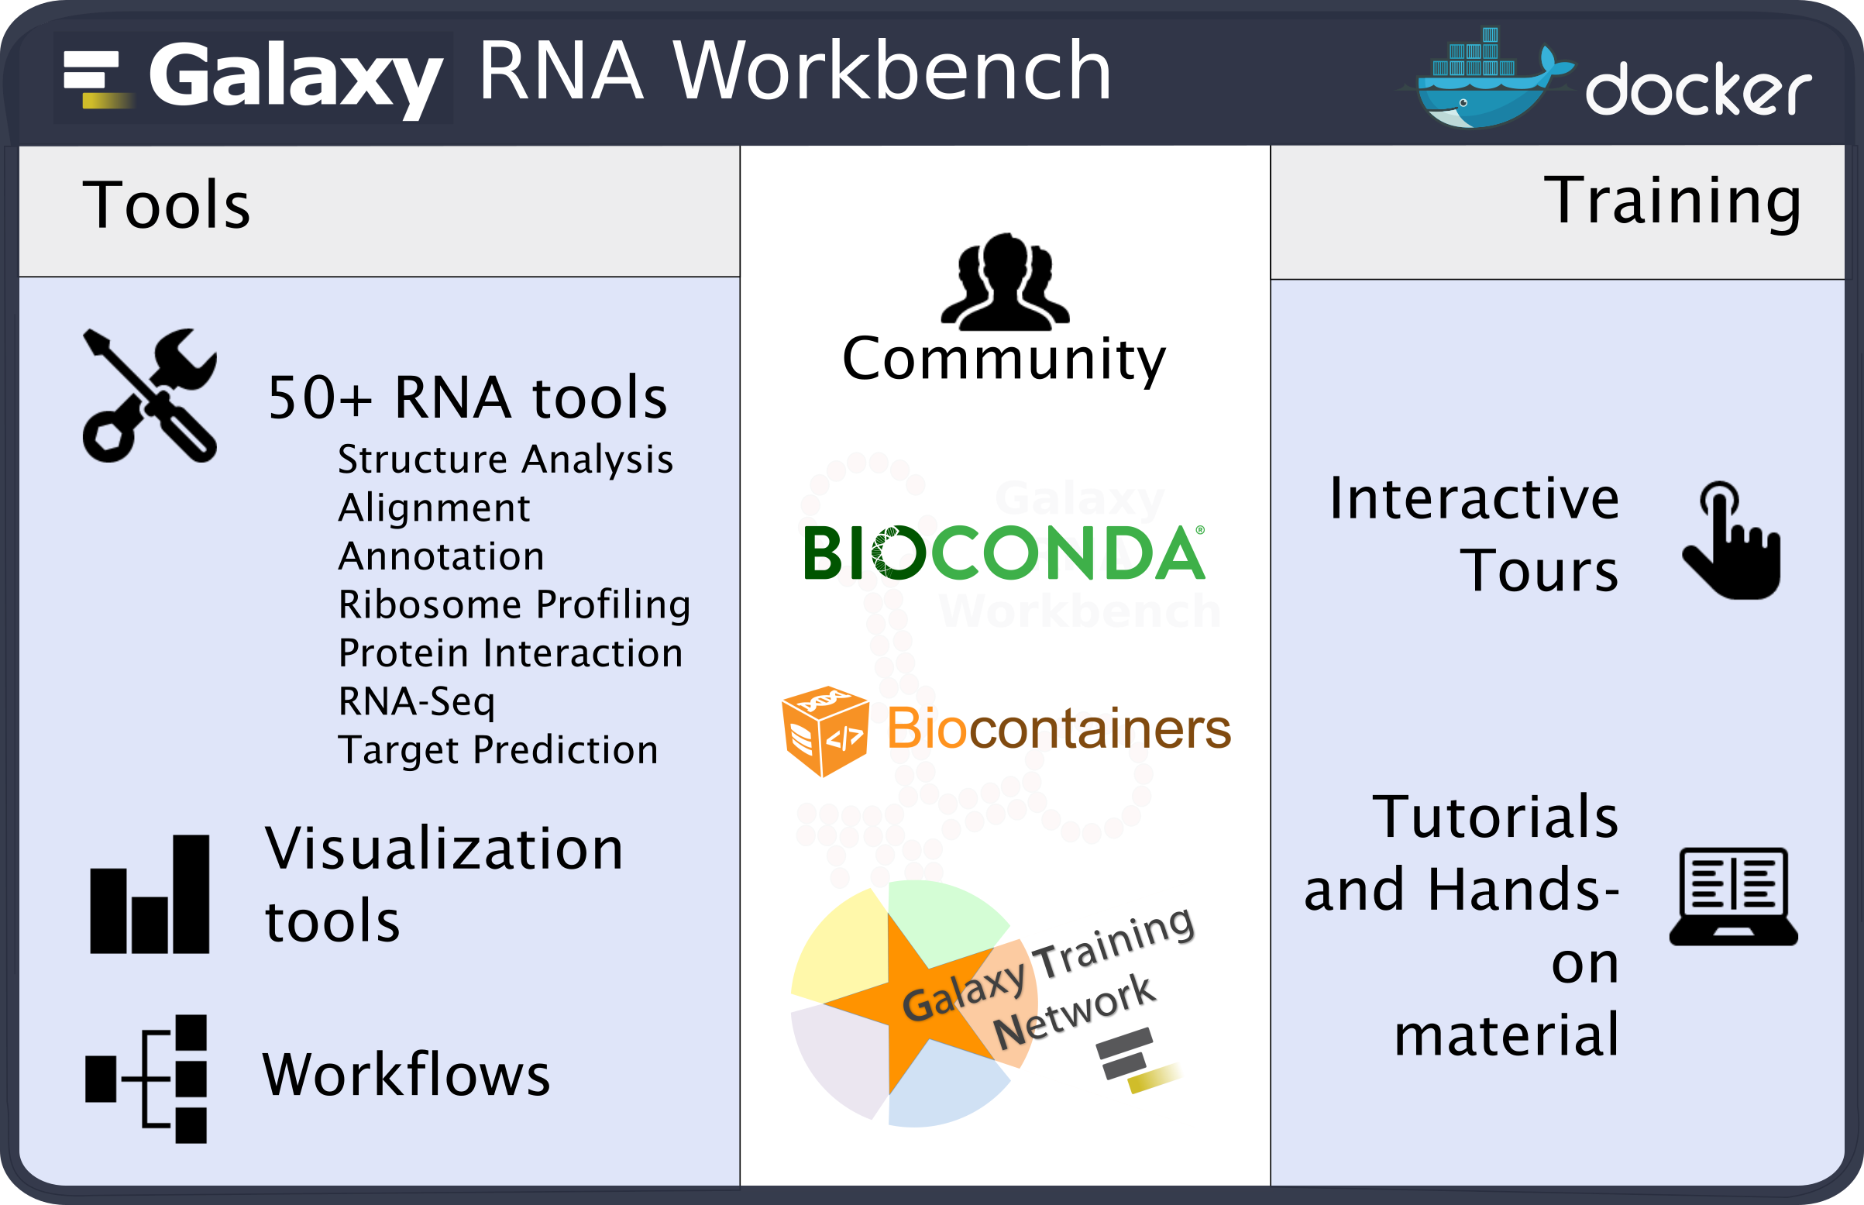



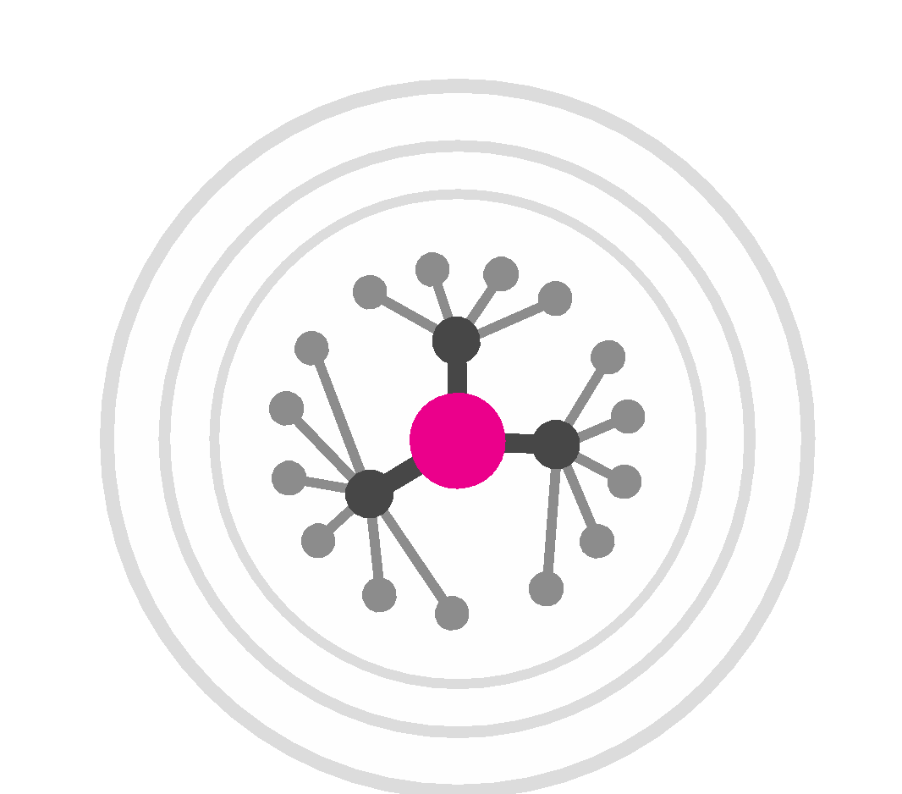
RBC-FR
RNA Bioinformatics Center
Freiburg Galaxy Team
Fkz 031A538A
Bérénice Batut, Anika Erxleben, Björn Grüning, Helena Rasche, Wolfgang Maier, Rolf Backofen
Chair of Bioinformatics, University of Freiburg, Germany
RBC Freiburg
Progress report
Services
Opening of the Freiburg Galaxy Server to all European
researchers, a huge step for open, accessible and reproducible research in Germany and Europe!
Launch of the ELIXIR Galaxy community
Publication of the Bioconda manuscript in Nature Methods Recognition of Biocontainers as one pillar of the ELIXIR tools
Expansion of de.NBI Cloud FR to 3.5k cores, 15TB RAM
Major events
Galaxy User Conference (15.-16.03.18), Freiburg
>120 participants. 3 continents
European Galaxy Days (19.-20.11.18), Freiburg
>40 participants, 2 continents
Galaxy Community Conference (1.-6.07.19), Freiburg
>200 participants expected, 5 continents
Training (2017-2018)
>40 training events
>1,500 trainees
Services
The European
Galaxy Server
3,000 users
2,000 tools
Training
Workshops and mentoring
Twice per year a full-week hands-on
high-throughput sequencing data
analysis workshop
Training around the world on demand
for data analysis, developers and administrators
On-site mentoring
HTS lectures and Galaxy courses for Master students
Online training material
Main contributors of Galaxy training material
https://training.galaxyproject.org
Freely accessible online material designed for both
self-training and workshops
>100 tutorials with hands-on and/or slides
Training Infrastructure-as-a-Service (TIaaS)
Dedicated compute resources for providing a Galaxy training
In past 6 months: >500 trainees, 21 events, 4 continents
Our flagship service is our Galaxy server (https://usegalaxy.eu) which is the biggest Galaxy instance in Europe, and one of the biggest worldwide, powered by de.NBI cloud and GDPR compliant.
Virtualization
RBC Freiburg is actively involved in making software user- accessible and cloud-ready. We joined and are leading the Bioconda and Biocontainers communities, to fix the software deployment problem once and for all.
We also developed Galaxy Docker, a production-ready, scalable Galaxy instance with customized tool sets. We provide the RNA-workbench flavour for all RNA related research.
Publications
Afgan, E. et al. (2018) The Galaxy platform for accessible, reproducible and collaborative biomedical analyses: 2018 update. Nucleic Acids Research, 46.
Batut,B. et al. (2018) Community-Driven Data Analysis Training for Biology. Cell Systems, 6, 752–758.e1.
Grüning, B. et al. (2018) Bioconda: sustainable and comprehensive software distribution for the life sciences. Nature Methods, 15, 475–476.
Grüning, B. et al. (2018) Practical Computational Reproducibility in the Life Sciences. Cell Systems, 6, 631–635.
Backofen,R. et al. (2017) RNA-bioinformatics: tools, services and databases for the analysis of RNA-based regulation. Journal of Biotechnology, 261, 76–84.
Batut,B. and Grüning,B. (2017) ENASearch: A Python library for interacting with ENA’s API. The Journal of Open Source Software, 2, 418.
Gruning, B.A. et al. (2017) Jupyter and Galaxy: Easing entry barriers into complex data analyses for biomedical researchers. PLoS Comput Biol, 13, e1005425.
Grüning, B. et al. (2017) The RNA workbench: best practices for RNA and high-throughput sequencing bioinformatics in Galaxy. Nucleic Acids Research, 45, W560–W566
Veiga Leprevost, F. da et al. (2017) BioContainers: an open-source and community-driven framework for software standardization. Bioinformatics, 33, 2580–2582.
General information on the project
3.0 staff paid from de.NBI grant + 1 cloud staff
+ 3.0 other staff involved
www.denbi.de

