Slide 1





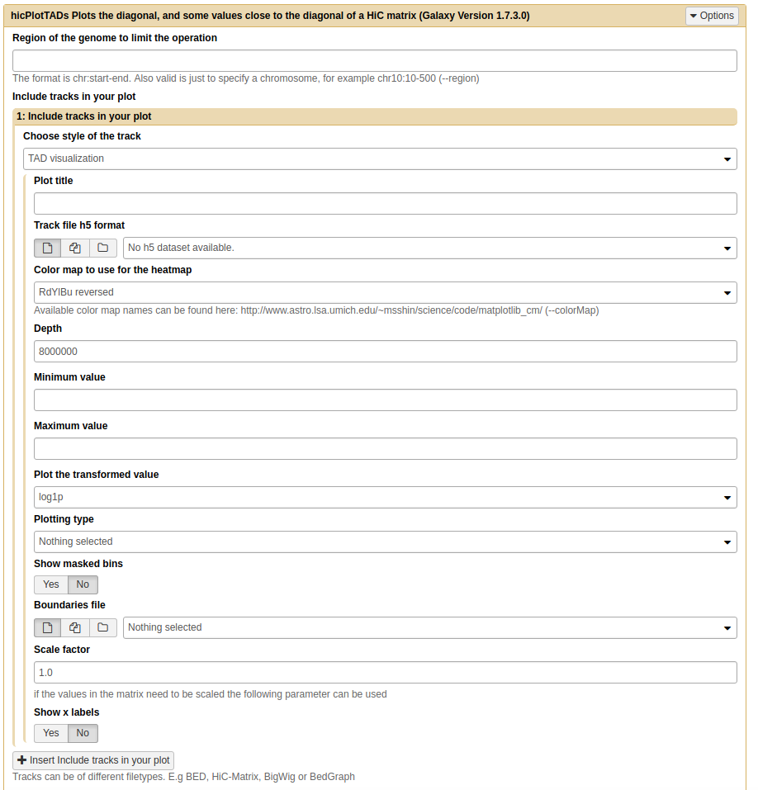
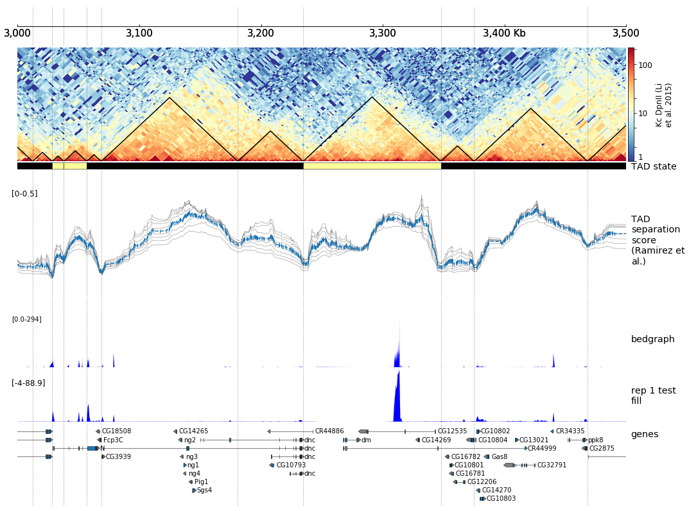



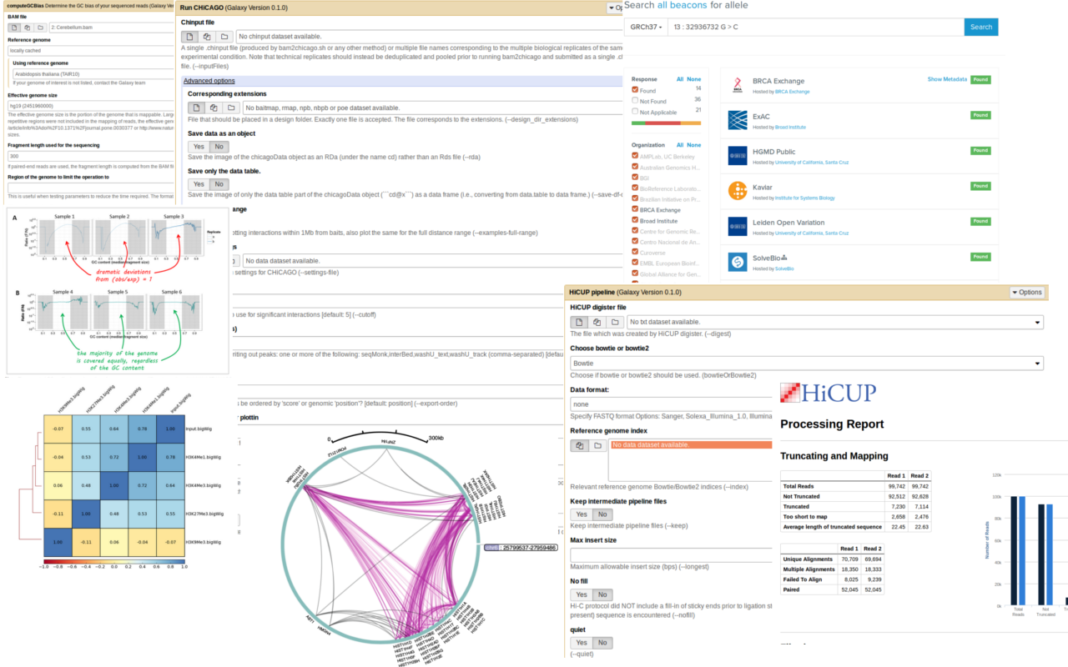
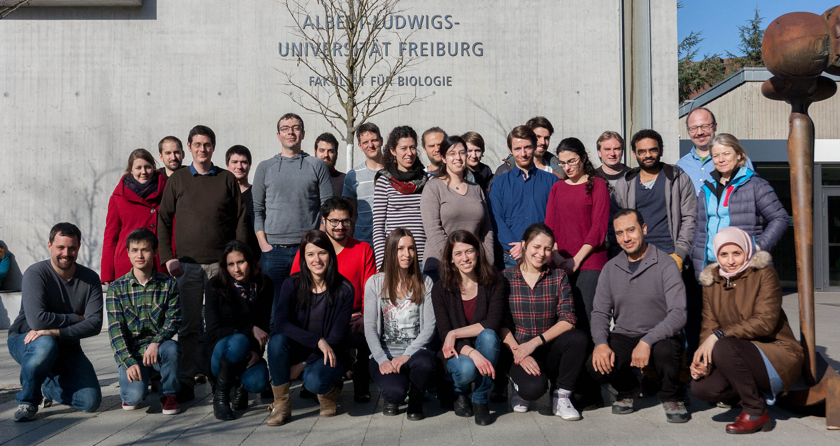
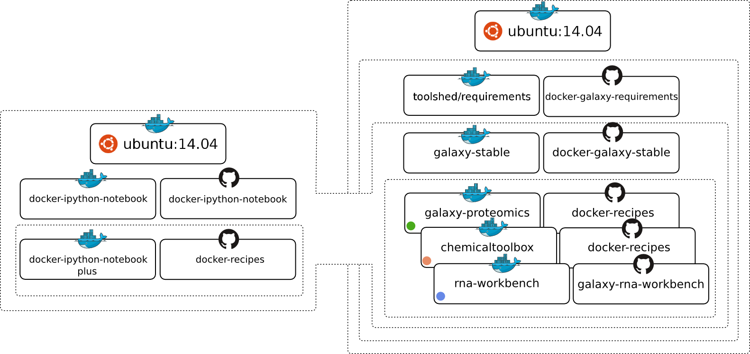






de.NBI − German Network for Bioinformatics Infrastructure
de.NBI-epi
RNA Bioinformatics Center
University of Freiburg
Chair of Bioinformatics
Björn Grüning, Joachim Wolff, Rolf Backofen
RNA Bioinformatics Center, University of Freiburg, Germany
Description of de.NBI-epi
de.NBI services
The de.NBI-epi project in Freiburg offers:
Visualisation, normalisation and quality assessment:
Hi-C data analysis
Methyl-Seq data analysis
ChIP-seq
bisulfite sequencing analysis pipelines
Training and user support:
Galaxy HTS data analysis workshops
Self learning material on training.galaxyproject.org
Direct user support via github
Available on:
an easy to use computing cluster: galaxy.uni-freiburg.de
your computer with conda and docker
Development and maintenance of software for Hi-C data analysis
HiCExplorer:
Interaction matrix creation 3x faster
Improved training material: hicexplorer.readthedocs.io
New Galaxy wrappers for a better user experience
Docker integration
Release 2.0 will have:
Python 3 support
‘Cool’ format support
A/B compartments
Improved visualizations
Maintenance and integration of software into Galaxy to provide easy access for epigenetic analysis software:
deepTools
Bismark
HiCUP
CHiCAGO
Methyldackel
Methtools
HiCExplorer
Community based infrastructure
BioConda is a conda channel which
provides software for biomedical research.
14,475 commits on GitHub
287 contributors
> 2,700 packages
BioContainers provides system-agnostic executable environments for bioinformatics software.
Based on Docker & rkt
> 1,800 Images
Automatic builds from BioConda
Galaxy is an open, web-based platform for data intensive research.
29,588 commits
163 contributors
One of the biggest
Galaxy instances
available for de.NBI
de.NBI training and education
The Galaxy Docker Project
The Galaxy Docker Image is an easy distributable full-fledged Galaxy installation, that can be used for testing, teaching and presenting new tools and features.
Portable data analysis in a box!
Hands-on training material for self-study available:
https://training.galaxyproject.org
Introduction to HTS
RNA-Seq
ChIP-Seq
Proteomics
MethylC-Seq
...and many more!
2016 / 2017 past events
15th – 16th Dec 2016 | Galaxy RNA-Seq analysis workshop | Freiburg
16th – 19th Jan 2017 | European Galaxy Developer workshop | Strasbourg
13th – 17th Feb 2017 | Galaxy HTS data analysis workshop | Freiburg
4th – 5th Apr 2017 | ELIXIR – de.NBI AAI workshop | Freiburg
14th – 18th Sep 2017 | Galaxy HTS data analysis workshop | Freiburg
2017 / 2018 planned events
https://github.com/bgruening/docker-galaxy-epigenetic
Publications
High-resolution TADs reveal DNA sequences underlying genome organization in flies.
doi: 10.1101/115063
Jupyter and Galaxy: Easing entry barriers into complex data analyses for biomedical researchers.
doi: 10.1371/journal.pcbi.1005425
The RNA workbench: best practices for RNA and high-throughput sequencing bioinformatics in Galaxy
doi: 10.1093/nar/gkx409
Global Organisation for Bioinformatics Learning, Education & Training
Förderkennzeichen Nr. 031L0101C
http://www.denbi.de

