Slide 1



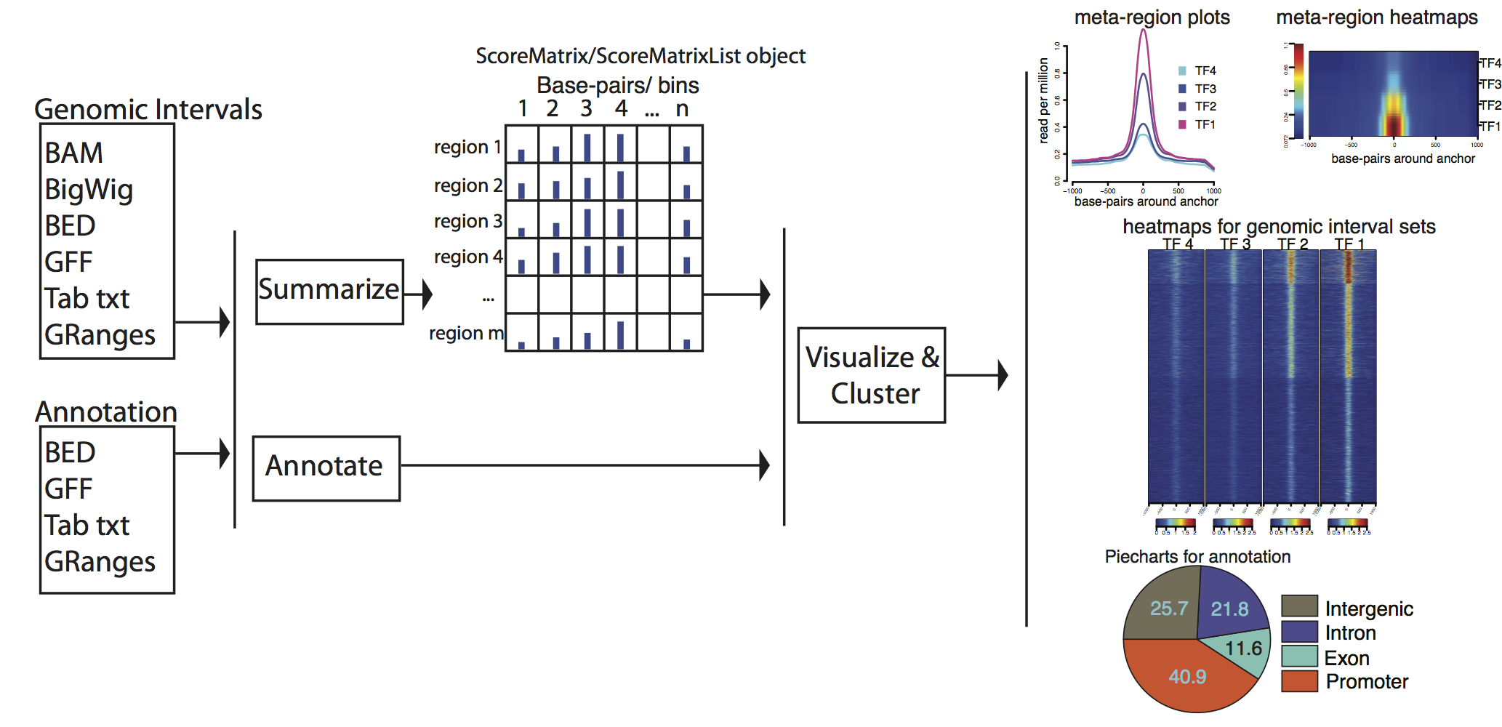






de.NBI − German Network for Bioinformatics Infrastructure
deNBI-epi:
BIMSB
deNBI epigenomics unit
The Berlin Institute for Medical Systems Biology
Altuna Akalin, Vedran Franke, Katarzyna Wreczycka, Alexander Godcshan, Uwe Ohler
The Berlin Institute for Medical Systems Biology, Max-Delbrueck Center for Molecular Medicine, Berlin, Germany
Short description of the project
de.NBI services
We offer tools, services and training for the epigenomics data analysis.
methylKit is a toolbox for analyzing methylation and hydroxymethylation profiles from BS-seq
Genomation is an R package that expedites genomic interval summary and annotation
Segmentation of genomics profiles – Unsupervised machine-learning methods for identification of genomic landmarks
Progress report
de. NBI training and education
Tasks performed up to October 2016
methylKit new features:
New statistical tests
Segmentation of methylomes
New flat-file data structures for large datasets
Genomation new features:
New annotation functions for data integration
Yearly computational genomics course in Berlin
90 applicants for 20 seats
Publications
Methylkit - Akalin et al. 2012. Genome Biology
Genomation – Akalin, Franke, et al. 2015. Bioinformatics
Offering weekly bioinformatics consultations at MDC
http://www.denbi.de

