Slide 1
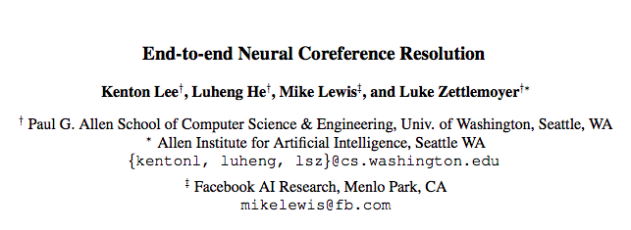

Slide 2
intro
1st end-to-end COREF model to outperform
No syntactic parser or mention-detector
All spans may be mentions, learn distributions
Context embeddings with head-finding attention mechanisms
Maximize antecedent from coref clusters
Aggressive prunning

Slide 3
Task
Set of decisions for each span i:
1 <= Start(i) <= End(i) <= N = T(T+1) / 2
Y(i) = {eps, 1, . . . , i − 1}
Eps:
Not a mention
Mention but not coref with antecedent
Defines final clustering

Slide 4
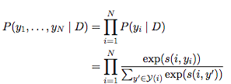

model
CPD for correct clustering
S(i,j) = score for spans i,j
(1) span i is a mention ?
(2) span j is a mention ?
(3) j is an antecedent of i ?
Sm(i) = unary score for mention
Sa(i,j) = score for j antecedent of I Problem?

Slide 5
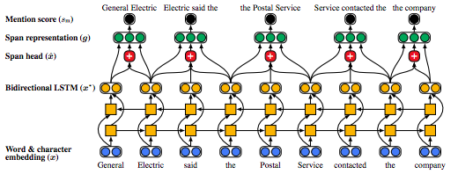
Architecture 1: Mention
Span representation and mention score
Prune low scores
Maximum width
Sm(i) = Wm · FFNNm(gi)

Slide 6
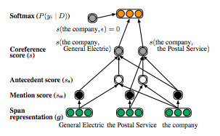
Architecture 2: antecedent
Correference score = sum
Sa(i, j) = Wa · FFNNa([gi , gj , gi ◦ gj , φ(i, j)])
Element-wise similarity
Feature vector
Speaker and genre info
Distance between spans

Slide 7
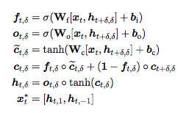
Span representation
Internal structure of span
Surrounding context
Attention mechanism to model head words
Pre-trained embeddings and 1-D CNN over chars
Concatenated output
Independent LSTM, cross-sentence not helpful

Slide 8
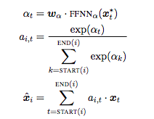


attention
Learn headedness
$\hat{x}i$ is a weighted sum of word vectors
The weights a_{i,t} are automatically learned
Correlates with traditional definition
Boundary representation (QA)
Head word vector + size of span

Slide 9

learning
Optimize marginal log-likelyhood by gold clustering
GOLD(i) is the set of spans in the gold cluster containing span i.
GOLD(i) = {eps} if all antecedents have been pruned
Random initial pruning, only gold mentions positive
Noise prevention
Single gold antecedent pruned
Non-gold antecedents lower
Cant dummy antecedent higher

Slide 10
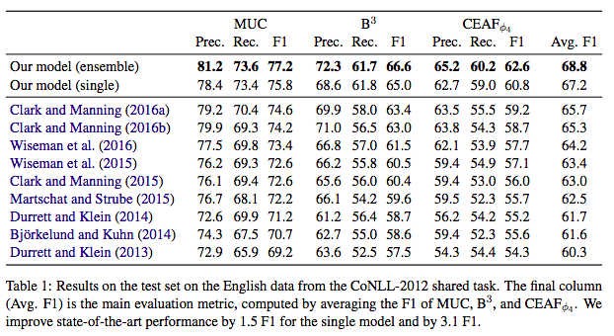
results

