Slide 2
boreholeEvent

Slide 3
TrajectoryReferent
boreholeEventLocation

Slide 4
TrajectoryReferent
BoreholeTrajectory
boreholeEventLocation

Slide 5
BhML flavoured ISO 19148 figure 1 to 4 (vertically)
Start
Start
R
R
distanceAlong
distanceAlong
distanceAlong
A
A
B
End
End

Slide 6
The collection defines its start and TrajectoryReferent

Slide 7
The TrajectoryReferent makes the connection between the local reference system (linear referencing) and the 3D geometry one

Slide 8
Within this linear referencing system, events locate Features at a given BoreholeEventLocation (at, fromMeasure/toMeasure, fromEvent/toEvent

Slide 9
Applied to geological log
Geometry or
Feature (URI) for complete description
Reference
TrajectoryReferent
Reference
Geometry or
Feature (URI) for complete description
BoreholeTrajectory
boreholeEvent
locatedFeature (URI)
Feature for
complete
description
boreholeEventLocation
(from/to)

Slide 10
Applied to geological log
Reference
THE BoreholeCollar (GWML2) description
or the WellHead (WITSML)
TrajectoryReferent
BoreholeTrajectory
Reference
the Borehole Geometry
boreholeEvent
locatedFeature (URI)
logResultElement
(ex : the earth
Material observed)
boreholeEventLocation
(from/to)
logResultElement

Slide 11
Applied to geological log
Reference
THE BoreholeCollar description
TrajectoryReferent
BoreholeTrajectory
Reference
the Borehole Geometry
1
boreholeEvent 2
3
4
5
6
7
8
A Log
(a BoreholeEventCollection)
…

Slide 12
Applied to Sample
Reference
THE BoreholeCollar (GWML2) description
or the WellHead (WITSML)
TrajectoryReferent
BoreholeTrajectory
Reference
the Borehole Geometry
boreholeEvent
locatedFeature (URI)
Sample (O&M)
taken at that
depth
boreholeEventLocation
(at Depth)
Sample

Slide 13
Applied to trajectory observation
Reference
THE BoreholeCollar description
TrajectoryReferent
BoreholeTrajectory
Reference
the Borehole Geometry
boreholeEvent
locatedFeature (URI)
boreholeEventLocation
(at Depth)
OM_Observation (O&M)
-> x,y,z values
+procedure: observed by
a ‘sensor’ or calculated by
an algotithm

Slide 14
Applied to trajectory observation
Reference
THE BoreholeCollar description
TrajectoryReferent
BoreholeTrajectory
Reference
the Borehole Geometry
A computed borehole trajectory
(a BoreholeEventCollection)
boreholeEvent

Slide 15
All the following slides are kept to keep memory of our discussions
They corresponds to the structure before revision 11

Slide 16
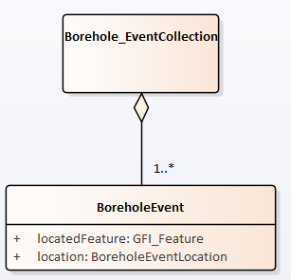
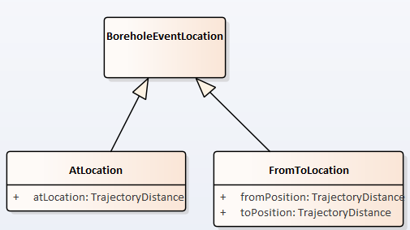
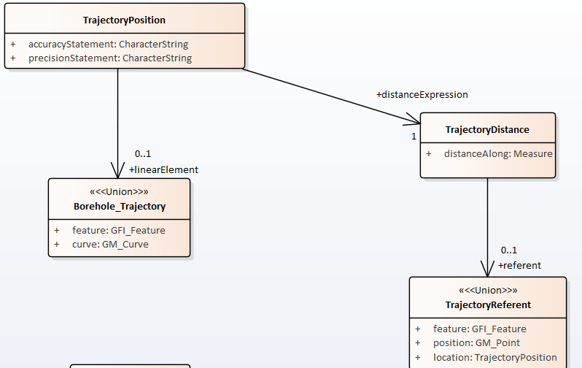
rev:10 model
1
2
3

Slide 17
rev:10 model
4
5

