Slide 1
Borehole
Borehole-Segment
Sample
Well
Logs
logResultElement
Borehole
Drilling details
On borehole
Borehole
Construction
Observations
Borehole
constructionElement
Reference(s) Z / origin
On sample
On monitoring facility
BoreholeTrajectory – how to position stuff down the hole
Borehole « context »: administrative
Borehole « context »: platform
Georesource

Slide 2
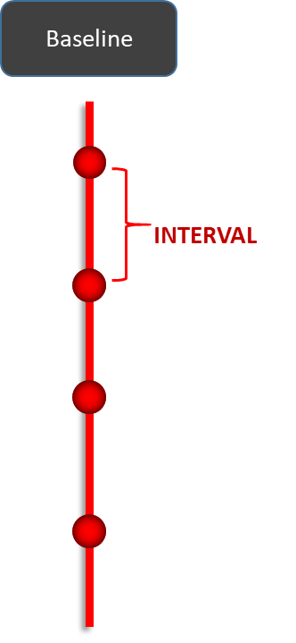
Borehole
Needs disambiguation
Well
« Baseline » is a
temporary word
geometry
BoreholeTrajectory

Slide 3
? <<FeatureType>> ? Baseline
Borehole
constructionElement: ?bhConstruction?
URI, type
INTERVAL
URI, type
<<FeatureTypes>>
connectionFeature
logResultElement:Observation
Pos°
(pk VS from/to)
Borehole-Segment:samplingFeature

Slide 4
Focus on logs
? <<FeatureType>> ? Baseline
URI, type
connectionFeature
logResultElement:Observation
INTERVAL
URI, type
connectionFeature
logResultElement:Observation
INTERVAL
URI, type
connectionFeature
logResultElement:Observation
INTERVAL
Pos°
(pk VS from/to)

Slide 5
Focus on logs
? <<FeatureType>> ? Baseline
URI, type
connectionFeature
logResultElement:Observation
INTERVAL
URI, type
connectionFeature
logResultElement:Observation
Log 1
INTERVAL
URI, type
connectionFeature
logResultElement:Observation
INTERVAL
Pos°
(pk VS from/to)

Slide 6
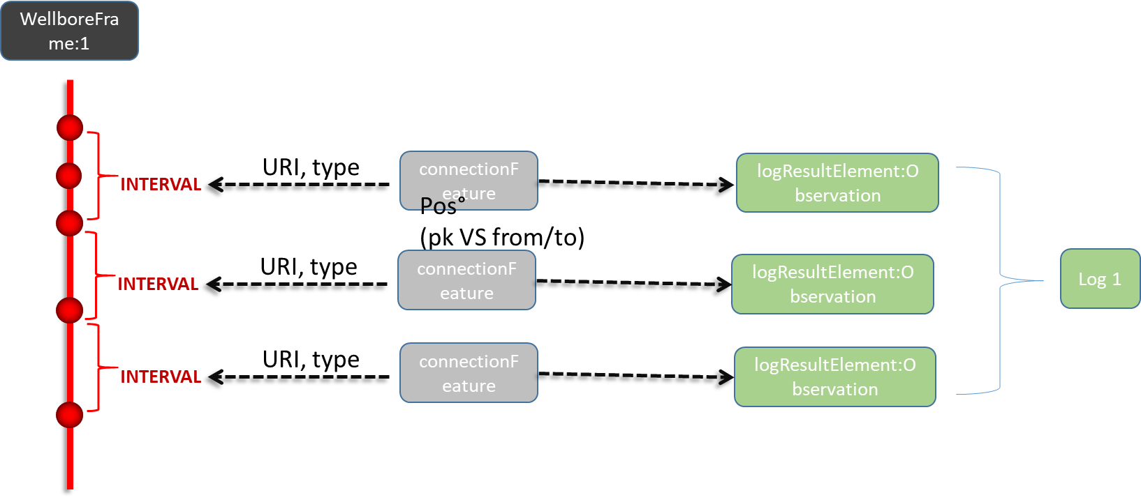
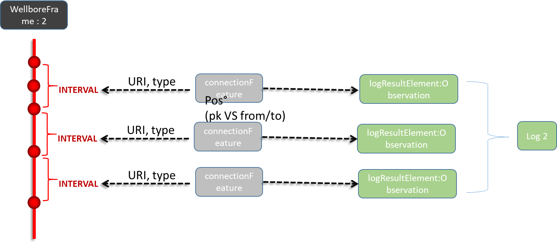
Focus on logs: WellboreFrame approach

Slide 7
1D local ? engineering?
Coord System
-> check ISO 19107
-> check ISO 19148
3D
constructionElement: ?bhConstruction?
Borehole
Trajectory
geometry
1D:LinearRef
URI, type
Baseline
URI, type
connectionFeature
logResultElement:Observation
Pos°
(pk VS from/to)
Borehole-Segment:samplingFeature
INTERVAL

Slide 8
Open questions
Refine BaseLine model
1D local ?engineering? / Coord System / -> check ISO 19107 terms
+ ISO 19148 terminology
Is the baseline a FeatureType ? a SRS ?
=> do we really need to create a specific concept or aren’t the Trajectory, ISO 19148 method and the ‘connected’ object sufficient ?
Topology needed ?
read “with its own constraints” = if you move a node then it has impacts...
can node can have properties ?
Bi-directionnality ?
Elements connected to the baseline know it.
BUT, should the baseline know all points and intervals that are attached to it ?
Look at NrCan 1998 contribution (https://geoscan.nrcan.gc.ca/starweb/geoscan/servlet.starweb?path=geoscan/fulle.web&search1=R=209958)
Baseline VS Trajectory
How when non discrete data ?
All relations bi-directionnal ?
From Baseline to connectors? (is the baseline aware of all the things plugged to it ) ?
Open segmentation

