Slide 2
boreholeEvent

Slide 3
TrajectoryReferent
boreholeEventLocation

Slide 4
TrajectoryReferent
Borehole_Trajectory
boreholeEventLocation

Slide 5
BhML flavoured ISO 19148 figure 1 to 4 (vertically)
Start
Start
R
R
distanceAlong
distanceAlong
distanceAlong
A
A
B
End
End

Slide 6
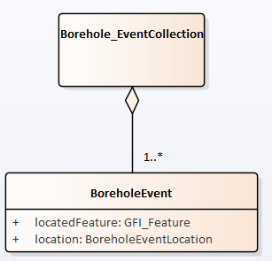
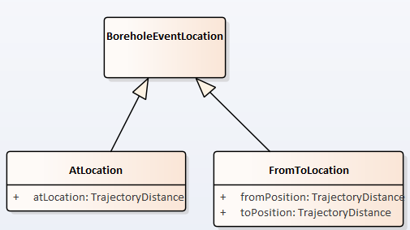
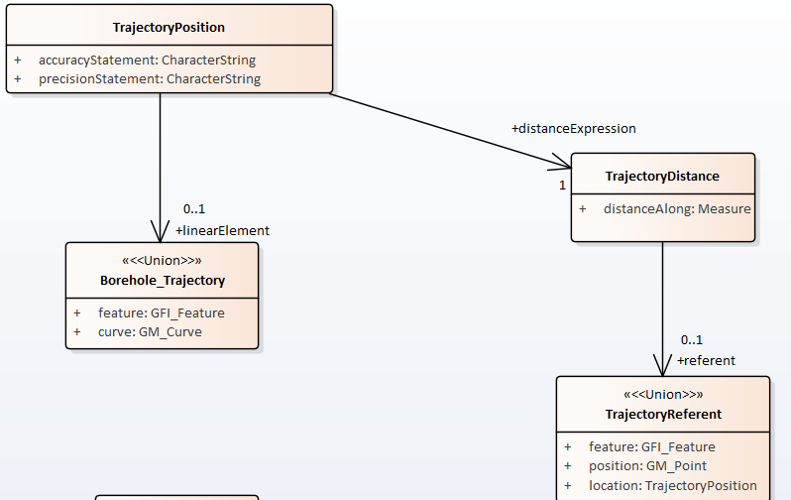
1
2
3

Slide 7
4
5

Slide 8
Applied to geological log
Geometry or
Feature (URI) for complete description
Reference
TrajectoryReferent
Reference
Geometry or
Feature (URI) for complete description
Borehole_Trajectory
boreholeEvent
locatedFeature (URI)
Feature for
complete
description
boreholeEventLocation
(from/to)

Slide 9
Applied to geological log
Reference
THE BoreholeCollar description
TrajectoryReferent
Borehole_Trajectory
Reference
the Borehole Geometry
boreholeEvent
locatedFeature (URI)
logResultElement
(ex : the earth
Material observed)
boreholeEventLocation
(from/to)

Slide 10
Applied to geological log
Reference
THE BoreholeCollar description
TrajectoryReferent
Borehole_Trajectory
Reference
the Borehole Geometry
1
boreholeEvent 2
3
4
5
6
7
8
A Log
(a BoreholeEventCollection)
…

Slide 11
Applied to Sample
Reference
THE BoreholeCollar description
TrajectoryReferent
Borehole_Trajectory
Reference
the Borehole Geometry
boreholeEvent
locatedFeature (URI)
Sample taken
at that depth
boreholeEventLocation
(at Depth)

