Slide 2




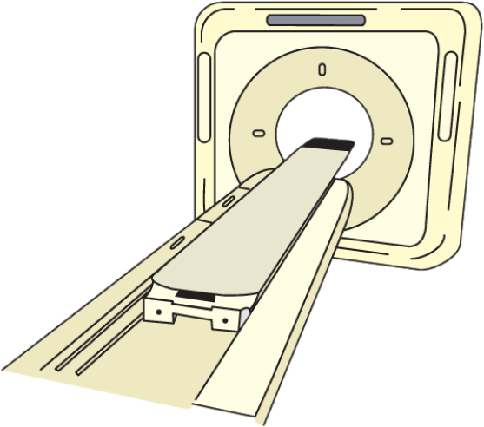


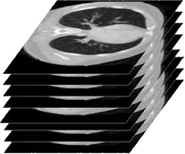
5
F
4
F
3
F
2
F
1
F
B
1
F

