Slide 1
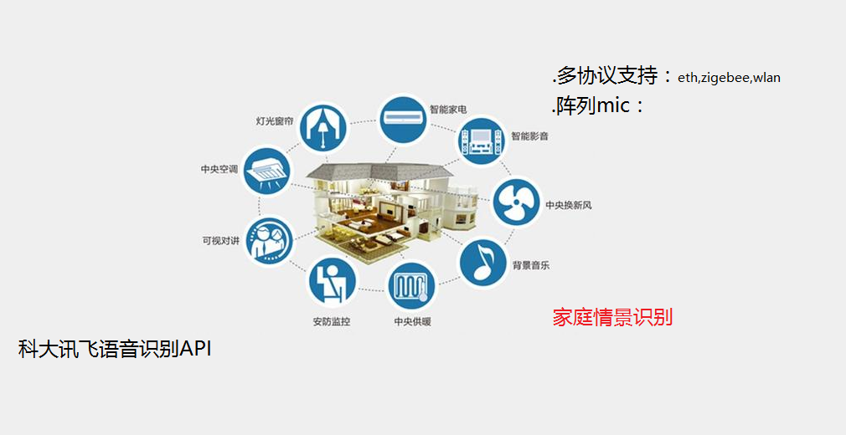
UlTIMATE AIM

Slide 2
Program
HOST:
------->Intel Edison
------->samsung 2440
------->Raspberry Pi
Purpose:
------->Handle Protocol of Link Devs
-------> Call Voice API of IFLYTEK CO.,LTD
-------> Smart Patch Control
-------> Users Interface

Slide 3
Program
Mic client:
Zigbee:TI CC2531 powered by 8051
Wifi: Samsung 2410+RLK3070/BCM
BT: CSR BC6130 powered by ARM
Marvell: EZ-Connect(FreeRTOS )(BT/Zigbee/Wifi)
TI : SimpleLink WiFi
Atmel: SmartConnect SAM W23 (BT)

Slide 4
Knowledge Needed
. Programming Language
>ASM/c/c++/java/(python)/Makefile
. Protocol
>Zigbee/BT/Wifi

