Slide 1
ANSYS Macro Mania
Benjamin Guest

Slide 2
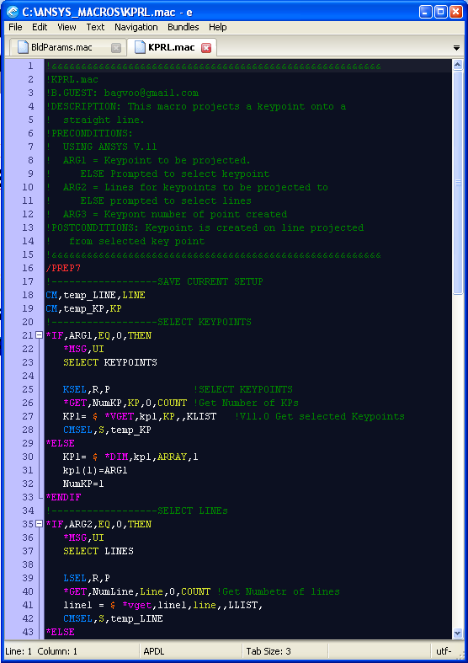
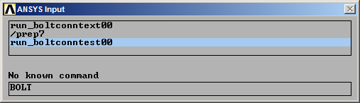
What Are ANSYS Macros?
A text file containing a series of ANSYS command
File ends with .mac
Similar to existing ANSYS batch files you might use using “/input,<somefile>,txt”
Can be called from
ANSYS command line
a batch file
Another macro.
Called using just the macro name w/o the .mac (See below)

Slide 3
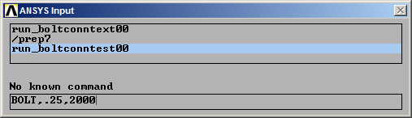
What Are ANSYS Macros
Macros can include arguments to add functionality to the macro
For Example: in the BOLT macro below
Argument 1 specifies a .25” bolt diameter
Argument 2 specifies a bolt preload of 2000 lbf

Slide 4
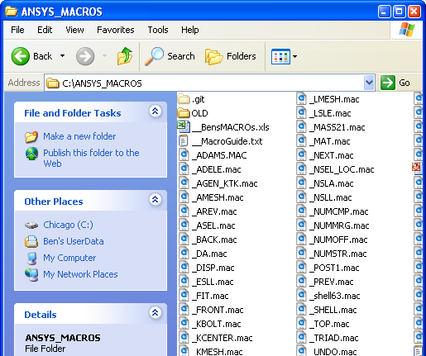
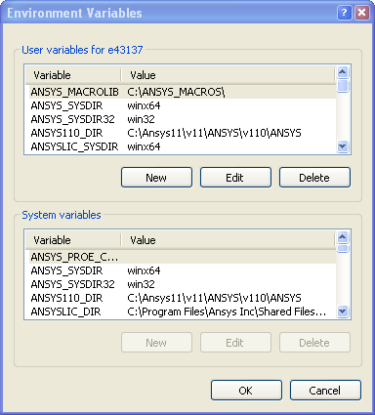
How to set up computer for Macros
Create a folder for your macros
Create ANSYS_MACROLIB environmental variable with the path of your macro
You can reference several macro directories, see ANSYS help files

Slide 5
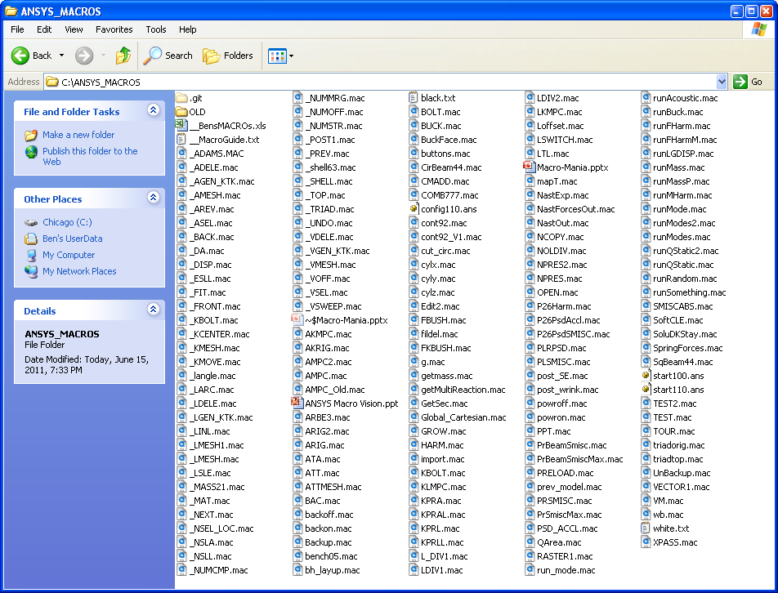
Macro Mania – Current Macros
There are a lot of macros…

Slide 6
Macro Mania – What do they all do?
Short answer: Make your life easier, make you more productive.
Long answer:
Aside from adding functionality to ansys (like projecting a keypoint onto a line), there are two very important software design principals that every one should know
1) Don’t Repeat Yourself (DRY)
Copying pasting code is bad
This principle basically says that code should only be written once, if you are writing the same thing a bunch of times, it should be abstracted to a function or macro
Leads to shorter files. Shorter files are easier to debug.
If you find a bug in some piece of code you don’t have to find that same bug in a hundred other places where you copied that code
If multiple people are copying and pasting code you never know which version of anything you are using.
Standardization is a good thing. If you do one thing a bunch, warp it up, never touch it again.
2) Standardization over Customization
This principle states that you should have to do as little setup as possible to make something work. Instead there should be a default, which you can customize if you want.
Ansys APDL does not follow this principal.

Slide 7
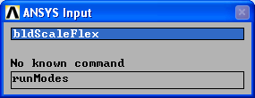
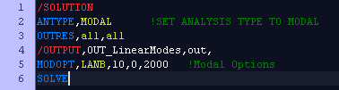
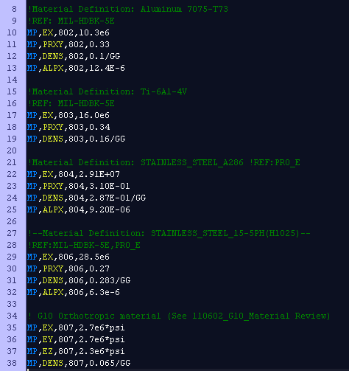
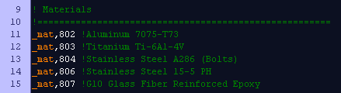
Macro Mania – Software Design Principals
Examples
10+ Mouse Clicks, plus thinking which button to press.
Vs.
Why use six lines when one will do?
Vs.
Copy/paste will ask these questions:
Did you copy the right material properties?
Did I set up the input deck correctly?
Is this the way I had it for the last model?
If you use macros you don’t ask, you know.

Slide 8
How Macros Are Organized (Dependencies)
Build Files
BldScaleFlex, BldMaterials, ect…
Macros
_MAT.mac, _SAVE.mac
Ansys APDL
Bundles of code should only depend on what is below them, not too them selves.
This prevents code from being two interdependent (Spaghetti Code)

Slide 9

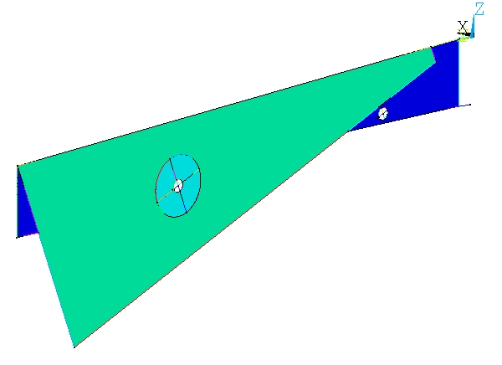
So what can they do? – Macro by Macro.
_ADELE
“Think Area Delete”
, <first area>, <last area> , < increment >
Same as Preprocessor >> Modeling >> Delete >> Areas and Below
In nifty macro form for quicker action
Now you see them
Now you don’t
_ADELE,-1 → deletes all selected areas
Ooops…. Don’t worry _UNDO.mac

Slide 10
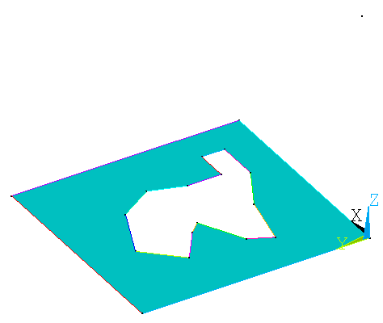
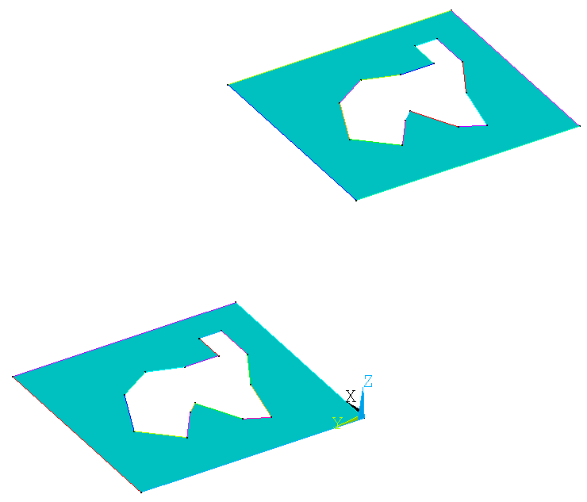
What can they Do? - _AGEN_KTK.mac
“Think: Area Generate Keypoint To Keypoint”
_AGEN_KTK, <area>, <from keypoint>, <to keypoint>
Copies an area or set of selected areas from one keypoint to another.*
To Keypoint
area
From Keypoint
*Technically it copies areas, translating them based on the vector from the first key point to the second key point

Slide 11


Does anyone read headers?
“Think: Area Reverse”
_AREV, <first area>,<last area>, <increment>
This macro works similar to the AREVERSE* command, however if you are making an input deck instead of having to type AREV,1 $ AREV,2 $ AREV,3 … $ Arev,50, you can simply write _AREV,1,50
* The AREVERSE command flips the area and associated element normal's

Slide 12
Go, _BACK (And Forth)
“Think: Back View”
_BACK → view model from the back
Pretty obvious, but wait there’s MORE!
Someone could implement the missing orientation macros if they felt like it.
_FRONT
→ view model from the front
_TOP
→ view model from the front
_FIT
→ fit model in the view
_RIGHT
_LEFT
→ view model from the front
→ view model from the front
Oh, and one more:
G
→ Exactly the same as /replot
You may think it’s crazy to create a macro that does exactly the same thing as /rep, however, those typing those extra letters ads up. I chose g because it’s not used for anything else, and it’s on the home row.
Guru Bonus:
I have one of the extra buttons on my mouse set to “return” that way in order to quickly refresh the screen, all I have to do is type “g” and press a button, Hooray Laziness!

Slide 13
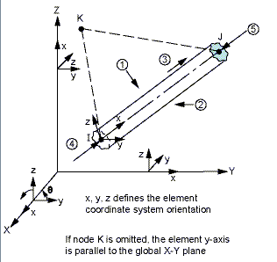
_Beam44.mac→ Quick General Beams
“Think: Circular Beam44”
_Beam44,<MatNum>, <Area>, <Ixx>, <Iyy>, <Izz> <Material>
Creates Circular Beam 44 Element
MatNum
Resulting Type, Real (and Material Number if Material is specified)
Area
X-Sectional Area
Ixx
Torsional Moment of Inertia
Iyy
Bending Moment of Inertia about Y - axis
Izz
Bending Moment of Inertia about Z - axis
Material
See _MAT.mac
See Also: SqBeam44.mac & CirBeam44.mac
Example
_Beam44, 10, 1.1, 4.25, 8.1, 8.1, 802 !General Aluminum Beam, A = 1.1, Ixx = 4.25, Iyy = Izz = 8.1

Slide 14
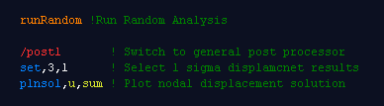

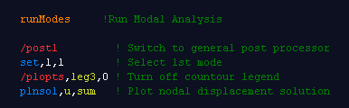

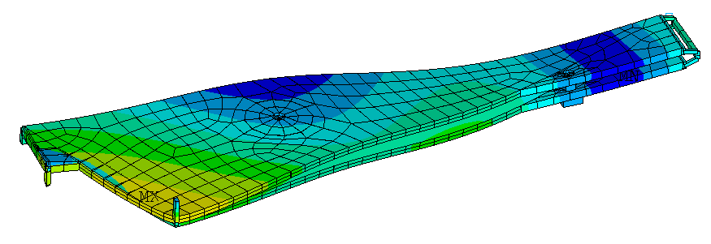
Plotting the displaced shape is something we do a lot
“Think: _Displacements”
_DISP ,<load step>, <substep>, <display type>
Plots nodal displacements for specified set, defaults to correct set based on analysis that has been run.
Without _DISP:
Using _DISP
By saving a few key stokes on something we do many times, a lot of time can be saved

Slide 15
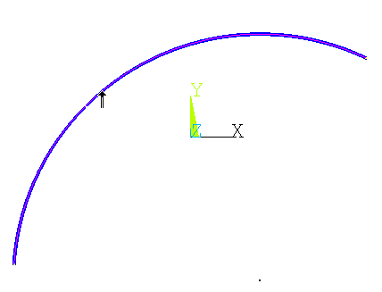

Simply create a keypoint at the center of any arc
“Think: _Keypoint at the Center”
_KCENTER, <arc>,
Creates keypoint at the center of an arc
Step 1: _kcenter
Requires Ansys V11+
Step 2: Select Arc
Alternative method
Keypoint is created

Slide 16
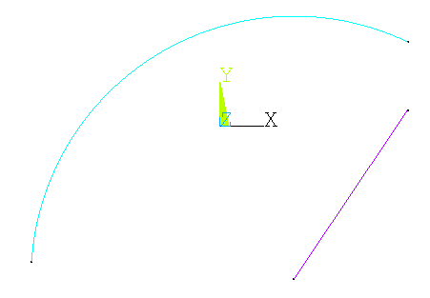
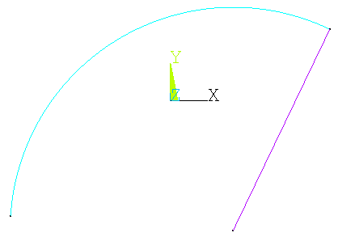
Simply create a keypoint at the center of any arc
“Think: _Keypoint Move”
_KMOVE, <keypoint to move>,<kepoint to move too>
Creates keypoint at the center of an arc
Step 1: _kmove
Step 3: Select keypoint to move TOO
Step 2: Select Keypoint to move
If possible the keypoints are merged

Slide 17
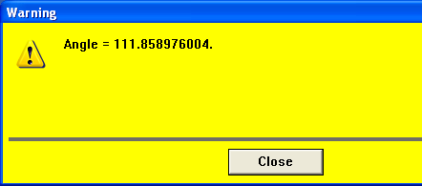
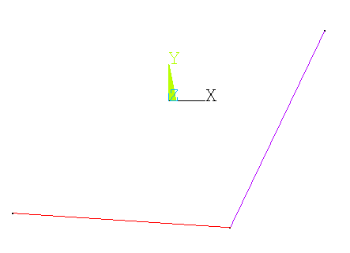
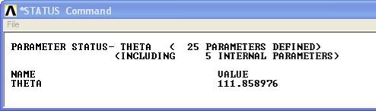
Simply create a keypoint at the center of any arc
“Think: _Line Angle”
_LANGLE, <first line>, <second line>
Creates a arc given the two endpoints to the arc and a center keypoint
Step 1: _langle
Step 2: Select Two Lines
*status,theta
Use *AFUN, DEG to get results in degrees
Use *AFUN, RAD to get results in radians
Depending on how lines were created you may get the supplementary angle

Slide 18
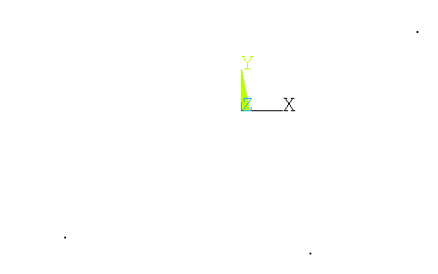
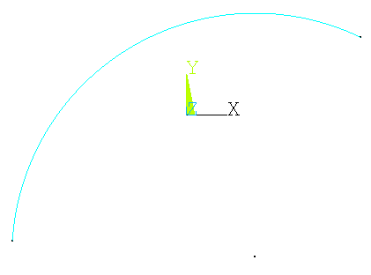
_LARC: Creates an arc between two keypoints
“Think: _Line Arc”
_LARC, <arc end>,<arc end>, <arc center>
Creates a arc given the two endpoints to the arc and a center keypoint
Step 1: _larc
Step 2: Select end points
Step 3: Select center keypoint
ARC-TASTIC!
Radius of arc is the average distance of the arc endpoints to the arc center

Slide 19
_LDELE: Deletes Lines and Below
“Think: _Line Delete”
_LDELE, <first line>,<last line>, <line increment>
Deletes lines and associated keypoints.
Same as Preprocessor >> Modeling >> Delete >> Lines and Below
Implementation Question: Should lines be deleted by this command even if they are meshed?

Slide 20
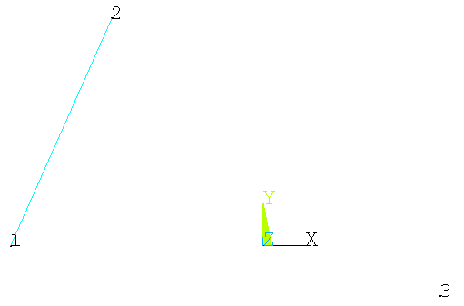
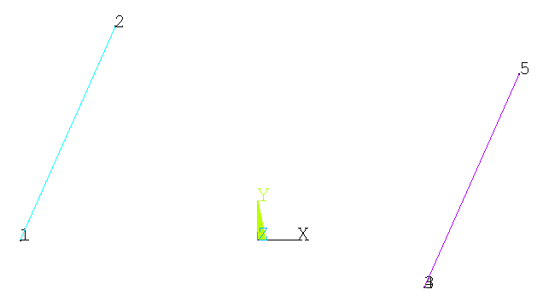
_LGEN_KTK
“Think: Line Generate Keypoint To Keypoint”
_LGEN_KTK, <line>, <from keypoint>, <to keypoint>
Copies a line or set of selected areas from one keypoint to another.*
Line
From Keypoint
To Keypoint
Notice that there are now two keypoints
*Technically it copies areas, translating them based on the vector from the first key point to the second key point

Slide 21
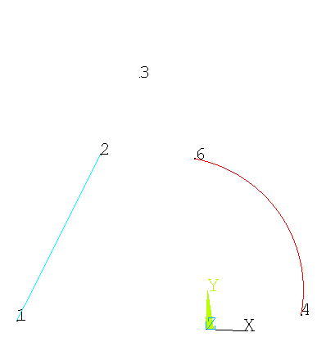
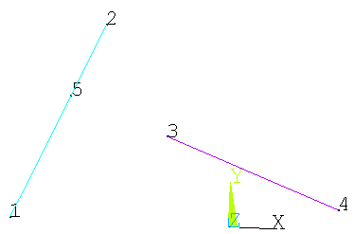
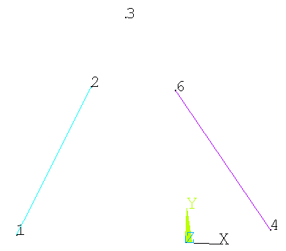
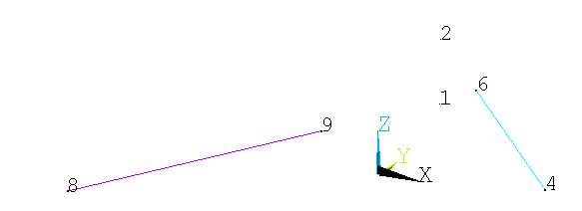
_LINL: Line Intersect Line
“Think: Line Intersect Line”
_LINL, <line 1>, <line 2>, <resultant keypoint>
Creates a keypoint at the intersection between two lines
New Keypoint
Step 1: Select Two Lines
Works even if lines do not intersect
Does not work as expected with curved lines
Works in 3D as well.
Uses common perpendicular between lines to find intersection points

Slide 22
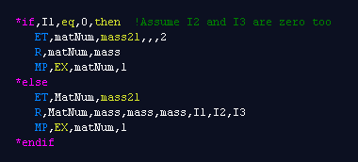


_MASS21: Create A Mass 21 Property Definition
_MASS21, <Prop Number>, <Mass>, <I1>,<I2>,<I3>
Creates a mass21 property in one line with little thinking

Slide 23

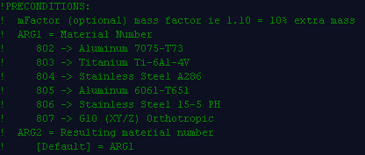
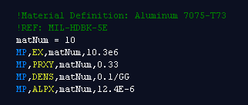

_MAT.mac : Standard Material Properties
“Think: Um, Material”
_MAT, <standard material number>, <assigned number (optional)>
Creates standard MP (Materials Property) commands for common materials
No strength data included
Ansys will only allow you to include strength data for a limited number of materials.
What’s Currently Included:
Note that if you want to scale the densities of any material, you can do so by setting the mFactor parameter
Implantation Question:
Would you rather see something like

Slide 24
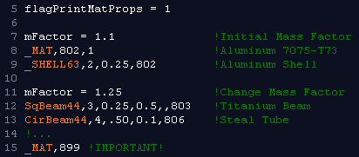
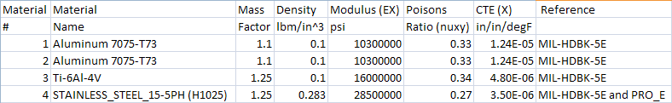
_MAT.mac : Automated Material Info Table
Common Customer Question: What material propertied did you use in your model?
Common Solution: Manually copy material properties from input deck to excel spread sheet.
If it’s not obvious by now, I hate any solution that involves “Manually”
Now there is a simple way to export material information to excel:
Output is a Coma Separated Value file, simply change the .out to .csv
You are encouraged to add materials to the _MAT.mac file, simply follow the format of the other materials, just change the file and let me know that you have changed it…

Slide 25

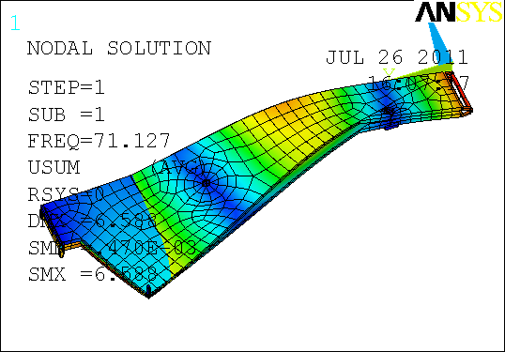
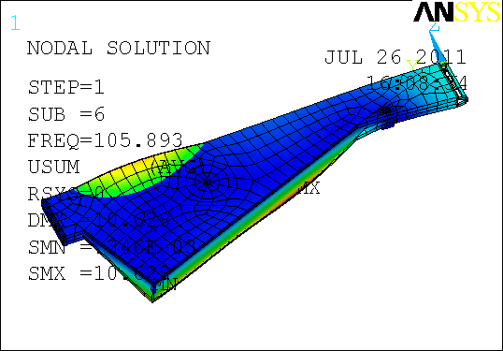
_NEXT.mac → Next Set of Resutls
“Think: _Next set of results”
_NEXT, <number of steps>
Post processing command that sets results to the next set of results
_NEXT,5

Slide 26
_NSEL_LOC.mac → Select Node By Loacation
“Think: _Node Select by Location”
_NSEL_LOC, <x>,<y>,<z>,<tolerance>
Select Node based on location. Useful for macros,

Slide 27
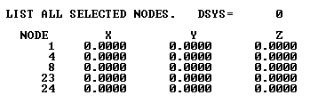
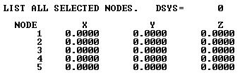
_NUMCMP.mac→ like numcmp but better
“Think: _Numbers Compress”
_NUMCMP, <what else?>
Compresses numbers assigned to keypoints, lines, areas and volumes back to zero
ARG1 = 1 → Nodes and Elements Compressed as well
ARG1 = 2 → Keypoings, lines, areas, nodes, elements, materials, type and reall all compressed
_NUMCMP,1

Slide 28
_NUMMRG.mac → Merge Like You Mean It.
“Think: _Numbers Compress”
_NUMMRG, <Tolarance>, <Retain High Number?>
Merges nodes AND keypoints. Repeats several times, you will ushaly see errors.

Slide 29
_NUMOFF.mac → Offset your world.
“Think: _Numbers Offset”
_NUMOFF, <Offset Number>,<What Else?>
Offsets numbers assigned to keypoints, lines, areas and volumes back to zero
ARG1 = 1 → Nodes and Elements are offset as well
ARG1 = 2 → Key points, lines, areas, nodes, elements, materials, type, real and secn are all offset
Nodes and key points (Because there are so many) of them are offset by 10X the offset number

Slide 30
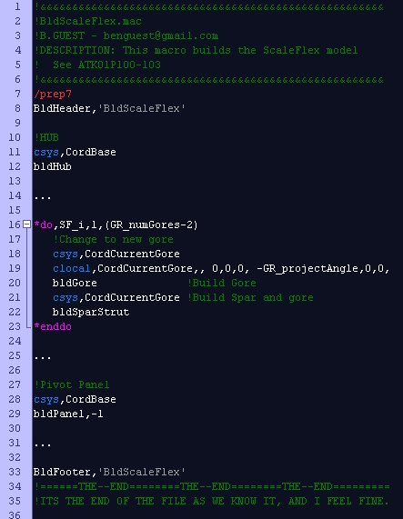
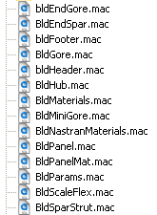
How do these all work together?
Typical Parametric Build Directory
Modular, Modular, Modular….

Slide 31
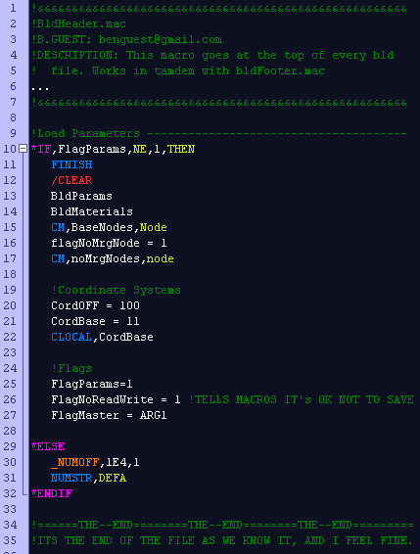
How do these all work together?
Typical Parametric Build Directory
Modular, Modular, Modular….

Slide 32
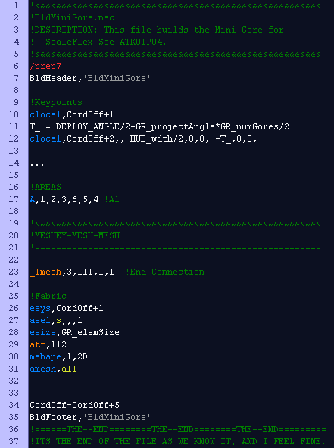
How do these all work together?
Typical Parametric Build Directory
Modular, Modular, Modular….

Slide 33
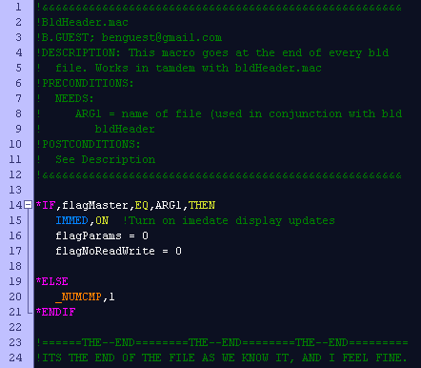
How do these all work together?
Typical Parametric Build Directory
Modular, Modular, Modular….

Slide 34
_POST1.mac = /Post1 $ Set
/POST1
SET ,1,3
This is two lines of code…
Two lines of code to do one thing… Just not right
/POST1 $ SET ,1,3
This is one lines of code…
But it’s not any shorter too to type
_POST1,1,3
This feels right, less to type.
_SET,1,3
Does not work.
Caveat
In order to use Lstep text commands like first, last, prev, ect., the command needs to be encapsulated with single quotes, ie 'last' or 'first'
/POST1 $ SET, first
➔
_SET, ‘first’
=
_POST, ‘first’
/POST1 $ SET, next
➔
_SET, ‘next’
=
_POST, ‘next’
/POST1 $ SET, prev
➔
_SET, ‘prev’
=
_POST, ‘prev’
/POST1 $ SET, last
➔
_SET, ‘last’
=
_POST, ‘last’

Slide 35

_PREV.mac → Next Set of Results
“Think: _Previous set of results”
_PREV, <number of steps>
Post processing command that sets results to the previous set of results
_PREV,5

Slide 36
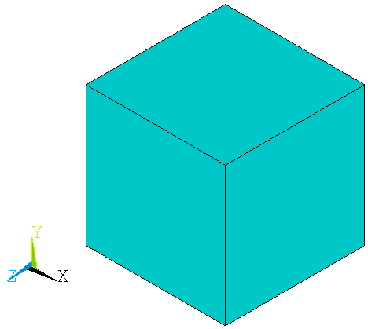

_RIGHT.mac gives you the Right View.
“Think: _Right View”
_RIGHT
Switches to a right view.

Slide 37
_SAVE.mac → For your macros.
“Think: Smart _Save”
_SAVE, <name of save file (optional)>
Saves when you want to, don’t save when you want to be efficient.
PROBLEM:
Some macros do some crazy things: Create hundreds of elements, delete everything, mesh all the selected elements.
SOLUTION:
So , we put save commands all through our macros and build decks.
!MyMacro.mac
SAVE ,saved, db
LCLEAR, ALL ! Dangerous things
!Your Build File
*do ,k, 1, 1000 ! Loop that takes forever to run
MyMacro ! Macro that saves every time
*enddo
PROBLEM:
Writing to disk is the slowest thing ANSYS does. All these added save commands can slow down the building of a model significantly.
SOLUTION:
Use _SAVE.mac instead of SAVE
!MyMacro.mac
_SAVE
LCLEAR, ALL ! Dangerous things
!Your Build File
FlagNoReadWrite = 1
*do ,k , 1, 1000 ! Loop that runs quickly
MyMacro ! Dangerous macros that uses _SAVE
*enddo
FlagNoReadWrite = 0
! End of Build File

Slide 38
_SHELL63.mac → The quick way to define a shell
“Think: _Shell63 property”
_SHELL63, <property number>, <shell thickness>, <shell material>
Creates a standard shell63 property with constant thickness
Property Number:
Resulting Element Type and Real Property number
Shell Thickness (Optional) :
Thickness of the resulting shell, default is 1 (unit thickness)
Shell Material(Optional) :
Standard _MAT material assigned to property number.
If blank, no material is created.
Example Use
mFactor = 0.95 ! Set material density to 95% of normal
_SHELL63 ,1,0.25,802 ! Create 0.25 thick aluminum shell
_SHELL63 ,2,0.50,803 ! Create 0.50 thick titanium shell
ASEL ,S,P ! Pick some areas
AMESH , ALL ! Mesh Picked Areas (will be meshed with titanium shell)
Bonus:
Materials properties can be out put to .csv by setting FlagPrintMatProps = 1 & _MAT,899
Current material, real, type and section are set to Property Number

Slide 39

_RIGHT.mac gives you the Right View.
“Think: _Top View”
_TOP
Switches to a top view.

Slide 40

What Can They Do? – _UNDO.mac
_UNDO, <redo?>
Certain macros (Destroy_All_Your_Work_If_You_Breath_Wrong.mac, _ADELE.amac) could really screw things up for you if you do the wrong thing or you had everything selected but didn’t think you did. So…
Lots of macros start with this..
This saves you whole database to a file that can be resumed from if the macro does something bad like delete all the lines in your model and replace them with bananas.
You could type
resume,saved,db
but
_undo
is so much shorter
Plus it makes sense, and issues
save,saved1,db,,all
So you can type
_undo,1
Like Redo
_undo
And you’ll be back to where you were before you issued the

Slide 41

_VDELE.mac → Delete Volumes and Below
_VDELE
“Think _Volume Delete”
, <first volume>, <last volume> , < increment >
Same as Preprocessor >> Modeling >> Delete >> Volumes and Below
In nifty macro form for quicker action
Now you see it
Now you don’t
_VDELE,-1 → deletes all selected volumes
Ooops…. Don’t worry _UNDO.mac

Slide 42


_VGEN_KTK.mac → Copy Volumes
“Think: Volume Generate Keypoint To Keypoint”
_VGEN_KTK, <volume>, <from keypoint>, <to keypoint>
Copies an area or set of selected areas from one keypoint to another.*
To Keypoint
_VGEN_KTK
Volume
From Keypoint
*Technically it copies areas, translating them based on the vector from the first key point to the second key point

Slide 43

_VMESH.mac → Mesh That Volume.
“Think: Volume Mesh”
_VMESH, <Material Number>,<ESize>,<Volume Number>,<Smart Size>
Material Number
Material Number assigned to material, can be one of the _MAT materials
ESize
Element Size
Volume Number
Volume to be meshed (-1 for all). If omitted, user is asked to select volumes
Smart Size
See SMRT Command
_VMESH ,802,0.25,-1

Slide 44
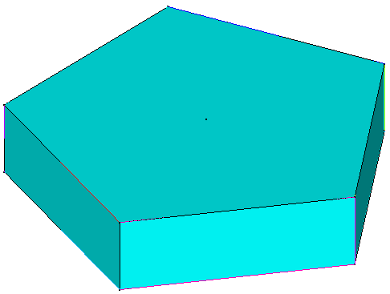
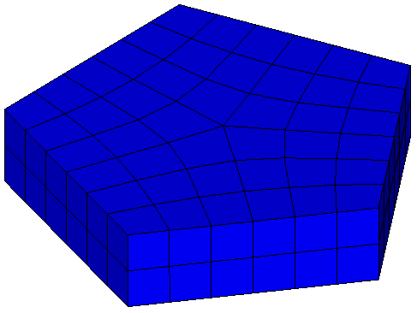
_VSWEEP.mac→ Sweep That Volume.
“Think: Volume Sweep”
_VSWEEP, <Material Number>,<ESize>,<Volume Number>
Material Number
Material Number assigned to material, can be one of the _MAT materials
ESize
Element Size
Volume Number
Volume to be meshed (-1 for all). If omitted, user is asked to select volumes
_VSWEEP,802,0.05,-1
Works with _UNDO

Slide 45
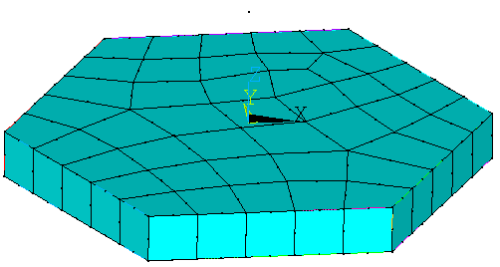
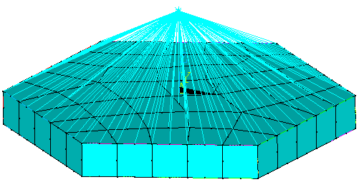
AKMPC.mac → The Spider Web Maker
“Think: Area To Keypoint Multi-Point Constraint”
AKMPC, <Keypoint>,<Area>,<Link?>,<Lagrange?>
Creates “Spider Web” of rigid elements between a key point and an area
AKMPC
To Keypoint
Area
Works with _UNDO

Slide 46


ATA.mac → Volumes from Areas… Quickly!
“Think: Area To Area”
ATA, <First Area>,<Second Area>,<Link?>
Creates a volume between two areas
Step 1: Select Two Areas
Works with _UNDO

Slide 47

ATT.mac → Quick Set Attributes
“Think: Attributes”
ATT, <Attributes Number>,<Coordinate System>

Slide 48



ATTMESH.mac → Set Attributes and Mesh
“Think: Attribute Mesh”
ATTMESH, <Type>,<Element Type / Real >, <First Thing>,
<Last Thing>, <Inclement>, <KP Orient>
Lots of stuff on one line…
Type
Type of thing to mesh “kp”, “line”, “area”, “volu”
Element Type / Real
Element Type and Real Number to be assigned
Material Number
Material Number to be assigned
First Thing
First “kp”, “line”, “area” or “volu” to be meshed
Last Thing
Last “kp”, “line”, “area” or “volu” to be meshed
Increment
Increment through things, ie 2 → every other thing from first to last
KP Orient
Orients meshed lines to that keypoint (optional)
Works with _UNDO

Slide 49


PPT.mac & BAC.mac → PowerPoint Fun.
“Think: Power Point”
PPT, <Shrink Window?>
Sets background to white and optionally shrinks viewing window.
PPT, 1

Slide 50
PPT.mac & BAC.mac → Fun with Power Point
BAC
“Think: Back To Normal”
Resets Window back to black background and full size
BAC

Slide 51




BUCK.mac → Sandwich Construction Failures
BUCK,<Cell Size>, <Results Display>, <Calculations>
“Think: Sandwich Structure Buckling”
Calculates Composite Sandwich Structure Buckling
Cell Size
Cell Size of Honeycomb core
Display Results
0 → Shows Failed Elements
1 → “Buckling Stress” 1= Failed
Calculations
0 → Minimum Margin
1 → Inter Cellular Buckling
2 → Face sheet Wrinkling
3 → Shear Crimping (X-Direction)
4 → Shear Crimping (Y-Direction)
5 → Core Strength (X-Direction)
6 → Core Strength (Y-Direction)
ONLY WORKS FOR: Shell181, Solid185, Solid186, Solsh190, Shell208, Shell209 & Shell281
Doesn’t Work For Shell91!!!
Can be quite time consuming for large numbers of elements;
current formulation calculates facesheet stiffness for every element…

Slide 52
CirBeam44.mac → Quick Circular Beams
“Think: Circular Beam44”
CirBeam44,<MatNum>, <Outer Diameter>, <Thickness>, <Material>
Creates Circular Beam 44 Element
MatNum
Resulting Type, Real (and Material Number if Material is specified)
Outer Diameter
Circular Beam outer diameter
Thickness
Tube wall thickness (default = ½ Outer Diameter)
Material
See _MAT.mac
Example
CirBeam44, 10, 1.25, 0.25, 802 !Circular Aluminum Beam, Diameter = 1.25”, Wall thickness = 0.25”
See Also: SqBeam44.mac & _Beam44.mac

Slide 53


AWESOME, where can I find out more?
Header of the macros! They are there too help, if something is confusing, let me know, I’m also a decent writer and I can try to clarify.
__BensMacros.xls is a kind of up to date listing of all the macros with a brief description. Let me know if something is missing, I’ll fix it.

