Slide 1
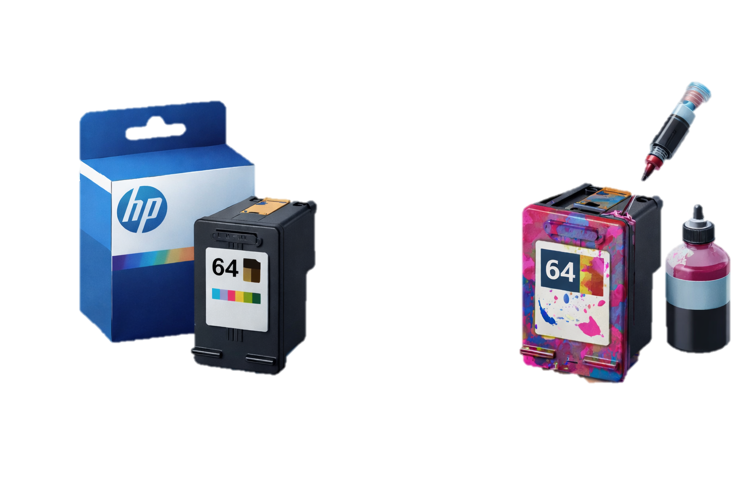
OEM Printer Cartridge vs. Refilled Cartridges
vs.
Bianca Guimaraes Barros Leal Santos
This analysis was prepared by the User Support Team for the Production Department of a book publishing company.
Notes:
This presentation was created to help the Production Department understand the advantages and disadvantages of using OEM printer cartridges versus refilled cartridges.

Slide 2

Why This Topic Matters
Production uses many printers every day
OEM cartridges are expensive
Some employees believe refilled cartridges could save money
Support team must consider reliability and problems
Notes:
Pat Hughes from the Production Department contacted the support team because printer supply costs are high. This presentation explains whether switching to refilled cartridges is a good idea.

Slide 3

What Is an OEM Cartridge?
Made by the printer manufacturer
Designed specifically for the printer
Very reliable
Usually more expensive
Notes:
OEM means Original Equipment Manufacturer. For example, HP cartridges are made by HP to work best with HP printers.

Slide 4
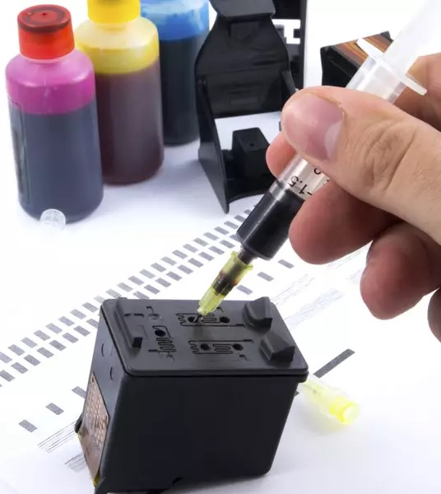
What Is a Refilled Cartridge?
Used OEM cartridge that is cleaned and refilled
Sold by third-party companies
Lower cost
Quality depends on the supplier
Notes:
Refilled cartridges reuse old cartridges. They can save money and reduce waste, but quality can vary depending on how well they are refilled.

Slide 5
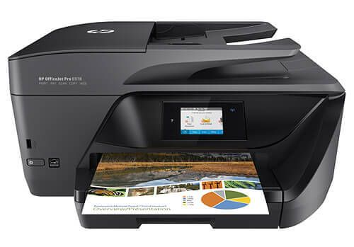
Cost Comparison (Example Printer)
Example printer: HP OfficeJet Pro 6978
OEM HP cartridge: higher price
Refilled cartridge: about 30–50% cheaper
OEM: higher page yield
Refilled: may require more frequent replacement
Notes:
For this comparison, we are using an HP OfficeJet Pro 6978, a common office printer. According to Quill and Inkjets.com, refilled cartridges for HP printers often cost 30–50% less than OEM cartridges. However, lower page yield and reprints can reduce these savings.

Slide 6
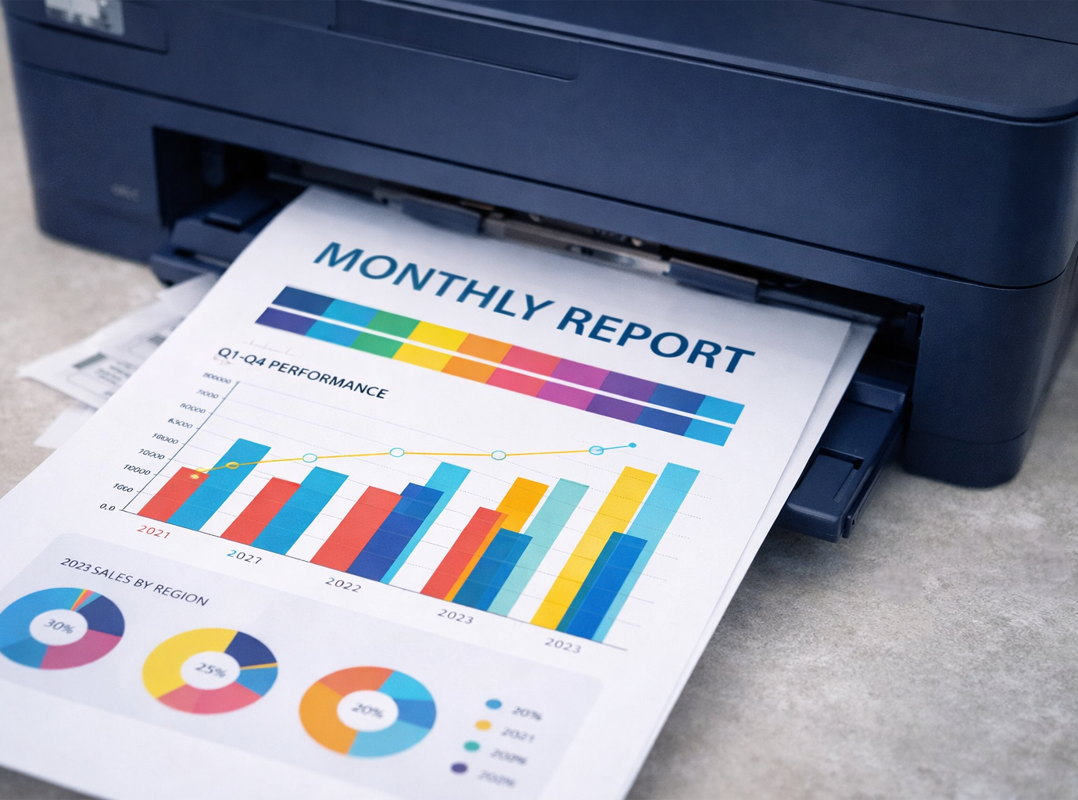
Factors Other Than Cost
Print quality
Page yield (how long cartridges last)
Printer reliability
Warranty coverage
Environmental impact
Notes:
Cost is important, but it is not the only factor. In a book publishing company, print quality and reliability are very important.

Slide 7
Pros and Cons of OEM Cartridges
✅ Pros
✨ Best print quality
🤝 Most reliable
🛡️ Covered by manufacturer warranty
⛔ Cons
💵 Higher cost
♻️ More new materials used
Notes:
OEM cartridges usually cause fewer printer problems. For the support team, this means fewer help desk tickets.

Slide 8
Pros and Cons of Refilled Cartridges
✅ Pros
💵 Lower cost
♻️ Less waste
⛔ Cons
✨ Inconsistent print quality
⌛ Shorter lifespan
⚠️ Risk of leaks or printer damage
🛡️ Possible warranty issues
Notes:
Cartridge World and Inkjets.com explain that refilled cartridges can work well, but problems are more likely if the supplier is not reliable.

Slide 9
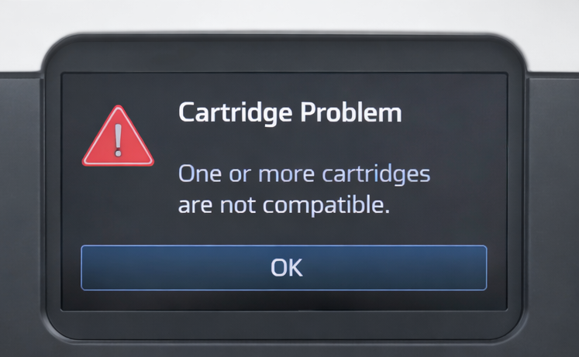
Manufacturer Policies
Many manufacturers recommend using only OEM cartridges
Firmware updates may block refilled cartridges
Warning messages may appear
Damage may not be covered by warranty
Notes:
HP explains that firmware updates can prevent refilled cartridges from working. If a refilled cartridge damages the printer, repairs may not be covered.

Slide 10

Impact on the Support Team
More printer-related problems
Harder troubleshooting
More time spent on printer tickets
Increased downtime for users
Notes:
When refilled cartridges fail, the support team has more work. It becomes harder to identify whether the problem is the printer or the cartridge.

Slide 11

Impact on the Production Department
Printing delays
More reprints
Missed deadlines
Employee frustration
Notes:
Unreliable printing can slow down production and affect the publishing schedule.

Slide 12

Recommendation
Use OEM cartridges for critical printers
Test refilled cartridges before switching
Use trusted suppliers only
Keep OEM cartridges as backup
Notes:
A mixed approach may work best. OEM cartridges reduce risk, while refilled cartridges can be tested in low-risk situations. In a publishing company, print quality and reliability are critical, especially for proofs, contracts, and marketing materials

Slide 13
Case Study Questions
What are the cost differences between OEM and refilled cartridges?
What factors other than cost should be considered?
Do manufacturers discourage refilled cartridges? How?
How does this choice affect the support team?
Notes:
These required questions are answered throughout the presentation using real research and examples.

Slide 14
Sources
Cartridge World. “Printer Cartridge Refill vs. Replacement: Which Option Is Better for You?” Cartridge World, 17 June 2024, https://cartridgeworldusa.com/blog/printer-cartridge-refill-vs-replacement-which-option-is-better-for-you
Inkjets.com. “HP Cartridges for Printers: Can You Use Remanufactured Ink Cartridges in HP Printers?” Inkjets.com, 4 July 2024, https://www.inkjets.com/blogs/printer-ink-guides/hp-cartridges-for-printers
Knerl, Linsey. “Are Off-Brand Ink Cartridges as Good as Name Brand? A Comprehensive Guide.” HP Tech Takes, 29 Aug. 2024, www.hp.com/us-en/shop/tech-takes/are-off-brand-ink-cartridges-as-good-as-name-brand
“5 Reasons You’ll Regret Using Refill Ink.” HP Tech Takes, 28 Feb. 2018, www.hp.com/us-en/shop/tech-takes/5-reasons-youll-regret-using-refill-ink

Slide 15
Sources
Toal, J.“OEM vs. Remanufactured vs. Compatible Printer Cartridges: What’s the Difference?” Quill, 24 Feb. 2025, www.quill.com/blog/oem-vs-remanufactured-vs-compatible-printer-cartridges-whats-the-difference/
“Toner Cartridges: Genuine OEM vs Compatible vs Remanufactured (Pros & Cons).”TonerBuzz, 3 Apr. 2025, www.tonerbuzz.com/blog/toner-cartridges-genuine-oem-vs-compatible-vs-remanufactured/

