Slide 1

Discussion of “Cultural Anchors and the Heterogenous Impact of Uncertainty on Housing Returns” – Dissanayake, Samarasinghe, Torgler & Wu Benedict Guttman-Kenney Rice University 14th December 2025

Slide 2
Paper Summary
Construct cross-country panel data on housing returns, economic uncertainty, economic conditions, & culture
Study relationship between uncertainty and housing returns using:
Fixed effects
Instrument Variable: Election timing
Difference-in-difference: Turkish protests in May 2013

Slide 3
Paper Summary
Construct cross-country panel data on housing returns, economic uncertainty, economic conditions, & culture
Study relationship between uncertainty and housing returns using:
Fixed effects
Instrument Variable: Election timing
Difference-in-difference: Turkish protests in May 2013
Key findings
⬆️ economic uncertainty ➡️ housing returns ⬇️
Relationship not explained by risk or other economic conditions
Heterogeneity by individualism, government effectiveness, long-term orientation, young age, work ethic

Slide 4
#1: Linking Two Big Topics

Slide 5
Economic Policy Uncertainty Matters!
Influential literature since Baker, Bloom, & Davis (2016 QJE)
Bianchi, Ilut, & Schneider
(2018 RESTUD)
Baker, Bloom, & Terry
(2024 RESTUD)
Baker, Davis, & Levy
(2022 JME)
Ahir, Bloom, & Furceri (2022)

Slide 6
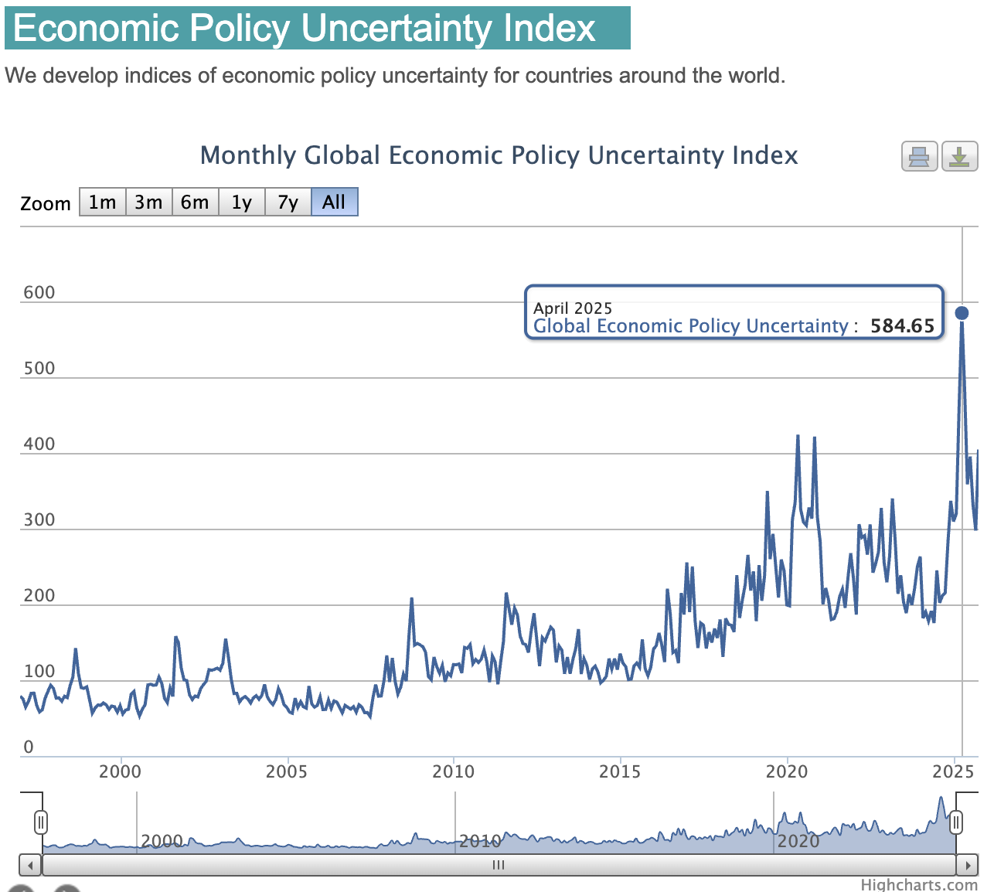
Economic Policy Uncertainty Matters!
Influential literature since Baker, Bloom, & Davis (2016 QJE)
Bianchi, Ilut, & Schneider
(2018 RESTUD)
Baker, Bloom, & Terry
(2024 RESTUD)
Baker, Davis, & Levy
(2022 JME)
Ahir, Bloom, & Furceri (2022)
Quite topical!

Slide 7
“Housing Is the Business Cycle” – Ed Leamer (2007)
Housing is “a volume cycle not a price cycle”

Slide 8
“Housing Is the Business Cycle” – Ed Leamer (2007)
Housing is “a volume cycle not a price cycle”
Ghent & Owyang (2010, JUE):
U.S. city-level evidence shows House Price ⬇️
not followed by Employment ⬇️
“Housing is merely a proxy for other consumption or wealth indicators”

Slide 9
“Housing Is the Business Cycle” – Ed Leamer (2007)
Housing is “a volume cycle not a price cycle”
Ghent & Owyang (2010, JUE):
U.S. city-level evidence shows House Price ⬇️
not followed by Employment ⬇️
“Housing is merely a proxy for other consumption or wealth indicators”
Link with these existing literatures
What is the key differentiator of your paper?
Is housing different to how uncertainty affects asset prices?
Engage with Leamer debate
Is there a VIX-type measure of uncertainty that you could use?
- Something to capture real-estate specific uncertainty would be great.

Slide 10
#2: Difference-in-Differences

Slide 11
Sharpen Difference-in-Differences Analysis
DID is a nice idea but it needs more work to be convincing!
How similar are control to treatments? Compare baseline means across variables (e.g., homeownership rate, demographics, religion) and institutional details of housing/mortgage markets and government
Eastern European countries seem quite different culturally to Turkey
Can you use a similar country? Azerbaija

Slide 12
Sharpen Difference-in-Differences Analysis
DID is a nice idea but it needs more work to be convincing!
How similar are control to treatments? Compare baseline means across variables (e.g., homeownership rate, demographics, religion) and institutional details of housing/mortgage markets and government
Eastern European countries seem quite different culturally to Turkey
Can you use a similar country? Azerbaijan?
Test for common trends in pre-period
Show figure of dynamic DID (including pre and post periods)

Slide 13
Sharpen Difference-in-Differences Analysis
DID is a nice idea but it needs more work to be convincing!
How similar are control to treatments? Compare baseline means across variables (e.g., homeownership rate, demographics, religion) and institutional details of housing/mortgage markets and government
Eastern European countries seem quite different culturally to Turkey
Can you use a similar country? Azerbaijan?
Test for common trends in pre-period
Show figure of dynamic DID (including pre and post periods)
“Uncertainty was largely disconnected from underlying business cycle”
- show me evidence to support this! What happened to stock market in Turkey?
Robust Standard errors should normally be clustered by country in DID …but as you only have 1 treated cluster follow rearrangement procedure of Hagemann (2025 RESTUD, R/STATA code)

Slide 14
#3 Other Suggestions

Slide 15
Cultural Anchors Or Heterogeneity
Suggest removing the emphasis on cultural anchors
Term is not well-explained/justified to link to psychology on anchoring
Less contentious economics phrase is heterogeneity as moderators of relationship between housing returns and uncertainty
Factors such as government effectiveness I don’t think of as cultural per se
I don’t think you have great variation here to exploit

Slide 16
Cultural Anchors Or Heterogeneity
Suggest removing the emphasis on cultural anchors
Term is not well-explained/justified to link to psychology on anchoring
Less contentious economics phrase is heterogeneity as moderators of relationship between housing returns and uncertainty
Factors such as government effectiveness I don’t think of as cultural per se
I don’t think you have great variation here to exploit
I’m not a macro person and use micro rather than cross-country data
But you may benefit from following the methods used in uncertainty literature e.g., structural VAR analysis in Baker, Bloom, & Terry (2024)
Their code and data are public
Also see Bianchi, Ilut, & Schneider (2018 RESTUD)

Slide 17

Thank You!

Slide 18
Other Feedback
Abstract is too long. It would benefit from being more focused,
Both the abstract and conclusion would benefit from contain some numbers estimated from a key results.
Housing returns and uncertainty are two big topics of broadest interest to frame paper around
I did not find the theoretical framework informative. The idea is straightforward so could be described in a few lines. If you wanted something more rigorous, see the models in the seminal uncertainty papers (but not much gain to you doing so unless there’s some non-obvious direct tests you can map to data).
Data description is unclear. What years are covered?
Section 2.4, what it the third dimension?
What period covered in Table 1? How do I interpret units of economic uncertainty measure?
Table 2. I want to know how much time series variation there is to exploit in these measures. Is the variation informative or due to measurement error? Are there policy/demographic changes shifting this?
Section 3.1 would be useful to write that X_i,t are time-varying controls just to make this explicitly clear. The problem here is we worry about an endogenous control biasing estimates. This issue needs a brief discussion about the direction in which it may bias estimates.
Section 3.2 Election_Exec_i,t, in text but Election_i,t in equation 2. How many have presidential regimes? Any shifted to/from this over time may be better source of variation? Are you including non-presidential regime countries, if so you may want to drop these. See methods for other shocks in other uncertainty papers cited below.
Not clear if you are looking at real or nominal returns. Real returns would make most sense to me. I want to know the baseline means for these returns to evaluate how large these estimates are. This is especially important for the DID where few readers will know Turkish real estate returns! How do they compare to Jorda, Knoll, Kuvshinov, Schularick, & Taylor (2019 QJE) Chambers, Spaenjers, & Steiner (2021 RFS)
Figure 1 is unclear and not referred to in the paper. What are the two panels? What are the two lines? Figure notes are vague and incorrectly refer to equation 4.

