Slide 1
“Rewards and Consumption in the Credit Card Market” by Tianyu Han
Discussion: Benedict Guttman-Kenney
Rice University

Slide 2
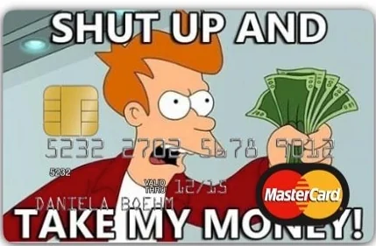
Credit Card Context
Many papers documenting behavioral mistakes in the credit card market
- Focus on costs of mistakenly incurring interest or late fees
(Beshears, Choi, Laibson, Madrian 18 Handbook Chapter)
- Increasing recent focus on rewards
(e.g., Mukharlyamov & Sarin, 24; Wang 24; Huynh, Nicholls and Shcherbakov 22; Agarwal, Presbitero, Silva, and Wix 23; Agarwal, Ang, Wang, and Zhang 24)

Slide 3
Data and Methods
Administrative data from large Chinese bank who offers credit cards.
RDD for platinum reward card eligibility to estimate effects of rewards on spending.
(“Fuzzy RDD is IV”, Angrist and Pischke, 2009)
Use linked survey of 4,565 credit card users. Response rate?
(see Stantcheva 22 Ann. Review of Economics; Bergman, Chinco, Hartzmark, & Sussman 20)
Structural model evaluating implications for market structure & welfare.

Slide 4
Han’s Hypothesis
1. Rewards ➡️ Spend More on Reward and on Non-Reward Categories
Reward spending $64 (30%?), non-reward spending $54 (5%?)
2. Why ⬆️ Non-Reward Spending? ‘Complementary Ignorance’ (naïve consumers under-estimate how rewards change non-reward spending)
e.g., airline rewards ➡️ book flight.
But don’t consider also spend on non-reward category (e.g. car rental)
3. Implications?
(i) Incentive banks to offer more generous rewards
(ii) Cross-subsidizes less to more sophisticated
(iii) 2.5% consumption cost per month

Slide 5
Big Picture
Impressive data collection
Convincing RDD design to show that rewards “work”
Interesting new theory
Three Discussion Points:
Rewards
Mistakes
Implications

Slide 6
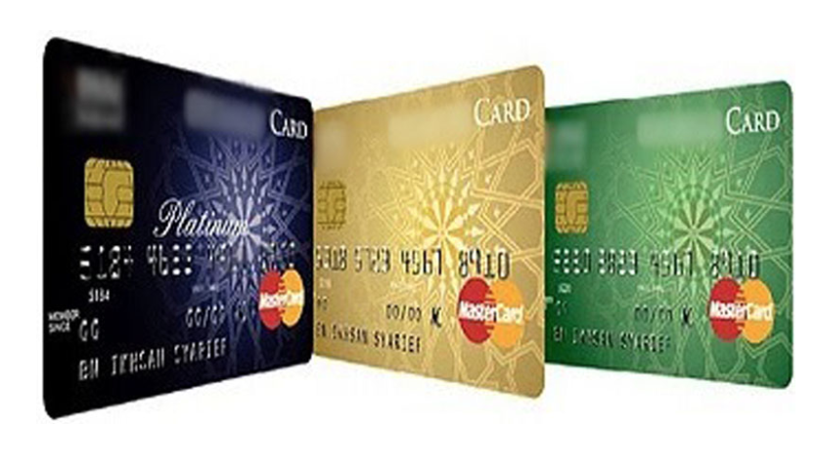
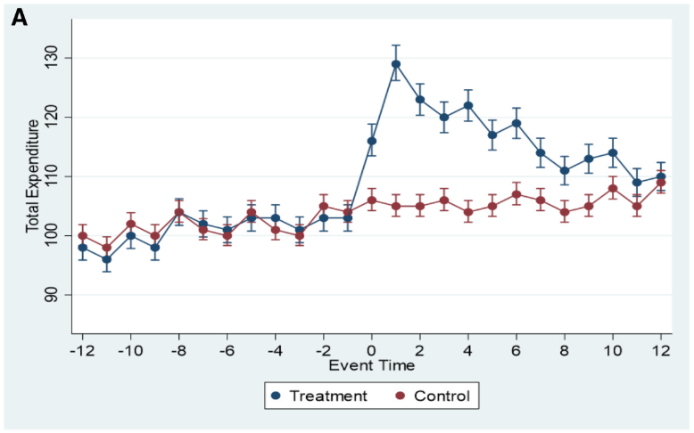
Linking Reward Effects to Literature
Good job of linking to Bursztyn, Ferman, Fiorin, Kanz, & Rao (17 QJE)
platinum cards are status goods & ⬆️ in-person spending
➡️ Han’s paper shows effect on online transactions.
Gelman & Roussanov (24 RFS):
New credit card -> ⬆️ credit card spending
➡️ What is the marginal value of rewards?
Rewards ⬆️ spending is consistent with US evidence
(Agarwal, Presbitero, Silva, & Wix 23; Agarwal, Ang, Wang, & Zhang 24)
➡️ Decompose non-reward effects into credit card & non-credit card?

Slide 7
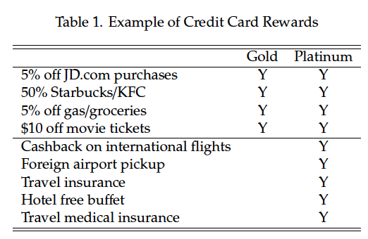
#1: Platinum vs. Gold Rewards
Rewards (slightly?) reduce price of travel
Are platinum rewards only for travel?
Which rewards are % spending?
Which are salient?
Which MCCs drive “non-reward” results?
Beyond scope of this paper… how do consumers value different rewards?

Slide 8
#2 Mistakes
What I expected:
Survey expectations of future spending
Exogenous variation in platinum cards
Compare ex-ante expectations vs. realized spending
What this paper does:
Study causal effects on historical spending
Survey understanding of realized spending in last 6 months.

Slide 9
#2 Mistakes
“Credit card rewards can lure naive consumers into booking reward-earning goods and services while overlooking the complementary purchases that will be necessary in the future.”
Consumers less aware of total spending is different to
consumers not planning their non-rewards expenditure & overconsuming.
Spending in last 6 months is a mix of consumers (average 282 days with current card):
(i) 6+ months platinum (ii) <6 months platinum (iii) Never platinum.
Is there learning? Story most convincing if persistent errors among experienced users.
➡️ Heterogeneity has noisy nulls for longer-holding & older users.
Total spend under-reporting: $82 (s.e. $51) & $60 (s.e. $44)

Slide 10
#3 Implications
Model shows welfare loss. What about counterfactual policies?
Interchange caps of different levels (5.25% baseline)
Simplify reward structure (e.g., can only be X% of any spending)
(Iberti, Kulkarni, & Truffa, 23; US regulations do not standardize reward disclosures)
More generally, complexity in credit card rewards appears productive area to explore:
How difficult to choose optimal credit card to maximize benefits?
For credit cards held, how do cardholders allocate spending to maximize benefits?
Many reward categories. Different units: points, miles, cash. Annual fees. Bundled benefits.
(Agarwal, Chomsisengphet, Liu 10 JMCB; Agarwal, Chomsisengphet, Liu, Souleles 15 RCFS; Stango & Zinman, 16 RFS; Ru & Schoar, 23; CFPB 24)

Slide 11
Thanks!
www.benedictgk.com
benedictgk@rice.edu

Slide 12
Other Feedback
Report survey response rate and compare representativeness of survey sample to population data.
How many Chinese credit cards do consumers normally have?
Report baseline means in text / tables to interpret estimates.
Make drafting clearer on timing of survey relative to timing of platinum card eligibility and administrative outcomes.
Increase power of RDD by doing local estimation with full sample of data (not just survey respondents) for outcomes / heterogeneity.
Local estimation for key outcome of total spending under reporting appears under-powered in Table A1 column 4. Noisy null 67 (36).
Are effects persistent? Look at dynamics of outcomes over different time horizons.
Show pre-period outcomes before platinum card opening as falsification tests – e.g., Gathergood, Guttman-Kenney, Hunt 19 RFS
Show total assets over time as an outcome to show not being manipulated over time. Unclear the point-in-time currently used.
Do rewards affect loyalty? This would be a natural way to increase profits. My JMP shows large variation in credit card tenure.
Compare magnitudes of your causal estimates of spending to Gelman & Roussanov and Agarwal et al. papers.
I think you may need to make an assumption that the mis-estimation you measure is persistent and affects future choices.
Increase precision by winsorizing variables (e.g., 99th non-zero value of spending)
CDFs of responses and spending. Account for rounding behavior by aggregating into coarse bins. (see Sakaguchi, Gathergood, & Stewart 24; Herzog and Bartels 24)
“It is interesting to note that if the bank imposes rewards on the products that do not come with complements (when m = 0), then naive consumers would not suffer from excess and unexpected spending.” <- can’t you test this in data by using variation in how much complementary there is between spending categories? Would predict stronger responses for categories closer to the reward category. Seasonal rewards sounds like excellent variation you could exploit.
Show original Chinese version of survey in appendix.
IRB?

Slide 13
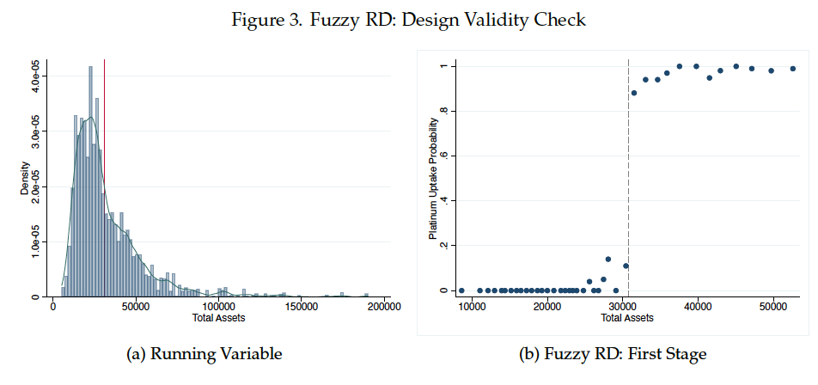
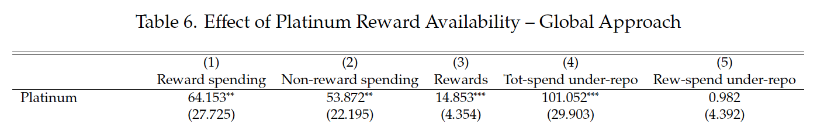
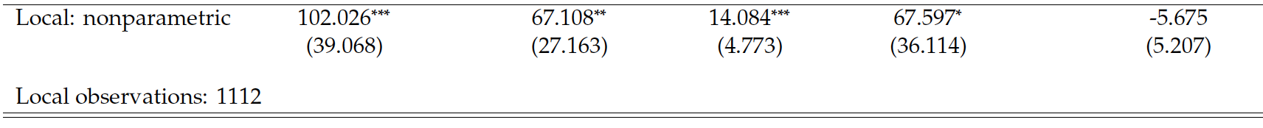

Slide 14
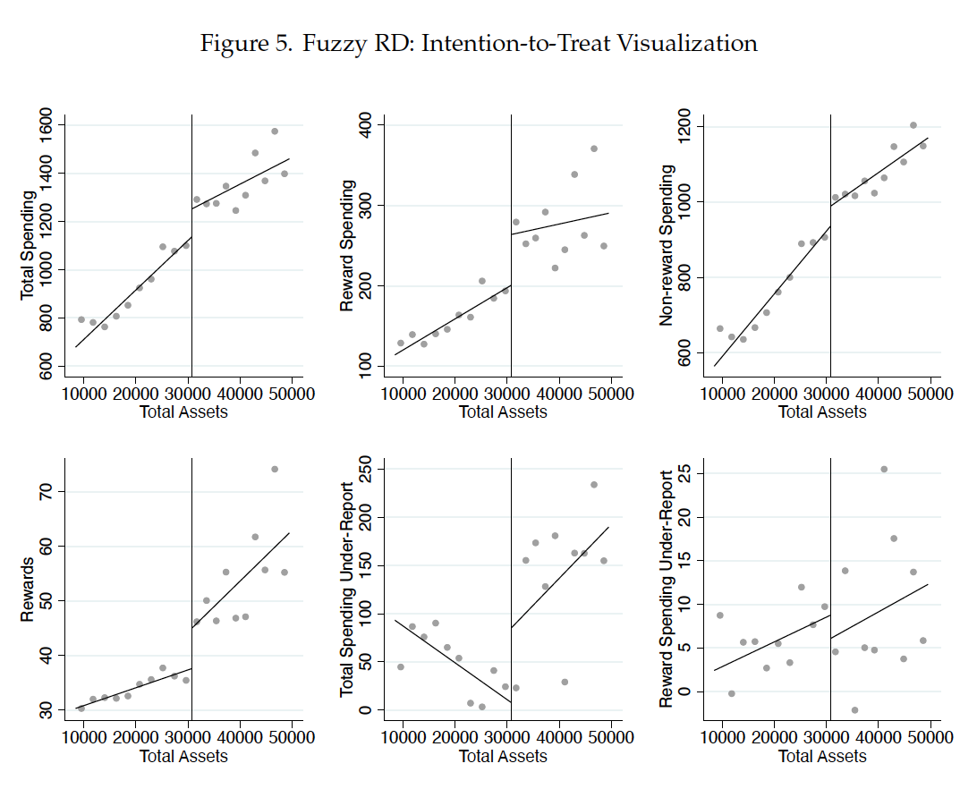

Slide 15
