Slide 1

Discussion of “Buy Now Pay (Less) Later: Leveraging Private BNPL Data in Consumer Banking” - Laudenbach, Molin, Roszbach, & Sondershaus Benedict Guttman-Kenney Rice University 10 July 2025

Slide 2
What This Paper Does: How Does Observing BNPL Information Affect A Bank’s Non-BNPL Lending?
Nordic Bank Data
Consumer loan applications, credit scores (internal & external), contracts, and repayments, & BNPL with bank
Compare consumers with recent vs. non-recent BNPL use with bank
Key Results
Recent BNPL use with bank is an informative signal of credit risk, used by bank to price discriminate consumer loans
(Recent) BNPL users have: Pr(approved) ⬆️, interest rate ⬇️, default ⬇️
⬆️ credit access through learning (to repay via BNPL)

Slide 3
#1: Identification

Slide 4
Effects of BNPL Usage In This Paper Apply To A Small Subset Of Consumers (Average Age ~50)
In US, 12-21% consumers used BNPL in 2022 & average ages < 35
(Federal Reserve, 2024; Consumer Financial Protection Bureau, 2025)
In Denmark/Norway/Sweden, 18-24% consumers use BNPL
BNPL Usage in Paper | 3+ BNPL transactions with Bank in last 12 months (“Internal BNPL”) | “Internal BNPL” + “External BNPL” < 3 BNPL transactions with Bank in last 12 months AND >0 BNPL transactions with Bank ever
Consumer Loan Applications (1,066,503 “Whole Sample”) | 2.8% (30,115) | 9.2% (98,203)
Consumer Loan Approvals (8,661 “Whole Sample”) | 8.7% (754) | 15.7% (1,363)

Slide 5
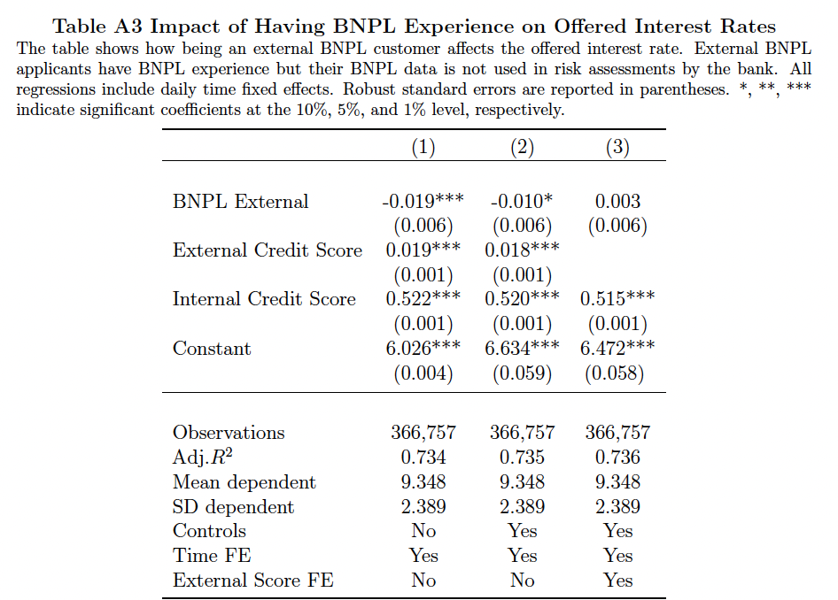
Marginal Information from BNPL in Credit Score
Paper controls for external credit score
Observe lender’s internal credit score
Uses Internal BNPL & non-BNPL information
Doesn’t use External BNPL information
Internal credit score explains
dispersion in offered interest rates:
R² ⬆️ from ~0.3 to ~0.74
Does BNPL use have little-to-no information beyond internal credit score (using non-BNPL information)?

Slide 6
Prediction Problem Or Causal Problem?
Prediction Problem:
Does Past BNPL Use Provide Informative Signal For Non-BNPL Lending Outcomes?
Causal Question:
Does Past BNPL Use Cause Changes In Non-BNPL Lending Outcomes?
(Kleinberg, Ludwig, Mullainathan, Obermeyer, 2015; Mullainathan & Speiss, 2017)
Better causal identification methodology would benefit the paper
Current identification strategy is conditional on observables & only observe outcomes when bank uses BNPL information
Ideally want exogenous variation in BNPL usage and/or adoption of BNPL information by bank
Ideas for better causal identification strategies
Exploit BNPL information dropping off internal credit score: compare applications with BNPL use 12 vs. 13 months prior (alternatively 2 vs. 3 BNPL transactions in last year may also be ok)
(bankruptcy flag lit. e.g., Bos, Breza, & Liberman, 2018; Dobbie, Goldsmith-Pinkham, Mahoney, & Song, 2020)
Variation in consumer BNPL usage driven by bank starting to offer BNPL services
(e.g., IV for BNPL take-up; within-person variation in loan terms pre/post BNPL use)
Fuzzy RDD (IV) in BNPL credit score (e.g., Shupe & Palloni, 2025)
Or lean into prediction problem showing the marginal value of BNPL information
I want to know how bank’s adoption of BNPL information changes their lending decisions, but only post-adoption observed
Follow methods in prior work (e.g., out-of-sample AUC without vs. with BNPL information) & benchmark to other information
(e.g., Berg, Burg, Gombović, & Puri, 2020; Fuster, Goldsmith-Pinkham, Ramadorai, & Walter, 2022;
Blattner & Nelson, 2024; Duarte, Fonseca, Kohli, & Reif, 2025; Guttman-Kenney, 2025)

Slide 7
#2: Extensive Margin

Slide 8
Paper Finds “That BNPL Transaction Data Can Expand Credit Access”
Paper shows loan offer acceptance rates & interest rates vary with BNPL use
What happens to the extensive margin?
Does overall quantity of lending ⬆️ at bank / overall? Is the bank converting more applications?
How do terms (interest rates, loan sizes) of N^{th} consumer loan change within-consumer?
How does access vary depending on whether you repay BNPL or default on BNPL?
To study whether BNPL expands credit access you would need better data
as you do not see loan applications or approvals by other banks & non-banks

Slide 9
#3: Information Sharing

Slide 10
How To Access Better Credit In The U.S. (+U.K.)
Consumers start without a credit score
Take out a credit card
Demonstrate low credit risk behaviors
Don’t miss a credit card payment (by 30+ days),
Don’t spend to near your credit card limit (utilization)
Don’t close your credit card
Over time your credit score ⬆️ & you can access cheaper credit

Slide 11
The Problem With… How To Access Better Credit In The U.S. (+U.K.)
Credit cards are:
Expensive (~20% APR)
Hard to pay off debt (need self-discipline on both spending and repayment)
Amortize slowly (minimum payment is ~1% balance)
“Junk fees”
Plethora of research shows consumers often misunderstand credit cards, & make costly mistakes
(reviewed in Beshears, Choi, Laibson, & Madrian, 2018; Gomes, Haliassos, & Ramadorai, 2021)
BNPL potentially offers a better way for consumers to build credit:
Interest-free
Debt amortizes in a few weeks/months
No junk fees

Slide 12
The Big Unanswered Question: Should BNPL Lenders Share Information?
BNPL lenders historically do not share information with consumer credit reporting agencies (Equifax, Experian, TransUnion) & BNPL not a credit score input (FICO)
Why don’t BNPL lenders voluntarily share information?
BNPL use would be interpreted as negative signal (even if repaid loan)
FICO/VantageScore & BNPL lenders working on adjusting this
Issue not specific to BNPL, also applies to credit building loans (Burke, Jamison, Karlan, Mihaly, & Zinman, 2023) and payday loans (Jansen, Kruger, Maturana, & Shams, 2025)
BNPL lenders worried about credit card lenders targeting their profitable customers.
Similar to credit card lenders’ information sharing decisions (Guttman-Kenney & Shahidinejad, 2025)
Heterogeneity by BNPL lenders’ business models (e.g., Affirm competing with mainstream credit, Klarna finding new-to-credit customers) could mean some reduced access via reduced relationship lending
“How can BNPL payment histories be effectively integrated into traditional credit reporting systems to help borrowers build credit profiles?”
- U.S. Department of Housing and Urban Development (HUD) Request for Information, June 2024
U.K. Financial Conduct Authority (2023) proposed mandating information sharing

Slide 13

Thank You!

Slide 14
BNPL vs. Bank BNPL
BNPL lenders (Affirm, Afterpay, Klarna, PayPal)
BNPL is payment option offered by merchant at point-of-sale (& via app)
Merchant pays BNPL lender a merchant fee
Worthwhile for merchant to do so as offering BNPL increases sales
(Desai & Jindal, 2024; Berg, Burg, Keil, & Puri, 2025; Maesen & Ang, 2025)
Who would use? Liquidity constrained consumers, behavioral consumers (decouple pain of payment, anchoring, present bias)
“BNPL” offered by banks
Very different proposition (at least in U.K. & U.S.A.)
Consumer already made a purchase on credit/debit card with that bank
Consumer later selects a bank transaction to repay in installments
This paper studies a BNPL Lender who is part of a bank
A separate, interesting question that prior literature has not explained is why banks offer BNPL
Banks have more profitable credit offerings (credit cards, overdrafts) than BNPL
Competitive pressures from BNPL lenders?
Mechanism to acquire new customers / increase customer loyalty & lifetime profits?

Slide 15
Learning Channel Needs More Work
Not convinced results are explained by learning as opposed to different types of consumers having different likelihoods of repayment
To study learning channel, you need repeated interactions with a consumer over time
Follow consumers across multiple interactions pre & post BNPL usage
What changes when control for person fixed effects, and compare applications and application outcomes going from without BNPL to with BNPL to multiple BNPL? Cluster at consumer-level.
Also do splits by age

Slide 16
Other Suggestions
I didn’t get anything from the framework in Appendix D. The idea that a bank will update its pricing in response to new information is obvious, and that it will only lend to be profitable. It shouldn’t take 38 equations to make the point. Make it simply or drop entirely. The framework also completely ignores two key ideas: (1) relationship lending that means that firms may make loss-making loans to attract customers who become profitable over time through repeat business (2) preferences & bank market power that means that a bank (as an inside lender) can make loans at a higher interest rate than outside lenders without an existing relationship.
Link to theory on how private information can lead to credit rationing e.g., Stiglitz & Weiss. Can also link to FinTech literature e.g., Di Maggio & Yao (2021) Review of Financial Studies and literature on credit information signals e.g., Blattner & Nelson (2024).
Some other new BNPL citations to review and add in. Desai & Jindal (2024) Quantitative Marketing and Economics. Theory on BNPL lending. Shupe and Palloni (2025) CFPB Working Paper on effects of BNPL on consumers. Maeson & Ang (2025) Journal of Marketing. Effects of BNPL on merchants.
Section 5 needs citations for statements about prior research. It is not clear what papers you are referring to
The sample construction is a bit odd. “We exclude internal customers with a prior relationship with the bank through other services than BNPL”. You are restricting on the outcome of interest. Maybe you are doing so to exclude relationship lending, but please be clear on the reasoning. Similarly, the focus on first time applicants makes sense to me but it would help to explain why you are doing this
What are these unsecured loans used for? How I view consumers taking out this debt very much depends on how they are used
What are the substitutes for BNPL in your setting. Credit cards? Consumer loans?
I found the language ‘internal/external BNPL’ confusing because you don’t observe BNPL with other lenders. All BNPL lending is internal to that bank. Mayber ‘recent BNPL’ and ‘no recent BNPL’?
Section 3.1 uses ‘BNPL Customer’ but the tables use ‘Internal BNPL’ . It would help the reader to be consistent in terminology
In section 2.2 it would be helpful to report how many BNPL users there are in the full sample before applying restrictions that substantially reduce the size of the dataset
People don’t normally use OLS to predict delinquency because it is highly non-linear. Logistic or ML models would align closer to the literature and what industry does
With fixed effects, constant not very informative – no need to include in tables. It is distracting because it changes a lot across models with different fixed effects but that isn’t meaningful
Applying Finkelstein & Poterba (2014 Journal of Risk and Insurance) test for adverse selection using BNPL information not used by lender
If there are multiple observations per consumer you should cluster standard errors in Equation 1 by consumer
In Figure 1 it would be helpful to show the Y axis in percent so it is more easily interpreted. Or show a CDF
In Figures 2 and A1, there’s very few observations in most of these quadrants. It may be clearer to present 10 quantiles to ensure sufficient observations in each cell. Similarly, in Figure 4, there’s effectively no observations after ~4 so the line is not that insightful. Suggest presenting as a binscatter instead
Before Table 3 you would benefit by setting up and discussing why the sign is theoretically ambiguous, what this means, and so important to estimate
Table 4, looking at the r-squared there is quite a lot of unexplained variation in offered rates. Are there other variables that the lender uses beyond external credit score that you observe? If so, you should include these.
Internal and external credit scores have different ranges. This makes them hard to compare. It would be helpful to report the correlation between them and/or the r2 from a regression (linear probably ok but if not try something non-parametric) of one on the other
Do formal covariate balance tests for internal vs. external BNPL users in Table 2 to test whether they are similar on observables. As your identification strategy is conditional on observables, you should be including any differences in all regressions
Quantifying the interest savings e.g., given X% interest rate reduction, and consumer loan of size $Y, a typical consumer would save $Z in interest over the course of the consumer loans. Then given K consumers use BNPL this equates to $L aggregate savings

