Slide 1
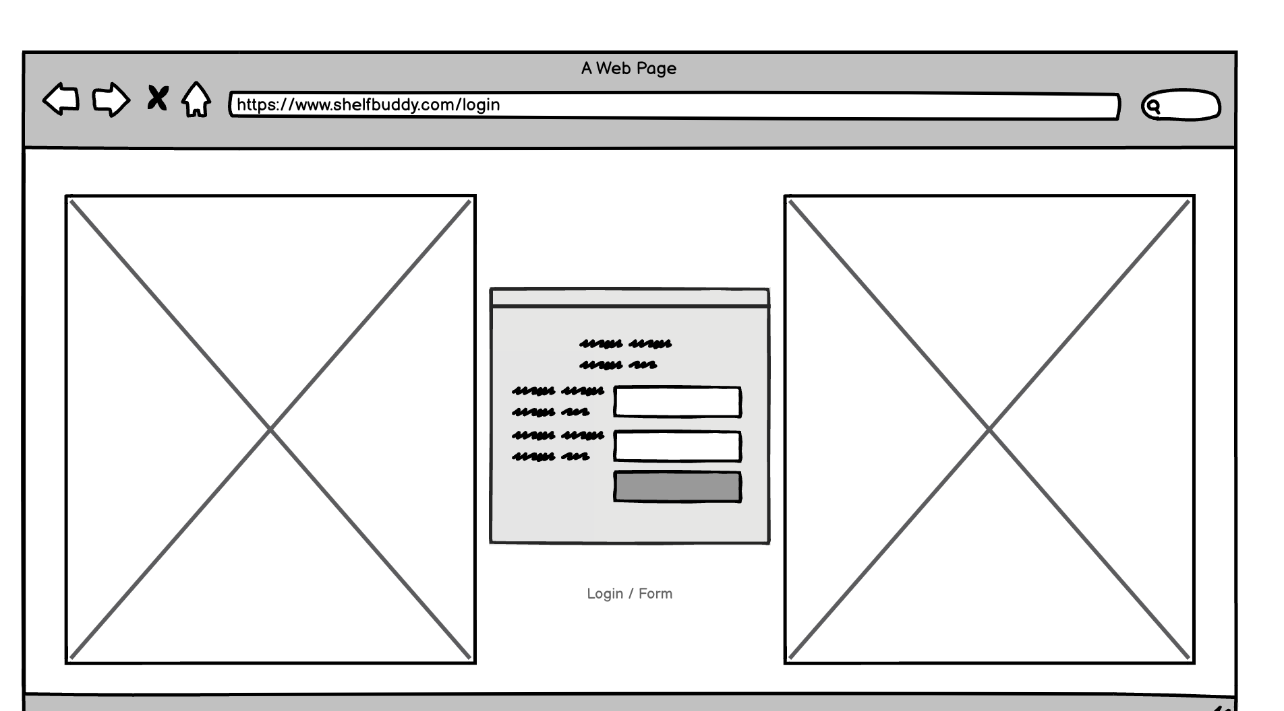
Challenge 1: Prevention of Duplicate Purchases
User logs in.

Slide 2
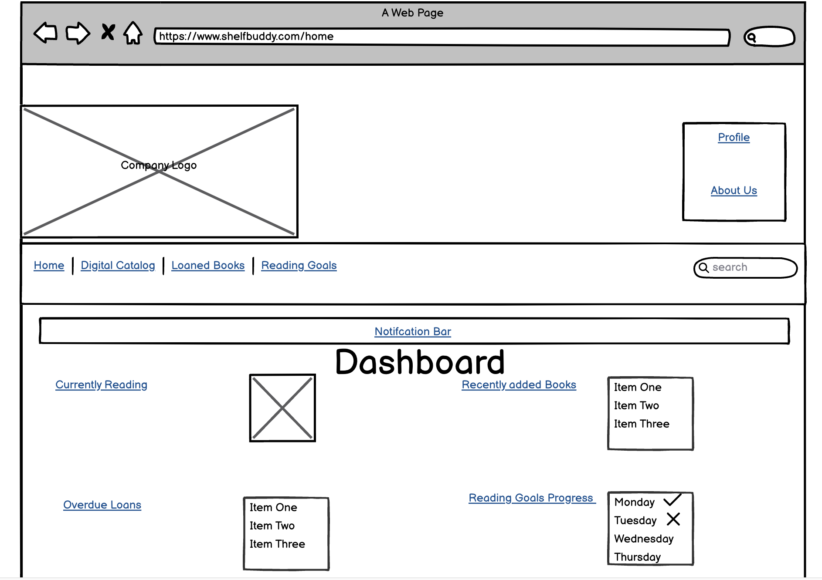
Challenge 1: Prevention of Duplicate Purchases
User lands on Dashbard and inputs book into search input.

Slide 3
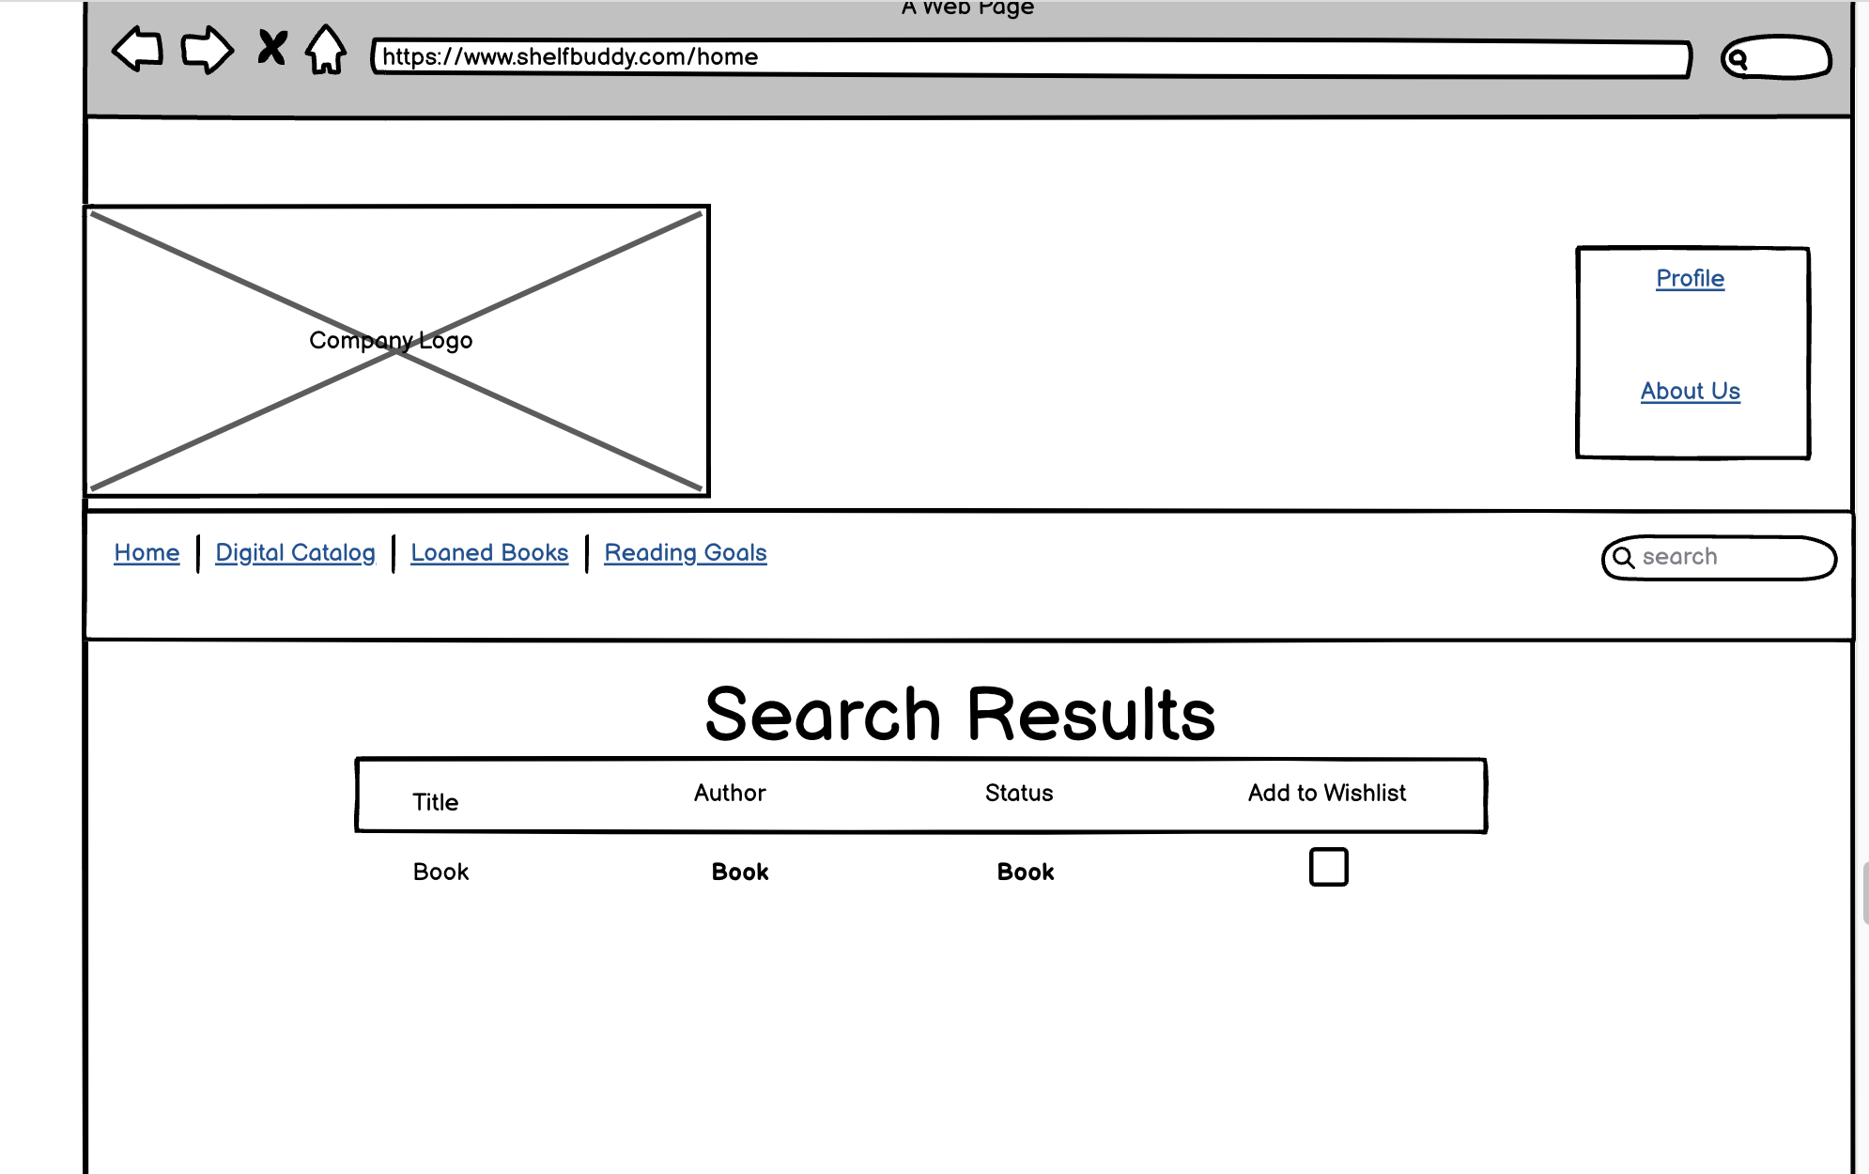
Challenge 1: Prevention of Duplicate Purchases
User will go to search results screen and status will show “In Your Library” or “Loaned” to inform
user that they have the book already.

Slide 4
Challenge 2: Losing track of loaned books
User logs in.

Slide 5
Challenge 2: Losing track of loaned books
User lands on Dashbard and can see Overdue Loans or can go to Loaned books link in menu..

Slide 6
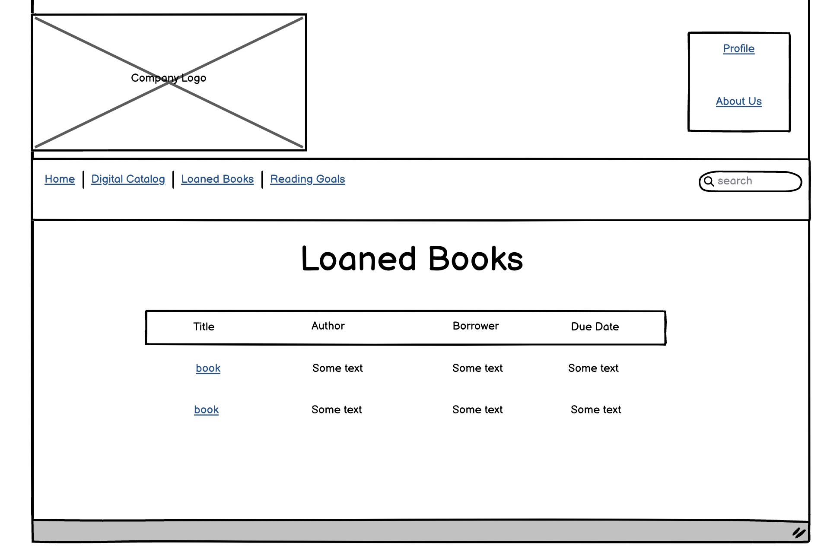
Challenge 2: Losing track of loaned books
Overdue Loans Link and Loaned Books link takes user here. They can click on the book link to get more details.

Slide 7
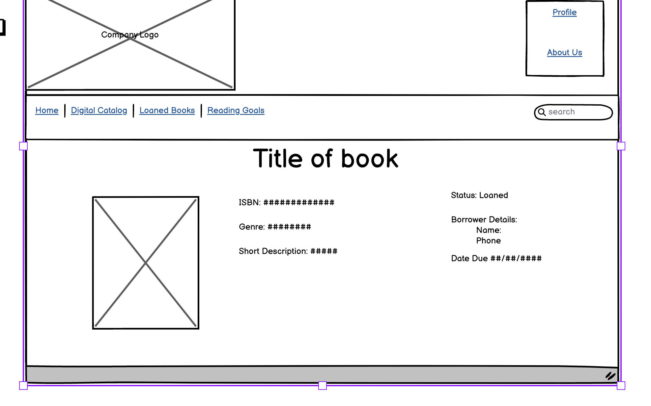
Challenge 2: Losing track of loaned books
User will be able to see details about book and who has book.

Slide 8
Challenge 3: Reading Goals and Planning
User logs in.

Slide 9
Challenge 3: Reading Goals and Planning
User lands on Dashboard and goals to Reading Goals link.

Slide 10
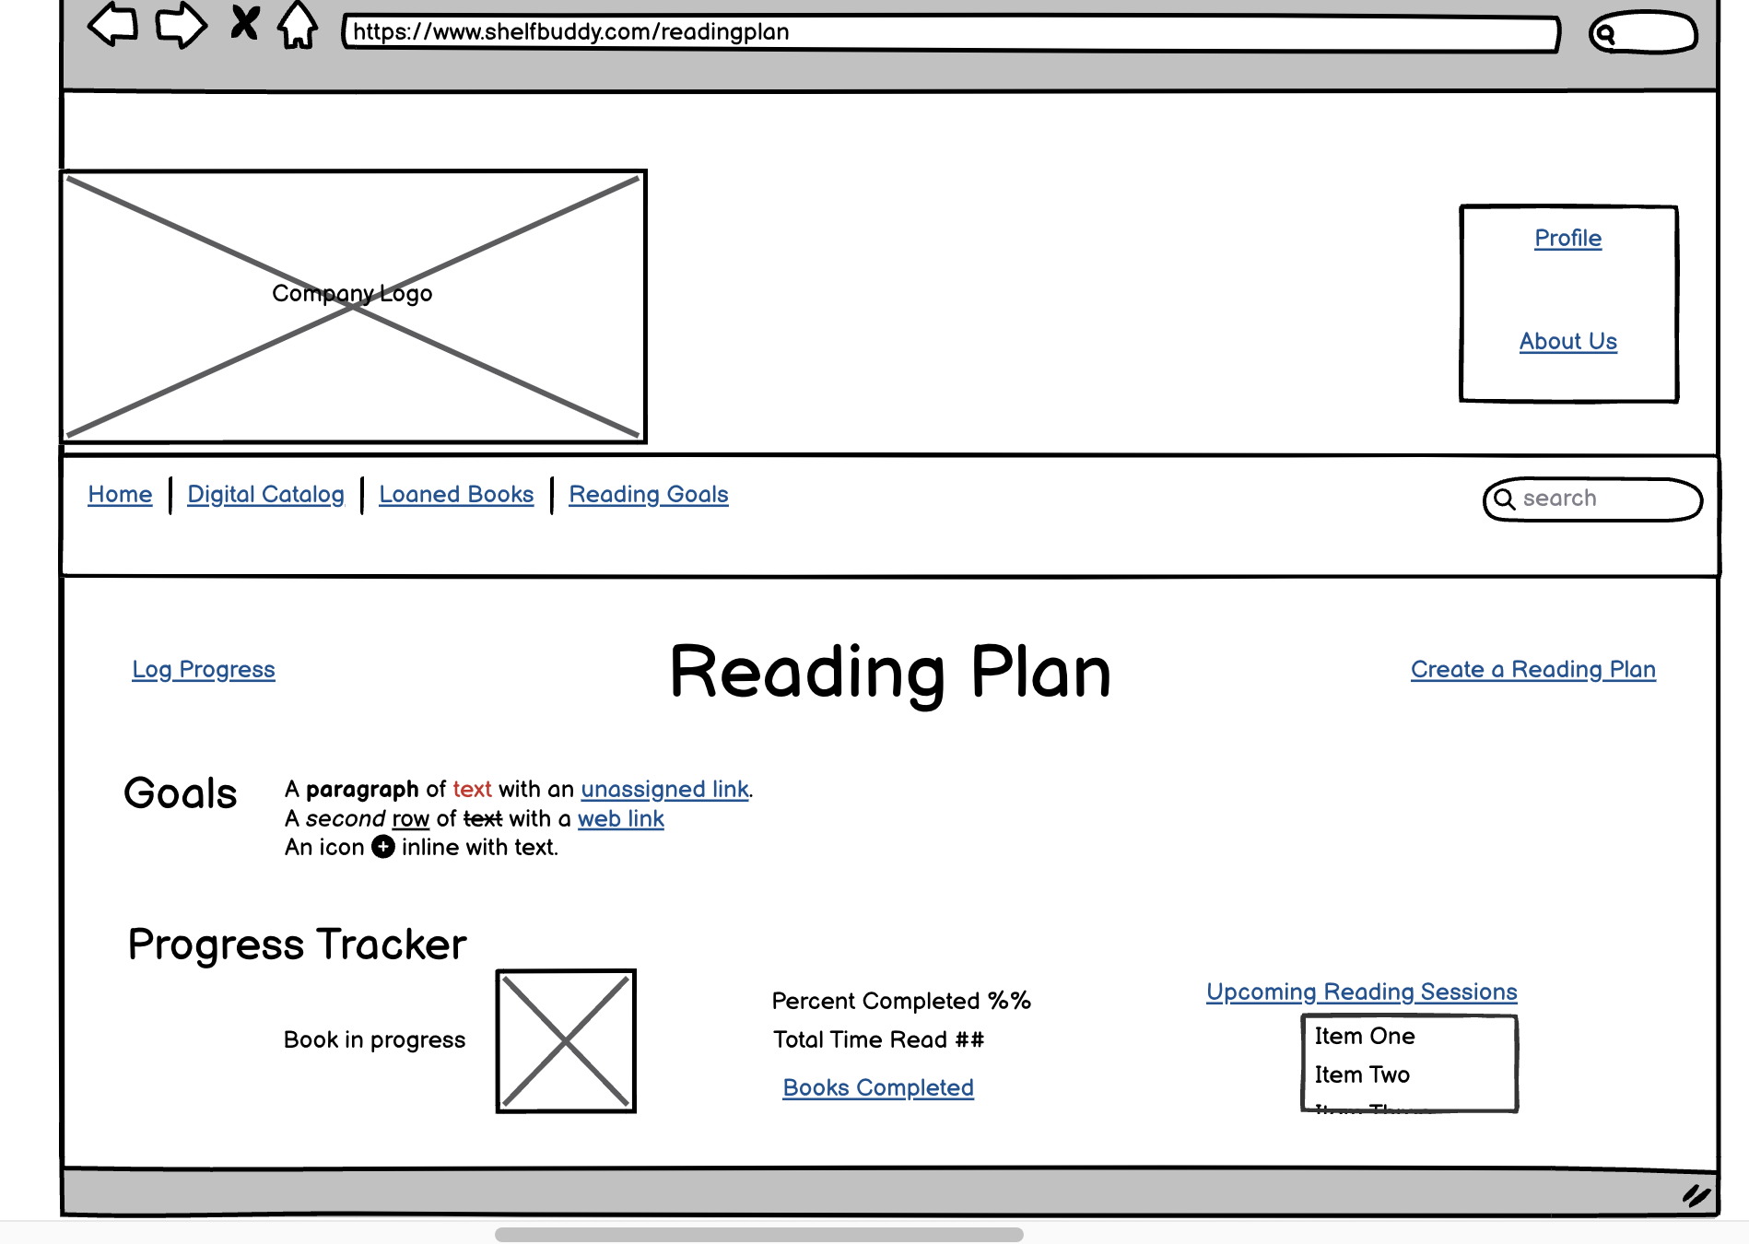
Challenge 3: Reading Goals and Planning
User will be able to view goals, progress, and upcoming schedule on this page. If user has
no goals or will like to create a new one they will go to create a reading plan.

Slide 11
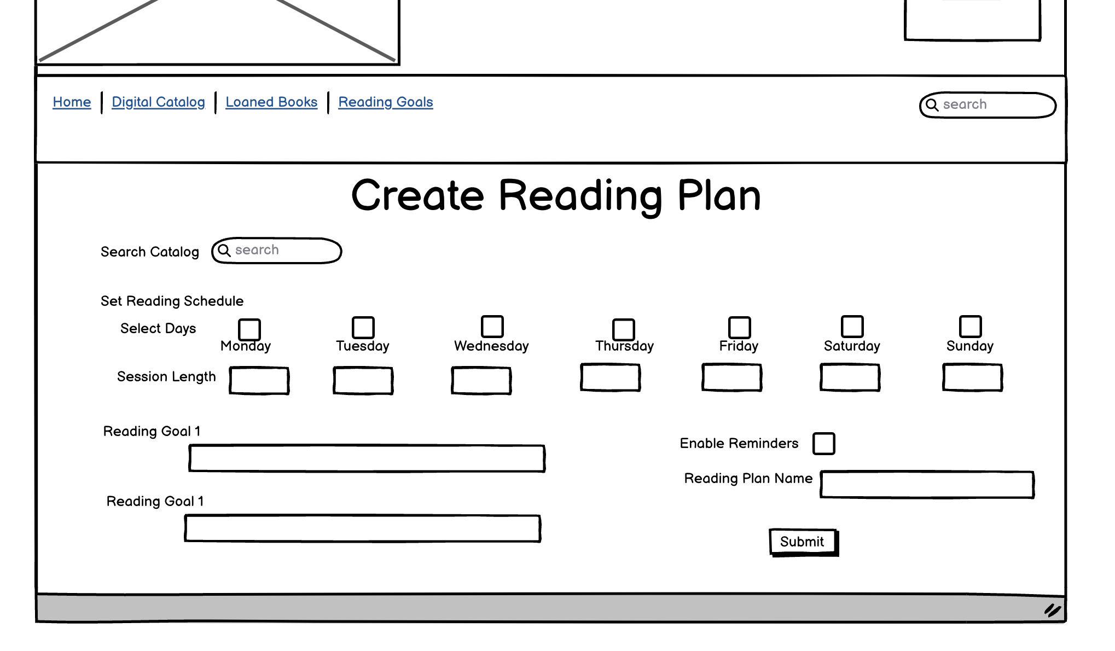
Challenge 3: Reading Goals and Planning
User will create a plan on this page and press submit when they are done.

Slide 12
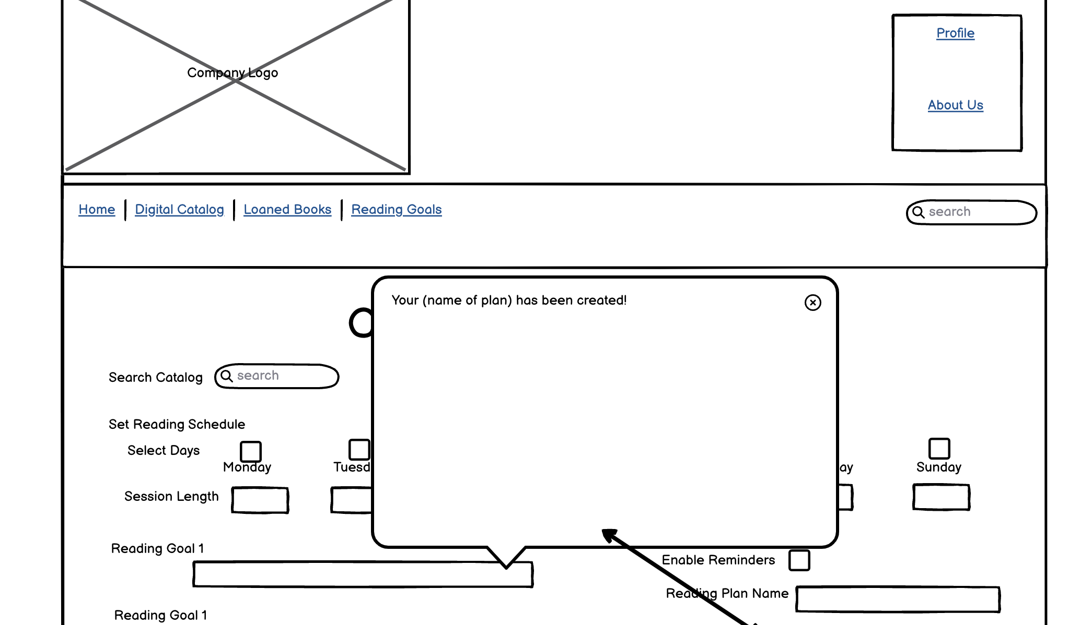
Challenge 3: Reading Goals and Planning
User will get a popup confirming plan was created.

Slide 13
Challenge 3: Reading Goals and Planning
To log progress, user will select Log Progress.

Slide 14
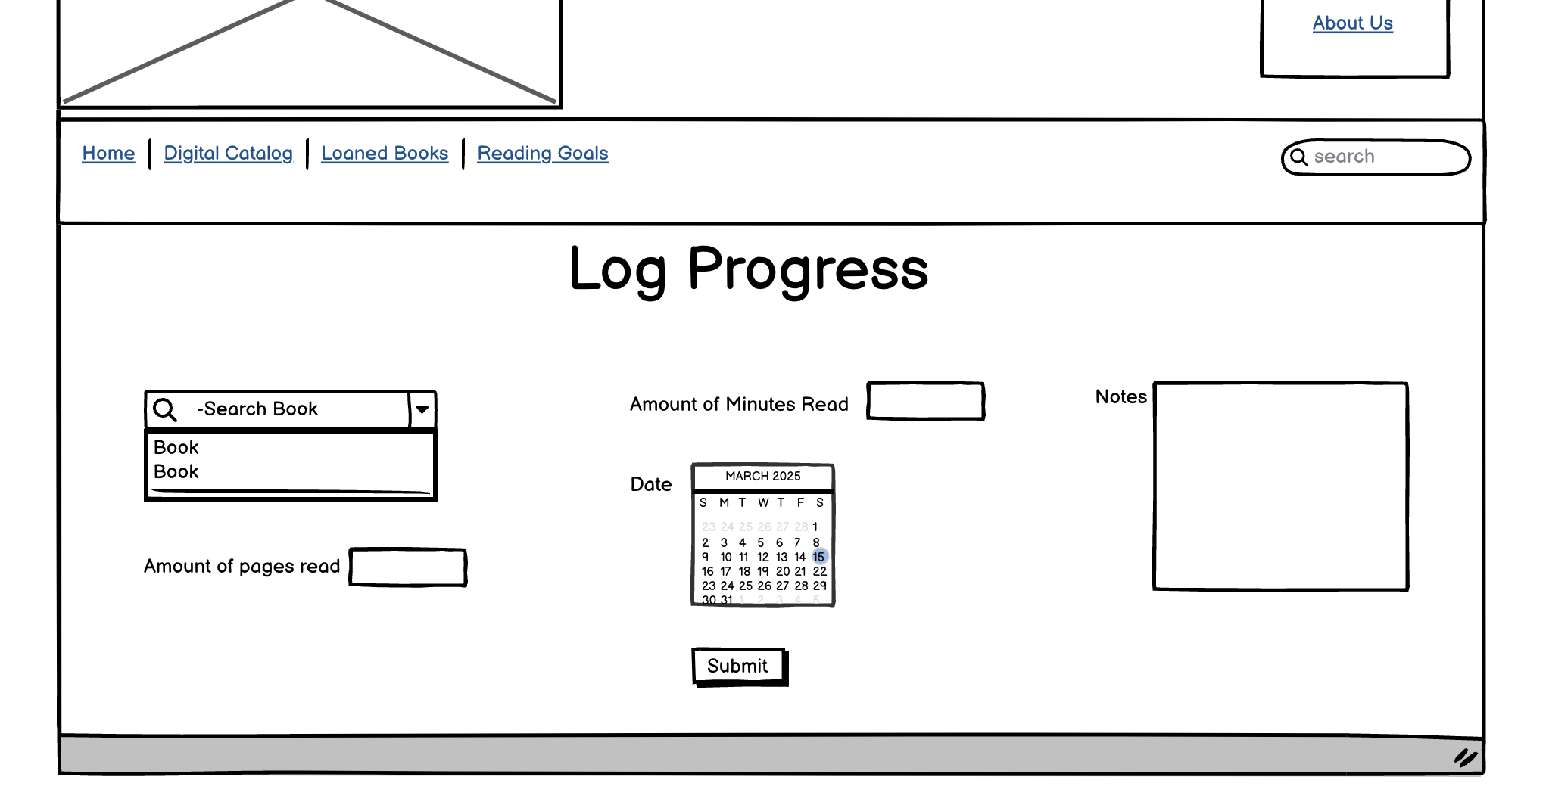
Challenge 3: Reading Goals and Planning
User will log progress and press submit to save.

Slide 15
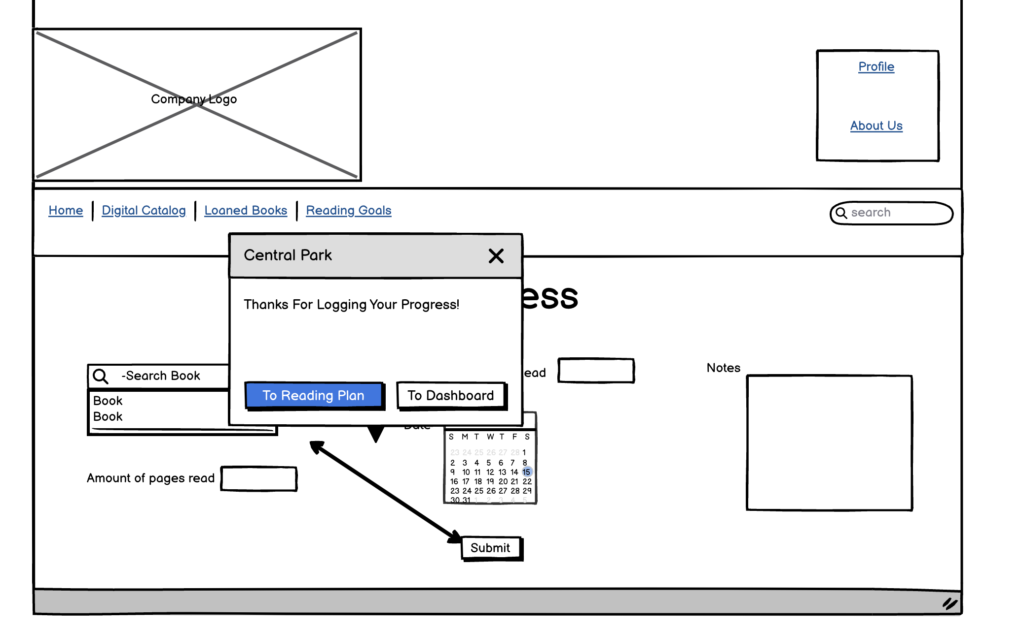
Challenge 3: Reading Goals and Planning
Confirmation of progress logged.

