Slide 1
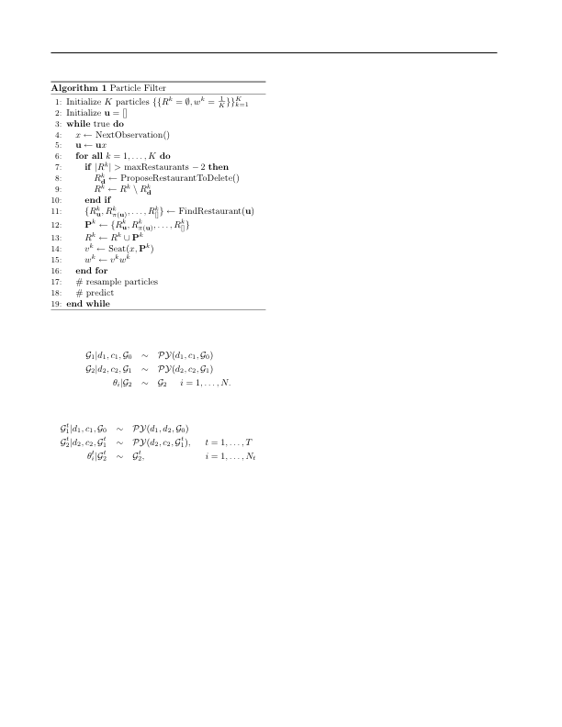
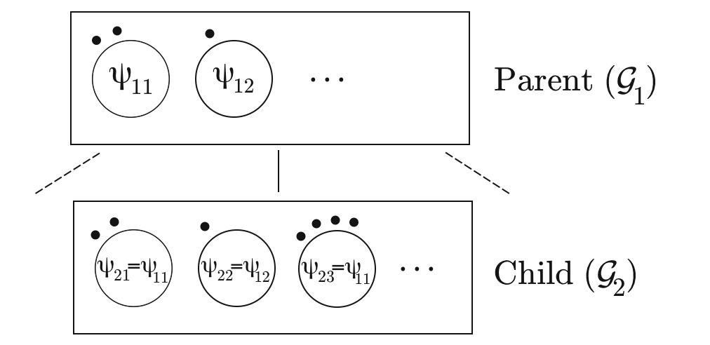
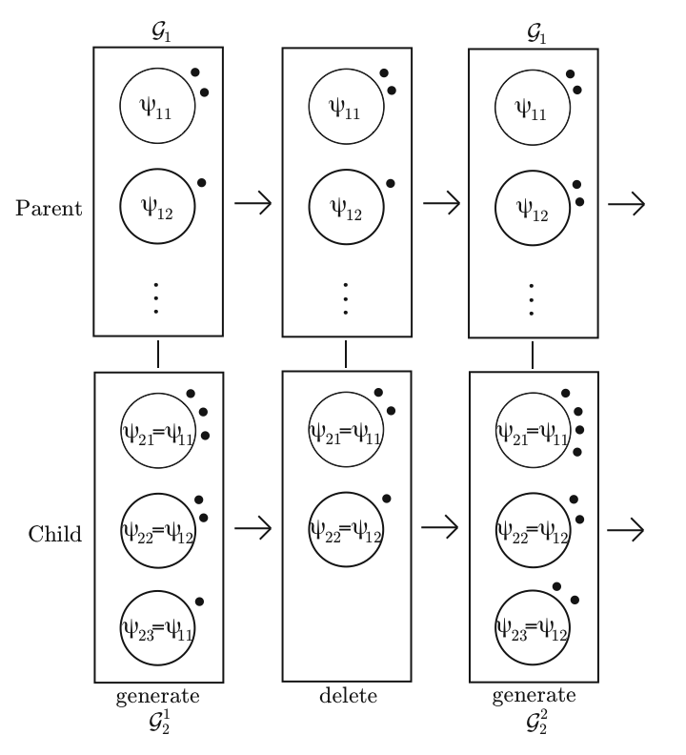
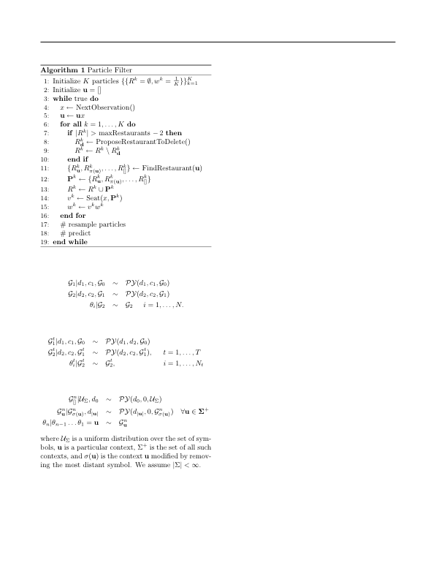
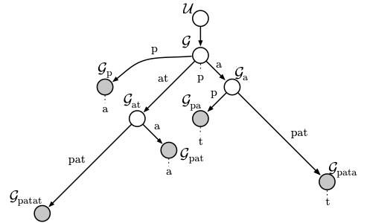
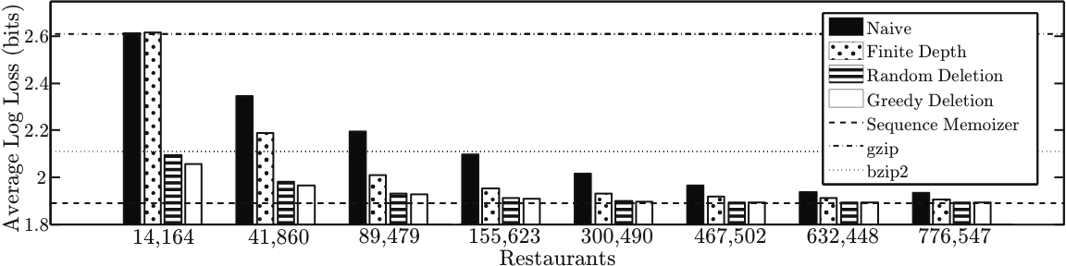
Constant Memory Inference for a Dependent Hierarchical Pitman-Yor Process
Nicholas Bartlett*, David Pfau†, Frank Wood*
Introduction
Dependent Hierarchical Pitman-Yor Process
Results
Goals | Constant memory hierarchical Bayesian nonparametric model. Allow for varying data distribution
Results | Dependent hierarchical Pitman-Yor process Incremental estimation procedure Constant time prediction Constant space model storage
The Ewen’s consistency property under deletion can be used to define a dependent hierarchical Pitman-Yor process (DHPYP). The generative procedure is an extension of the generalized Polya urn scheme for dependent Dirichlet processes [2]. In this DHPYP, deletion only takes place in leaf nodes. A small example model is
Pitman-Yor Process (PYP) [5]
Depiction of Deletion Process
Intuitions
One application of discrete sequence modeling is compression. Results on the Calgary Corpus [1] are shown for four constant space modeling approaches. On the y-axis is the average per byte predictive log loss which translates to the number of bits per byte required to represent the file in the compression setting. Dividing the y-axis by eight gives the compression ratio.
Since restaurants in the CRF representation require constant space, the amount of memory used is approximately proportional to the number of restaurants. Each block of four bars shows compression results with a specified limit on the number of restaurants used. The number of restaurants used in each block is the number of restaurants required by a 3-gram up to a 10-gram. Vertical lines show the performance of commercial compressors and the full SM.
The PYP is a distribution over distributions. It is a generalization of the Dirichlet process. Sampling from the PYP can be done in two steps :
Draw a partition of the first N integers from the Ewen’s two parameter sampling distribution [3].
To each part of the partition assign a value drawn from the base distribution. The value of sample element J is the value assigned to the part of the partition containing the integer J.
• Dependence between steps is induced by
undeleted customers.
• Customers in the parent are not deleted if
the corresponding table is removed from
the child.
• The deletion process can remove all
customers in a given leaf restaurant.
• Empty leaf restaurants need not be
explicitly represented.
Hierarchical Pitman-Yor Processes (HPYP) [6]
Hierarchically composing PY processes is a way to smooth distribution estimates
Sequence Memoizer [8]
Discussion and Future Work
The SM is a linear space HPYP model with all concentration parameters set to zero. Linear growth is impractical for very long sequences.
• Other ways to create dependence in a sequence of HPYPs
• More extensive testing with massive data
• Testing of structure discovery with synthetic data
• Properties of single particle sequential Monte Carlo
Discrete Sequence Modeling
SM Graphical Model
Graphical Depiction of Draw from HPYP
In a HPYP discrete sequence model nodes correspond to conditional distributions given some context. The parent node corresponds to a distribution conditioned on a more general context. Leaf nodes in the sequence model describe the distribution of symbols appearing after very long contexts and are unlikely to appear often in the data.
Particle Filter Inference
References
The Chinese Restaurant Franchise (CRF) [7] is depicted here. The dots are customers and the boxes are restaurants.
[1] Bell, T., Witten, I.H., and Cleary, J.G. Modeling for text
compression. ACM Computing Surveys (CSUR), 21(4)
557–591, 1989.
[2] Caron, F., Davy, M., and Doucet, A. Generalized Polya urn
for time-varying Dirichlet process mixtures. In 23rd
Conference on Uncertainty in Artiﬁcial Intelligence
(UAI’2007), Vancouver, Canada, July 2007, 2007.
[3] Ewens, WJ and Tavare, S. The Ewens sampling formula.
Multivariate Discrete Distributions. Wiley, New York,
1995.
[4] Pitman, J. Exchangeable and partially exchangeable
random partitions. Probability Theory and Related Fields,
102(2):145–158, 1995.
[5] Pitman, J. and Yor, M. The two-parameter Poisson-
Dirichlet distribution derived from a stable subordinator.
Annals of Probability, 25:855–900, 1997.
[6] Teh, Y. W. A hierarchical Bayesian language model based
on Pitman-Yor processes. In Proceedings of the
Association for Computational Linguistics, pp. 985–992,
2006.
[7] Teh, Y. W., Jordan, M. I., Beal, M. J., and Blei, D. M.
Hierarchical Dirichlet processes. Journal of the American
Statistical Association, 101(476): 1566–1581, 2006.
[8] Wood, F., Archambeau, C., Gasthaus, J., James, L., and
Teh, Y. W. A stochastic memoizer for sequence data. In
Proceedings of the 26th International Conference on
Machine Learning, pp. 1129–1136, Montreal, Canada,
2009.
DHPYP Discrete Sequence Model
Ewen’s Consistency Property
A dependent discrete sequence model based on the SM can be formulated
If N objects are partitioned following the Ewen’s sampling distribution and one object is removed uniformly at random, the resulting partition also follows the Ewen’s sampling distribution [4].
*Statistics Department, Columbia University | †Center for Theoretical Neuroscience, Columbia University

