Slide 1
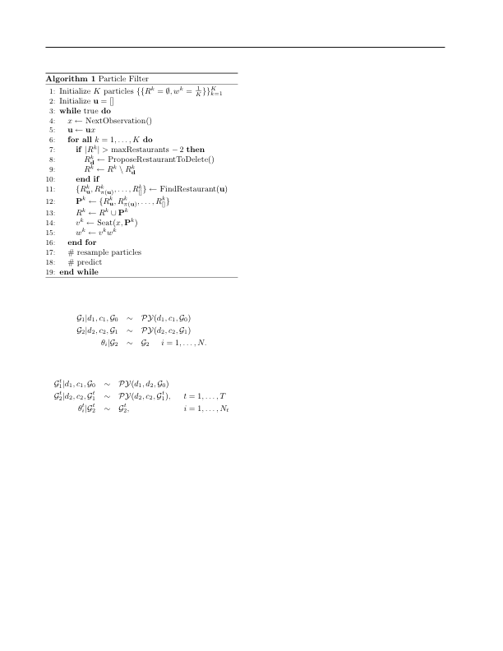
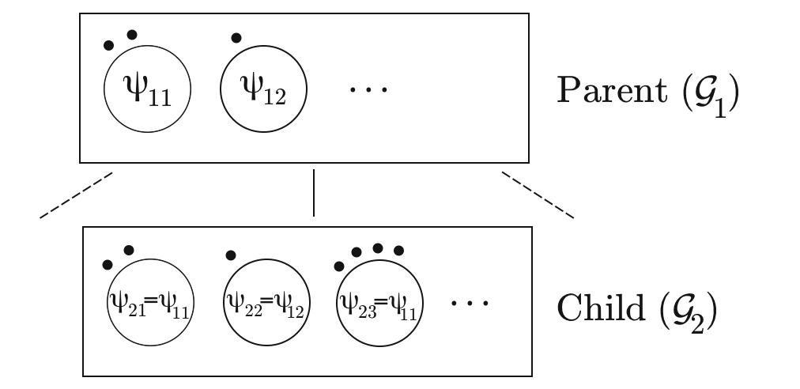
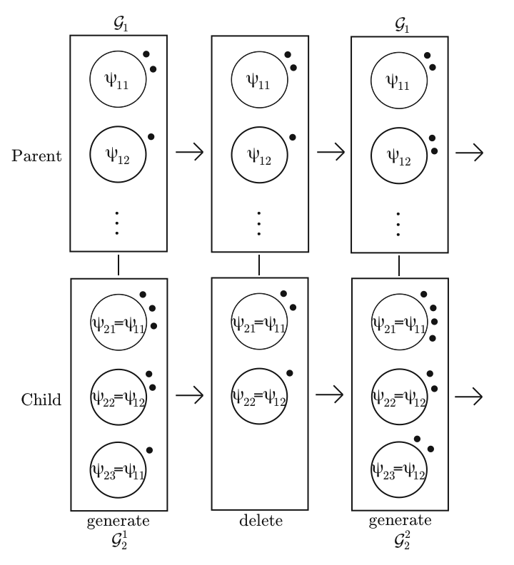
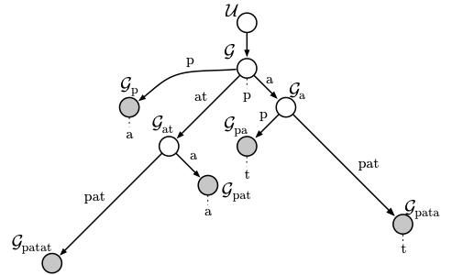
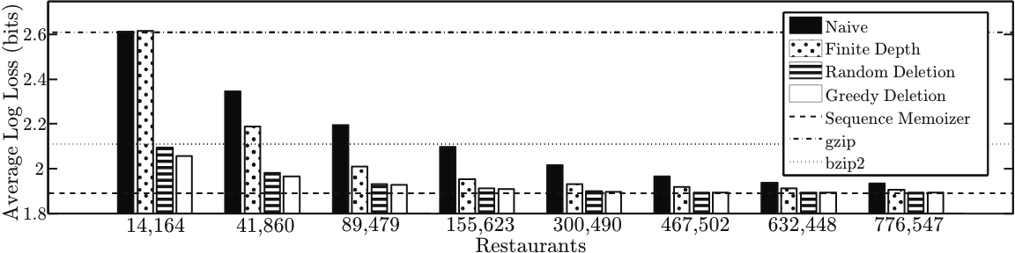
Constant Memory Inference for a Dependent Hierarchical Pitman-Yor Process
Nicholas Bartlett*, David Pfau†, Frank Wood*
Introduction
Results
Particle Filter Inference
Goals: - Describe dependent hierarchical
Pitman-Yor Process
Results: - Constant space sequence model
-Test data entropy approaching the sequence
memoizer model
-Incremental Estimation procedure
Drawing from a Pitman-Yor Process
Sequence Memoizer Model
Draw a partition of the first N integers from the Ewen’s two parameter sampling distribution.
If part J of the partition is made up of K integers, assign K elements in the final sample a value drawn from the base distribution.
The SM model is a HPYP model with all concentration parameters set to zero. This allows for linear space complexity as seen in the graphical model.
Dependent Hierarchical Pitman-Yor Process
Hierarchical Pitman-Yor Processes (HPYP)
The consistency property can be used to create the generative process of a dependent hierarchical Pitman-Yor process. In this process, deletion only takes place in leaf nodes, such as those shaded grey in the SM graphical model.
Graphical Depiction of Draw from HPYP
Depiction of Deletion Process
SM Graphical Model
Ewen’s Consistency Property
If N objects are partitioned following the Ewen’s sampling distribution and one object is removed uniformly at random, the resulting partition also follows the Ewen’s sampling distribution.
*Statistics Department, Columbia University | †Center for Theoretical Neuroscience, Columbia University

