Slide 1
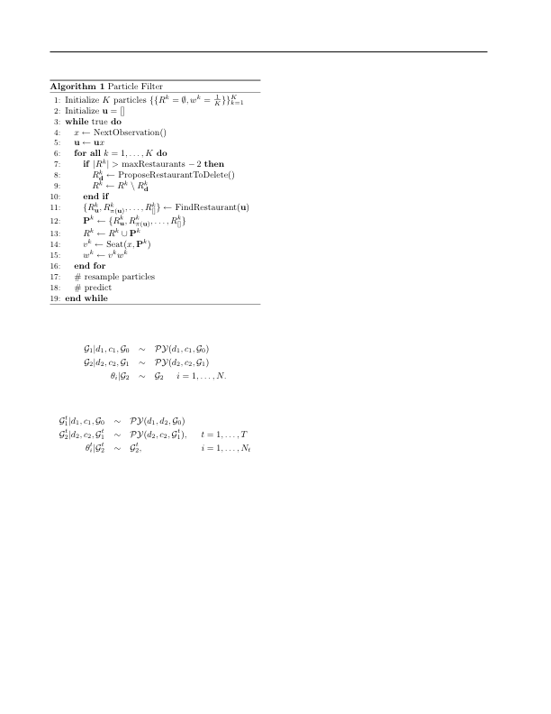
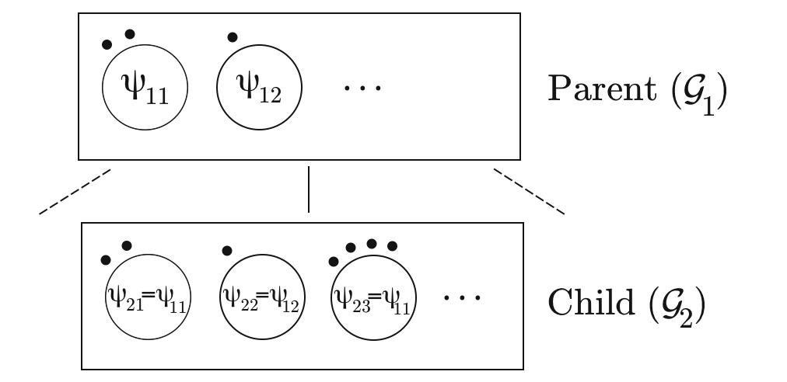
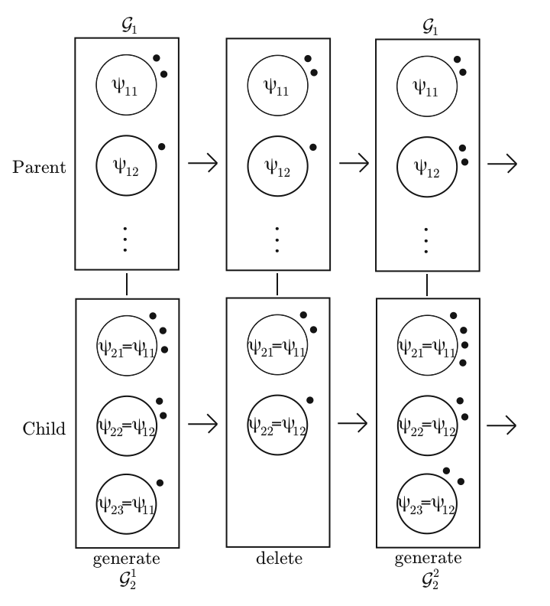
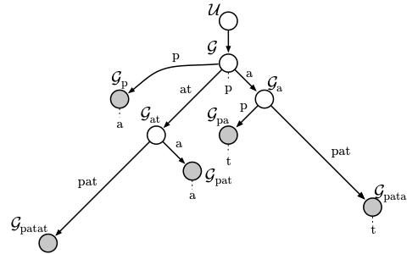
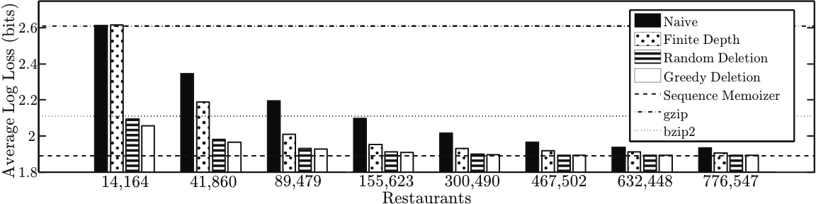
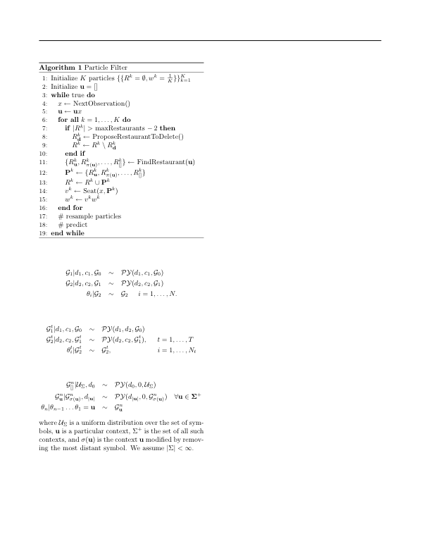
Constant Memory Inference for a Dependent Hierarchical Pitman-Yor Process
Nicholas Bartlett*, David Pfau†, Frank Wood*
Introduction
Sequence Memoizer Model
Dependent HPYP Sequence Model
Goals: - Describe dependent hierarchical
Pitman-Yor Process
Results: - Constant space sequence model
-Test data entropy approaching the sequence
memoizer model
-Incremental Estimation procedure
The SM model is a HPYP model with all concentration parameters set to zero. This allows for linear space complexity as seen in the graphical model.
Dependent Hierarchical Pitman-Yor Process
Particle Filter Inference
Drawing from a Pitman-Yor Process
Draw a partition of the first N integers from the Ewen’s two parameter sampling distribution.
If part J of the partition is made up of K integers, assign K elements in the final sample a value drawn from the base distribution.
The consistency property can be used to create the generative process of a dependent hierarchical Pitman-Yor process. In this process, deletion only takes place in leaf nodes, such as those shaded grey in the SM graphical model.
Hierarchical Pitman-Yor Processes (HPYP)
Results
Graphical Depiction of Draw from HPYP
Depiction of Deletion Process
SM Graphical Model
Ewen’s Consistency Property
If N objects are partitioned following the Ewen’s sampling distribution and one object is removed uniformly at random, the resulting partition also follows the Ewen’s sampling distribution.
*Statistics Department, Columbia University | †Center for Theoretical Neuroscience, Columbia University

