Slide 1
The Sequence Memoizer
Frank Wood
Cedric Archambeau
Jan Gasthaus
Lancelot James
Yee Whye Teh
Gatsby
UCL
Gatsby
HKUST
Gatsby
TexPoint fonts used in EMF.
Read the TexPoint manual before you delete this box.: AAAAAAAA

Slide 2
Executive Summary
Model
  Smoothing Markov model of discrete sequences
  Extension of hierarchical Pitman Yor process [Teh 2006]
    Unbounded depth (context length)
Algorithms and estimation
  Linear time suffix-tree graphical model identification and construction
  Standard Chinese restaurant franchise sampler
Results
  Maximum contextual information used during inference
  Competitive language modelling results
    Limit of n-gram language model as n!1
  Same computational cost as a Bayesian interpolating 5-gram language model

Slide 3
Executive Summary
Uses
  Any situation in which a low-order Markov model of discrete sequences is insufficient
  Drop in replacement for smoothing Markov model
Name?
  ``A Stochastic Memoizer for Sequence Data’’ ! Sequence Memoizer (SM)
    Describes posterior inference [Goodman et al ‘08]

Slide 4
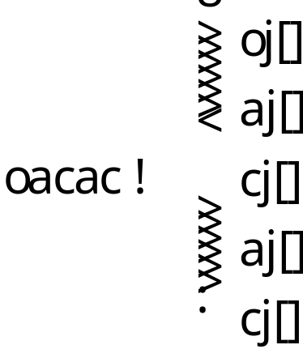
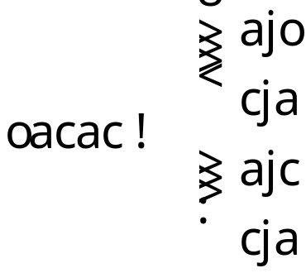
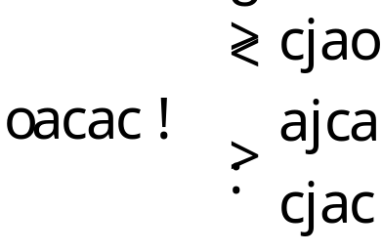
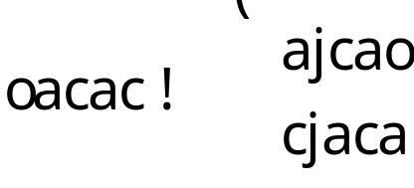
Statistically Characterizing a Sequence
Sequence Markov models are usually constructed by treating a sequence as a set of (exchangeable) observations in fixed-length contexts
unigram
bigram
trigram
4-gram
Increasing context length / order of Markov model
Decreasing number of observations
Increasing number of conditional distributions to estimate (indexed by context)
Increasing power of model

Slide 5
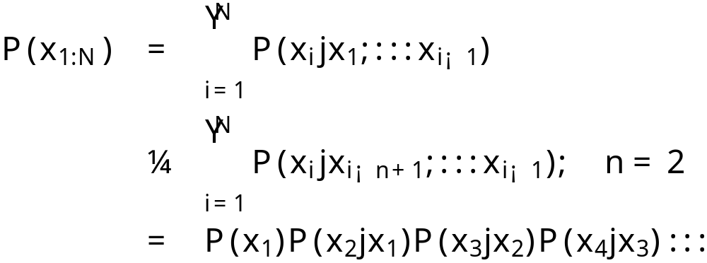
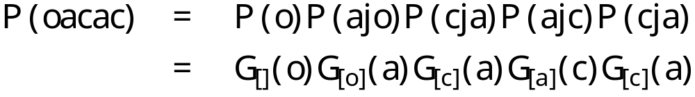
Finite Order Markov Model
Example

Slide 6

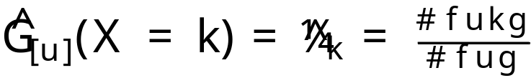
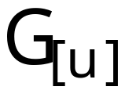


Learning Discrete Conditional Distributions
Discrete distribution $ vector of parameters
Counting / Maximum likelihood estimation
  Training sequence x_{1:N}
  Predictive inference
Example
  Non-smoothed unigram model (u = ²)
Notes:
Unigram probability \phi_k = word, \pi_k = probability of seeing word

Slide 7

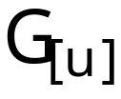
Bayesian Smoothing
Estimation
Predictive inference
Priors over distributions
Net effect
  Inference is “smoothed” w.r.t. uncertainty about unknown distribution
Example
  Smoothed unigram (u = ²)
Notes:
Smoothing unigram language model – uncertainty about G,

Slide 8
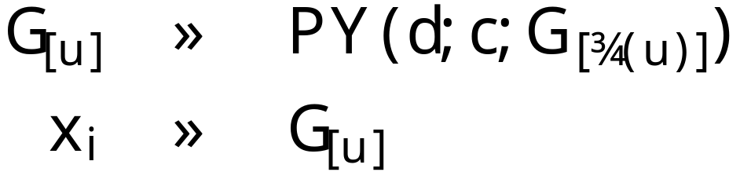
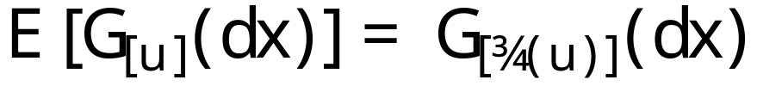
A Way To Tie Together Distributions
Tool for tying together related distributions in hierarchical models
Measure over measures
Base measure is the “mean” measure
A distribution drawn from a Pitman Yor process is related to its base distribution
  (equal when c = 1 or d = 1)
discount
concentration
base distribution
[Pitman and Yor ’97]
TexPoint fonts used in EMF.
Read the TexPoint manual before you delete this box.: AAAAAAA

Slide 9
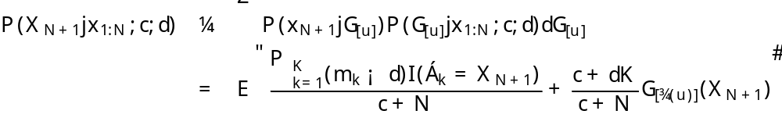
Pitman-Yor Process Continued
Generalization of the Dirichlet process (d = 0)
  Different (power-law) properties
  Better for text [Teh, 2006] and images [Sudderth and Jordan, 2009]
Posterior predictive distribution
Forms the basis for straightforward, simple samplers
Rule for stochastic memoization
Can’t actually do this integral this way
TexPoint fonts used in EMF.
Read the TexPoint manual before you delete this box.: AAAAAAA

Slide 10

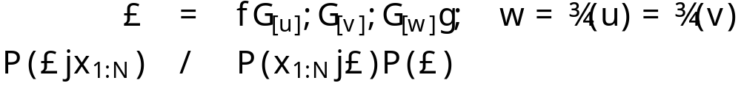

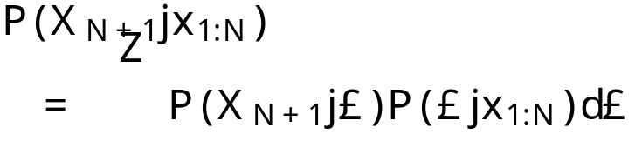






Hierarchical Bayesian Smoothing
Estimation
Predictive inference
Naturally related distributions tied together
Net effect
  Observations in one context affect inference in other context.
  Statistical strength is shared between similar contexts
Example
  Smoothing bi-gram (w = ², u,v 2 Σ)
Notes:
really a 3*K integral now

Slide 11





SM/HPYP Sharing in Action
Observations
Conditional Distributions
Posterior Predictive Probabilities
TexPoint fonts used in EMF.
Read the TexPoint manual before you delete this box.: AA

Slide 12



CRF Particle Filter Posterior Update
Observations
Conditional Distributions
Posterior Predictive Probabilities
CPU

Slide 13


CRF Particle Filter Posterior Update
Observations
Conditional Distributions
Posterior Predictive Probabilities
CPU
CPU

Slide 14






HPYP LM Sharing Architecture
Share statistical strength between sequentially related predictive conditional distributions
  Estimates of highly specific conditional distributions
  Are coupled with others that are related
  Through a single common, more-general shared ancestor
Corresponds intuitively to back-off
Unigram
2-gram
3-gram
4-gram

Slide 15
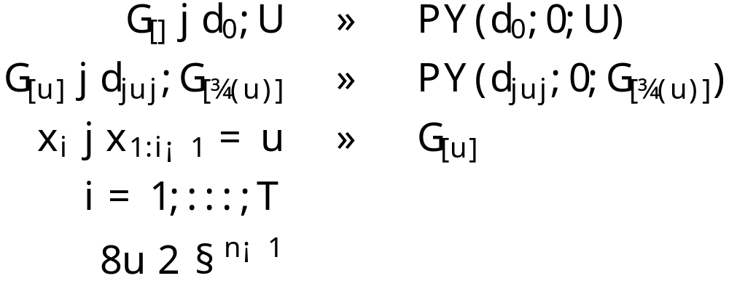
Hierarchical Pitman Yor Process
Bayesian generalization of smoothing n-gram Markov model
Language model : outperforms interpolated Kneser-Ney (KN) smoothing
Efficient inference algorithms exist
  [Goldwater et al ’05; Teh, ’06; Teh, Kurihara, Welling, ’08]
Sharing between contexts that differ in most distant symbol only
Finite depth
[Goldwater et al ’05, Teh ’06]

Slide 16
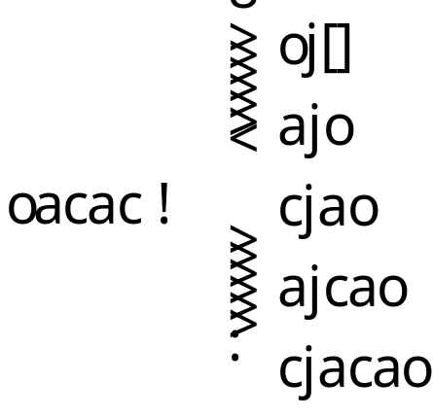
Alternative Sequence Characterization
A sequence can be characterized by a set of single observations in unique contexts of growing length
Increasing context length
Always a single observation
Foreshadowing: all suffixes of the string “cacao”

Slide 17
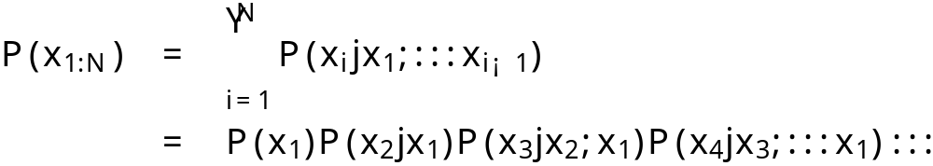
``Non-Markov’’ Model
Example
Smoothing essential
  Only one observation in each context!
Solution
  Hierarchical sharing ala HPYP

Slide 18
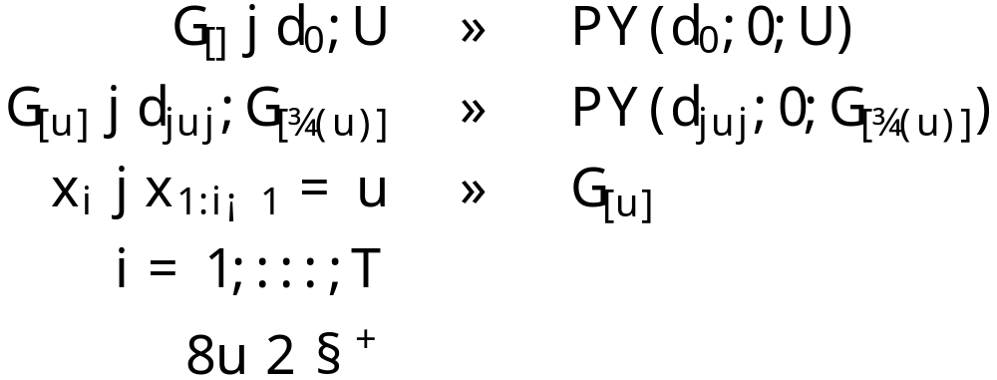



Sequence Memoizer
Eliminates Markov order selection
Always uses full context when making predictions
Linear time, linear space (in length of observation sequence) graphical model identification
Performance is limit of n-gram as n!1
Same or less overall cost as 5-gram interpolating Kneser Ney

Slide 19
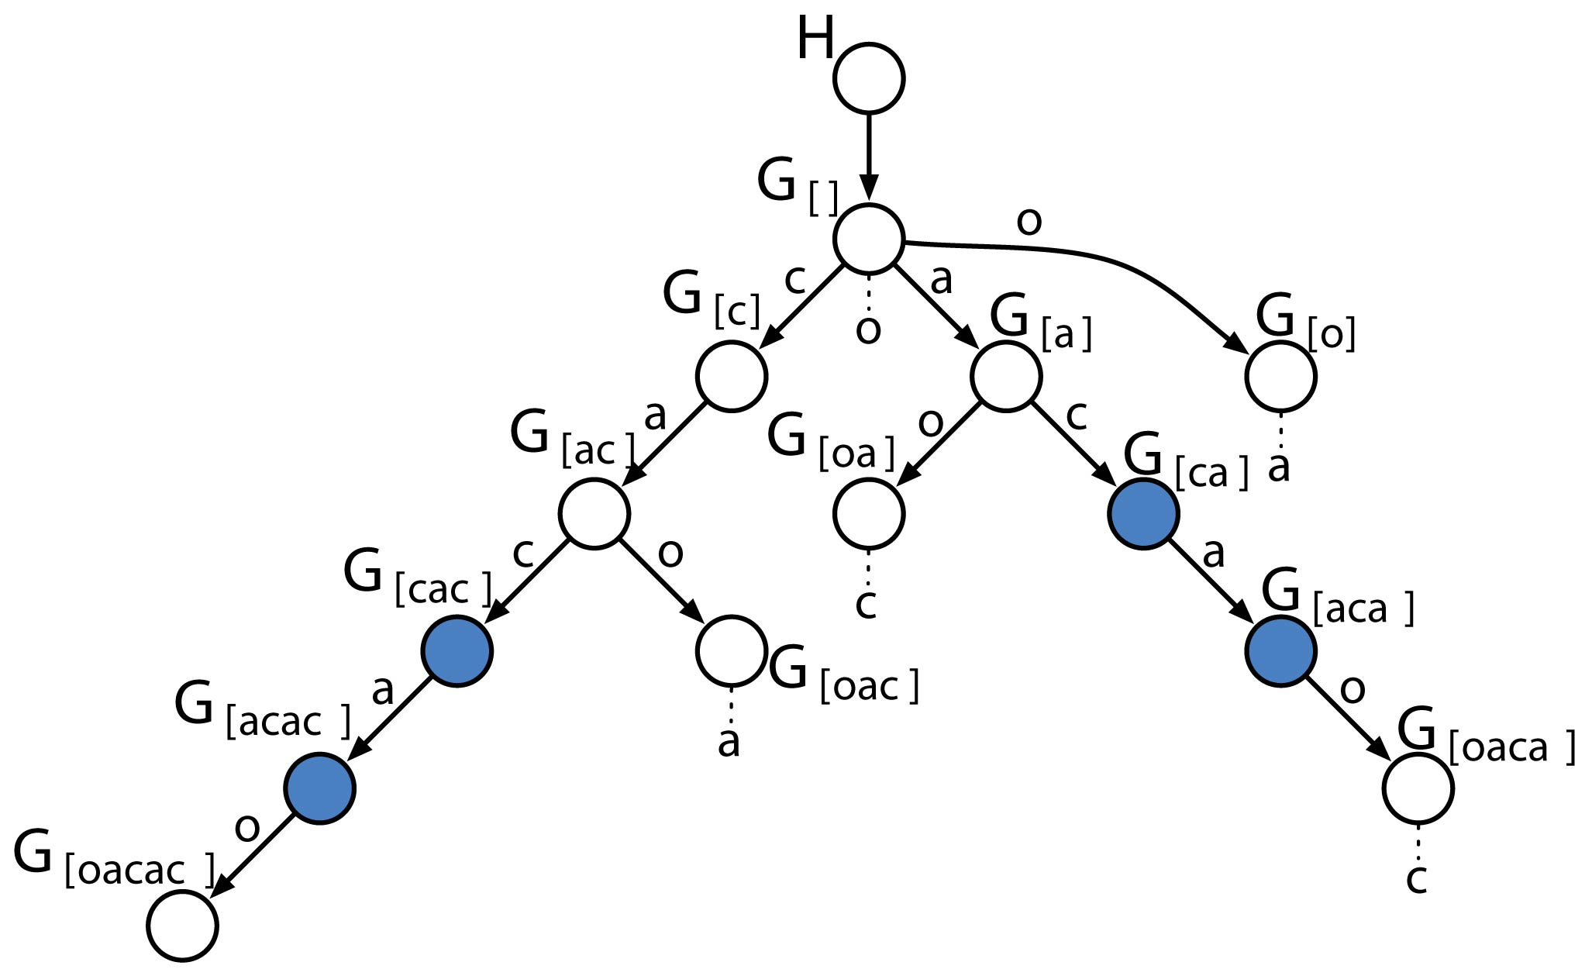
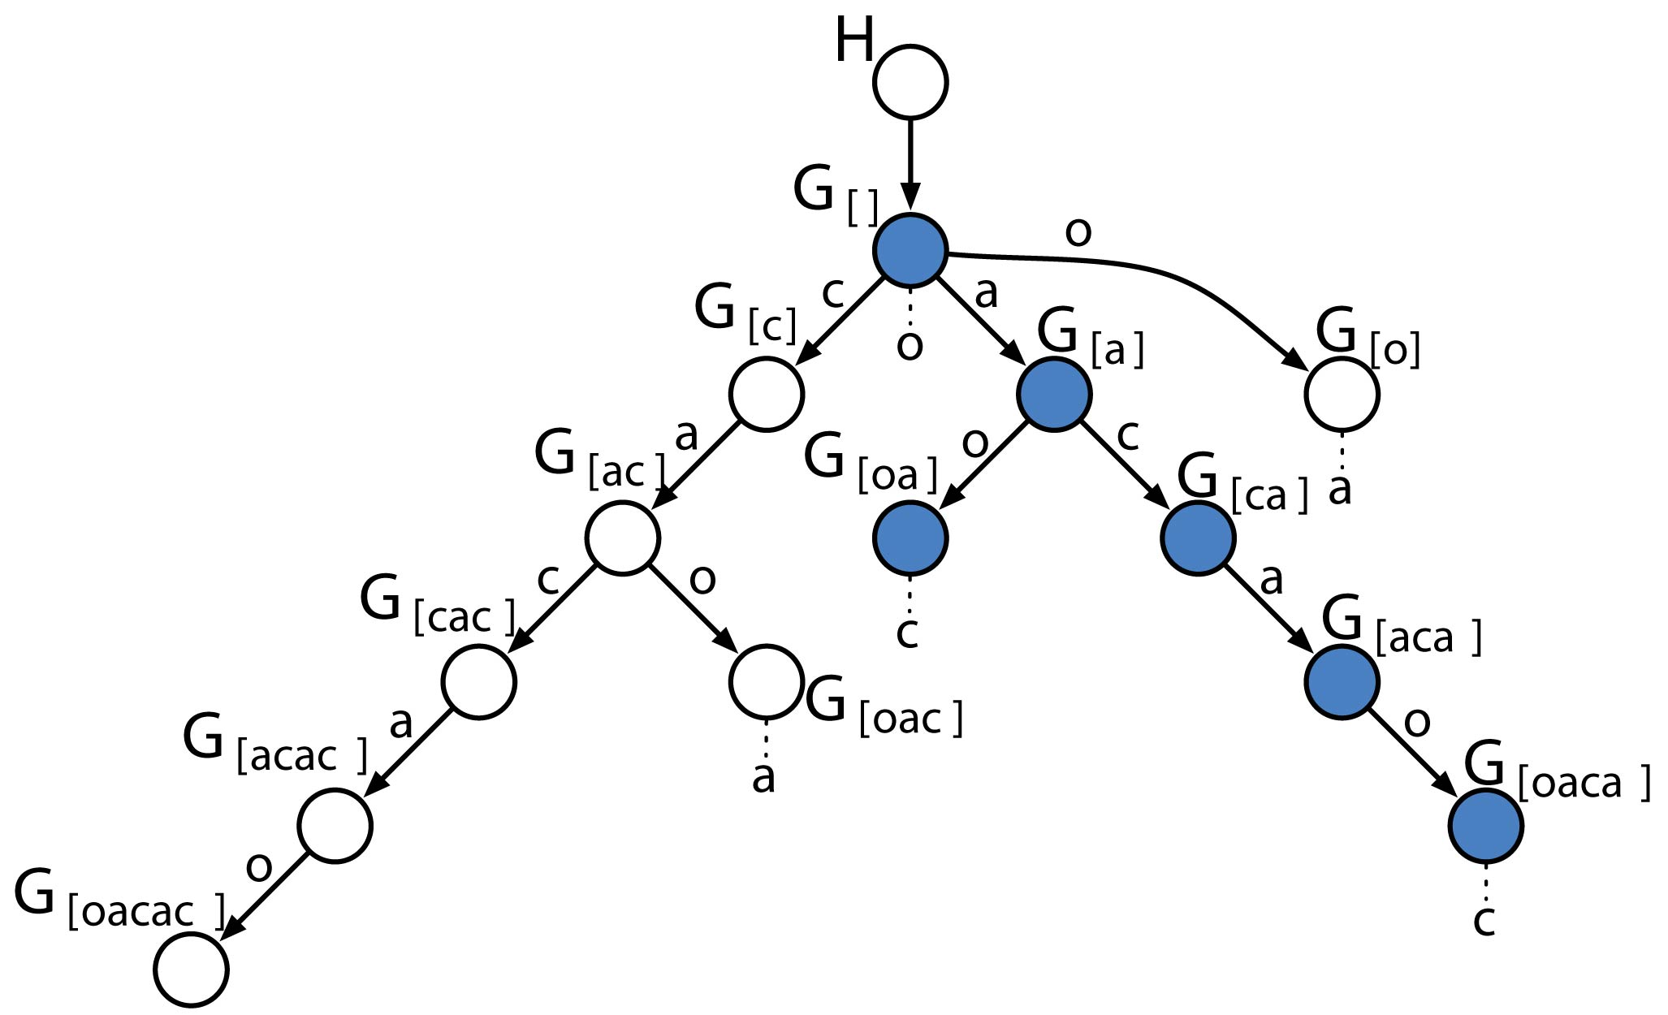
Graphical Model Trie
Observations
Latent conditional distributions with Pitman Yor priors / stochastic memoizers

Slide 20
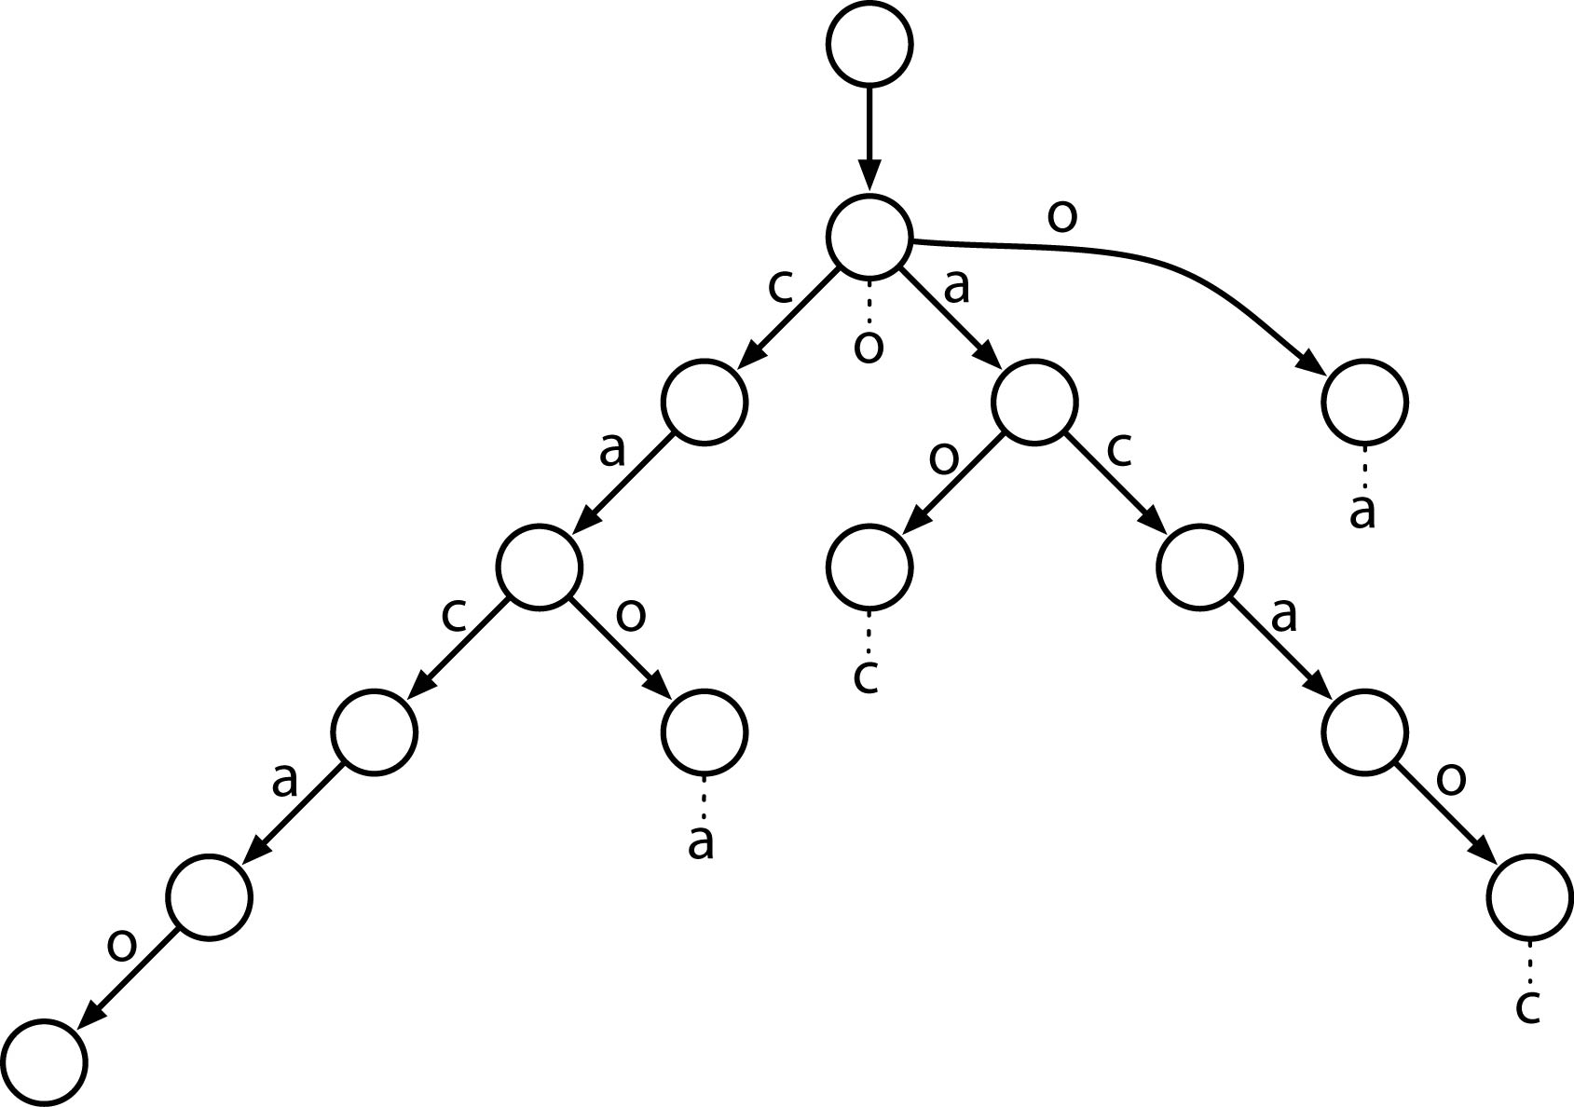
Suffix Trie Datastructure
All suffixes of the string “cacao”

Slide 21
Suffix Trie Datastructure
Deterministic finite automata that recognizes all suffixes of an input string.
Requires O(N²) time and space to build and store [Ukkonen, 95]
Too intensive for any practical sequence modelling application.

Slide 22
Suffix Tree
Deterministic finite automata that recognizes all suffixes of an input string
Uses path compression to reduce storage and construction computational complexity.
Requires only O(N) time and space to build and store [Ukkonen, 95]
Practical for large scale sequence modelling applications

Slide 23
Suffix Trie Datastructure

Slide 24
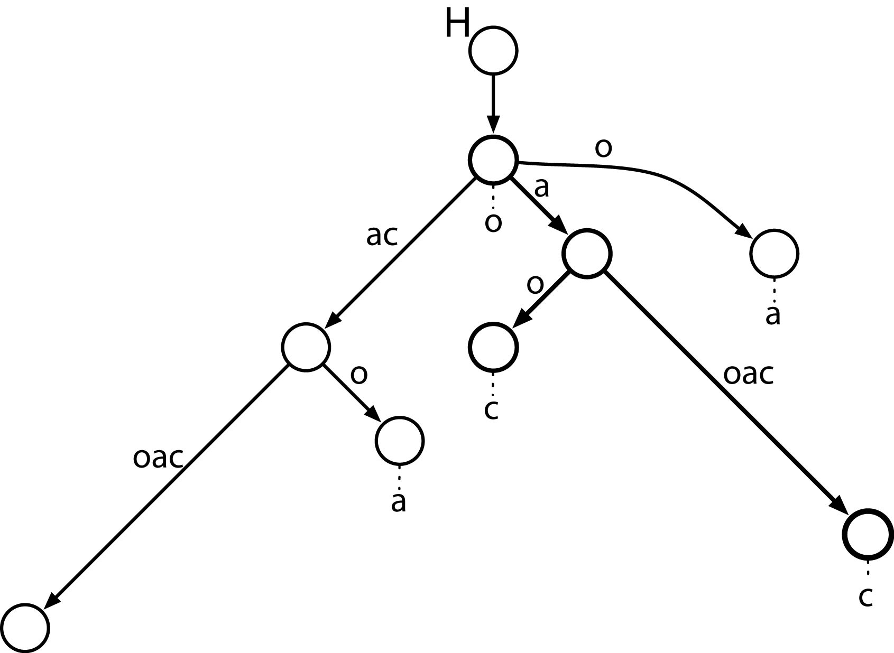
Suffix Tree Datastructure

Slide 25
Graphical Model Identification
This is a graphical model transformation under the covers.
These compressed paths require being able to analytically marginalize out nodes from the graphical model
The result of this marginalization can be thought of as providing a different set of caching rules to memoizers on the path-compressed edges

Slide 26
Marginalization
Theorem 1: Coagulation
G₁
G₁
G₂
→
G₃
G₃
[Pitman ’99; Ho, James, Lau ’06; W., Archambeau, Gasthaus, James, Teh ‘09]

Slide 27
Graphical Model Trie

Slide 28
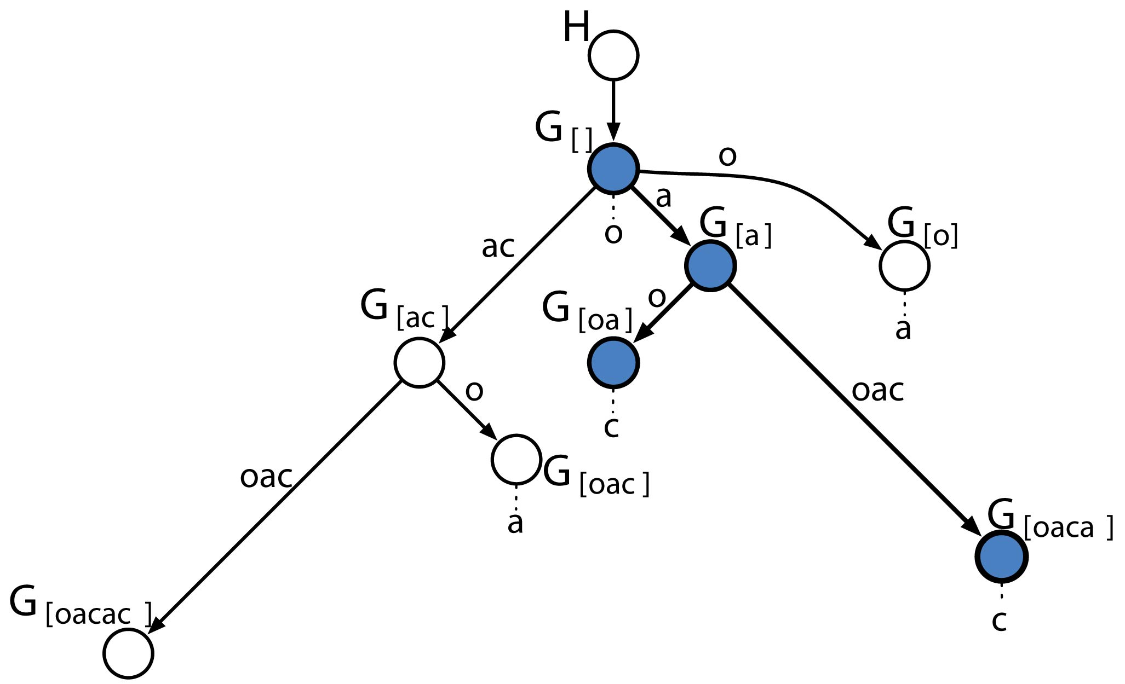
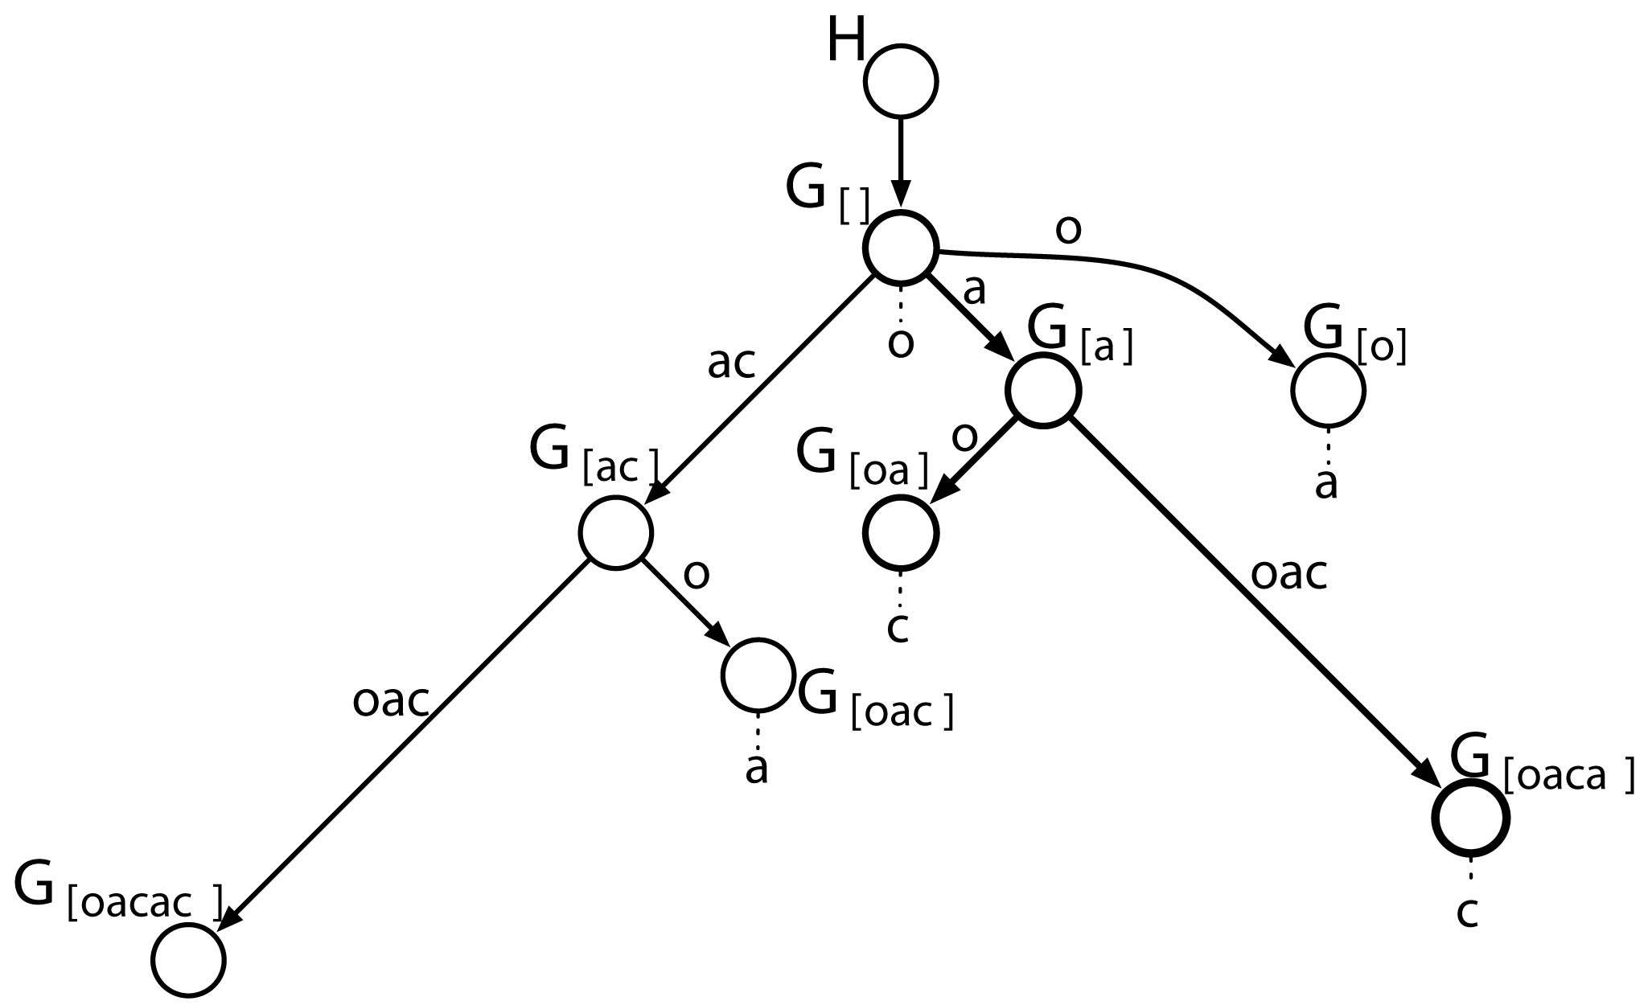
Graphical Model Tree

Slide 29
Graphical Model Initialization
Given a single input sequence
  Ukkonen’s linear time suffix tree construction algorithm is run on its reverse to produce a prefix tree
  This identifies the nodes in the graphical model we need to represent
  The tree is traversed and path compressed parameters for the Pitman Yor processes are assigned to each remaining Pitman Yor process

Slide 30
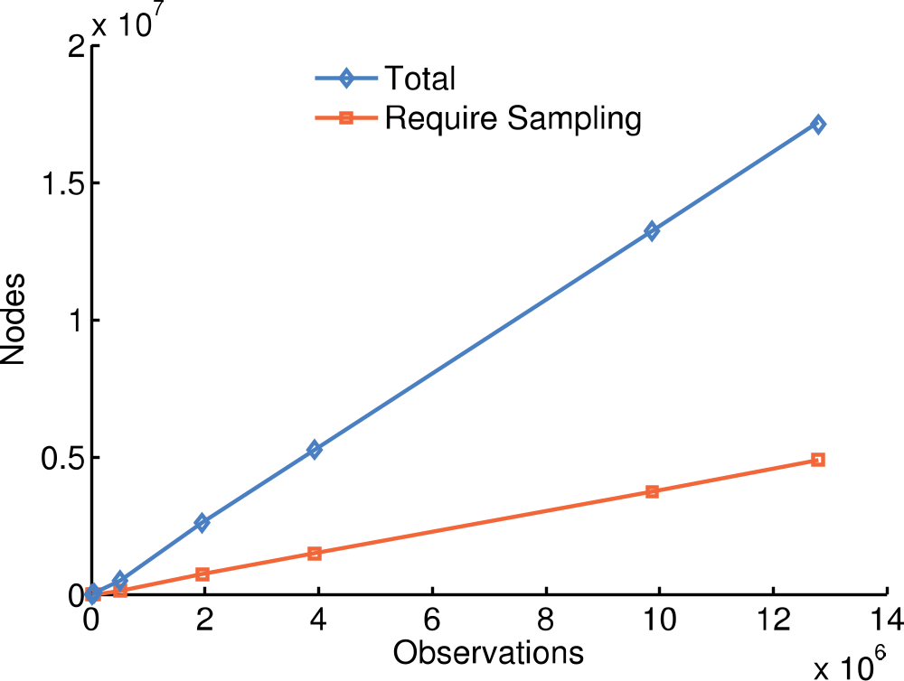
Nodes In The Graphical Model

Slide 31
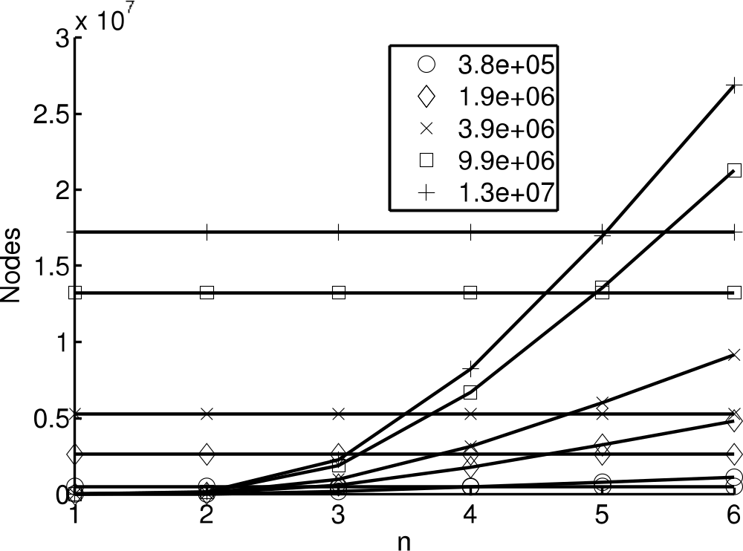
Never build more than a 5-gram

Slide 32
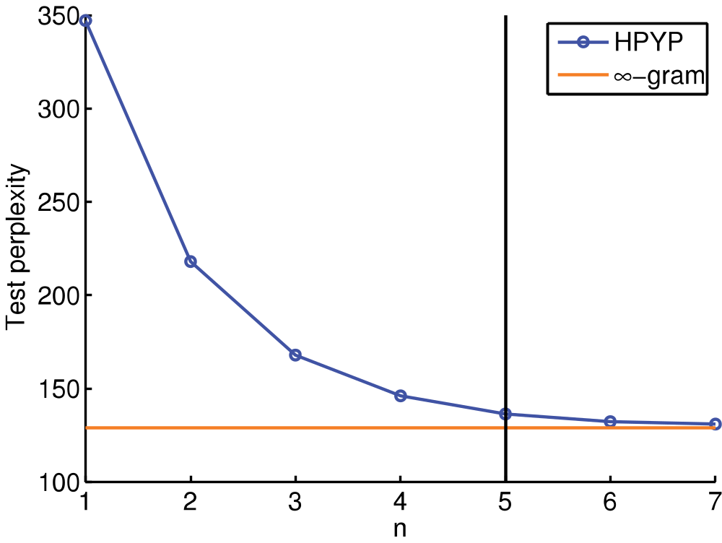
Sequence Memoizer Bounds N-Gram Performance
HPYP exceeds SM computational complexity

Slide 33
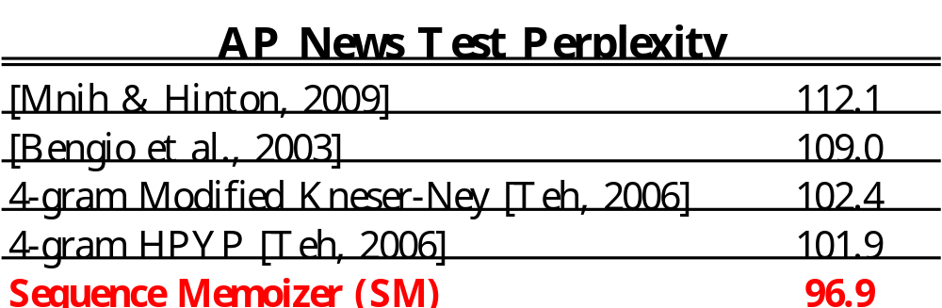
Language Modelling Results

Slide 34
The Sequence Memoizer
The Sequence Memoizer is a deep (unbounded) smoothing Markov model
It can be used to learn a joint distribution over discrete sequences in time and space linear in the length of a single observation sequence
It is equivalent to a smoothing ∞-gram but costs no more to compute than a 5-gram

