Slide 1
Training Products of Experts by Minimizing Contrastive Divergence
Geoffrey E. Hinton
presented by Frank Wood

Slide 2
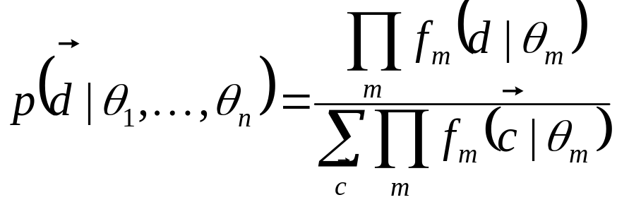
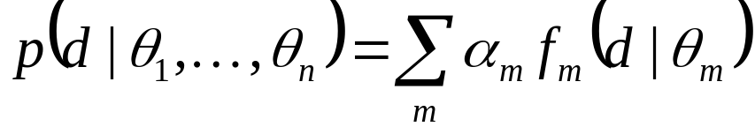
Goal
Learn parameters for probability distribution models of high dimensional data
  (Images, Population Firing Rates, Securities Data, NLP data, etc)
Mixture Model Use EM to learn parameters | Product of Experts Use Contrastive Divergence to learn parameters.

Slide 3
Take Home
Contrastive divergence is a general MCMC gradient ascent learning algorithm particularly well suited to learning Product of Experts (PoE) and energy- based (Gibbs distributions, etc.) model parameters.
The general algorithm:
  Repeat Until “Convergence”
    Draw samples from the current model starting from the training data.
    Compute the expected gradient of the log probability w.r.t. all model parameters over both samples and the training data.
    Update the model parameters according to the gradient.

Slide 4
Sampling – Critical to Understanding
Uniform
  rand() Linear Congruential Generator
    x(n) = a * x(n-1) + b mod M
  0.2311 0.6068 0.4860 0.8913 0.7621 0.4565 0.0185
Normal
  randn() Box-Mueller
    x1,x2 ~ U(0,1) -> y1,y2 ~N(0,1)
      y1 = sqrt( - 2 ln(x1) ) cos( 2 pi x2 )
      y2 = sqrt( - 2 ln(x1) ) sin( 2 pi x2 )
Binomial(p)
  if(rand()<p)
More Complicated Distributions
  Mixture Model
    Sample from a Gaussian
    Sample from a multinomial (CDF + uniform)
  Product of Experts
    Metropolis and/or Gibbs

Slide 5
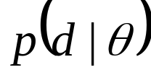
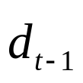
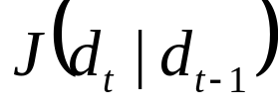
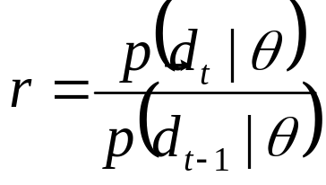


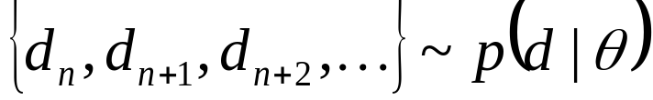
The Flavor of Metropolis Sampling
Given some distribution , a random starting point , and a symmetric proposal distribution .
Calculate the ratio of densities
where is sampled from the proposal distribution.
With probability accept .
Given sufficiently many iterations
Only need to know the distribution up to a proportionality!

Slide 6
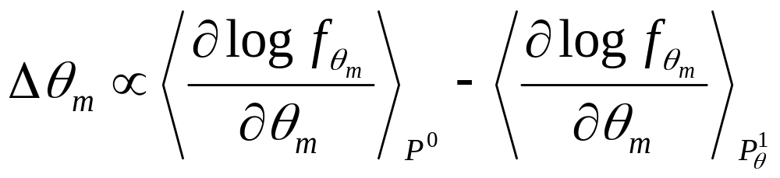
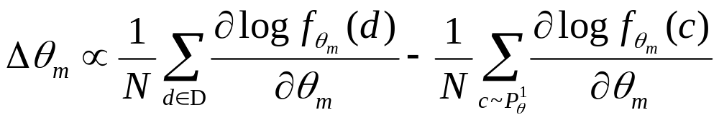
Contrastive Divergence (Final Result!)
Training data (empirical distribution).
Model parameters.
Samples from model.
Law of Large Numbers, compute expectations using samples.
Now you know how to do it, let’s see why this works!

Slide 7
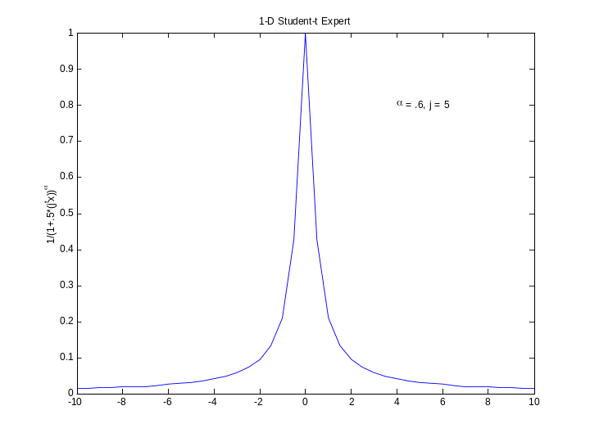
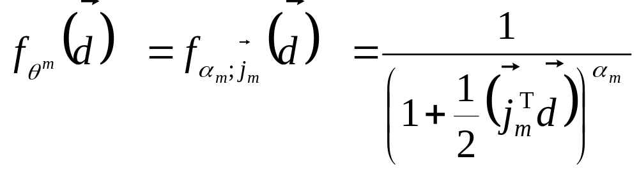
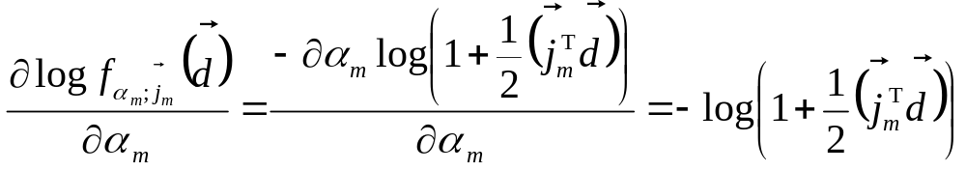
But First: The last vestige of concreteness.
Looking towards the future:
  Take f to be a Student-t.
  Then (for instance)
Dot product ⬄Projection ⬄1-D Marginal

Slide 8
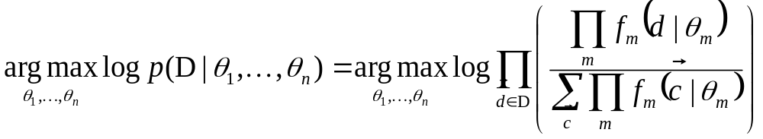
Maximizing the training data log likelihood
Standard PoE form
We want maximizing parameters
Differentiate w.r.t. to all parameters and perform gradient ascent to find optimal parameters.
The derivation is somewhat nasty.
Over all training data.
Assuming d’s drawn independently from p()

Slide 9
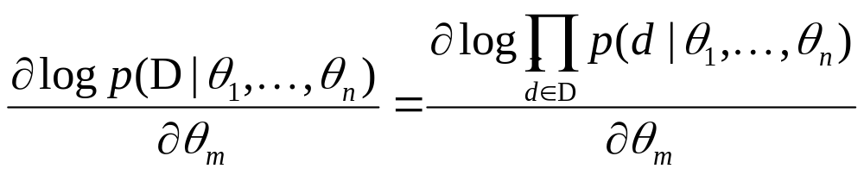
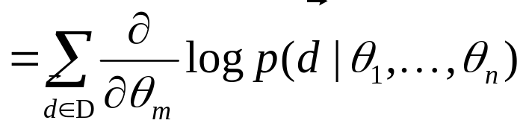
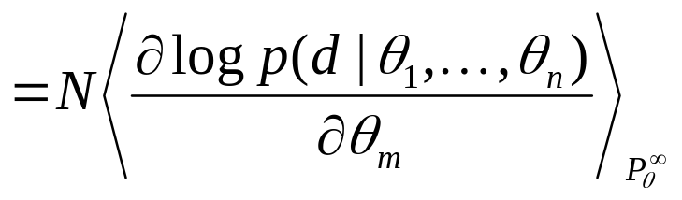
Maximizing the training data log likelihood
Remember this equivalence!

Slide 10
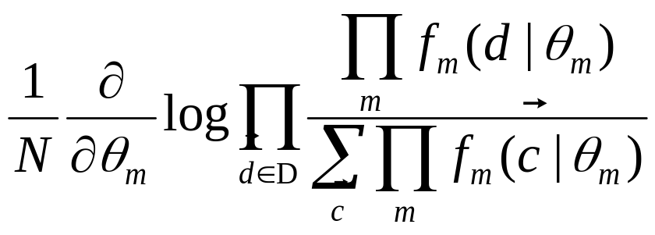
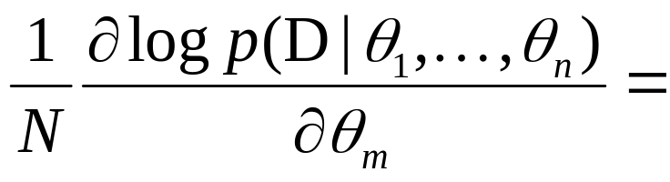
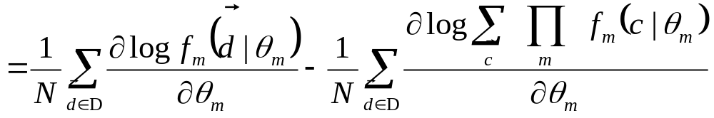
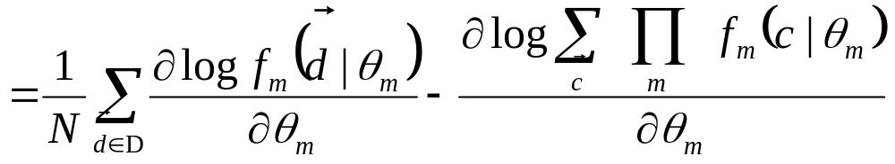
Maximizing the training data log likelihood

Slide 11
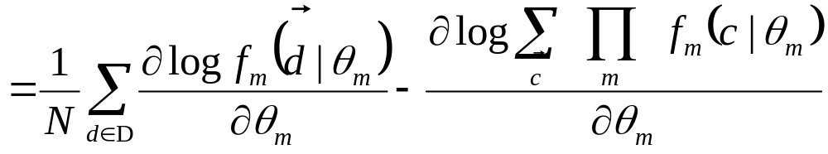
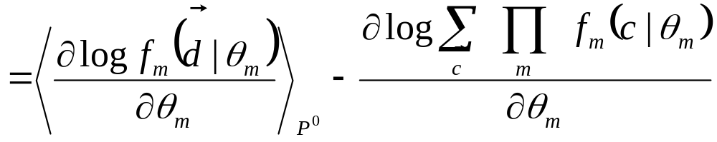
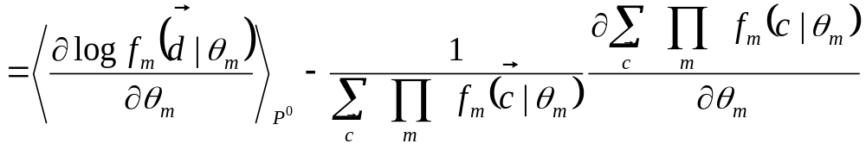
Maximizing the training data log likelihood
log(x)’ = x’/x

Slide 12
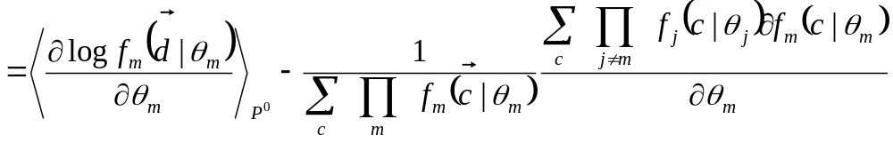
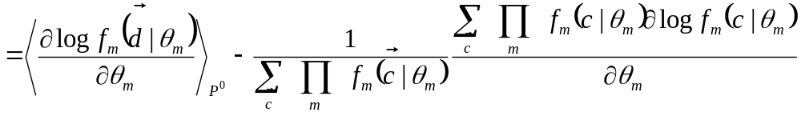
Maximizing the training data log likelihood
log(x)’ = x’/x

Slide 13
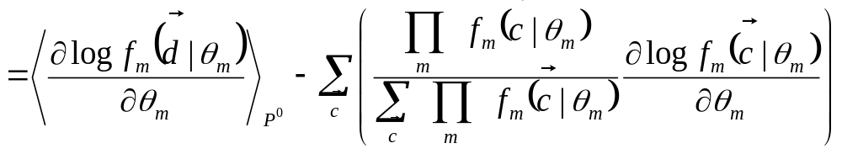
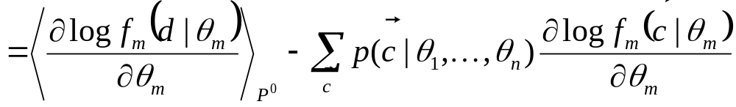
Maximizing the training data log likelihood

Slide 14
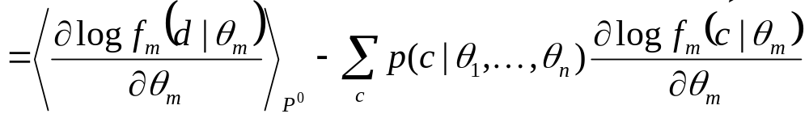
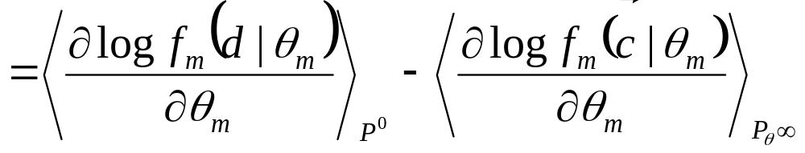
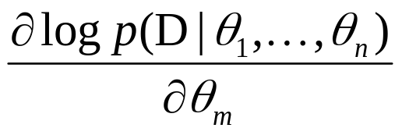
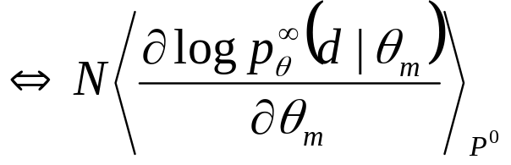
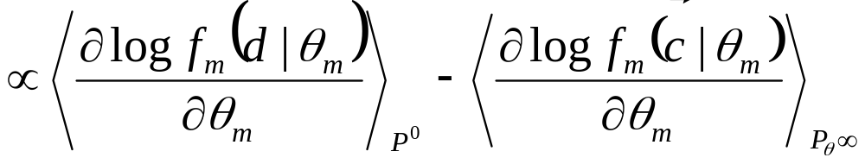
Maximizing the training data log likelihood
Phew! We’re done! So:

Slide 15
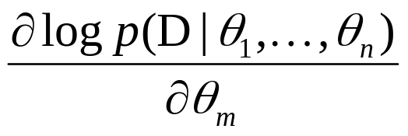
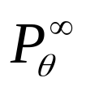
Equilibrium Is Hard to Achieve
With:
we can now train our PoE model.
But… there’s a problem:
  is computationally infeasible to obtain (esp. in an inner gradient ascent loop).
  Sampling Markov Chain must converge to target distribution. Often this takes a very long time!

Slide 16
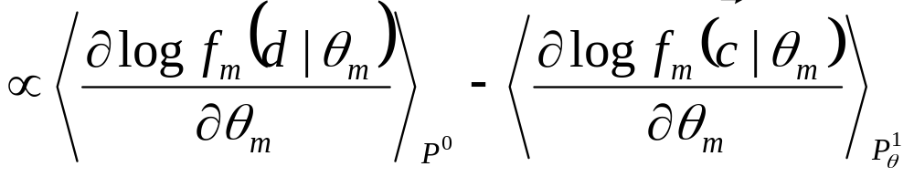
Solution: Contrastive Divergence!
Now we don’t have to run the sampling Markov Chain to convergence, instead we can stop after 1 iteration (or perhaps a few iterations more typically)
Why does this work?
  Attempts to minimize the ways that the model distorts the data.

Slide 17
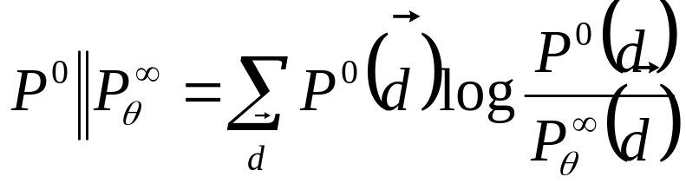
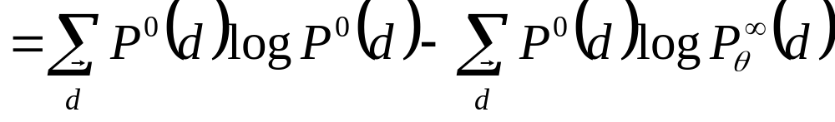
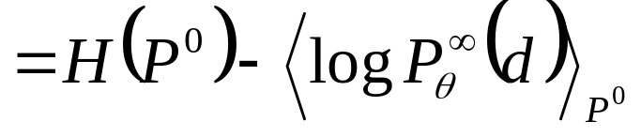
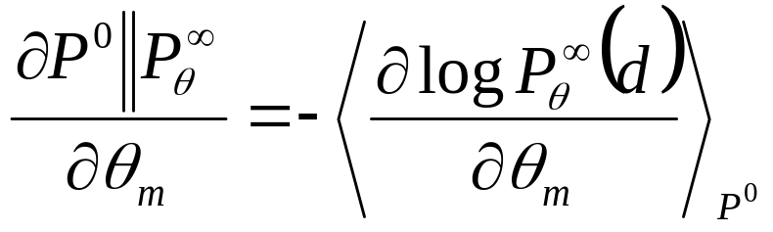
Equivalence of argmax log P() and argmax KL()
This is what we got out of the nasty derivation!

Slide 18
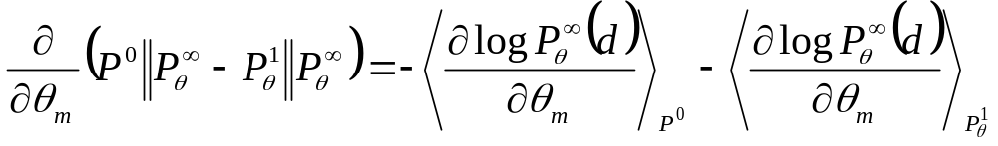
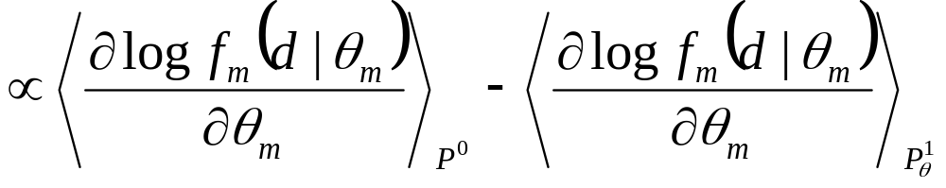
Contrastive Divergence
We want to “update the parameters to reduce the tendency of the chain to wander away from the initial distribution on the first step”.

Slide 19
Contrastive Divergence (Final Result!)
Training data (empirical distribution).
Model parameters.
Samples from model.
Law of Large Numbers, compute expectations using samples.
Now you know how to do it and why it works!

