Slide 1
Sequential Monte Carlo and Particle Filtering
Frank Wood
Gatsby, November 2007
TexPoint fonts used in EMF.
Read the TexPoint manual before you delete this box.: AAAAAAAAAAA

Slide 2
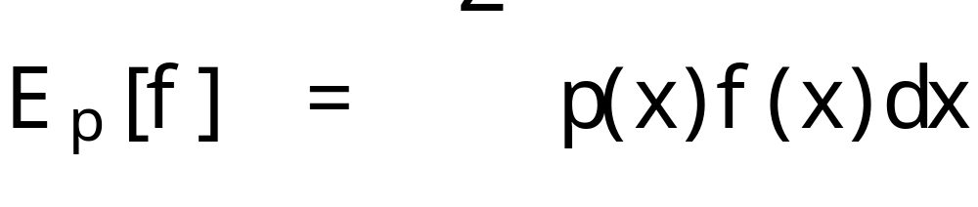
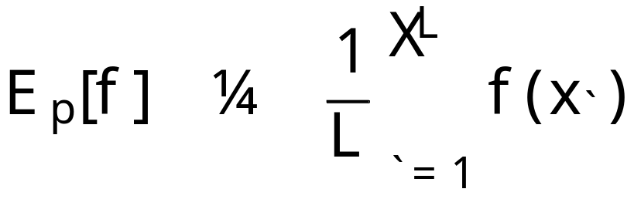
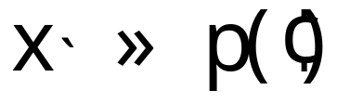
Importance Sampling
Recall:
  Let’s say that we want to compute some expectation (integral)
  and we remember from Monte Carlo integration theory that with samples from p() we can approximate this integral thusly

Slide 3
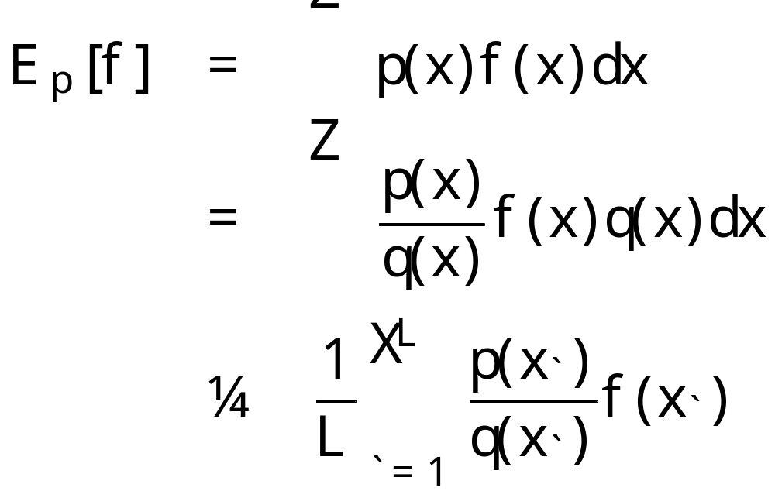
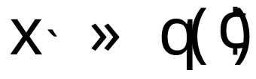
What if p() is hard to sample from?
One solution: use importance sampling
  Choose another easier to sample distribution q() that is similar to p() and do the following:

Slide 4
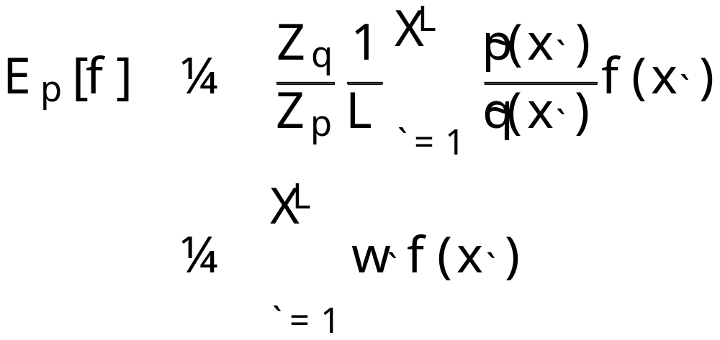
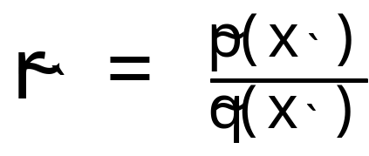
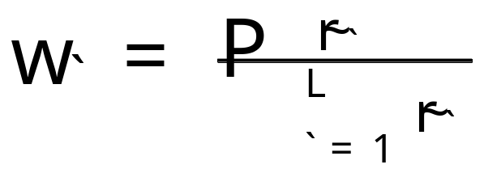
I.S. with distributions known only to a proportionality
Importance sampling using distributions only known up to a proportionality is easy and common, algebra yields

Slide 5






A model requiring sampling techniques
Non-linear non-Gaussian first order Markov model
Hidden and of interest
\\

Slide 6
Filtering distribution hard to obtain
Often the filtering distribution is of interest
It may not be possible to compute these integrals analytically, be easy to sample from this directly, nor even to design a good proposal distribution for importance sampling.

Slide 7
A solution: sequential Monte Carlo
Sample from sequence of distributions that “converge” to the distribution of interest
This is a very general technique that can be applied to a very large number of models and in a wide variety of settings.
Today: particle filtering for a first order Markov model

Slide 8
Concrete example: target tracking
A ballistic projectile has been launched in our direction.
We have orders to intercept the projectile with a missile and thus need to infer the projectiles current position given noisy measurements.

Slide 9
Problem Schematic
(x_{t}, y_{t})
r_{t}
µ_{t}
(0,0)

Slide 10
Probabilistic approach
Treat true trajectory as a sequence of latent random variables
Specify a model and do inference to recover the position of the projectile at time t

Slide 11
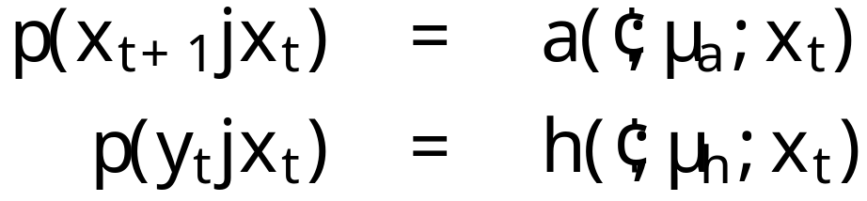
First order Markov model
Hidden true trajectory
Noisy measurements

Slide 12
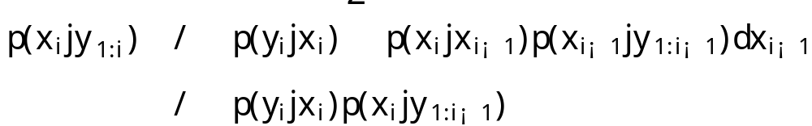
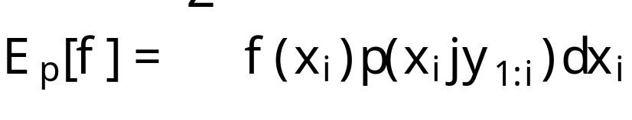
Posterior expectations
We want filtering distribution samples
so that we can compute expectations
Write this down!

Slide 13
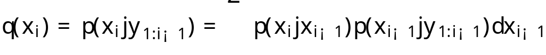
Importance sampling
Distribution from which we want samples
Proposal distribution
By identity the posterior predictive distribution can be written as

Slide 14
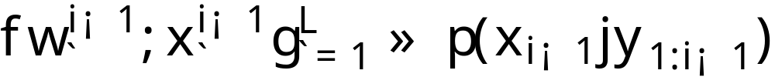
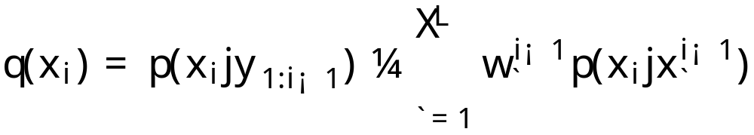
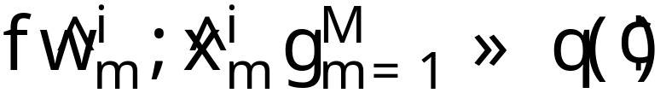
Basis of sequential recursion
If we start with samples from
then we can write the proposal distribution as a finite mixture model
and draw samples accordingly

Slide 15
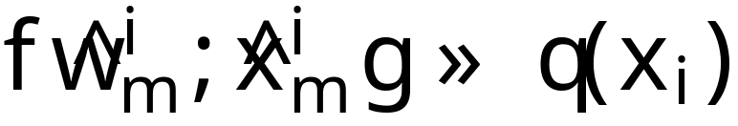
Samples from the proposal distribution
We now have samples from the proposal
And if we recall
Distribution from which we want samples
Proposal distribution

Slide 16
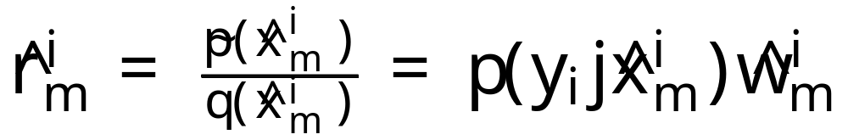
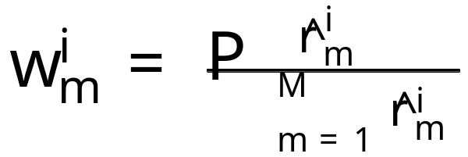
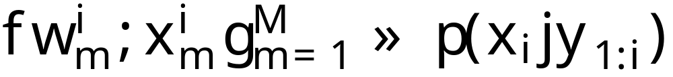
Updating the weights completes importance sampling
We are left with M weighted samples from the posterior up to observation i

Slide 17
Intuition
Particle filter name comes from physical interpretation of samples

Slide 18
Start with samples representing the hidden state
(0,0)

Slide 19
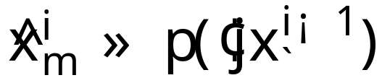
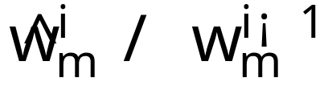
Evolve them according to the state model
(0,0)

Slide 20
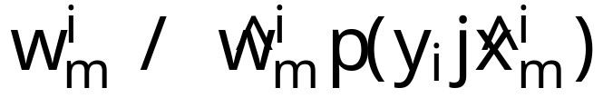
Re-weight them by the likelihood
(0,0)

Slide 21
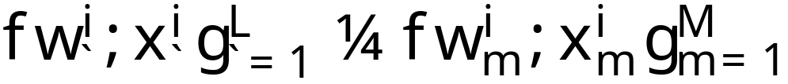
Results in samples one step forward
(0,0)

Slide 22
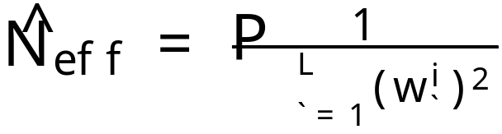
SIS Particle Filter
The Sequential Importance Sampler (SIS) particle filter multiplicatively updates weights at every iteration and thus often most weights get very small
Computationally this makes little sense as eventually low-weighted particles do not contribute to any expectations.
A measure of particle degeneracy is “effective sample size”
When this quantity is small, particle degeneracy is severe.

Slide 23
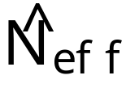
Solutions
Sequential Importance Re-sampling (SIR) particle filter avoids many of the problems associated with SIS pf’ing by re-sampling the posterior particle set to increase the effective sample size.
Choosing the best possible importance density is also important because it minimizes the variance of the weights which maximizes

Slide 24
Other tricks to improve pf’ing
Integrate out everything you can
Replicate each particle some number of times
In discrete systems, enumerate instead of sample
Use fancy re-sampling schemes like stratified sampling, etc.

Slide 25
Initial particles
(0,0)

Slide 26
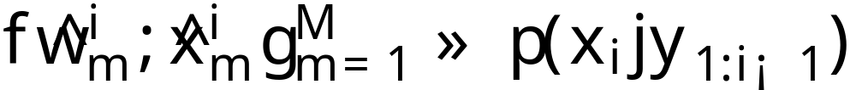
Particle evolution step
(0,0)

Slide 27
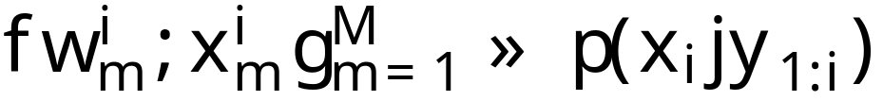
Weighting step
(0,0)

Slide 28
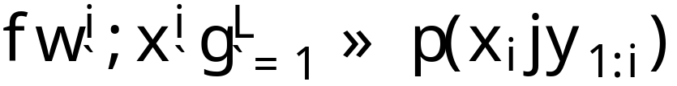
Resampling step
(0,0)

Slide 29
Wrap-up: Pros vs. Cons
Pros:
  Sometimes it is easier to build a “good” particle filter sampler than an MCMC sampler
  No need to specify a convergence measure
Cons:
  Really filtering not smoothing
Issues
  Computational trade-off with MCMC

Slide 30
Thank You

Slide 33
Tricks and Variants
Reduce the dimensionality of the integrand through analytic integration
  Rao-Blackwellization
Reduce the variance of the Monte Carlo estimator through
  Maintaining a weighted particle set
  Stratified sampling
  Over-sampling
  Optimal re-sampling

Slide 34
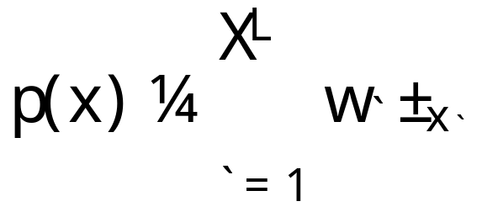
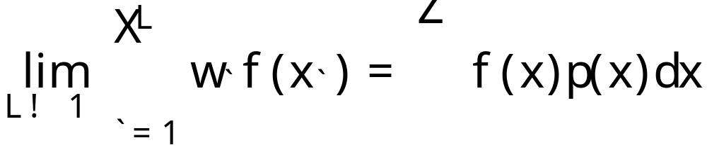
Particle filtering
Consists of two basic elements:
  Monte Carlo integration
  Importance sampling

Slide 35

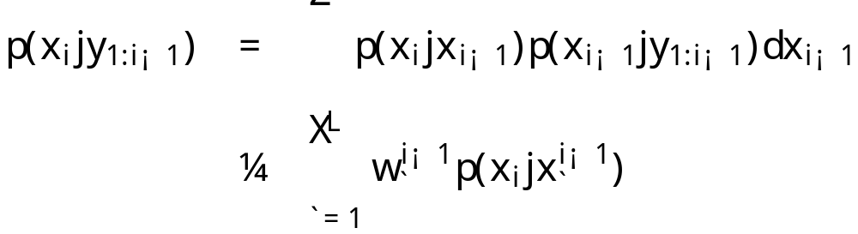
PF’ing: Forming the posterior predictive
Posterior up to observation
The proposal distribution for importance sampling of the posterior up to observation i is this approximate posterior predictive distribution

Slide 36
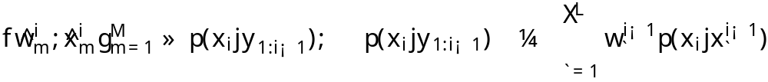
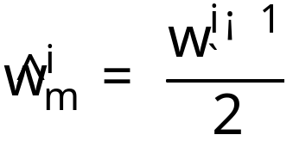
Sampling the posterior predictive
Generating samples from the posterior predictive distribution is the first place where we can introduce variance reduction techniques
For instance sample from each mixture component several twice such that M, the number of samples drawn, is two times L, the number of densities in the mixture model, and assign weights

Slide 37
Not the best
Most efficient Monte Carlo estimator of a function ¡(x)
  From survey sampling theory: Neyman allocation
  Number drawn from each mixture density is proportional to the weight of the mixture density times the std. dev. of the function ¡ over the mixture density
Take home: smarter sampling possible
  [Cochran 1963]

Slide 38
Over-sampling from the posterior predictive distribution
(0,0)

Slide 39
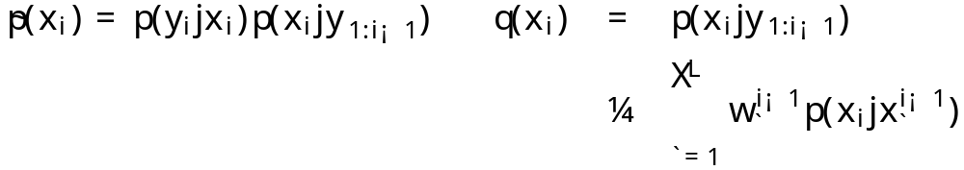
Importance sampling the posterior
Recall that we want samples from
and make the following importance sampling identifications
Proposal distribution
Distribution from which we want to sample

Slide 40
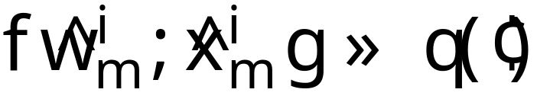
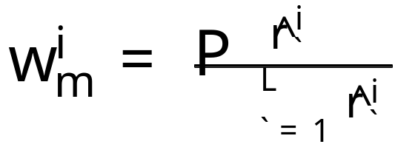
Sequential importance sampling
Weighted posterior samples arise as
Normalization of the weights takes place as before
We are left with M weighted samples from the posterior up to observation i

Slide 41
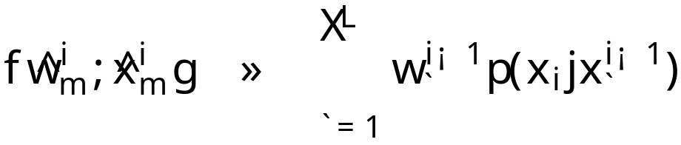
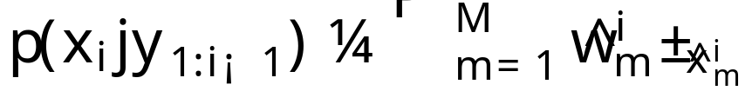
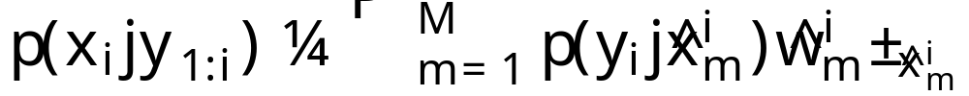
An alternative view

Slide 42
Importance sampling from the posterior distribution
(0,0)

Slide 43
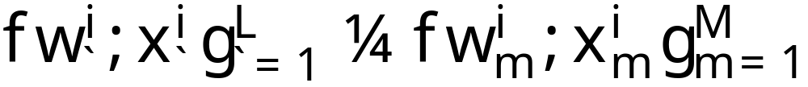
Sequential importance re-sampling
Down-sample L particles and weights from the collection of M particles and weights
this can be done via multinomial sampling or in a way that provably minimizes estimator variance
[Fearnhead 04]

Slide 44
Down-sampling the particle set
(0,0)

Slide 45
Recap
Starting with (weighted) samples from the posterior up to observation i-1
Monte Carlo integration was used to form a mixture model representation of the posterior predictive distribution
The posterior predictive distribution was used as a proposal distribution for importance sampling of the posterior up to observation i
M > L samples were drawn and re-weighted according to the likelihood (the importance weight), then the collection of particles was down-sampled to L weighted samples

Slide 46
LSSM Not alone
Various other models are amenable to sequential inference, Dirichlet process mixture modelling is another example, dynamic Bayes’ nets are another

Slide 47
Rao-Blackwellization
In models where parameters can be analytically marginalized out, or the particle state space can otherwise be collapsed, the efficiency of the particle filter can be improved by doing so

Slide 48
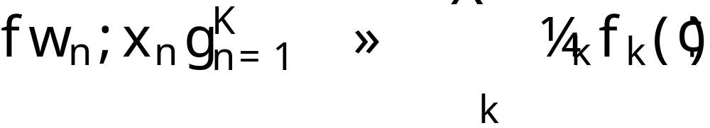
Stratified Sampling
Sampling from a mixture density using the algorithm on the right produces a more efficient Monte Carlo estimator
for n=1:K choose k according to ¼_{k} sample x_{n} from f_{k} set w_{n} equal to 1/N | for n=1:K choose f_{n} sample x_{n} from f_{n} set w_{n} equal to ¼_{n}

Slide 49
Intuition: weighted particle set
What is the difference between these two discrete distributions over the set {a,b,c}?
  (a), (a), (b), (b), (c)
  (.4, a), (.4, b), (.2, c)
Weighted particle representations are equally or more efficient for the same number of particles

Slide 50
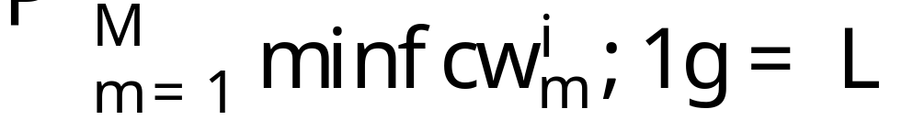
Optimal particle re-weighting
Next step: when down-sampling, pass all particles above a threshold c through without modifying their weights where c is the unique solution to
Resample all particles with weights below c using stratified sampling and give the selected particles weight 1/ c
Fearnhead 2004

Slide 51
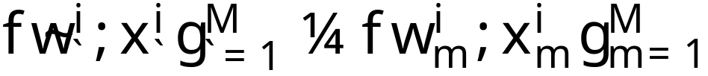
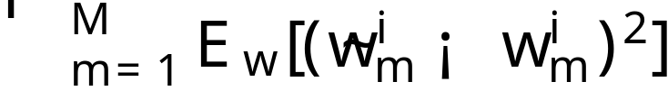
Result is provably optimal
In the down-sampling step
Imagine instead a “sparse” set of weights of which some are zero
Then this down-sampling algorithm is optimal w.r.t.
Fearnhead 2004

Slide 52
Problem Details
Time and position are given in seconds and meters respectively
Initial launch velocity and position are both unknown
The maximum muzzle velocity of the projectile is 1000m/s
The measurement error in the Cartesian coordinate system is N(0,10000) and N(0,500) for x and y position respectively
The measurement error in the polar coordinate system is N(0,.001) for µ and Gamma(1,100) for r
The kill radius of the projectile is 100m

Slide 53
Data and Support Code
http://www.gatsby.ucl.ac.uk/~fwood/pf_tutorial/

Slide 54
Laws of Motion
In case you’ve forgotten:
where v₀ is the initial speed and ® is the initial angle

Slide 55
Good luck!

Slide 56
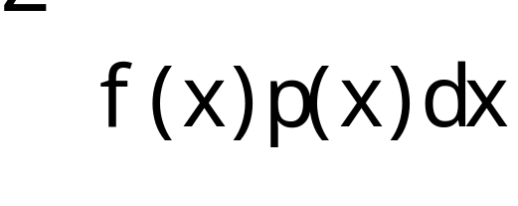
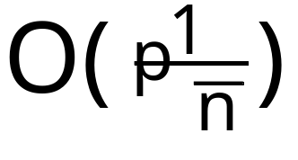
Monte Carlo Integration
Compute integrals for which analytical solutions are unknown

Slide 57
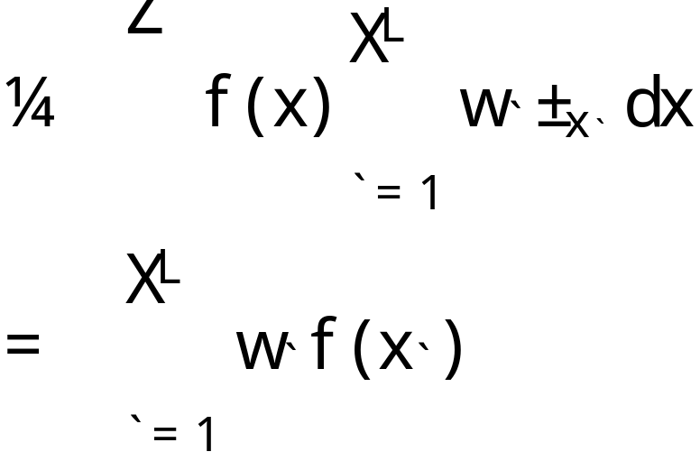
Monte Carlo Integration
Integral approximated as the weighted sum of function evaluations at L points

Slide 58
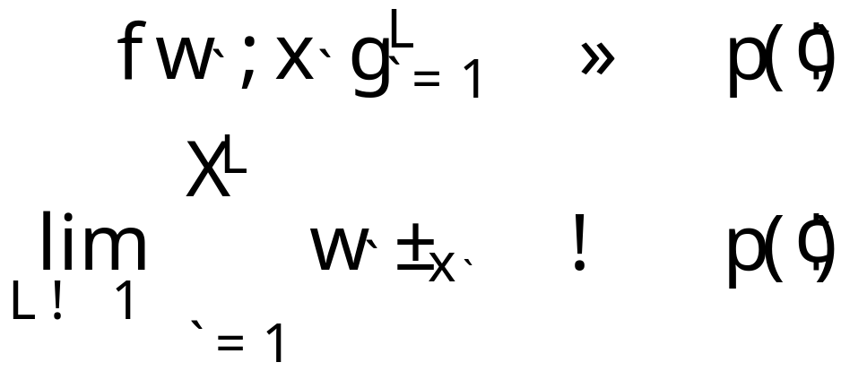
Sampling
To use MC integration one must be able to sample from p(x)

Slide 59
Theory (Convergence)
Quality of the approximation independent of the dimensionality of the integrand
Convergence of integral result to the “truth” is O(1/n^{1/2}) from L.L.N.’s.
Error is independent of dimensionality of x

Slide 60
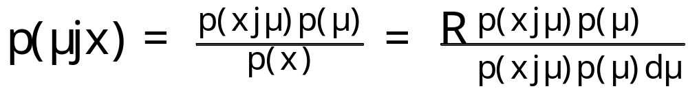
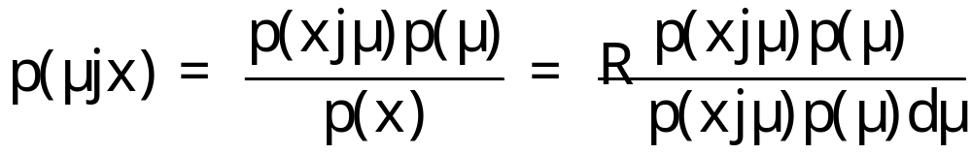
Bayesian Modelling
Formal framework for the expression of modelling assumptions
Two common definitions:
  using Bayes’ rule
  marginalizing over models
Posterior
Prior
Likelihood
Evidence

Slide 61
Posterior Estimation
Often the distribution over latent random variables (parameters) is of interest
Sometimes this is easy (conjugacy)
Usually it is hard because computing the evidence is intractable

Slide 62


Conjugacy Example
x successes in N trials, µ probability of success

Slide 63


Conjugacy Continued

Slide 64

Non-Conjugate Models
Easy to come up with examples

Slide 65
Posterior Inference
Posterior averages are frequently important in problem domains
  posterior predictive distribution
  evidence (as seen) for model comparison, etc.

Slide 66

Relating the Posterior to the Posterior Predictive

Slide 67
Relating the Posterior to the Posterior Predictive

Slide 68
Relating the Posterior to the Posterior Predictive

Slide 69
Relating the Posterior to the Posterior Predictive

Slide 70


Importance sampling
Proposal distribution: easy to sample from
Original distribution: hard to sample from, easy to evaluate
Importance
weights

Slide 71




Importance sampling un-normalized distributions
Un-normalized distribution to sample from, still hard to sample from and easy to evaluate
Un-normalized proposal distribution: still easy to sample from
New term: ratio of normalizing constants

Slide 72


Normalizing the importance weights
Un-normalized importance weights
Takes a little algebra
Normalized importance weights

Slide 73

Linear State Space Model (LSSM)
Discrete time
First-order Markov chain

Slide 74
Inferring the distributions of interest
Many methods exist to infer these distributions
  Markov Chain Monte Carlo (MCMC)
  Variational inference
  Belief propagation
  etc.
In this setting sequential inference is possible because of characteristics of the model structure and preferable due to the problem requirements

Slide 75
Exploiting LSSM model structure…

Slide 76
Particle filtering

Slide 77
Exploiting Markov structure…
Use Bayes’ rule and the conditional independence structure dictated by the first order Markov hidden variable model

Slide 78
for sequential inference

Slide 79
An alternative view

Slide 80
Sequential importance sampling inference
Start with a discrete representation of the posterior up to observation i-1
Use Monte Carlo integration to represent the posterior predictive distribution as a finite mixture model
Use importance sampling with the posterior predictive distribution as the proposal distribution to sample the posterior distribution up to observation i

Slide 81
What?
Posterior predictive distribution
State model
Likelihood
Start with a discrete representation of this distribution

Slide 82

Monte Carlo integration
General setup
As applied in this stage of the particle filter
Samples from
Finite mixture model

