Slide 1
AdKnowledge Hackathon - YouTube v3 Ranking System Based On Object Search
Group: CS551/PG # 37
By: Bhargava Gellaboina, Ramesh Kuthala and Rajesh Kapa

Slide 2
Abstract
YouTube Ranking is a web application with various components like login , YouTube video search, Dashboard for Video Ranking. Application is capable of retrieving the videos along with the metadata tied to it and maintains the database for the user search terms.
Dashboard displays the video ranking based on the user search terms and the average views, likes of the videos.

Slide 3
Technologies
CSS, Java Script, Bootstrap, Ajax
JAVA Servlets and JSP
JAVA RESTful services
MongoDB , MySQL

Slide 4
Existing Services/API
YouTube v3 API
To get list of videos available for the searchterm.
https://developers.google.com/youtube/v3/docs/search/list#type
Java REST API
REST calls are used to get data from MongoDB and MySQL

Slide 5
Analytics Reporting
Based on the Meta data available for the videos, ranking is calculated.
Top 10 different search keywords for the user are displayed dynamically as the categories in the dashboard. When selected each category, videos according to the rank are displayed.
Ranking for videos:
Average views of the video
Likes count for the video

Slide 6
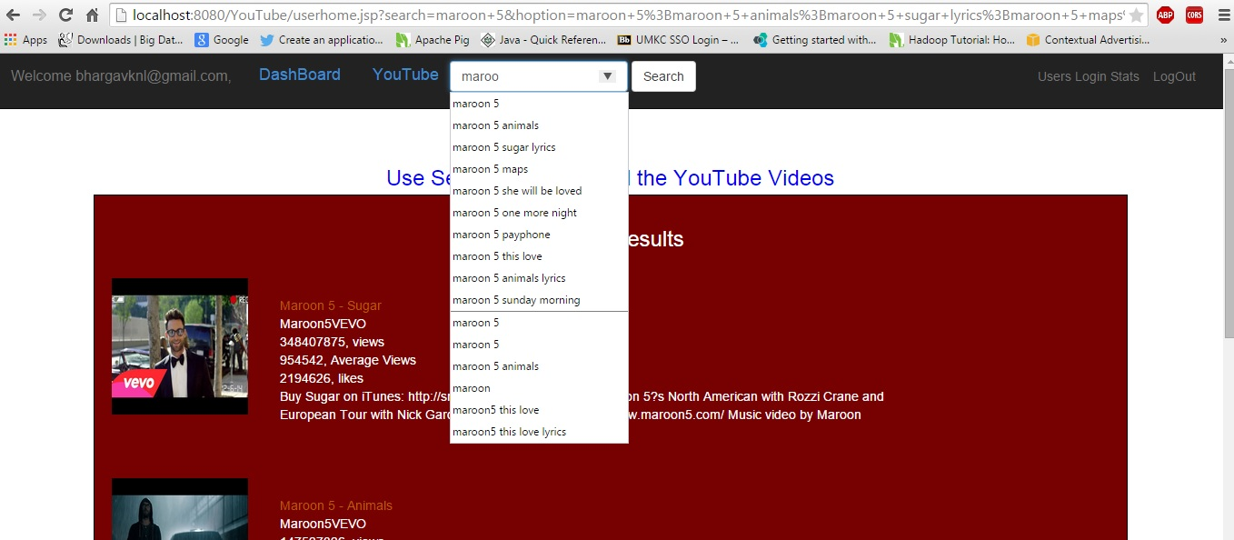
Application Home Page

Slide 7
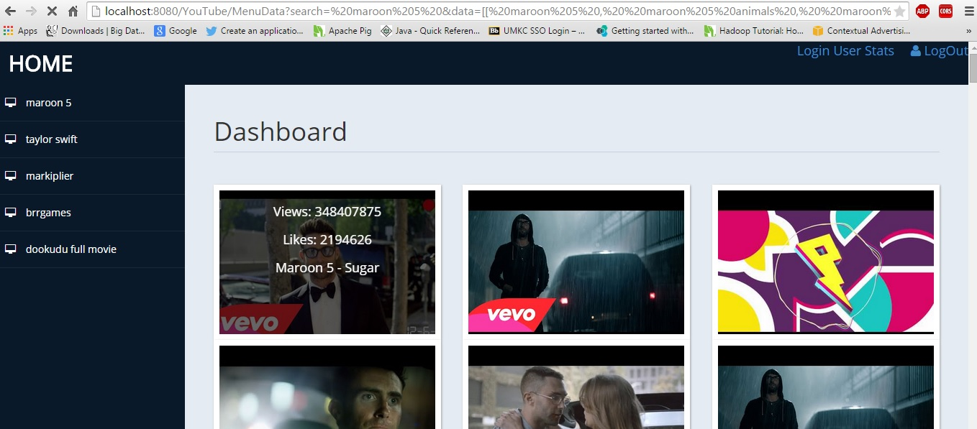
Application Dashboard Page

Slide 8
Conclusion
Using YouTube ranking we are finding the rank of a video based on its metadata. Machine learning techniques can be applied in this context including more data like video category, comments, …etc

