Slide 1
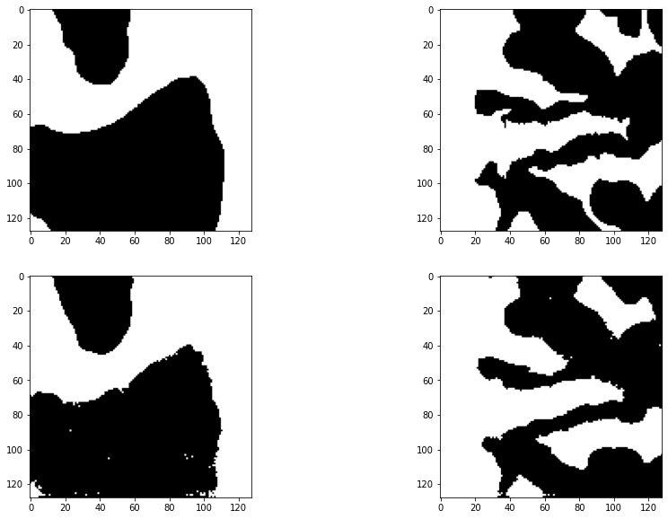
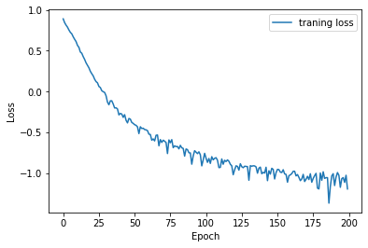
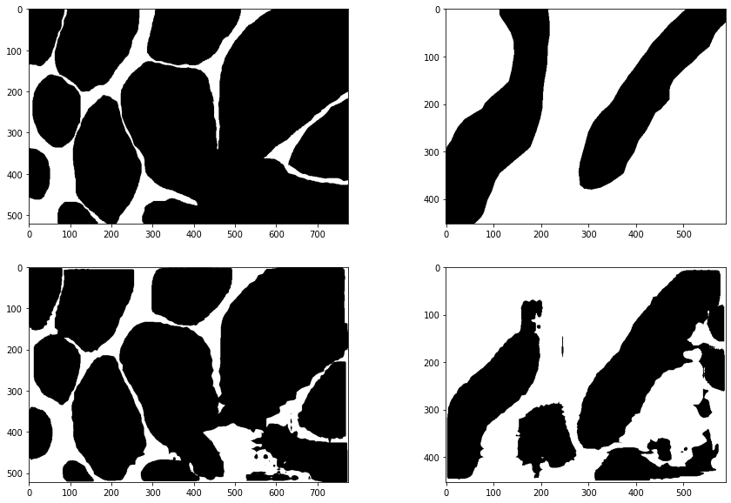

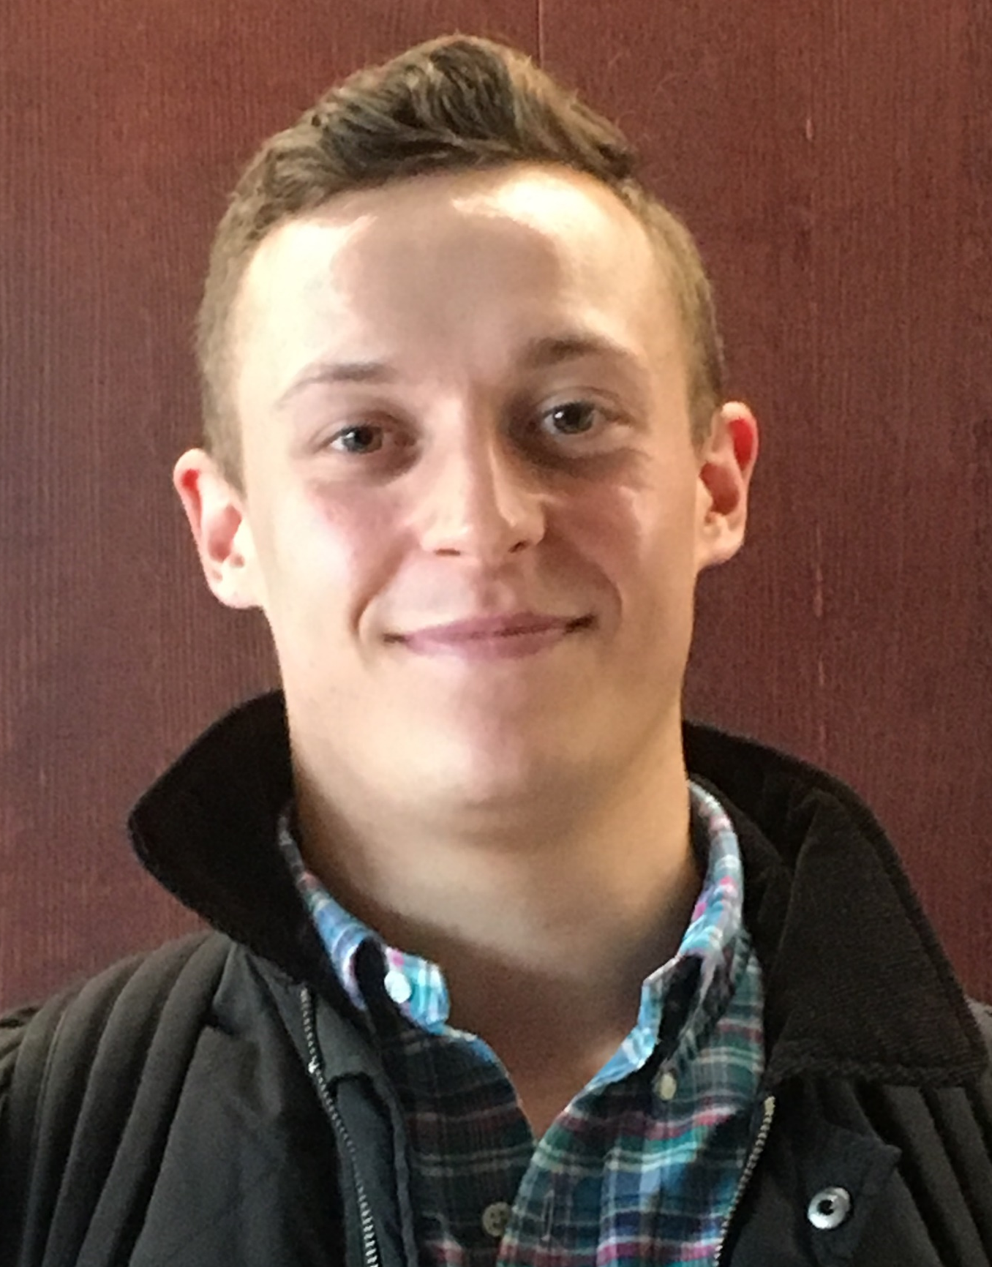
Pixelwise segmentation for medical images
Bjørn Hansen
DTU Compute, Technical University of Denmark, Lyngby, Denmark
Motivation:
The motivation for this project is to segment cells from real images in an automated fashion. This is important for many reasons such as reducing the time and energy it takes professionals to manually perform analysis of cell images in medical practice.
Background:
Medical image segmentation is an ongoing field of research
Some methods rely on pixel-wise classification others on detecting edges of the object
Typically used architectures rely on deep convolutional neural networks.
Classic network architectures includes Segnet and U-net. The U-net first introduced in 2015, variations have been developed since.
Milestones:
• Configure a functioning data loader.
• Implement the U-Net architecture.
• Implement a Masked RCNN architecture
Results:
Initial results have been good. Both the U-Net and Masked RCNN architectures can perform segmentation of cell images. Both however have limits and make clear misses around boarders of cells especially when cells are close together or relatively large.
Conclusions:
Both architectures can be used for segmentation. Here are the main take-aways thus far:
Masked RCNN has bboxes
Masked RCNN outputs number of objects
Masked RCNN is heavy/ complex and slow at run time
U-Net has arguably better segmentation results
U-Net is less complicated and faster at runtime
U-Net performs pixel-wise classification and thus does not give information about how many objects there are in the image or where these are located (bbox)
U-Net results:
IoU score: 0.332
F1 score: 0.643
Top Bench Mark results:
F1 score: 0.6-0.8
Masked R-CNN results:
IoU score: 0.419
F1 score: 0.592
Top Bench Mark results:
F1 score: 0.6-0.8
References:
U-Net: Convolutional Networks for Biomedical
Image Segmentation, Olaf Ronneberger, et.al
Mask R-CNN, Kaiming He, et.al
PyTorch Masked R-CNN implementation,
https://github.com/jwyang/faster-rcnn.pytorch
Find the Project code here:
https://github.com/bh1995
Bjørn Hansen
s193035@student.dtu.dk

