Slide 1
Hackathon 2022: Name Pronunciation
High level Design Approach
(Challengers Squad)

Slide 2
High level Requirements and insights
Customized name pronunciation option to be available for employees with an opt-out preference
Standard name pronunciation will be available by default for all employees.
Separate admin and employee portals should be available
Admin role can add the standard name pronunciation along with other approvals like ensuring the customized name recordings met the standards based on predefined rules
Alerts can be sent to employee upon login
Employees should be registered to use the tool
Employees can control the speed of the recorded message based on the preference

Slide 3
High Level Design - Name Pronunciation Layer
Data Ingestion Layer
Service Layer
Data Storage Layer

Slide 4
High Level Architecture - Name Pronunciation Layer
Discovery Server
Login Service
User Profile Data Layer
Web Channel
Registration Service
Name Record Service
IVR Channel
Name Pronunciation Service
Name Pronunciation Data Layer
ChatBot Channel
Rule Engine Service
Alerts
Service

Slide 5
Detailed Design - Name Pronunciation Layer
Discovery Server
Login Service
User Profile Database
Web Channel
Registration Service
Google Speech to Text
IVR Channel
Name Record Service
Google Text to Speech
Name Search Service
Name Pronunciation Database
Chat Bot Channel
Rule Engine Service
Alerts Service
Input Channels for Data
Deploy to Google Kubernetes Engine
Google Cloud SQL

Slide 6
Benefits of the Solution
Built a Channel Agnostic Solution. Users can use multiple channels to interact with the system
Web
IVR (Interact Voice Response)
Chat Bot
Web channel has all the required features needed including the Admin and Employee roles
IVR and Chatbot channel allows the user to search on a given ID, ability to retrieved the existing pronunciation and allows the user to record the customized name along with opt-out option
Separate portals for Admin and Employee
Employee can record customized name with an opt-out preference as needed
Speed control can be customized based on the user preference
Solution is deployed on the Google Kubernetes Engine making it very scalable solution
Database is designed using Google Cloud SQL
Used Google Text to Speech and Speech to Text API for recording
Customized rule engine is built to ensure the recorded voice follows the standard rules.
Ability to save the audio file and phonetics for a recorded Name
Thoroughly followed Security Standards using JWT tokens for user login.

Slide 7

IVR Call-Flow - Architecture
1. ivr user
User Dials TFN (Toll Free Number)
Call lands on Twilio platform via PSTN/SIP
Call is redirected to IVR controller app for IVR treatment
Controller app uses api to fetch and save audio details into database as audio/wav format.
dials tfn
UserDetails
-APIv1
Cloud SQL
http
3
IVR
Controller
App
http
4
NPT-DB
2.telephony platform
StoreAudio
-APIv1
audio/wav
IVR-App

Slide 8
IVR - Benefits
IVR channel acts as voice bot, where user can interact anytime & from anywhere using their cell phone.
Users really don’t have to be in front of laptop to record their name.
We can leverage exiting Wells Fargo telephony platform to build this application.
For Authentication of the user, we can leverage existing voice biometrics solution.

Slide 9
WhatsApp BOT - Architecture
1. WhatsApp user
WhatsApp user interacts with bot
Twilio sandbox redirects the requests to controller app using webhook.
Controller app sends out WhatsApp message via WhatsApp API through Twilio.
Controller app uses api to fetch user details and save audio recording as media url - audio/ogg format.
sends “hi”
message
UserDetails
-APIv1
Cloud SQL
http - webhook
3
Whatsapp
Controller
App
http
4
NPT-DB
2. sandbox
StoreAudio
-APIv1
audio/ogg
Backend-App

Slide 10
WhatsApp BOT - Benefits
WhatsApp channel gives ease-of-use.
Helps to propagate the feature to the wider user base.
This bot allows us to leverage existing WhatsApp features on client side and integrate with backend API’s
User don’t really have to be on laptop and Wells Fargo network

Slide 11
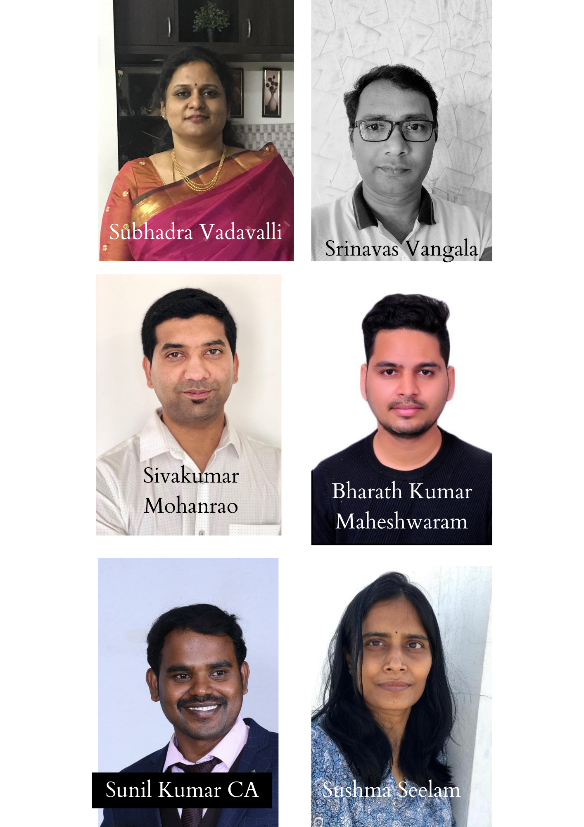
Challengers Squad

